Slide 2

What is SSL?

Slide 3
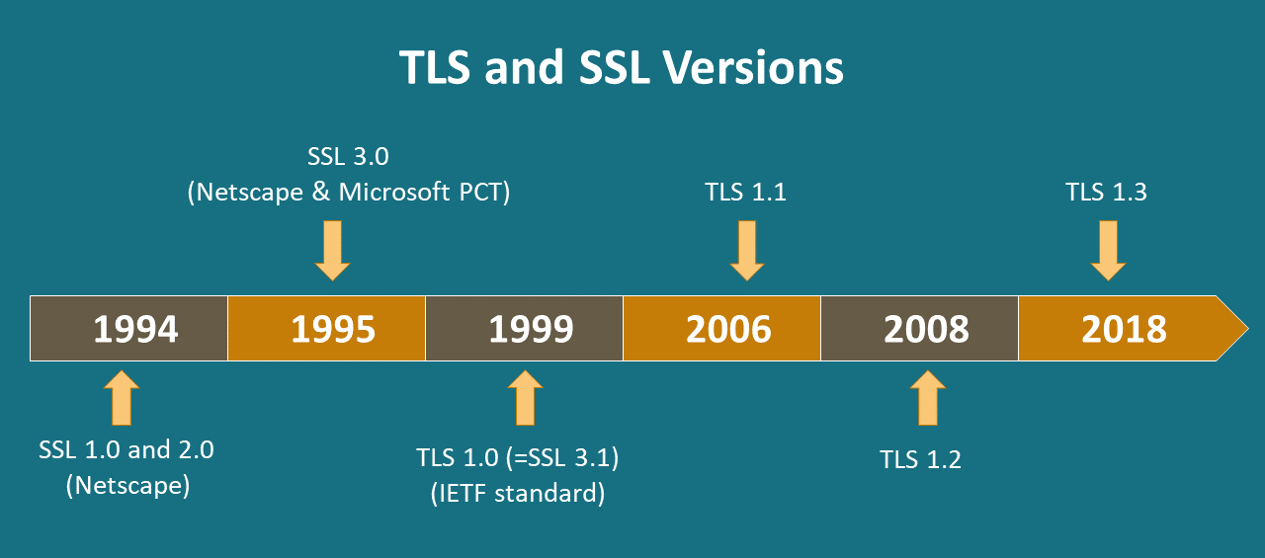
SSL and TLS

Slide 4
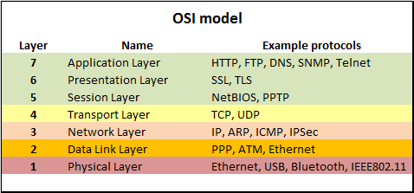
In OSI model

Slide 5

How SSL works

Slide 6
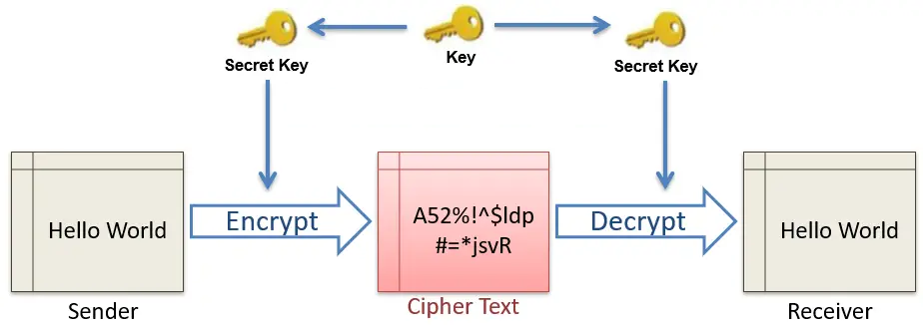
Symmetric Cryptography

Slide 7
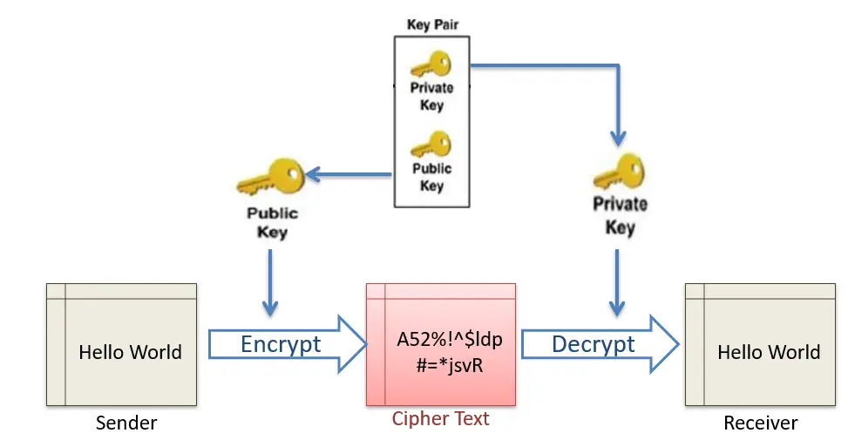
Asymmetric Cryptography

Slide 8
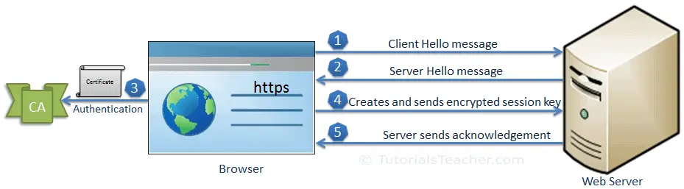
SSL Handshake

Slide 9
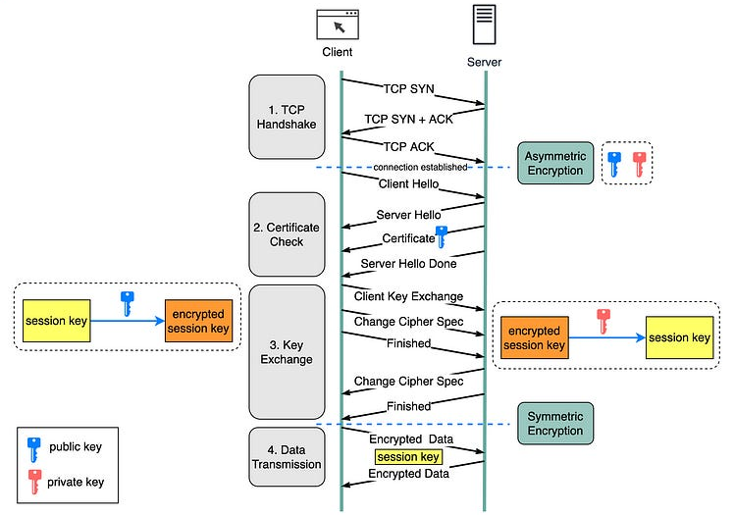
Complete process

Slide 10
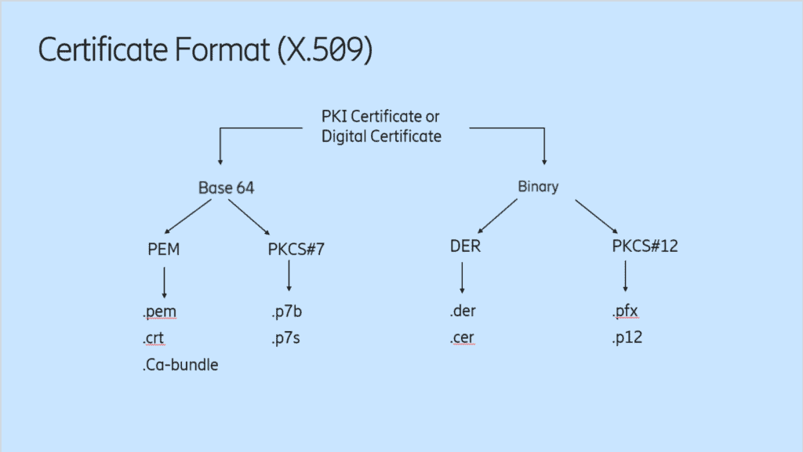
Certificates?

Slide 11
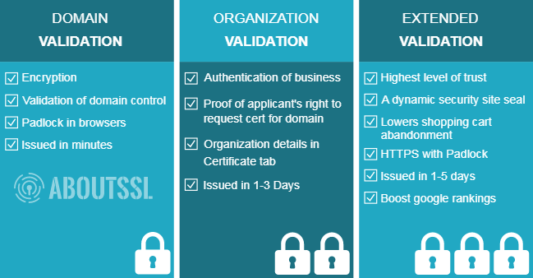
Certificates?

Slide 12
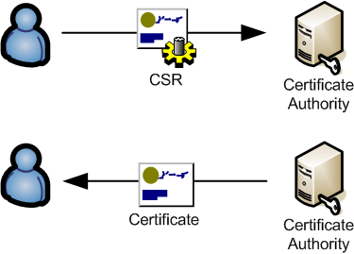
How create a certificate

Slide 13
Keytool in Java
C:\Program Files\Java\jdk-11.0.15\bin>keytool -genkey -alias server -keyalg RSA -keysize 2048 -keystore keystoreServer-keystore.jks
Enter keystore password:
Re-enter new password:
What is your first and last name?
[Unknown]: localhost
What is the name of your organizational unit?
[Unknown]: gti
What is the name of your organization?
[Unknown]: jp
What is the name of your City or Locality?
[Unknown]: caba
What is the name of your State or Province?
[Unknown]: bsas
What is the two-letter country code for this unit?
[Unknown]: ar
Is CN=localhost, OU=gti, O=jp, L=caba, ST=bsas, C=ar correct?
[no]: yes

Slide 14


Slide 15
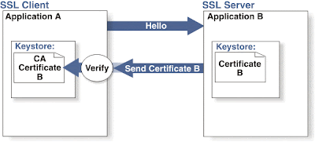
One Way

Slide 16
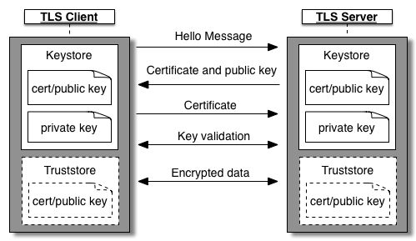
Two Way

Slide 17
Two Way with auth

Slide 18
Do it by your self
Client
Sign with private
Encrypt with public
Transfer Data
Server
Verify sign with public
Decrypt with private

Slide 19


