Slide 1
Laboratory for Information and Inference Systems
Semester Project
Blind Fairness
Pablo Ruiz de Velasco

Slide 2
Related work
Blind fairness (BF): subgroup labels are known
Goal: learning a feature representation (for a classification task) devoid of subgroup information
[1]: Madras et al., Learning Adversarially Fair and Transferable Representations, 2018:
an adversary tries to predict the subgroup from the representation during training
[2]: Kim et al., Learning Not to Learn: Training Deep Neural Networks with Biased Data, 2019:
add to classification loss a mutual information regularizer (between representation and subgroup), also implemented with an adversary
Notes:
Subgroup defined by values of spurious feature in the data (only 1 spurious feature considered in project)

Slide 3
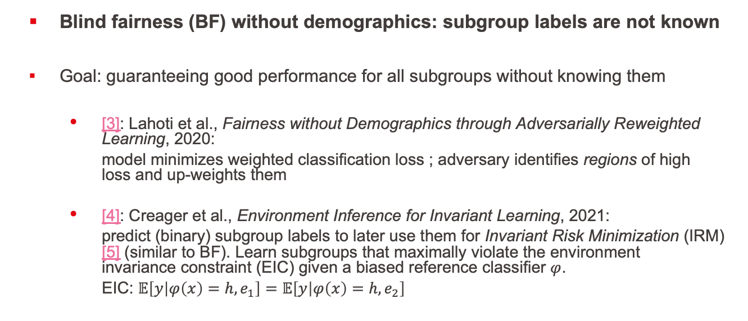
Related work
Blind fairness (BF) without demographics: subgroup labels are not known
Goal: guaranteeing good performance for all subgroups without knowing them
[3]: Lahoti et al., Fairness without Demographics through Adversarially Reweighted Learning, 2020:
model minimizes weighted classification loss ; adversary identifies regions of high loss and up-weights them
[4]: Creager et al., Environment Inference for Invariant Learning, 2021:
predict (binary) subgroup labels to later use them for Invariant Risk Minimization (IRM) [5] (similar to BF). Learn subgroups that maximally violate the environment invariance constraint (EIC) given a biased reference classifier $φ$.
EIC: $𝔼\left[y | φ\left(x\right)=h,e_{1}\right]=𝔼\left[y | φ\left(x\right)=h,e_{2}\right]$
Notes:
Lke BF, IRM promotes representations invariant to subgroups, optimal clf trained on top of rpz is the same for all envs
Subgroups in IRM differ by the degree of correlation between label and spurious feature (rather than by the value of the spurious feature)
EIC: E[ Y | Phi(X)=h, e1] = E[ Y | Phi(X)=h, e2] i.e. samples yielding same representation h should have same label regardless of environment
-> violate EIC by putting samples of different class but giving same representation through ref. classifier (i.e. they have same color) in different subgroups
Subgroups predicted: samples where spurious correlation is strong and samples where it isn’t.
Example continued (for [5]): subgroups: (mostly) landbirds on land, and waterbirds on water vs. (mostly) landbirds on water, and waterbirds on land

Slide 4
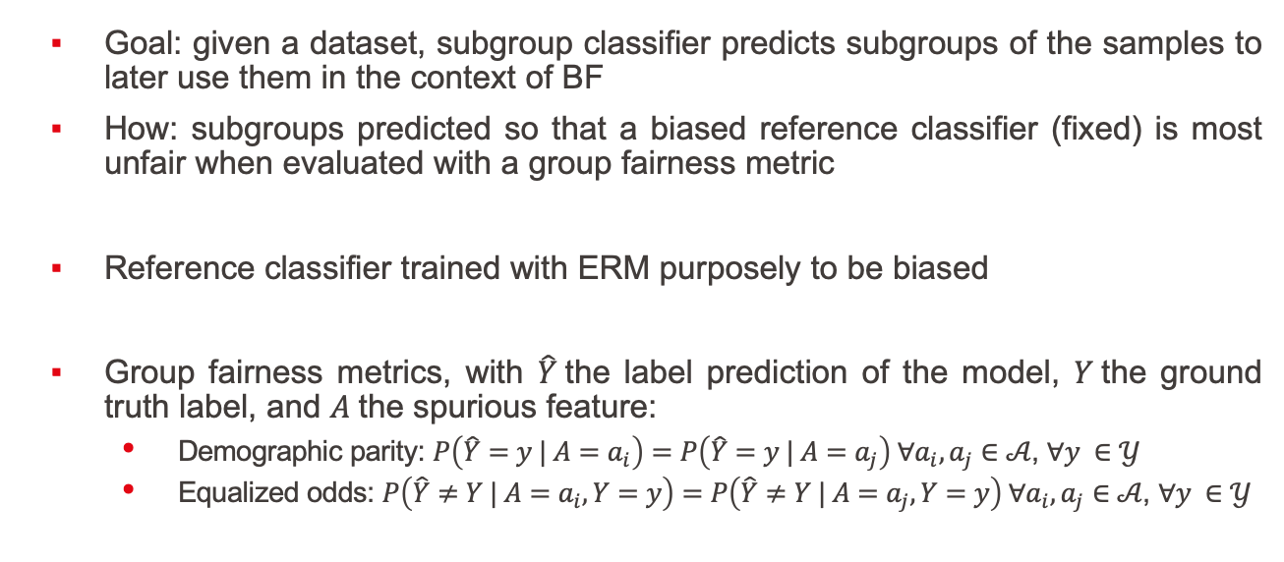
Project goal
Goal: given a dataset, subgroup classifier predicts subgroups of the samples to later use them in the context of BF
How: subgroups predicted so that a biased reference classifier (fixed) is most unfair when evaluated with a group fairness metric
Reference classifier trained with ERM purposely to be biased
Group fairness metrics, with $\hat{Y}$the label prediction of the model, $Y$the ground truth label, and $A$the spurious feature:
Demographic parity: $P\left(\hat{Y}=y | A=a_{i}\right)=P\left(\hat{Y}=y | A=a_{j}\right) ∀a_{i},a_{j}∈𝒜$, $∀y ∈𝒴$
Equalized odds: $P\left(\hat{Y}≠Y | A=a_{i}, Y=y\right)=P\left(\hat{Y}≠Y | A=a_{j}, Y=y\right) ∀a_{i},a_{j}∈$ $𝒜$, $∀y ∈𝒴$
Notes:
Example continued: desired subgroups: birds (both types) on land vs. birds (both types) on wáter
The dataset should of course contain a bias of some sort

Slide 5
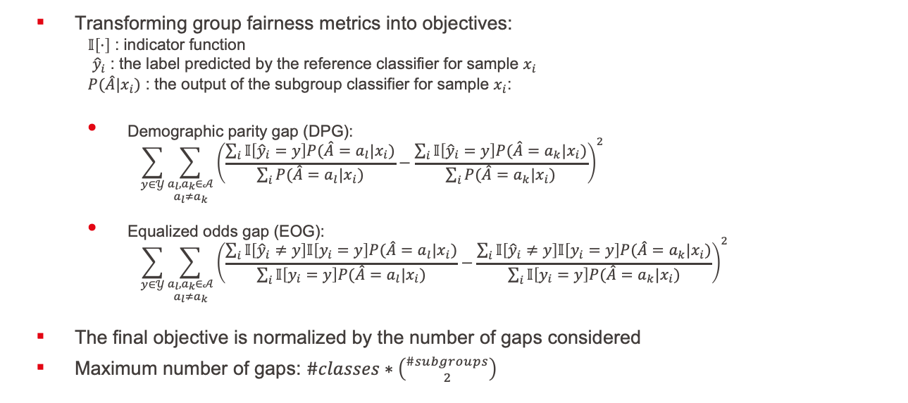
Implementation – Objective function
Transforming group fairness metrics into objectives:
$𝕀\left[·\right]$ : indicator function
${\hat{y}}_{i}$ : the label predicted by the reference classifier for sample $x_{i}$
$P(\hat{A}|x_{i})$ : the output of the subgroup classifier for sample $x_{i}$:
Demographic parity gap (DPG):
$$\sum_{y∈𝒴}{\sum_{\begin{aligned}a_{l},a_{k}∈𝒜 \\ a_{l}≠a_{k}\end{aligned}}{{\left(\frac{\sum_{i}{𝕀\left[{\hat{y}}_{i}=y\right]P(\hat{A}=a_{l}|x_{i})}}{\sum_{i}{P(\hat{A}=a_{l}|x_{i})}}−\frac{\sum_{i}{𝕀\left[{\hat{y}}_{i}=y\right]P(\hat{A}=a_{k}|x_{i})}}{\sum_{i}{P(\hat{A}=a_{k}|x_{i})}}\right)}^{2}}}$$
Equalized odds gap (EOG):
$$\sum_{y∈𝒴}{\sum_{\begin{aligned}a_{l},a_{k}∈𝒜 \\ a_{l}≠a_{k}\end{aligned}}{{\left(\frac{\sum_{i}{𝕀\left[{\hat{y}}_{i}≠y\right]𝕀\left[y_{i}=y\right]P(\hat{A}=a_{l}|x_{i})}}{\sum_{i}{𝕀\left[y_{i}=y\right]P(\hat{A}=a_{l}|x_{i})}}−\frac{\sum_{i}{𝕀\left[{\hat{y}}_{i}≠y\right]𝕀\left[y_{i}=y\right]P(\hat{A}=a_{k}|x_{i})}}{\sum_{i}{𝕀\left[y_{i}=y\right]P(\hat{A}=a_{k}|x_{i})}}\right)}^{2}}}$$
The final objective is normalized by the number of gaps considered
Maximum number of gaps: $\#classes∗\left({\#subgroups \atop 2}\right)$

Slide 6
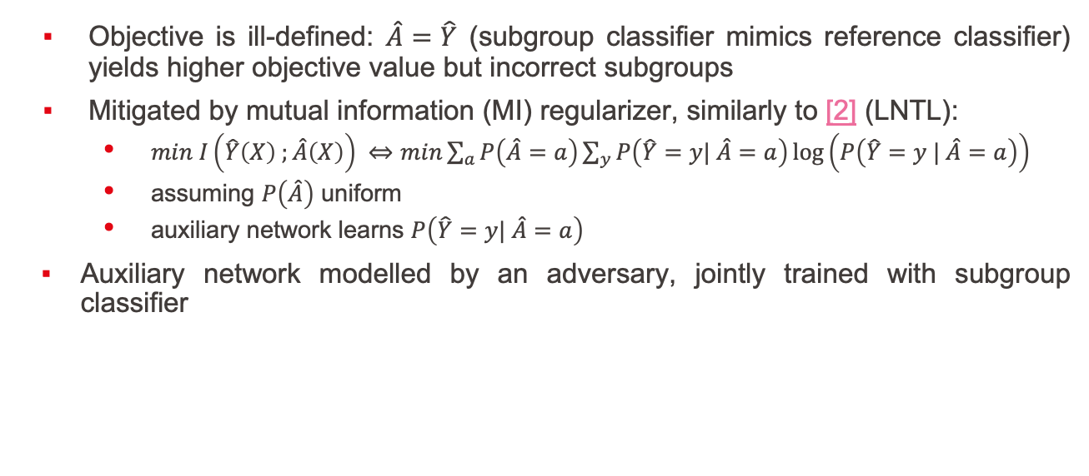
Implementation – MI regularizer
Objective is ill-defined: $\hat{A}=\hat{Y}$ (subgroup classifier mimics reference classifier) yields higher objective value but incorrect subgroups
Mitigated by mutual information (MI) regularizer, similarly to [2] (LNTL):
$min I\left(\hat{Y}\left(X\right) ;\hat{A}\left(X\right)\right) ⇔min\sum_{a}{P\left(\hat{A}=a\right)\sum_{y}{P\left(\hat{Y}=y| \hat{A}=a\right)}}\log\left(P\left(\hat{Y}=y | \hat{A}=a\right)\right)$
assuming $P\left(\hat{A}\right)$ uniform
auxiliary network learns $P\left(\hat{Y}=y| \hat{A}=a\right)$
Auxiliary network modelled by an adversary, jointly trained with subgroup classifier
Notes:
incorrect subgroups unless perfectly biased ref clf

Slide 7

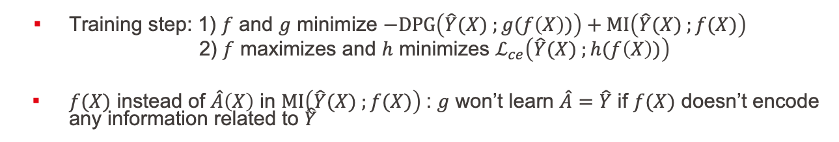
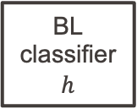

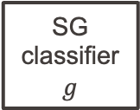
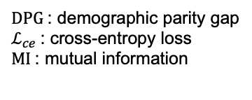
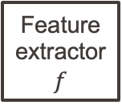

Implementation – Final architecture
Feature extractor
$$f$$
$$f(X)$$
SG
classifier
$$g$$
Subgroup prediction
SG : subgroup
GR : gradient reversal
BL : biased label (from
reference classifier)
Image X
$$P\left(\hat{A} | X\right)$$
G
R
BL
classifier
$$h$$
BL prediction
$DPG$: demographic parity gap
$ℒ_{ce}$: cross-entropy loss
$MI$: mutual information
$$P\left(\hat{Y} | f(X)\right)$$
Training step: 1) $f$ and $g$ minimize $−DPG\left(\hat{Y}(X) ;g(f\left(X\right))\right)+MI\left(\hat{Y}(X) ;f(X)\right)$
2) $f$ maximizes and $h$ minimizes $ℒ_{ce}\left(\hat{Y}(X) ;h(f\left(X\right))\right)$
$f(X)$ instead of $\hat{A}\left(X\right)$ in $MI\left(\hat{Y}(X) ;f(X)\right)$: $g$ won’t learn $\hat{A}=\hat{Y}$ if $f(X)$ doesn’t encode any information related to $\hat{Y}$

Slide 8
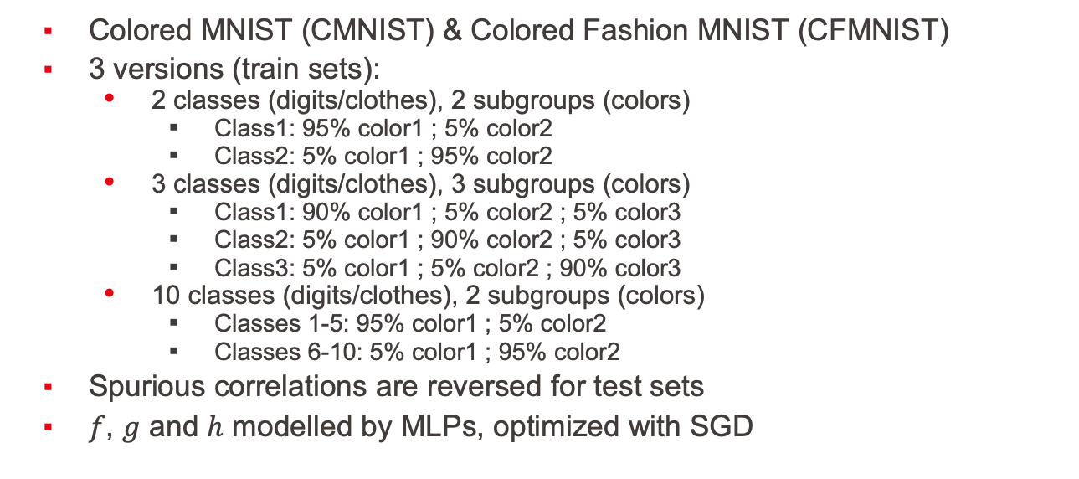
Experiments – Datasets and Models
Colored MNIST (CMNIST) & Colored Fashion MNIST (CFMNIST)
3 versions (train sets):
2 classes (digits/clothes), 2 subgroups (colors)
Class1: 95% color1 ; 5% color2
Class2: 5% color1 ; 95% color2
3 classes (digits/clothes), 3 subgroups (colors)
Class1: 90% color1 ; 5% color2 ; 5% color3
Class2: 5% color1 ; 90% color2 ; 5% color3
Class3: 5% color1 ; 5% color2 ; 90% color3
10 classes (digits/clothes), 2 subgroups (colors)
Classes 1-5: 95% color1 ; 5% color2
Classes 6-10: 5% color1 ; 95% color2
Spurious correlations are reversed for test sets
$f$, $g$ and $h$ modelled by MLPs, optimized with SGD

Slide 9
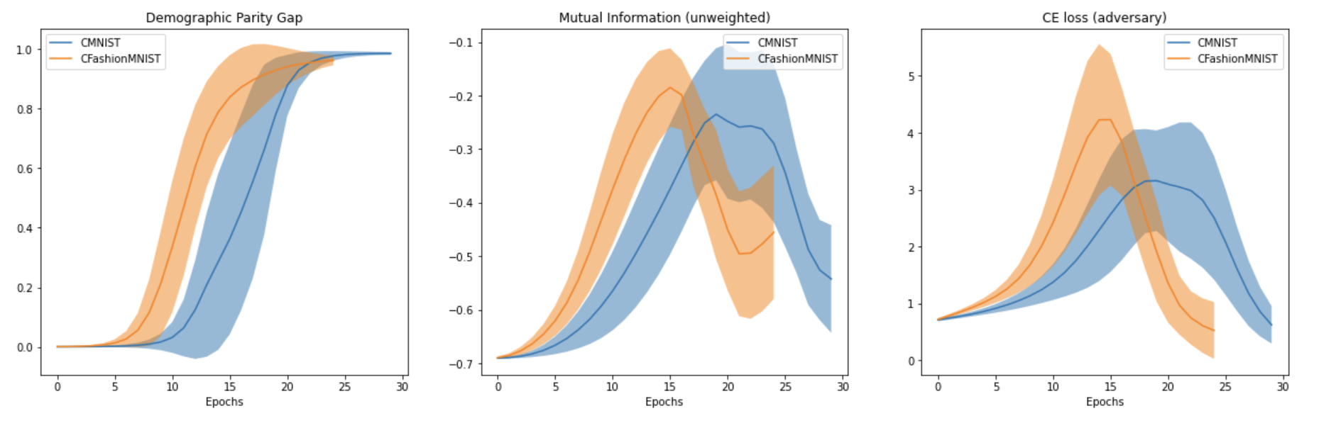
Experiments – 2 classes, 2 subgroups
Dataset | Train acc | Test acc
CMNIST | 1.0 ± 0.0 | 1.0 ± 0.0
CFMNIST | 0.987 ± 0.012 | 0.980 ± 0.031
Results averaged over 10 runs
Target DPG (CMNIST): 0.999
Target DPG (CFMNIST): 0.9916
Notes:
Here EOG can work too but less reliably
DPG(bp, CMNIST) = 1
DPG(bp, CFMNIST) = 1

Slide 10
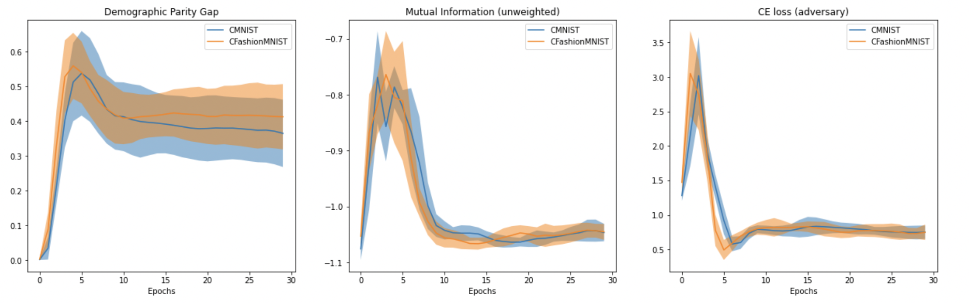

Experiments – 3 classes, 3 subgroups
Dataset | Train acc | Test acc
CMNIST | 0.857 ± 0.287 | 0.813 ± 0.371
CFMNIST | 0.899 ± 0.298 | 0.899 ± 0.298
Results averaged over 10 runs
Often 1/10 or 2/10 fail completely
The rest reach train and test accuracies $≥$ 0.99
Target DPG (CMNIST): 0.6374 ; Target DPG (CFMNIST): 0.6505
Notes:
Here EOG can work too but less reliably
Only way I found to make it super stable was by using 1 full batch and fixing init (notebook CMNIST2)
DPG(bp, CMNIST) = 0.6667
DPG(bp, CFMNIST) = 0.6667

Slide 11
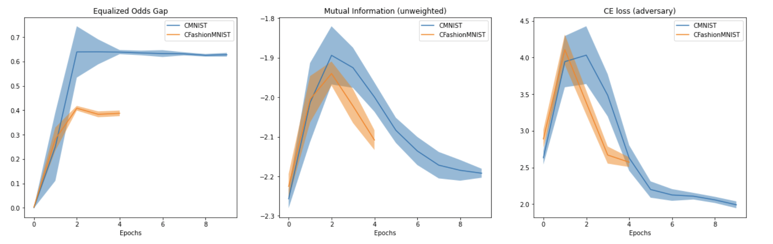
Experiments – 10 classes, 2 subgroups
Dataset | Train acc | Test acc
CMNIST | 0.999 ± 8e-05 | 1.0 ± 0.0
CFMNIST | 0.720 ± 0.097 | 0.902 ± 0.029
Results averaged over 10 runs
EOG instead of DPG
Reference classifier harder to bias for CFMNIST than CMNIST
Target EOG (CMNIST): 0.7333 ; Target EOG (CFMNIST): 0.4088
Notes:
Here only EOG Works
EOG(bp, CMNIST) ≈ 0.1
EOG(bp, CFMNIST) = 0.1

Slide 12
Next steps
Redefining the objective so that target and optimum coincide
Stabilizing training
Towards real world datasets: e.g.
not all subgroups present in each class
minority subgroups present at different rates in different classes
more than one binary spurious feature instead of a single non-binary one
Generalizing MI regularizer for non-uniform subgroups
More complex datasets and models (e.g. CelebA, Cifar-S, CNNs)
Objective based on an individual fairness metric
Notes:
more than one spurious feature instead of a single non-binary one: e.g. instead of 4 colors, 2 colors and 2 tilt angles
failed experiments:
CIFAR-S: 2 subgroups: color images ; grayscale images
CelebA: 2 subgroups: males ; females
Learner modelled by CNN and adversary modelled by MLP
Main issue was training instability

Slide 13
References
[1] Madras et al., Learning Adversarially Fair and Transferable Representations, 2018
[2] Kim et al., Learning Not to Learn: Training Deep Neural Networks with Biased Data, 2019
[3] Lahoti et al., Fairness without Demographics through Adversarially Reweighted Learning, 2020
[4] Creager et al., Environment Inference for Invariant Learning, 2021
[5] Arjovsky et al., Invariant Risk Minimization, 2020

