Slide 1
IESC Seven Segment Options Report Out ww43
Oliver Chen
Romanna Flores

Slide 2
Contents
Goals
IESC 7 segment module
RPS- One player
RPS- Two player
RPS- ConnectAnything
Recommendation
Backup

Slide 3
Goals
Add options to existing 7 segment module
Limit incremental BOM changes
Manage complexity for 50 minute window
Accommodate ~30 students
Strategy: introduce buttons and gameplay;
halve number of groups at each stage;
reduce BOM costs by sharing multiple kits in groups;
reduce complexity pairing faster teams with others.

Slide 4
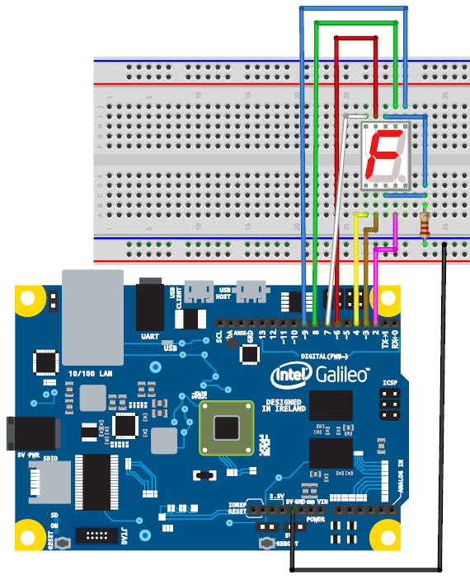
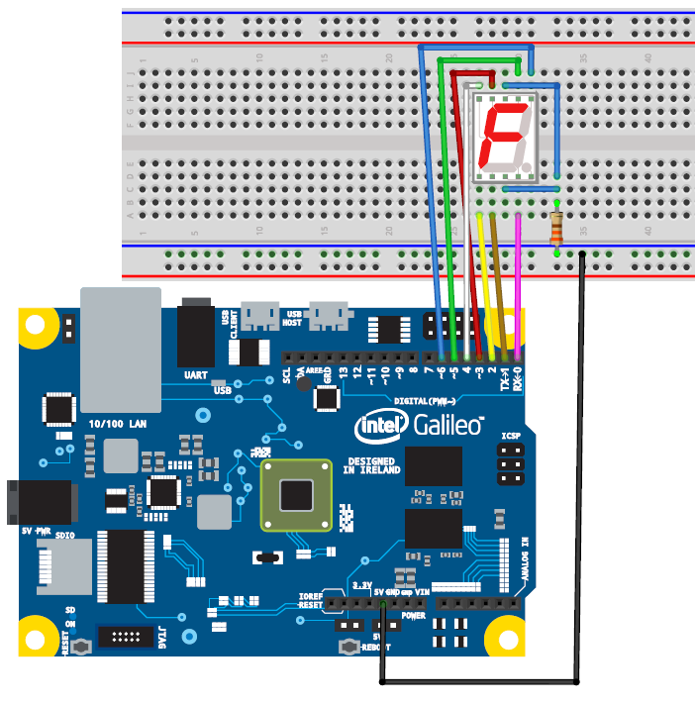
Original IESC 7 Segment Module
Existing
Hardware: all groups wire up the 7 segment LED according to the Fritzing diagram
Software: all groups copy and modify existing alpha numeric patterns A-F. 0-9 to make new symbols like G
Modification
Hardware: all groups wire up the 7 segment LED according to the shifted Fritzing diagram
Software: all groups copy and modify existing alpha numeric patterns A-F. 0-9 to make new symbols r, P, and S in preparation for next exercise

Slide 5
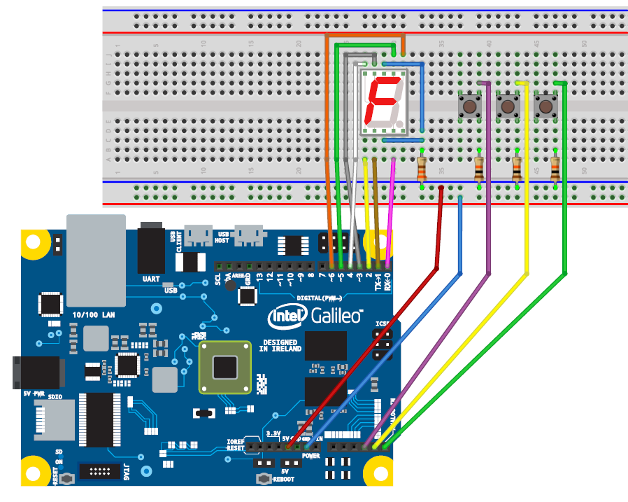
RPS One Player
Hardware: all teams wire 3 additional buttons and resistors
Software: all teams copy r, P, and S symbols into new sketch
Cost per Kit
Part | # | 1st H BOM | Cost | Total | Comment
10k resistor | 3 | 20 | $.04-.05 | 0
Mini Pushbutton Switch | 3 | 0 | $0.28-.35 | $1
Bread board | 1 | 1 | $3.75-4.95 | 0
Cost Delta: $1/Kit
30 students+leader:16 teams:$16
1 kit shared across 2 students
Notes:
Optional Scaffold: Software – Spock/Lizard; Hardware – LED or buzzer for win/loss

Slide 6
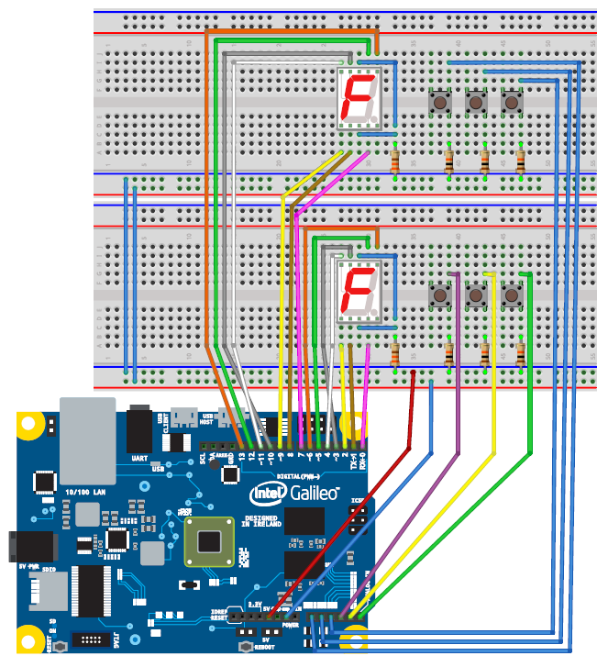
RPS Two Player
Hardware: 2 teams partner wire up 2 prebuilt and tested boards from RPS one player to one Galileo. Fastest team pairs with team that needs help for internal mentoring.
Software: no change
Cost per Kit
Part | # | 1st H BOM | Cost | Total | Comment
10k resistor | 3 | 20 | $.04-.05 | 0
Mini Pushbutton Switch | 3 | 0 | $0.28-.35 | $1
7 segment LED | 1 | 1 | $.97-1.19 | 0
Bread board | 1 | 1 | $3.75-4.95 | 0
Cost Delta: $1/Kit
30 students+leader:16 teams:$16
1 kit shared across 2 students
Notes:
Optional Scaffold: Software – Spock/Lizard or score board

Slide 7
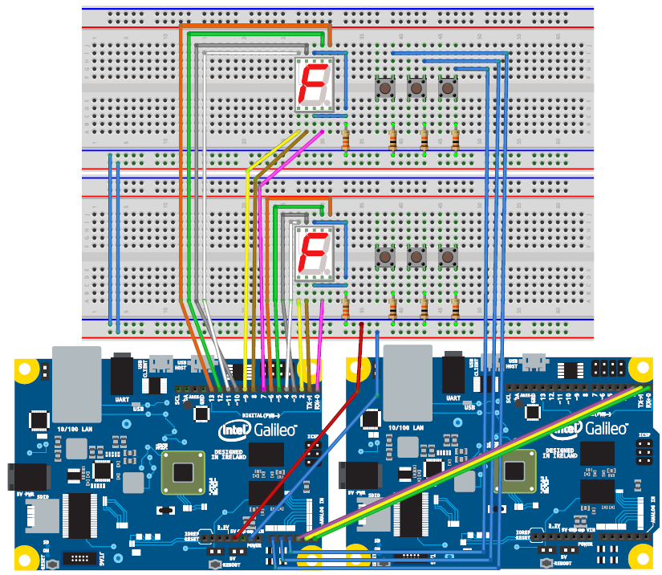
RPS ConnectAnything
Hardware: 2 groups partner to become 1 mega group and replace RPS button input with output from 2nd Galileo. Fastest groups pairs with groups that needs help for internal mentoring.
Software: ConnectAnything on 2nd Galileo
Cost per CAT
Part | # | 1st H BOM | Cost | Total | Comment
WiFi Card N 6235 | 1 | 0 | $16 | $16 | Donation likely
Half to full PCI-E bracket | 1 | 0 | $5 | $5 | Donation likely
Wi-Fi antenna | 1 | 0 | $5 | $5 | Donation likely
Micro SD 4GB-32GB | 1 | 0 | $7 | $7 | Donation likely
Cost Delta: $33/CAT
30 students+ leader:4 groups: $16+33
CAT shared across 8 students
Notes:
Optional Scaffold: Software – Spock/Lizard or score board; Hardware – CAT for 2nd player
All CAT components are likely available to be donated through Stewart Christie’s group.

Slide 8
Options
Cost delta for 30 students
$16 - RPS one and two player
$16 + WiFi donations – RPS one, two player, and CAT
$49 – RPS single, double player and CAT

Slide 9
Backup
Videos uploaded to IESC Inside Blue project below.

Slide 10
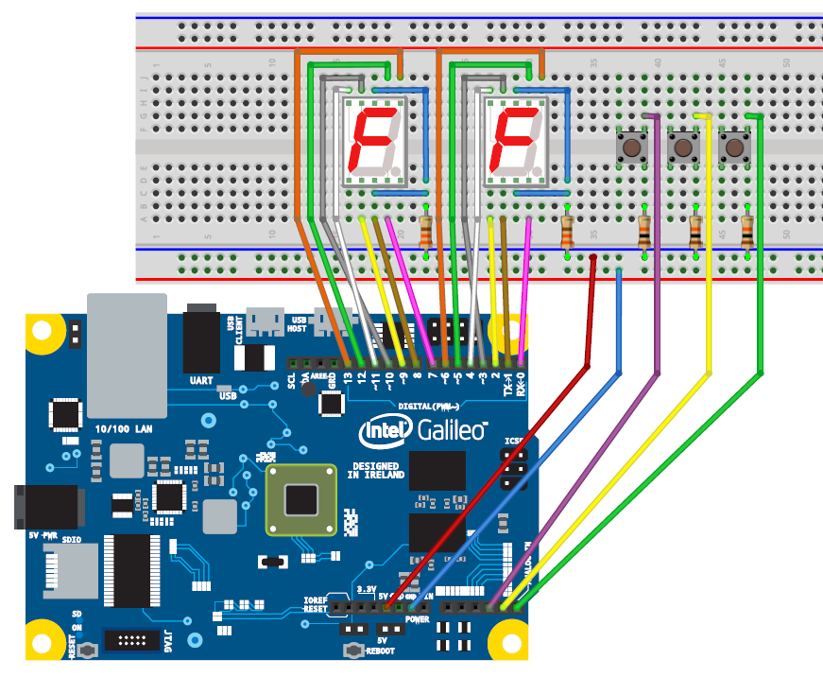
RPS One Player two 7 segments
Hardware: students wire 1 additional 7 segment, 3 buttons and resistors
Software: no change
Scaffold: Software – Spock/Lizard or score board; Hardware – LED or buzzer for win/loss
Part | # | 1st H BOM | Cost | Total | Comment
10k resistor | 3 | 20 | $.04-.05 | 0
Mini Pushbutton Switch | 3 | 0 | $0.28-.35 | ~$1
7 segment LED | 2 | 1 | $.97-1.19 | ~$1
Bread board | 1 | 1 | $3.75-4.95 | 0
Cost Delta: ~$2/group
1 group = 1 Galileo

Slide 11
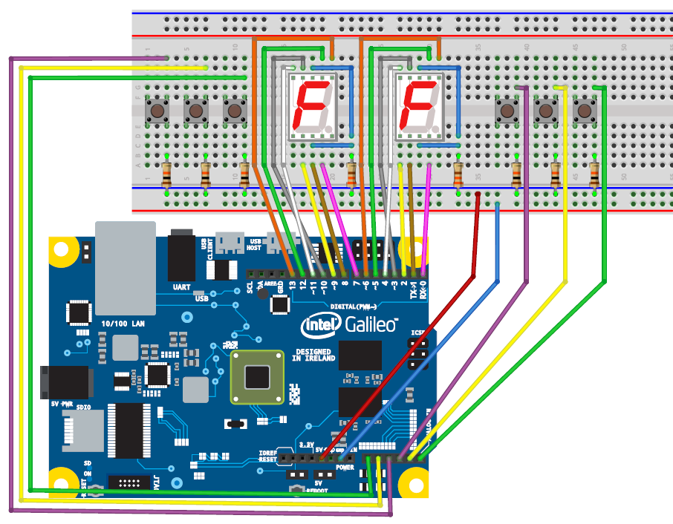
RPS Two Player
Hardware: students wire 1 additional 7 segment, 6 buttons and resistors, on a bigger bread board
Software: no change
Scaffold: Software – Spock/Lizard or score board
Part | # | 1st H BOM | Cost | Total | Comment
10k resistor | 6 | 20 | $.04-.05 | 0
Mini Pushbutton Switch | 6 | 0 | $0.28-.35 | ~$2
7 segment LED | 2 | 1 | $.97-1.19 | ~$1
Bigger Bread board | 1 | 0 | $7.96-9.95 | ~$8
Cost Delta: ~$11/group
1 group = 1 Galileo

Slide 12
RPS Two Player
Hardware: students wire 1 additional 7 segment, 6 buttons and resistors, on a 2nd bread board
Software: no change
Scaffold: Software – Spock/Lizard or score board
Part | # | 1st H BOM | Cost | Total | Comment
10k resistor | 6 | 20 | $.04-.05 | 0
Mini Pushbutton Switch | 6 | 0 | $0.28-.35 | ~$2
7 segment LED | 2 | 1 | $.97-1.19 | ~$1
Bread board | 2 | 1 | $3.75-4.95 | ~$4
Cost Delta: ~$7/group
1 group = 1 Galileo

