Slide 2
Outline
Read quality assessment (NanoQC)
Read filtering (NanoFilt)
Assembly (Flye)
Results analysis
Polishing
Circularization (dnaapler)
Annotation (Prokka)
Gene search strategies (Blast)

Slide 3
Assembly basis
Process that reconstructs a whole genome sequences from a set of reads. It works by aligning and merging the raw sequencing reads.
Mainly done by graph-based apporaches:
DeBrujinn graphs → Exact matches of k-mers
Repeat graphs → Approximate sequence matches
The graphs can be visualized to assess how good the assembly is

Slide 4
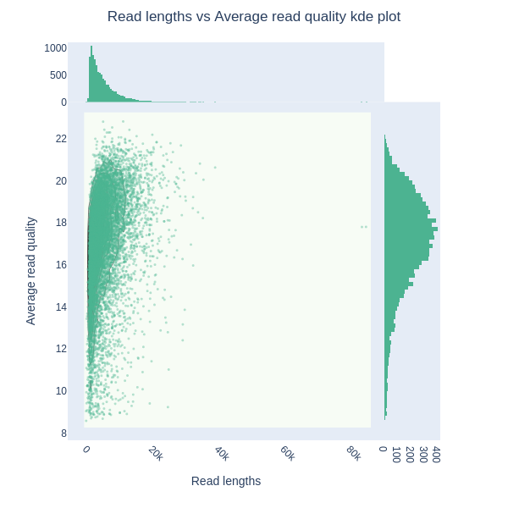
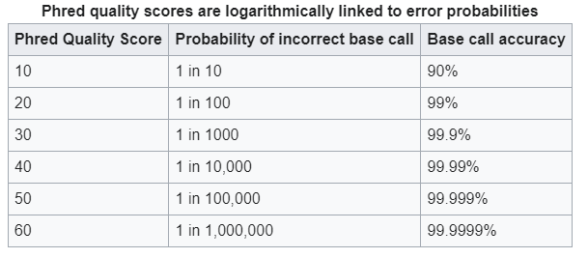
Preparation
Assesing intial read quality
Quality (phred score)→ Estimate of the sequencing error
Length
Number of reads

Slide 5
Graph example

Slide 6
Dnaapler
Looks for dnaA gene or rep1 (plasmids) and reorients the genome
Perfect for our assembly, as it is already circular
Check that installation is working:
Circlator progcheck
Run the cirucularization tool:

Slide 7

Hybrid assembly
Combining the power of both short and long reads.
Two approaches based on the available data
Assembly based
Short reads assembly → Long reads resolve
Alignment based
Long reads assembly → Short reads polish
Long reads
Short reads

Slide 8
