Slide 1
Scaling Systematic Reviews: A Solo Researcher's Workflow with Gemini
Pablo Bernabeu, Department of Education

Slide 2
Scaling Systematic Reviews: A Solo (?) Researcher’s Workflow with Gemini
100s/1000s of papers are often required.
Extract same information from all papers (previously successful: Malik & Sime, 2025, https://doi.org/10.18260/1-2--57199)
The more supervision and collab, the better!
+copilot, -autopilot for best results.
NotebookLM + Gemini + other tools like R.

Slide 3
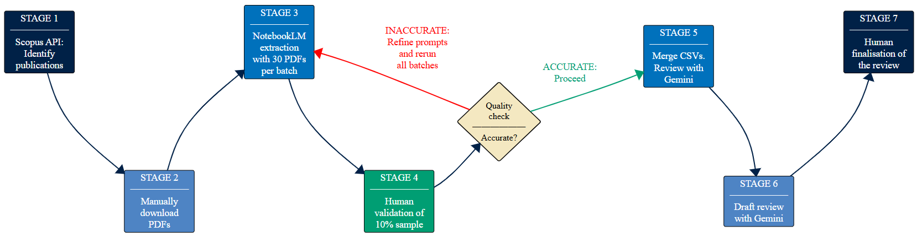
Search and access PDFs

Slide 4
→ NotebookLM batches

Slide 5
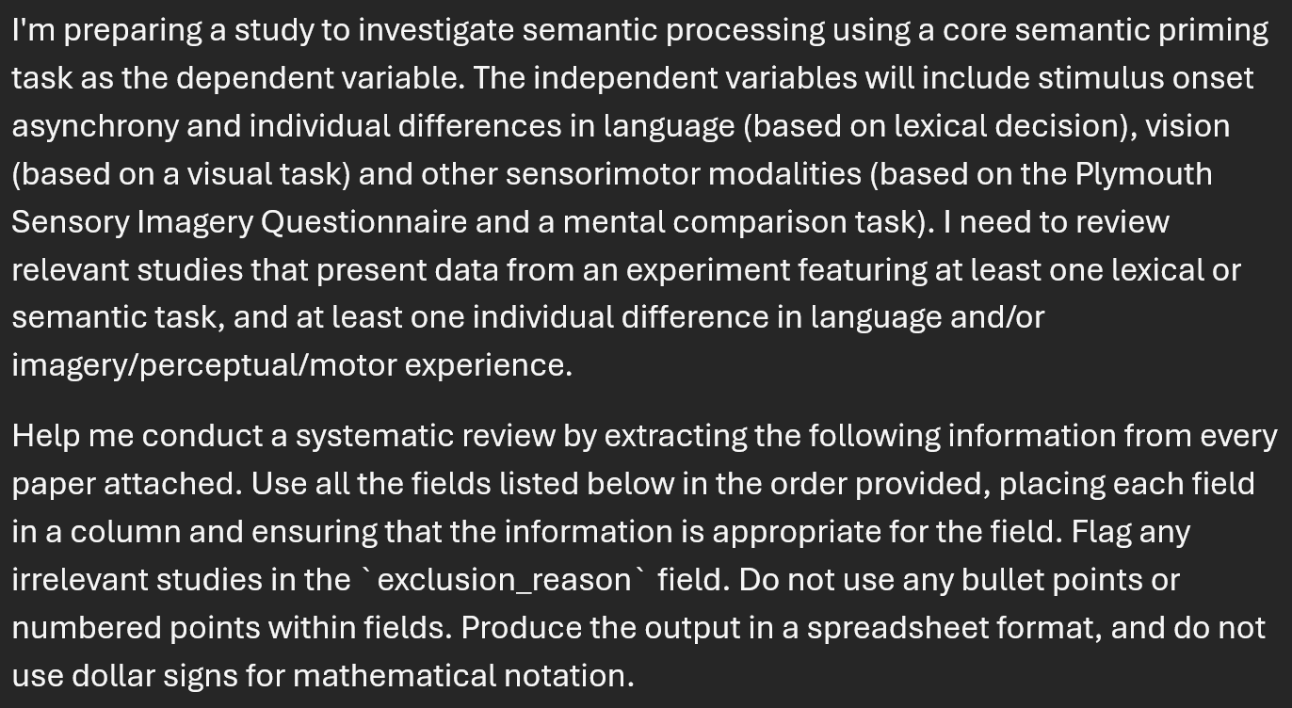

Slide 6
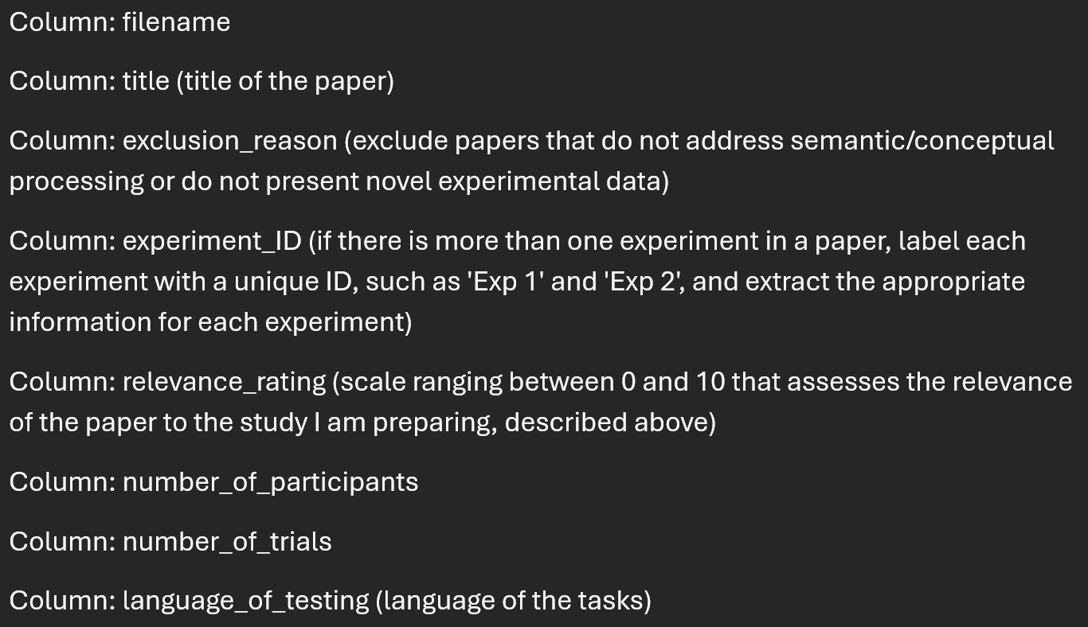

Slide 7
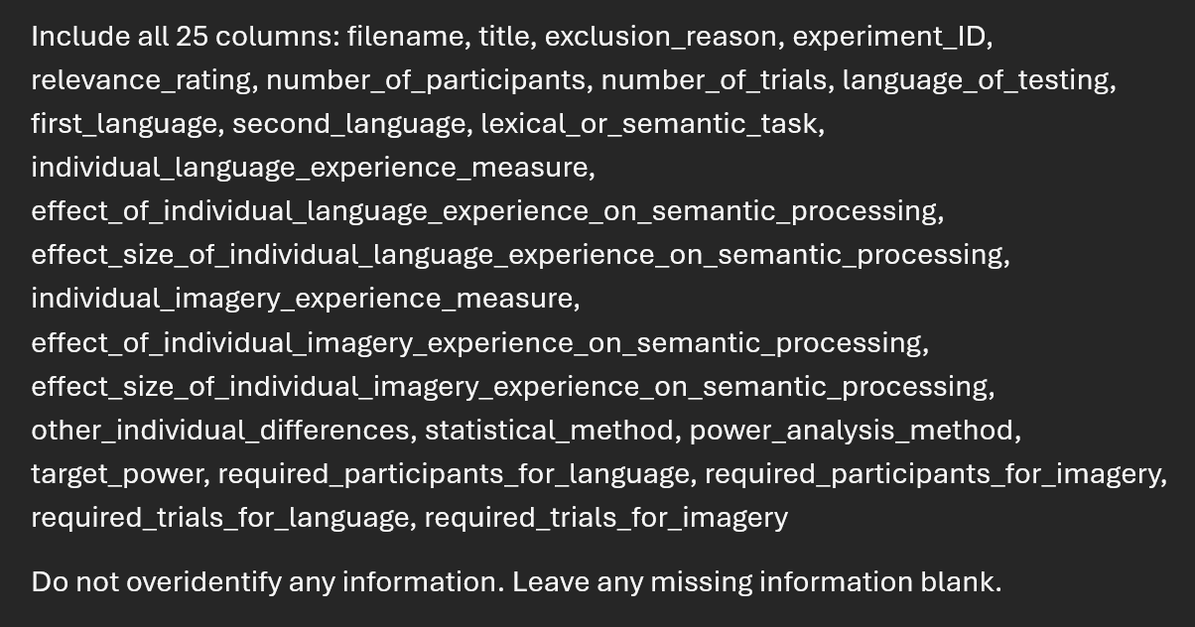

Slide 8
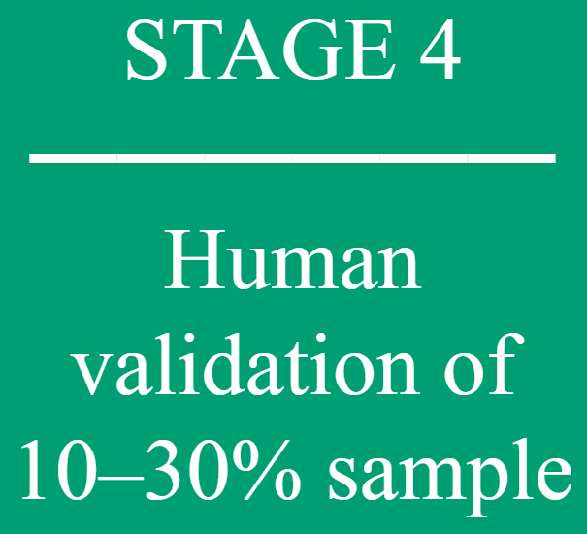
→ Quality check

Slide 9
→ Merge and Gemini review

Slide 10
→ Draft and human finalisation

Slide 11


Thank you Explore → Stay hungry, stay foolish
https://github.com/pablobernabeu/ Gemini_literature_review_workflow
Unprecedented individual role in AI
AI-supported workflows are multiplying and improving thanks to projects big and small, including modest, individual attempts.

