Slide 1
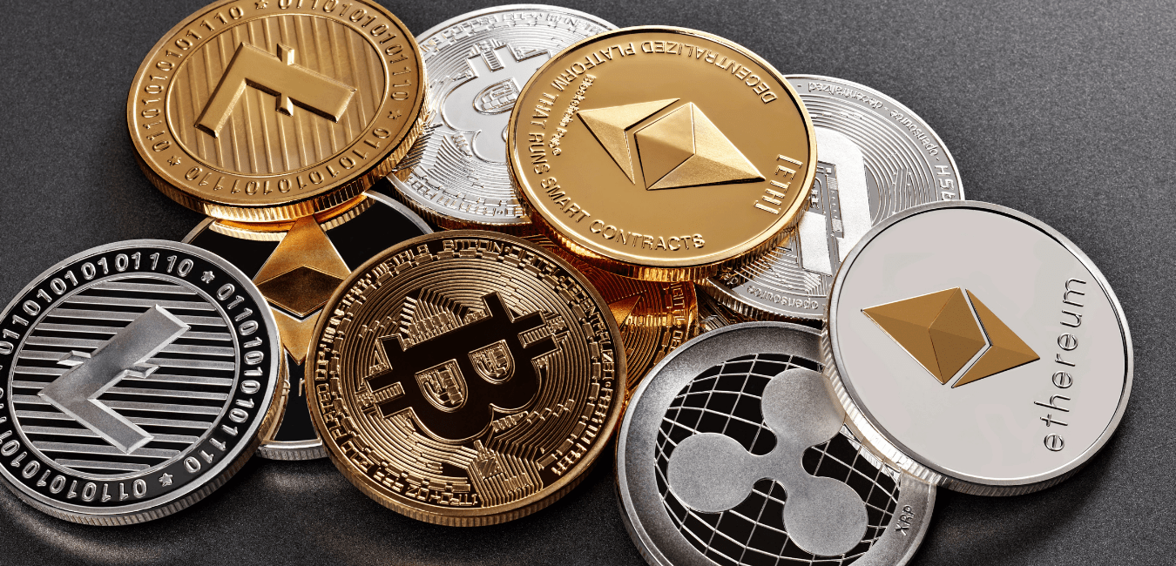
EDA Cryptocurrency

Slide 2
QUESTIONS
Is it safe to invest in Bitcoin?
What is the influence of Bitcoin on the global market?
Is it a growing market?
In which cryptocurrencies to invest?
When should I do it?

Slide 3
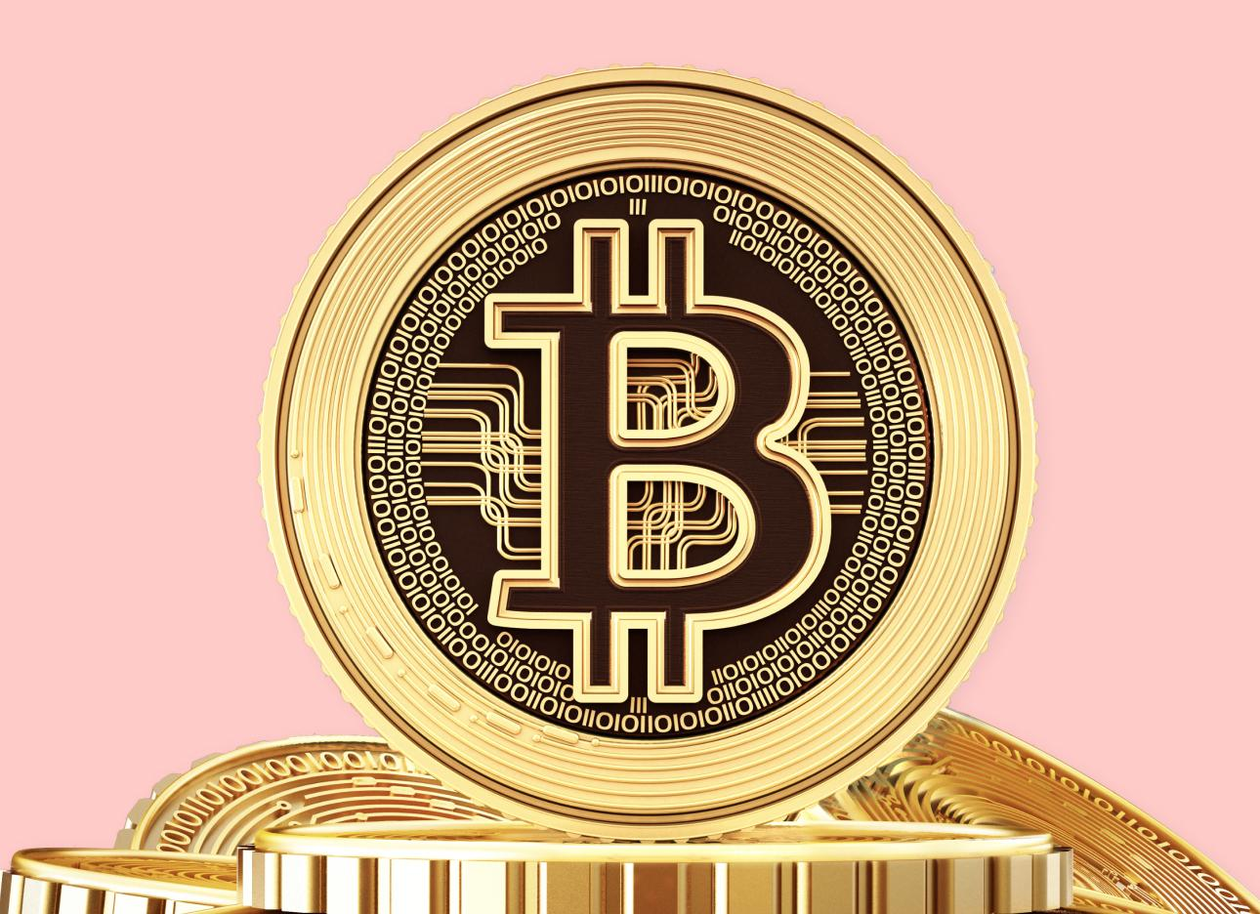
1. BITCOIN
¿What is Bitcoin?
Bitcoin is a virtual currency used to acquire products and services like any other currency.
Its main feature is that it is decentralized.

Slide 4
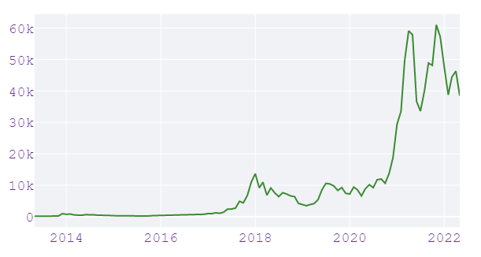
2. Is it safe to invest in Bitcoin?
Evolucion del precio del Bitcoin en $
Despite some specific price drops, the upward trend can be appreciated.

Slide 5
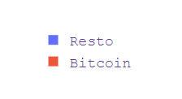
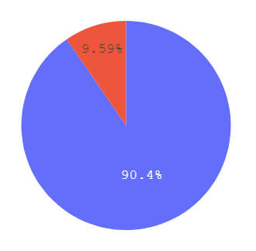
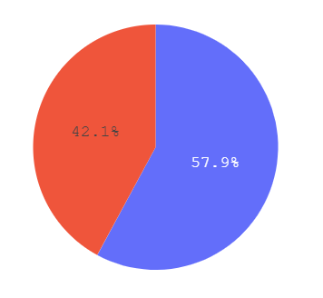
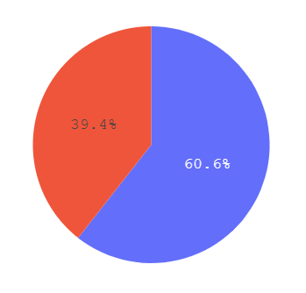
3. How much influence does Bitcoin have on the crypto market?
Comparison of bitcoin market cap with other cryptocurrencies
2013
2018
2022
By 2013 it was 90%,
this has been decreasing
over the years.
 | 2013 | 2018 | 2022
Bitcoin | 3.15 | 135.91 | 817.8
Resto | 0.33 | 186.98 | 1257.74

Slide 6
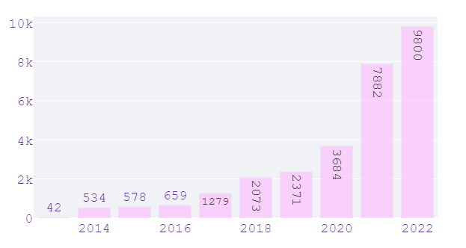
4. Is it a growing market?
Cryptocurrency count per year
Every year the number of cryptocurrencies has been increasing, it is a constantly growing market.

Slide 7
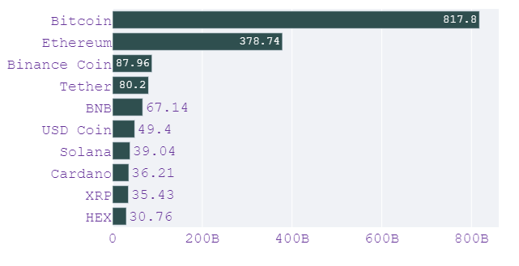
5. ¿En que criptomonedas invertir?
I recommend looking for reliable and useful cryptocurrencies. The ones with higher capital tend
to be more secure but give less yield.

Slide 8
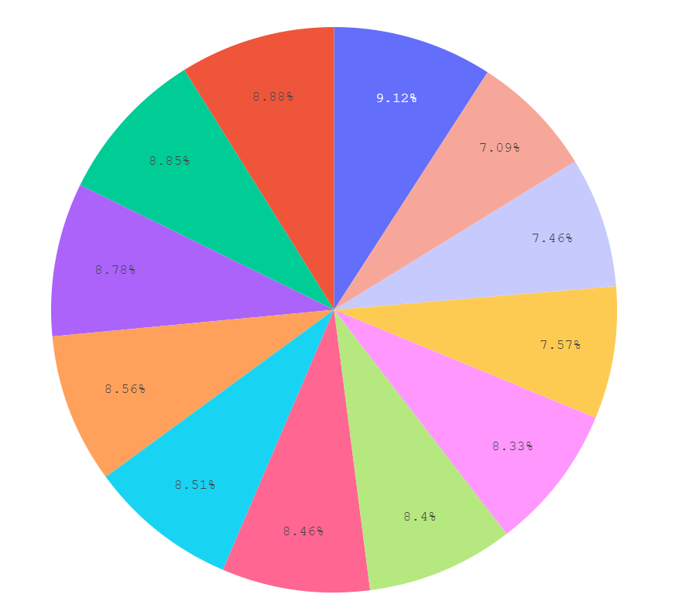

6. When should you invest?
Average market capital per month from 2013 to 2022
The months of July and February are the ones with
the least capital and therefore, the most feasible.
Finally, I would avoid the months of May and
January, being the ones with the most capital.

Slide 9
7. Resources
Data collection:
https://coinmarketcap.com/historical/
- Shape: 220566 rows and 9 columns .
Python libraries:
Pandas, Plotly, BeautifulSoup, Selenium, Calendar, Math, Time, Csv.
Dashboard:
Streamlit.
Link: https://share.streamlit.io/pablod1/streamlit-test/main/main.py.

Slide 10
8. Conclusions
My conclusion is that the cryptocurrency market is growing massively over time and a general upward trend can be seen in almost all years.
I would try to invest in stable and known cryptocurrencies, always long term and in the July or February months.
Remember to always use the money you can afford to lose. Though we can affirm is it safe you never know what can happen in the future

Slide 11
¿DOUBTS?
Directed by Pablo Díaz

