Slide 1
Advanced Audio Features

Slide 2

Agenda
01
Advanced Audio Features
02
Integration of Audio Features

Slide 3

01 – Advanced Audio Features

Slide 4

Advanced Audio Features
Older Car Audio System
Overview
Definition: Android Automotive (AAOS) offers a platform for car manufacturers to integrate advanced audio features that enhance the in-vehicle listening experience
Importance: these advanced audio features contribute to a more immersive and enjoyable experience
Surround Sound
Noise Cancellation
Audio Signal Processing
Notes:
Surround sound:
Creates a multi-dimensional audio experience using multiple speakers strategically positioned throughout the cabin.
Enhances the feeling of being in the center of the action, particularly for movies, music, and games.
Requires specialized hardware like multiple amplifiers and speakers.
Noise cancellation:
Utilizes microphones and digital processing to reduce unwanted background noise from the road, engine, and wind.
Improves clarity of phone calls, music playback, and voice assistant interactions.
Can be implemented actively (cancelling specific noise frequencies) or passively (using soundproofing materials).
Digital signal processing (DSP):
A broad range of audio adjustments and effects enabled by digital signal processing algorithms.
Allows for customization of sound profiles, equalization, and speaker balancing.
Enables features like bass boost, voice enhancement, and sound virtualization for a more personalized listening experience.
Important Notes
While AAOS provides the platform to develop these features... some of them are dependent on specific hardware which could vary depending on the manufacturer, make, model, etc.
Discussion
How can car manufacturers leverage advanced audio features to differentiate their vehicles?
What are the potential safety considerations of noise cancellation on driver awareness?
How can AAOS facilitate the development and integration of even more advanced in-car audio technologies?

Slide 5
02 – Integration of Audio Features

Slide 6
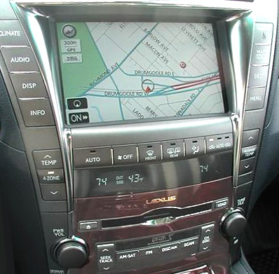
Integration of Audio Features
Vehicle Navigation Screen
Overview
Definition: the integration of audio features with other vehicle systems
Importance: creates a more integrated and user-friendly experience
Navigation Systems
Voice Assistants
Phone Calls
ADAS
Notes:
Navigation systems:
Turn-by-turn instructions can be seamlessly voiced through the speakers, even when music is playing.
Audio volume may be automatically lowered for crucial instructions and then raised back to the previous level.
Some systems might even allow integration with music streaming services, allowing users to discover points of interest along the route with curated playlists.
Voice assistants:
Voice commands can be used to control music playback, adjust audio settings, or initiate phone calls without taking hands off the wheel.
The audio system can intelligently distinguish between user voice commands and incoming navigation instructions.
Phone calls:
Incoming calls can be automatically routed through the car's speakers and microphone, enabling hands-free communication.
The audio system might adjust volume and filter out background noise to ensure clear call quality.
Driver assistance systems (ADAS):
Audio alerts for critical ADAS warnings (lane departure, blind spot detection) can be prioritized over music playback, grabbing the driver's attention.
Some systems might even utilize spatial audio to indicate the direction of a potential hazard.
Discussion Points:
How can car manufacturers ensure a safe and intuitive user experience when integrating audio features with other systems?
What are the potential privacy concerns when sharing audio data between different car systems?
How can AAOS evolve to support even more advanced integration features in the future?
Image Source: https://commons.wikimedia.org/wiki/File:Lexus_Gen_V_navigation_system.jpg Licensed Under: https://creativecommons.org/licenses/by-sa/3.0/deed.en

Slide 7
Thank You!

