Slide 1
AI Algorithms in ADAS

Slide 2

Agenda
01
Advanced AI Techniques in ADAS
02
Predictive ADAS Features
03
Deep Learning
04
Ethics of AI-based ADAS

Slide 3

01 – Advanced AI Techniques in ADAS

Slide 4
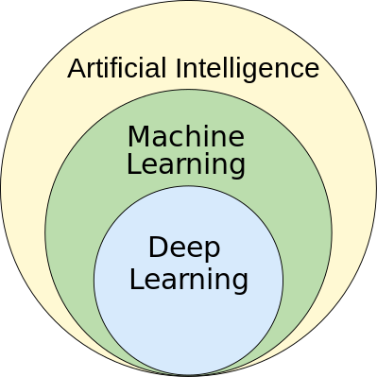
Advanced AI Techniques in ADAS
AI, ML, and Deep Learning
Overview
Definition: The integration of AI algorithms within ADAS to significantly enhance a vehicle's perception, decision-making, and overall performance.
Importance: AI enables systems to solve complex problems in real time, which is essential for ADAS systems
Machine Learning
Deep Learning
Computer Vision
Notes:
The integration of sophisticated artificial intelligence algorithms, particularly deep learning, within Advanced Driver-Assistance Systems (ADAS) to significantly enhance a vehicle's perception, decision-making, and overall performance.
Machine Learning – algorithms that can learn from data and generalize to unseen data
How it Works
Data Collection – collecting a large amount of data to train the system
Data Processing – taking the raw data and converting it to a form that is accepted by the machine learning algorithm (cleaning, formatting, removing outliers)
Training – Choose a model based on the requirements of a system (for computer version, most likely a deep learning model) and train the model on the data
The model "learns" by modulating internal parameters and recognizing patterns/relationships in the data
Evaluation – the model is evaluated by having the model make predictions on known data and seeing if the predictions are accurate
Deployment - once the model is evaluated, it is deployed to the system where it can make predictions on real data, such as images recorded by a camera on a car
Useful for
Decision-making algorithms: Analyze sensor data and predict potential hazards or optimal maneuvers for the ADAS system to take.
Path planning algorithms: Determine the safest path for the vehicle in various situations (e.g., highway driving vs. navigating a busy intersection)
Deep Learning – a subfield of machine learning that is particularly good at handling complex visual data
Useful for
Object detection and recognition (cars, pedestrians, traffic signs)
Lane line detection and tracking
Traffic light recognition
Computer Vision
Computer Vision - Computer vision techniques extract meaningful information from visual data.
How it Works
Preprocessing – resizing, normalizing, reducing noise on the image
Feature Extraction – analyzing and extracting characteristics from the image that can be used for recognition
Edge detection – identifying the boundaries between objects and surroundings
Color Histograms – distribution of colors throughout the image
SIFT (Scale-Invariant Feature Transform) - identifying features in an image that are detectable even under changes in scale, noise, rotation, etc.
Model Training – the model is trained on a dataset that already has labels
Classification – the model can now classify new images based on what it "learned"
Evaluation – The model can be evaluated by testing in on another set of pre-labelled images
Useful for
Image segmentation (classifying different parts of an image, like road vs. sky)
Object tracking (following the movement of objects)
Scene understanding (interpreting the overall traffic situation)
By analyzing camera footage, computer vision helps ADAS systems "see" the road and its elements.
Discussion:
What infrastructure improvements are necessary to support the widespread adoption of AI-powered ADAS features?
How can we strike a balance between driver assistance and automation to promote safe and responsible driving?
Image Source: https://commons.wikimedia.org/wiki/File:AI_hierarchy.svg Licensed Under: https://creativecommons.org/licenses/by-sa/4.0/deed.en

Slide 5
02 – Predictive ADAS Features

Slide 6

Predictive ADAS Features
Overview
Definition: ADAS functionalities that can anticipate potential hazards and situations on the road, enabling proactive interventions to enhance safety and driving experience.
Importance: Predictive ADAS features powered by AI algorithms offer significant advancements in driver assistance
Proactive Risk Mitigation
Enhanced Decision-Making
Personalized Assistance
Notes:
Developing predictive ADAS features involves utilizing various AI algorithms, particularly (bit of recap from last slide)
Deep Learning: Analyzing sensor data to predict future actions of pedestrians, vehicles, and other road users.
Machine Learning: Identifying patterns in historical traffic data and real-time sensor information to anticipate potential congestion or accidents.
Computer Vision: Extracting insights from camera footage to predict upcoming traffic light changes or hazards obscured from the driver's view.
Proactive Risk Mitigation:
Benefits: Enables ADAS systems to initiate preventive actions like pre-emptive braking or steering adjustments to avoid collisions.
Considerations: Requires robust algorithms to distinguish between genuine threats and false positives to avoid unnecessary interventions.
Examples: Predicting a potential rear-end collision and initiating automatic emergency braking.
Enhanced Decision-Making:
Benefits: Allows ADAS systems to make informed choices based on predicted scenarios, improving overall driving performance.
Considerations: Transparency in decision-making processes is crucial to maintain driver trust.
Examples: Predicting optimal lane changes based on traffic flow and suggesting maneuvers to the driver.
Personalized Assistance:
Benefits: Adapts ADAS behavior to individual driving styles and road conditions for a more tailored experience.
Considerations: Data privacy concerns need to be addressed when collecting and using personal driving data.
Examples: Adjusting the following distance for Adaptive Cruise Control (ACC) based on driver preferences.
Discussion Points:
How can we ensure the reliability and safety of predictive ADAS features in various driving scenarios?
How can we strike a balance between driver autonomy and the level of intervention from predictive ADAS systems?
Image Source: https://commons.wikimedia.org/wiki/File:Japanese_car_accident.jpg Licensed Under https://creativecommons.org/licenses/by-sa/2.0/deed.en

Slide 7
03 – Deep Learning

Slide 8
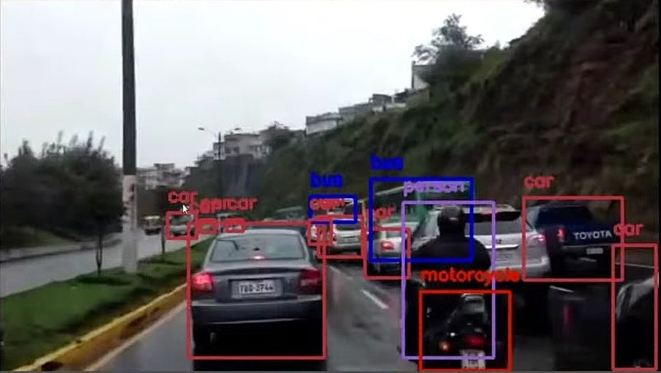
Deep Learning
Computer Vision
Overview
Definition: A subset of machine learning that simulates the decision-making power of the human brain
Importance: Deep Learning improves ADAS functionalities in multiple ways
Elevating Perception Accuracy
Enabling Proactive Responses
Driving Innovation in ADAS Features
Notes:
Elevating Perception Accuracy:
Benefits: Enables ADAS systems to achieve high accuracy in object detection and recognition, even in challenging conditions like low light or bad weather.
Considerations: Requires large, diverse datasets for training to ensure the model generalizes well to unseen scenarios.
Examples: Precise identification of pedestrians and cyclists for improved collision avoidance.
Enabling Proactive Responses:
Benefits: Allows ADAS to anticipate potential hazards and react swiftly, improving overall driving safety.
Considerations: Requires robust decision-making algorithms to determine the appropriate level of intervention.
Examples: Predicting a potential lane departure and initiating steering correction.
Driving Innovation in ADAS Features:
Benefits: Deep learning paves the way for the development of more advanced ADAS features like:
Fully automated emergency braking systems.
Traffic jam assist with automatic lane centering and stop-and-go functionality.
Personalized driver assistance adapting to individual preferences and driving styles.
Considerations: Regulatory frameworks and clear definitions of driver responsibility need to be established alongside technological advancements.
Discussion Points:
How can we ensure the explainability and transparency of deep learning models used in ADAS for driver trust and acceptance?
What are the challenges of balancing computational efficiency with the processing demands of deep learning algorithms in ADAS systems?
How can we promote responsible development and deployment of deep learning-powered ADAS features to minimize potential risks?
Image Source: https://commons.wikimedia.org/wiki/File:Computer_vision_sample_in_Sim%C3%B3n_Bolivar_Avenue,_Quito.jpg Licensed Under: https://creativecommons.org/licenses/by-sa/3.0/deed.en

Slide 9
04 – Ethics of AI-based ADAS

Slide 10

Ethics of AI-based ADAS
Data Privacy
Overview
Definition: The ethical dilemmas and privacy concerns surrounding the use of AI in ADAS
Importance: Addressing the ethics of AI usage helps ensure safety, data privacy, and trust
Ethical Considerations
Privacy Considerations
Notes:
Ethical Considerations
Bias in AI algorithms: Training data can perpetuate biases that lead to unfair or discriminatory behavior by ADAS systems. (e.g., favoring pedestrians with certain characteristics in collision avoidance).
Responsibility in decision-making: Who is accountable for accidents or malfunctions caused by AI-based ADAS? (driver, manufacturer, developer)
Moral dilemmas in critical situations: How should ADAS prioritize safety in unavoidable crashes (e.g., swerving to avoid a pedestrian but hitting an oncoming car)?
Privacy Considerations:
Data collection and storage: The vast amount of data collected by ADAS systems raises concerns about user privacy and potential misuse.
Data security and hacking: Robust security measures are needed to protect sensitive data from cyberattacks.
Driver monitoring and behavior analysis: ADAS systems with driver monitoring capabilities raise concerns about potential surveillance and limitations on driver freedom.
Discussion:
What are the ethical considerations surrounding data privacy and driver behavior analysis for developing personalized ADAS features?
How can we mitigate bias in training data for AI algorithms used in ADAS?
How can we establish clear lines of responsibility for accidents involving AI-based ADAS features?
What are the ethical considerations for developing ADAS systems that can handle complex moral dilemmas in critical situations?
How can we ensure user privacy when implementing data collection and storage practices within ADAS systems?
What cybersecurity measures are necessary to safeguard sensitive data collected by ADAS systems?
How can we strike a balance between driver privacy and the potential benefits of driver monitoring features in ADAS?
Image Source: https://commons.wikimedia.org/wiki/File:DataPrivacy.jpg Licensed Under: https://creativecommons.org/licenses/by-sa/2.0/deed.en

Slide 11
Thank You!

