Slide 1
Audio System Customization & User Experience

Slide 2

Agenda
Optimal Audio Quality & User Experience
01
02
User Testing & Feedback Collection

Slide 3

01 – Optimal Audio Quality & User Experience

Slide 4
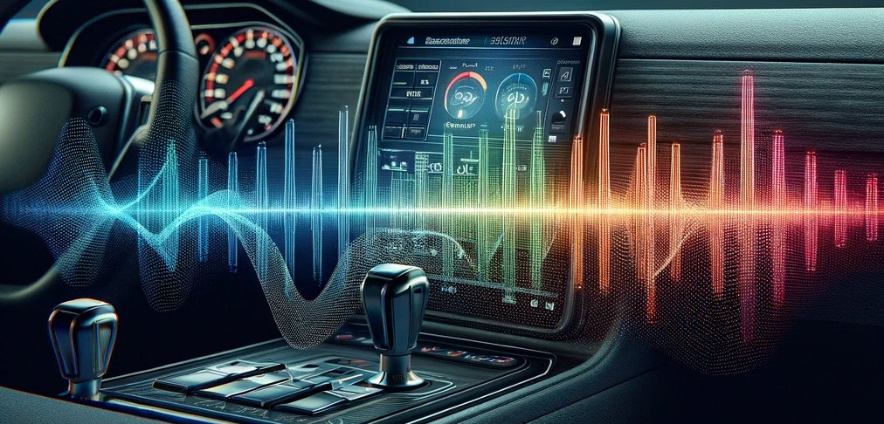
Optimal Audio Quality & User Experience
Optimizing Audio
Overview
Definition: Optimal audio quality and user experience refers to delivering clear, immersive, and driver-safe audio playback
Importance: High-fidelity audio and a well-designed user interface (UI) are crucial for a positive in-car experience, minimizing distractions and ensuring ease of use
Balancing Fidelity & Safety
User Interface Considerations
Customizability & Accessibility
Audio Source Optimization
Notes:
Balancing Fidelity and Safety: AAOS needs to balance delivering high-quality audio with prioritizing driver safety. Loud or distorted audio can be distracting, while crucial alerts and navigation instructions need to be audible.
User Interface Considerations: The AAOS audio UI should be intuitive and minimize driver distraction. Simple controls, voice commands, and clear visual feedback are essential.
Customizability & Accessibility: AAOS must include options to allow for the user to customize their experience to their preferences & help aid with any accessibility needs for those who might need audio aids while driving.
Audio Source Optimization: AAOS should optimize playback for various audio sources like FM radio, streaming services, and phone calls, accounting for in-car acoustics and background noise.
Discussion Points:
How can AAOS leverage machine learning to personalize audio settings based on driver preferences and in-car environment?
What are the trade-offs between offering advanced audio settings and maintaining a distraction-free UI?
How can car manufacturers integrate haptic feedback or spatial audio for a more immersive and informative audio experience?
References:
Building Audio Apps for Android Auto: https://developer.android.com/training/cars

Slide 5
02 – User Testing & Feedback Collection

Slide 6

User Testing & Feedback Collection
Feedback
Overview
Definition: Systematic processes to evaluate user interaction with in-car infotainment systems powered by AAOS
Importance: Helps identify usability issues, gauge user satisfaction, and refine the overall in-vehicle experience
Testing Methods
Feedback Collection Techniques
Focus on Safety
Notes:
Testing Methods: User testing can involve various methods like in-vehicle usability testing with real drivers, simulator-based testing, and remote user testing with prototypes.
Feedback Collection Techniques: Techniques include post-test interviews, surveys, in-app feedback mechanisms, and user research studies.
Focus on Safety: Testing should prioritize safety, ensuring tasks can be completed with minimal distraction while driving.
Additional Notes:
User testing: Testing should involve a diverse group of participants considering factors like age, technical experience, and driving habits.
Feedback collection: Collection of user feedback should be ongoing throughout the development process to ensure continuous improvement.
Testing Methods: In-Vehicle Testing: Users interact with AAOS in a simulated or real driving environment to assess real-world usability and potential distractions.
Lab Testing: Users interact with AAOS in a controlled lab setting to evaluate specific functionalities and user interface elements.
Remote Testing: Users interact with AAOS on simulators or emulators from a remote location.
Feedback Collection Techniques: Surveys and Questionnaires: Gather user opinions and preferences on AAOS features and overall experience.
Interviews: Conduct in-depth discussions with users to understand their thought processes and challenges while interacting with AAOS.
Usability Testing with Observation: Observe user interactions with AAOS to identify areas for improvement.
Discussion Points:
How can AAOS development leverage different user testing methods to gain well-rounded insights?
What are the ethical considerations when conducting user testing in a driving context?
How can car manufacturers effectively integrate user feedback into the AAOS development lifecycle?
References:
Test app feedback: https://developer.android.com/work/app-feedback/testing

Slide 7
Thank You!

