Slide 1
Future Trends & Research in ADAS

Slide 2

Agenda
01
Future Trends in ADAS
02
Research Areas in Autonomous Driving
03
Impact of Emerging Tech in ADAS Development

Slide 3

01 – Future Trends in ADAS

Slide 4
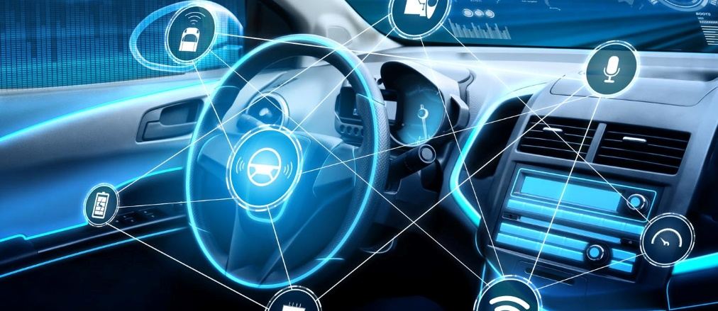
Future Trends in ADAS
Future ADAS Interconnection
Overview
Definition: Further advancement in the collection of technologies in a vehicle that electronically assist drivers with safety and enhancing the driving experience
Importance: Holds immense potential to revolutionize transportation
Reduced Human Error
Increased Automation & Convenience
Improved Traffic Flow & Efficiency
Notes:
Reduced Human Error: ADAS can react faster and more precisely than humans, mitigating accidents caused by driver fatigue, distraction, or impaired judgment.
Increased Automation and Convenience: As ADAS technology matures, it can take over more driving tasks, leading to partially and eventually fully autonomous vehicles.
Improved Traffic Flow and Efficiency: ADAS-equipped vehicles can communicate with each other and infrastructure, optimizing traffic flow and reducing congestion.
Notes:
Several trends are shaping the future of ADAS:
Sensor Fusion: Integrating data from cameras, radar, LiDAR, and other sensors creates a more comprehensive picture of the surroundings, enabling more precise and reliable ADAS features.
Artificial Intelligence (AI) and Machine Learning (ML): AI and ML algorithms can analyze sensor data in real-time, allowing ADAS systems to make complex decisions and react to unforeseen situations.
Vehicle-to-Everything (V2X) Communication: Vehicles will seamlessly communicate with each other and infrastructure (traffic lights, road signs, etc.) to improve coordination and safety.
Over-the-Air (OTA) Updates: ADAS systems can receive software updates wirelessly, ensuring they stay up-to-date with the latest advancements and bug fixes.
Standardization and Regulations: Establishing clear standards and regulations for ADAS functionality and safety is crucial for widespread adoption.
Discussion Points:
How can we ensure ethical considerations are addressed in the development and deployment of ADAS features, particularly regarding decision-making in critical situations?
What infrastructure improvements are needed to fully realize the potential of V2X communication for ADAS?
How can the public be educated about the capabilities and limitations of ADAS to promote safe and responsible use?
References:
5 Trends Shaping The Future of ADAS https://www.dataonesoftware.com/

Slide 5
02 – Research Areas in Autonomous Driving

Slide 6

Research Areas in Autonomous Driving
Market Research
Overview
Definition: Focuses on developing technologies that allow vehicles to navigate and operate without human input
Importance: Significant impacts on transportation of vehicles on the road minimalizing human error
Increased Safety
Improved Efficiency
Enhanced Mobility
Notes:
Increased Safety: Autonomous systems can react faster and avoid human errors, potentially reducing traffic accidents.
Improved Efficiency: Optimized traffic flow and reduced congestion can lead to shorter travel times and fuel savings.
Enhanced Mobility: Self-driving vehicles can provide transportation options to individuals who cannot drive themselves.
Notes:
Numerous areas are crucial for autonomous driving development:
Perception: Enabling vehicles to “see” and understand their surroundings through sensor fusion (cameras, LiDAR, radar) and advanced computer vision algorithms for object detection, classification, and scene understanding.
Localization and Mapping: Precisely determining the vehicle's location and continuously updating high-definition maps for real-time navigation. This includes technologies like GPS, Simultaneous Localization and Mapping (SLAM), and sensor fusion.
Decision Making and Path Planning: Developing algorithms that allow the vehicle to make safe and efficient decisions about its route, speed, and maneuvers based on real-time sensor data and map information. This involves areas like artificial intelligence, machine learning, and motion planning.
Control Systems: Designing robust control systems that translate high-level decisions from the planning module into real-time steering, braking, and acceleration commands for the vehicle.
Simulation and Testing: Creating realistic virtual environments to test and refine autonomous driving algorithms before real-world deployment. Additionally, rigorous real-world testing with diverse driving conditions is essential.
Cybersecurity: Ensuring the security of autonomous vehicles against hacking and cyberattacks is critical for safety and reliability.
Additional Notes:
Developing ethical frameworks for decision-making in critical situations (e.g., unavoidable accidents) is also a crucial research area.
Discussion Points:
How can sensor technology be further improved to ensure reliable perception in all weather and lighting conditions?
How can we create high-definition maps that are constantly updated and cover diverse geographical regions?
What challenges arise in ensuring the ethical and responsible decision-making of autonomous vehicles?
References:
Research Areas in Autonomous Driving https://www.sciencedirect.com/topics/computer-science/autonomous-driving

Slide 7
03 – Impact of Emerging Tech in ADAS Development

Slide 8
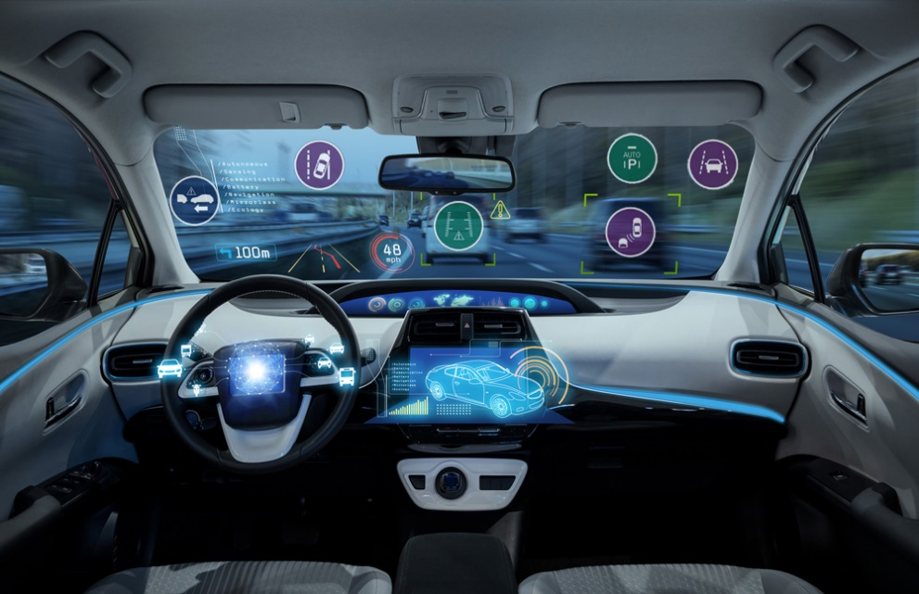
Impact of Emerging Tech in ADAS Development
Emerging Tech in ADAS
Overview
Definition: New and rapidly evolving advancements that push the boundaries of what's possible for driver-assistance systems
Importance: hold the promise of significantly enhancing ADAS capabilities to innovate the automotive industry
Robust Perception & Precision
Enhanced Decision Making
Greater Levels of Automation
Notes:
More Precise and Robust Perception: New sensor technologies and advanced processing techniques can create a more comprehensive and accurate understanding of the vehicle's surroundings.
Enhanced Decision-Making: Machine learning algorithms with improved capabilities can analyze complex traffic scenarios and make informed decisions in real-time.
Greater Levels of Automation: Advancements can pave the way for higher levels of automation in ADAS, potentially leading to partially or conditionally autonomous vehicles.
Notes:
Several emerging technologies are shaping the future of ADAS:
High-Resolution LiDAR: Next-generation LiDAR sensors with higher resolution and wider range can provide detailed 3D perception of the environment, even in low-light conditions.
Advanced Driver Monitoring Systems (DMS): These systems use cameras and sensors to monitor driver behavior, such as drowsiness, distraction, or potential health issues. They can provide alerts or even intervene to prevent accidents.
厘米波 (li mi bo) Radar (Millimeter-wave Radar): Millimeter-wave radar offers high-resolution object detection and precise range measurement, especially in adverse weather conditions where cameras may struggle. (In English, this translates to millimeter-wave radar.)
AI-powered Sensor Fusion: Artificial intelligence can analyze data from multiple sensors simultaneously, leading to a more robust and unified understanding of the environment.
Explainable AI (XAI): XAI techniques can help improve transparency and trust in ADAS decision-making processes by explaining how the system arrived at a particular action.
Additional Notes:
The development of these technologies needs to be accompanied by advancements in areas like cybersecurity, data privacy, and regulatory frameworks.
Discussion Points:
How can high-resolution LiDAR data be efficiently processed and interpreted for real-time ADAS applications?
How can DMS be balanced with driver privacy concerns?
What role can XAI play in building public trust in ADAS technology?
References: Revolutionizing Autonomy: The Latest Technologies Advancing ADAS https://www.allaboutcircuits.com/
ADAS technology | imec https://www.imec-int.com/en/sensor-networks-for-IoT/next-generation-adas-technology

Slide 9
Thank You!

