Slide 1
Future of Automotive Audio

Slide 2

Agenda
Emerging Trends & Future Tech
01
02
Role of Audio in Autonomous & EVs

Slide 3

01 – Emerging Trends & Future Tech

Slide 4
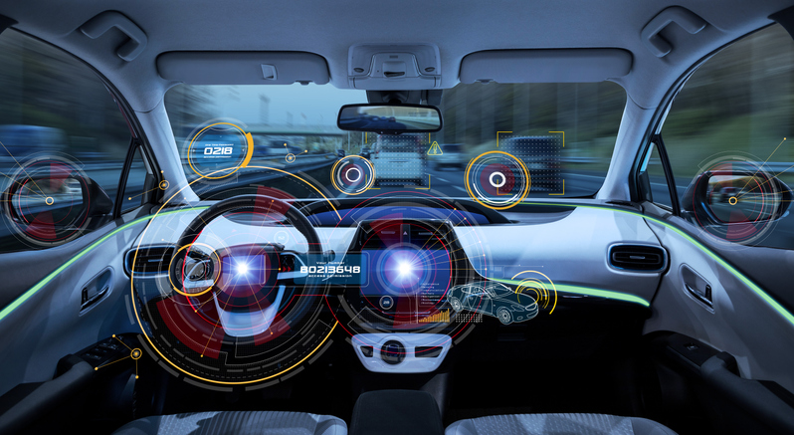
Emerging Trends & Future Tech
Future Tech
Overview
Definition: integration of new audio technologies and functionalities into AAOS
Importance: Shaping the future of in-car entertainment while improving overall user experiences while operating a vehicle
Personalization & Immersive Sound
Seamless Connectivity & Content Integration
Advanced Audio Processing
Notes:
Personalization and Immersive Sound:
Benefits:
User profiles can store personalized audio settings like equalizer adjustments and surround sound preferences.
Spatial audio can create a more realistic and immersive listening experience, like being in the middle of a concert.
Considerations:
The effectiveness of spatial audio may depend on the car's speaker configuration and acoustic environment.
User preferences for audio profiles may vary greatly.
Examples:
User profiles for different listening preferences (driver vs. passengers).
Spatial audio playback for compatible music streaming services or concerts.
Seamless Connectivity and Content Integration:
Benefits:
Easy access to a wider variety of audio sources like streaming services, online radio, and audiobooks directly through the AAOS interface.
Integration with smartphones and other connected devices for a more unified listening experience.
Considerations:
Data usage and connectivity can impact audio streaming quality.
The variety of available content platforms may vary depending on region and licensing agreements.
Examples:
Native integration with popular music streaming services like Spotify or Youtube Music.
Access to podcasts and audiobooks directly through the AAOS interface.
Advanced Audio Processing and Active Noise Cancellation:
Benefits:
Advanced audio processing algorithms can improve sound quality by adjusting for speaker limitations and cabin acoustics.
Active Noise Cancellation (ANC) can significantly reduce road noise and engine sounds, creating a quieter and more relaxing in-car environment.
Considerations:
The effectiveness of ANC may vary depending on the car's cabin design and background noise levels.
Advanced audio processing algorithms may require significant processing power.
Examples:
Automatic sound adjustments based on driving speed or road conditions.
ANC technology that reduces road noise and engine hum.
Additional Notes:
The future of Android Automotive Audio is likely to see further integration with Artificial Intelligence (AI) for features like personalized audio recommendations and voice-controlled audio adjustments. Additionally, the development of new audio codecs and advancements in audio transmission technology will continue to shape the listening experience within connected vehicles.
Discussion Points:
How can car manufacturers leverage Android Automotive Audio to differentiate their in-car entertainment systems?
What are the challenges of ensuring a safe and driver-distracting-free experience with advanced audio features?
How will the future of audio codecs and in-car connectivity impact the development of Android Automotive Audio?
References:
While there are no official references for Android Automotive Audio specifically, you can find relevant information on:
Android Open Source Project (AOSP): https://source.android.com/
Audio Capabilities in Android: https://developer.android.com/training/tv/playback/audio-capabilities

Slide 5
02 – Role of Audio in Autonomous & EVs

Slide 6
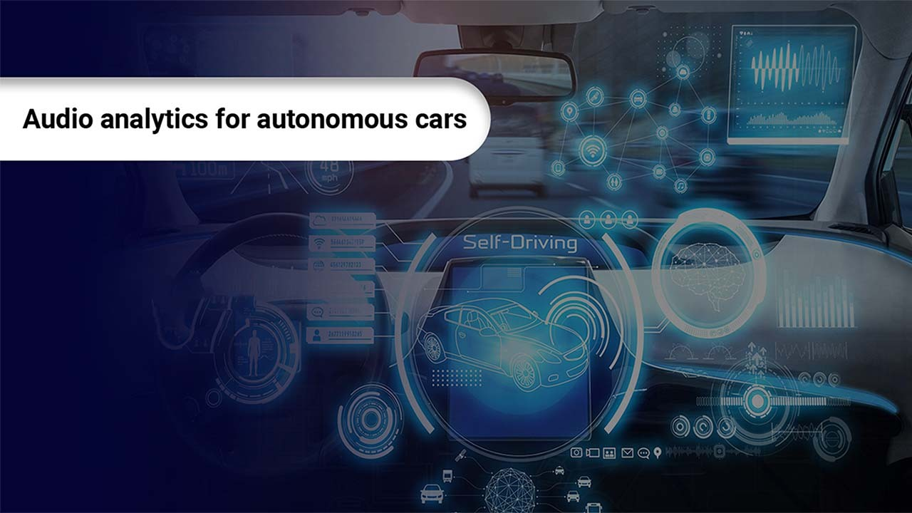
Role of Audio in Autonomous & EVs
Audio & Autonomous
Overview
Definition: impact of audio for a more comfortable & informative driving experience
Importance: Crucial role in both Autonomous & electric vehicles to enhance safety & awareness
Safety Communications
Environmental Awareness
Passenger Comfort & Entertainment
System Monitoring & Diagnostics
Notes:
Safety Communication:
Benefits:
Audible alerts can warn pedestrians and cyclists of an AV's presence, especially at intersections or during maneuvers.
Standardized warning sounds can improve overall road safety in a future filled with diverse vehicle types.
Considerations:
The design of audio alerts needs to be balanced to be noticeable but not startling.
Regulations may be required to ensure consistency in AV warning sounds across manufacturers.
Environmental Awareness:
Benefits:
Replacing engine noise with carefully crafted soundscapes can improve a driver's awareness of their surroundings in EVs, particularly at low speeds.
Pedestrian safety can be enhanced by generating audible warnings when an EV is reversing or turning.
Considerations:
The design of soundscapes should avoid creating unnecessary noise pollution.
Drivers may need to adapt to the lack of traditional engine noise and rely more on visual cues.
Passenger Comfort and Entertainment:
Benefits:
In AVs, where the driving experience is less engaging for passengers, high-quality audio systems and a wider variety of entertainment options can enhance comfort and enjoyment during rides.
Audio can also be used to provide passengers with information about the journey, upcoming destinations, or points of interest.
Considerations:
In-car audio systems should be designed to minimize sound fatigue for long journeys.
Audio entertainment options should cater to the diverse preferences of passengers.
System Monitoring and Diagnostics:
Benefits:
Specific audio cues can be used to alert drivers to potential problems with the AV system or EV drivetrain.
Audible warnings can help drivers take timely action and avoid more serious issues.
Considerations:
Audio warnings should be clear and easily distinguishable from other in-car sounds.
The over-use of audio warnings should be avoided to prevent driver distraction.
Additional Notes:
The future of audio in AVs and EVs is likely to see increased personalization, with soundscapes and audio alerts adapting to driver preferences and environmental conditions. Additionally, advancements in Audio-to-Vehicle (A2V) technology will enable real-time communication between vehicles and infrastructure, further enhancing safety and efficiency.
Discussion Points:
How can audio warning systems be designed to be effective yet unobtrusive for pedestrians and drivers?
What role can audio play in creating a sense of trust and confidence in AV technology?
How can in-car entertainment options be tailored to the unique needs of passengers in AVs?
References:
Self-driving cars offer chance to re-imagine sound systems: https://wearelisten.com/insights-future-of-sound-automotive/
Audio Analytics: An Important Technology for Autonomous Cars: https://www.volansys.com/blog/audio-analytics-an-important-technology-for-autonomous-cars/

Slide 7
Thank You!

