Slide 1
Introduction to Automotive Audio in AAOS

Slide 2

Agenda
Overview of Automotive Audio
01
02
AAOS Audio Architecture & Components

Slide 3

01 – Overview of Automotive Audio

Slide 4
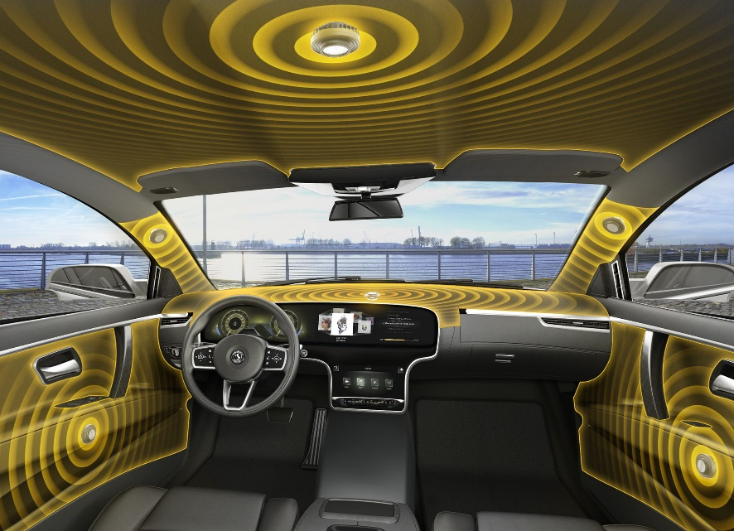
Overview of Automotive Audio
Audio Multi-Zone Balance
Overview
Definition: Sub-framework within the AAOS designed specifically to manage audio functionalities within vehicles
Importance: An effective in-car audio system is crucial for a safe and enjoyable driving experience
Streamlined Audio Management
Enhanced Audio Quality
Multi-Zone Audio Support
Safety Critical Audio Prioritization
Notes:
Streamlined Audio Management: Provides a centralized platform for managing various audio sources like media playback, navigation guidance, and phone calls.
Enhanced Audio Quality: Supports advanced audio codecs and processing techniques to deliver clear and immersive sound within the car's specific acoustics.
Multi-Zone Audio Support: Enables control over separate audio zones within the vehicle, catering to driver and passenger preferences.
Safety-Critical Audio Prioritization: Ensures critical alerts and warnings from the car are always audible, even during media playback.
Notes:
Android Automotive Audio leverages the Android Hardware Abstraction Layer (HAL) to interact with the car's specific audio hardware.
It manages audio streams through a concept called Audio Focus, which ensures different apps don't interfere with each other's playback.
The framework provides APIs for developers to integrate their in-car audio apps, allowing for a rich and customizable audio experience.
Discussion Points:
How can future iterations of Android Automotive Audio further optimize audio quality based on vehicle type and passenger occupancy?
What are the challenges and opportunities in integrating spatial audio technologies within the car environment?
How can developers ensure their in-car audio apps adhere to safety regulations and minimize driver distraction?
References:
Android Automotive Audio: https://source.android.com/docs/automotive

Slide 5
02 – AAOS Audio Architecture & Components

Slide 6
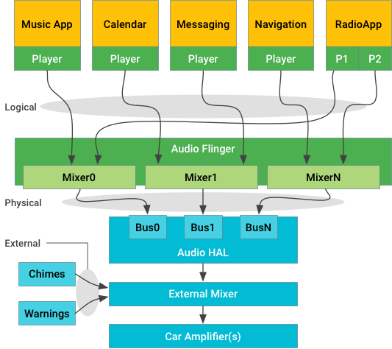
AAOS Audio Architecture & Components
AAOS Audio Architecture
Overview
Definition: Follows a layered approach with various software and hardware components working together to deliver in-car audio functionalities
Importance: Knowledge of this architecture by developers & car manufacturers is critical for working with the following components:
Android Audio Framework
Android Hardware Abstraction Layer (HAL)
Audio HAL
Audio Effects
Audio Apps
Notes:
Android Audio Framework: Provides the foundation for audio management, including APIs for routing, focus control, and playback.
Android Hardware Abstraction Layer (HAL): Acts as a bridge between the framework and the car's audio hardware, ensuring compatibility with diverse audio setups.
Audio HAL: Car vendor-specific implementation of the HAL, handling communication with the car's audio amplifiers, speakers, and microphones.
Audio Effects: Optional components that can be applied to enhance the audio experience, like equalization or noise cancellation.
Audio Apps: Third-party applications utilizing the AAOS Audio framework to deliver various audio experiences like music streaming, navigation, or podcasts.
Notes:
The architecture decouples the framework from the hardware, allowing for flexibility and customization across different car models.
Audio HAL implementations can vary depending on the car manufacturer, but they all adhere to a common interface defined by the Android framework.
AAOS Audio supports a variety of audio formats and codecs, ensuring compatibility with most audio sources.
Discussion Points:
How can the AAOS audio architecture be further standardized to simplify app development for car audio?
What are the trade-offs between using generic audio effects versus car manufacturer-specific optimizations?
How can future iterations of AAOS integrate with advanced audio hardware like head-up displays or in-seat speakers?
References:
Android Automotive Audio: https://source.android.com/docs/automotive

Slide 7
Thank You!

