Slide 1
ADAS Sensors and Data Processing

Slide 2

Agenda
01
ADAS Sensors
02
Sensor Data Processing

Slide 3

01 – ADAS Sensors

Slide 4
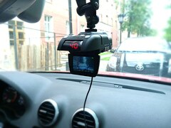
ADAS Sensors
Camera
Overview
Definition: sensors used to enable ADAS features for the vehicle
Importance: without these sensors, the car would be blind to the world and ADAS features wouldn't function properly
Cameras
Radar
LiDAR
Ultrasonic
Infrared
Notes:
Cameras are mounted to the car in various places to record and process objects in the environment such as traffic signs, pedestrians, other cars, and anything else in the environment that impacts driving.
They can help with ADAS features such as adaptive cruise control, automatic emergency brake, lane assistance, automatic headlight activation
With multiple cameras positioned on front/rear/sides, can achieve a 360 degree view of the world around the car
Cameras used in ADAS are different from simple dash cams in that they process the data coming in rapidly to improve decision-making
Radar is a type of sensor that is used mainly for collision avoidance. It works by sending out radio waves and measuring the time it takes for the waves to return, thus calculating a 3D map of the environment
Radar is used in ADAS features such as adaptive cruise control, blind-spot detection, collision warnings, and pedestrian detection
Also works in poor weather conditions, like rain or fog
LiDAR is an advanced type of sensor that sends out light photons to determine the positioning of objects similar to how radars use radio waves
LiDAR is much more precise than radar, making it useful for identifying people and smaller irregularities in the environment/terrain
LIDAR is more expensive than Radar
Ultrasonic Sensors: Emit high-frequency sound waves to detect nearby objects,
Commonly used in parking assistance systems to prevent collisions with obstacles.
Infrared Sensors: Detect infrared radiation emitted by objects to gauge their temperature and proximity
Useful for detecting the presence of pedestrians or animals in low-light conditions.
Read more at https://caradas.com/adas-sensors-guide/
Image licensed under https://creativecommons.org/licenses/by-sa/3.0/deed.en
Url: https://commons.wikimedia.org/wiki/File:Car_dvr_%2B_radar_in_my_car.jpg

Slide 5
02 – Sensor Data Processing

Slide 6
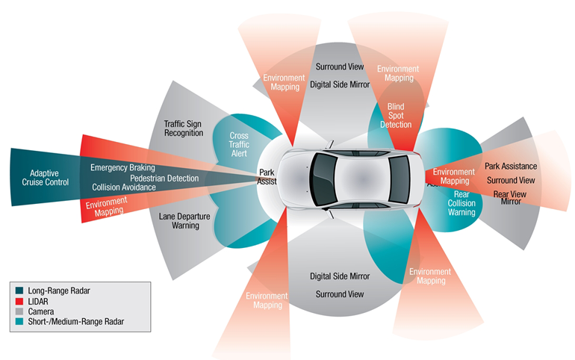
Sensor Data Processing
Overview
Definition: analyzing the data collected from sensors
Importance: once data is collected from sensors, it must be processed to influence decision-making
Image Processing
Time-of-Flight Calculations
Thermal Imaging
Sensor Fusion
Real-Time Processing
Notes:
(ADAS) heavily relies on a variety of sensors to gather data about the vehicle's surroundings:
Image Processing – Advanced cameras can have high-powered microprocessors and algorithms embedded in them to convert the continuously changing analog image obtained by the camera into digital data to be used for ADAS systems. Analysis of image includes recognition and object detection. The algorithms that make these judgements utilize machine learning to make predictions. They are trained on pre-labelled images and can thus make predictions on new data based on its learnings. For example, an image might be processed and reveal to the ADAS system that there is a person in the oncoming path of the vehicle.
Time of Flight - where radio waves/light are emitted, and the time it takes for these signals to bounce back is used to interpret the distance between the sensor and the object. LiDAR, Radar both utilize time-of-flight calculations. A longer time-of-flight indicates a longer distance from the sensor to the object. This data can be used to create 3D maps, with detail depending on which type of sensor is used. LiDAR is much more accurate than radar due to specific properties of light/radio waves (in particular: wave-length). Since light has a shorter wave-length, LiDAR data is much more precise than radar.
Ultrasonic also employs time-of-flight calculations; ultrasonic sensors emit high frequency sound waves and utilize the reflected waves to determine positioning of other objects
Thermal Imaging - Infrared sensors capture heat signatures from the environment. This thermal data is analyzed to estimate the size, shape, and temperature of the object. Based on these values, the system can make predictions about the object and classify them between pedestrians, vehicles, animals, etc (sometimes based on machine learning algorithms, such as those used for image processing).
Sensor Fusion – There are a lot of different drawbacks of the different sensors (see below). Using multiple sensors for a given feature (such as object detection) can provide more comprehensive coverage of the environment. For example, imagine a car driving down a road at night and an animal runs out in front of the car's path. Due to low-light conditions, camera systems might detect an object but not have enough fine detail to identify the image. Though, just knowing that something is there is an important discovery. With time-of-flight calculations from LiDAR and radar, the car could receive a more detailed map of where the object is, regardless of lighting conditions. Thus, more specific actions (breaking, steering adjustments) could be taken to mitigate damage. Thermal data could also be received to corroborate the existence of an obstacle in the path of the car.
Accordingly, this data needs to be processed in real time because in situations where potential accidents can occur, receiving/processing real-time data could be the difference between life and death.
Some examples of limitations/drawbacks:
LiDAR is expensive
Cameras can make mistakes in interpreting images. Of course, mistakes can happen with all types of sensors
Cameras don't work well in low-light conditions
Infrared can detect all sources of heat, potentially leading to some false positives
Some sensors are only placed in certain parts of the car, so multiple sensors could allow for 360 degree view
Image licensed under https://creativecommons.org/licenses/by-sa/4.0/deed.en
Source: https://commons.wikimedia.org/wiki/File:Figura-.png
Data Processing in ADAS: The processing of data from these sensors typically involves several layers:
Data Acquisition: Raw data is continuously collected from the various sensors.
Signal Processing: The raw data is filtered and processed to detect noise and correct errors. This step often involves algorithms to interpret the sensor signals in terms of the physical environment.
Data Fusion: Data from multiple sensors is combined to improve the accuracy and reliability of information. This fusion can occur at an early stage (sensor-level fusion) or after initial processing (feature-level or decision-level fusion).
Object Detection and Classification: This stage involves identifying objects like vehicles, pedestrians, and road signs, and classifying them based on their type and behavior.
Situation Assessment: The system assesses the current traffic situation, predicting potential hazards and the movement of other road users.
Decision and Control: Finally, the system makes decisions and takes actions, such as alerting the driver, adjusting the speed, or autonomously steering the vehicle to avoid collisions or maintain lane integrity.
Integration with Android Automotive: In vehicles equipped with Android Automotive OS, the processing and utilization of ADAS data can be integrated into the Android ecosystem in these ways:
APIs and Middleware: Android Automotive provides APIs that allow ADAS applications to interact with both the vehicle's hardware and Android's application layer. This middleware can manage the flow of sensor data and facilitate the integration of ADAS features with other applications, such as navigation and vehicle diagnostics.
User Interface: Android Automotive enables the development of user-friendly interfaces that can display ADAS warnings and information directly on the vehicle's infotainment screen. This helps in providing real-time feedback to the driver, enhancing both safety and user experience.
App Development: Developers can create or adapt apps specifically for automotive use, utilizing ADAS data to provide enhanced features like predictive navigation, which adjusts routes based on traffic conditions and driving behavior.

Slide 7
Thank You!
Notes:
In-depth articles for further research:
https://caradas.com/adas-radar-sensor/
https://caradas.com/understanding-ultrasonic-sensors-in-cars/
https://www.ti.com/lit/wp/slyy150b/slyy150b.pdf?ts=1715120188822
https://caradas.com/adas-cameras/

