Slide 1
Introduction to V2X

Slide 2

Agenda
01
V2X
02
Types of V2X
03
Applications of V2X

Slide 3

01 – V2X

Slide 4
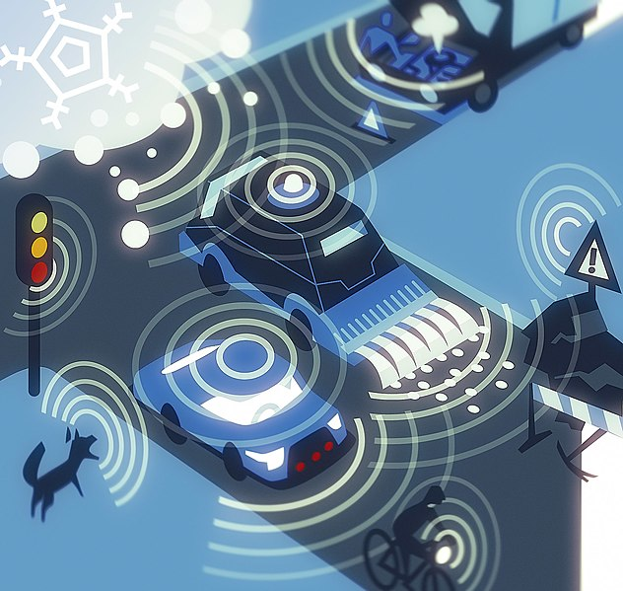
V2X
Overview
Definition: Communication between a vehicle and another entity
Importance: V2X is an essential factor in improving and optimizing the driving experience
Safety
Efficiency
Convenience
Notes:
V2X is communication between a vehicle and any other entity that is relevant, could affect, or be affected by the vehicle, such as other vehicles, devices, infrastructure, pedestrians, and more
V2X takes many different forms, each defined by the entity that is being communicated with (V2V, V2I, V2P, etc.). Accordingly, V2X has many relevant applications and can improve the following factors:
Safety – By communicating with nearby objects and entities, V2X ensures the current vehicle is aware of its surroundings. Thus the vehicle can maintain a safe distance away from objects and prevent collisions.
Efficiency – By sharing data about traffic and routes, V2X can enable more efficient driving and reduce congestion by suggesting alternate routes based on traffic flow, or allowing traffic lights to synchronize with real-time traffic data. This can also lead to more efficient energy consumption.
Convenience – V2X enables many features that make the driver's life easier such as automative toll payment and real-time parking availability data.
Discussion Questions:
What are some other examples of V2X improving safety, efficiency, and convenience?
What are some potential limitations/drawbacks of V2X?
Image: https://commons.wikimedia.org/wiki/File:Car2x_communication.jpg
Licensed Under https://creativecommons.org/licenses/by-sa/4.0/deed.en

Slide 5
02 – Types of V2X

Slide 6
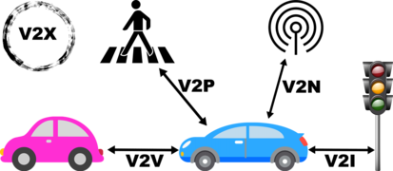
Types of V2X
Types of V2X
Overview
Definition: Different sub-categories of V2X, each referring to the type of entity with which the vehicle is communicating
Importance: Understanding the types of V2X shines light on what can be accomplished with V2X
V2V
V2I
V2D
V2P
V2C
Notes:
V2X, as defined earlier, is communicating between a vehicle and another entity. Discussing what types of entities can be communicated with can shine light on what V2X is really capable of:
V2V – Vehicle to Vehicle Communication – Communicating with other vehicles and realizing their location, speed, and other relevant information.
V2V is important for safety, such as blind spot monitoring
It is also helpful for traffic management – if many vehicles report on being in the same location, that could alert other drivers about possible congestion
V2I – Vehicle to Infrastructure – communicating with the very infrastructure that enables driving to begin with
Traffic Lights – awareness of traffic light status, could be modulated to improve efficiency depending on what cars around. Also cars can "know" when red lights are coming up.
Lane Markers – helpful for lane assistance
Parking Meters – automatic payments or notifications on parking availability
Toll Booths/Collectors - automatic toll collection
Road Signs – increased awareness of road signs and traffic rules can be achieved through V2I
V2D – Vehicle to Device – communicating with devices via bluetooth, Apple Carplay and Android Auto
Traffic Updates – receiving real-time traffic updates from smartphones
App Integration – such as a navigation app
V2P – Vehicle to Pedestrian – communicating with devices held by pedestrians
Reducing pedestrian accidents – if the cars is aware of where pedestrians are, can take measures to avoid hitting them
Cyclists - in addition to pedestrians, V2P can help ensure the safety of people on bicycles, scooters, and other smaller transportation units
V2C – Vehicle to Cloud – communicating to the cloud
Receiving updates over the air
Diagnostics
Discussion Questions:
What other types of V2X could there be?
Image licensed under https://creativecommons.org/licenses/by-sa/4.0/deed.en
Source: https://commons.wikimedia.org/wiki/File:Types_V2X_.png

Slide 7
03 – Applications of V2X

Slide 8
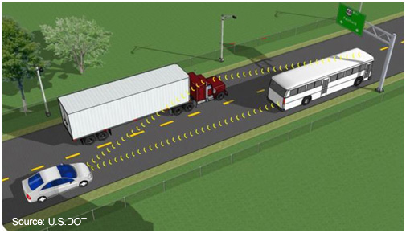
Applications of V2X
V2V
Overview
Definition: V2X has many applications, each contributing to the vehicle ecosystem in a different way
Importance: Discussing the applications of V2X, we can directly understand how V2X improves the driving experience
ADAS
Collision Avoidance
Traffic Management
Congestion Reduction
Real-Time Traffic Management
Notes:
Because V2X is so broad (it is comprised of many different sub-categories like V2I, V2D, etc.), its applications are varied.
ADAS – Advanced Driver Assistance Systems :
Collision Avoidance:
Blind Spot Monitoring – V2V can provide information about cars that could be sitting in blind spots
Lane Departure Warning – V2I can let you know you are leaving the designated lane boundary
Pedestrian and Cyclist detection – V2P provides data on where pedestrians and cyclists can be
Brake Detection – V2V, if another vehicle brakes (whether normally or suddenly, such as in response to an obstacle), the driver can be alerted that they should probably brake too
Forward Collision Warning – Depending on the type of entity that is ahead, V2X can alert us of potential obstacles in our path
Rear Cross-Traffic Alert – V2V or V2P could let us know that there is an entity that is going to cross the path when pulling out of a parking lot
Traffic Management:
Adaptive Cruise Control – V2V could provide positional data on the car ahead, which could be used in ACC calculations
Traffic Light Monitoring – V2I could provide data on upcoming red lights, and alert the driver to brake soon
Congestion Reduction:
Real-Time Traffic Management
Identification of congested routes – Vehicles can communicate which route they are taking, which could be used to create a congestion map
Alternate Routes - recommend alternate routes to avoid this congestion
Traffic Light Modulation – Traffic lights could be modulated based on real-time vehicle data to improve efficiency based on real-time V2X data
Parking Management – V2I provides real-time parking availability data and could automate payments
Image Source: https://commons.wikimedia.org/wiki/File:ITS_image_V2V_communication_on_freeways_will_help_to_prevent_crashes.jpg
Licensed Under Public Domain: https://en.wikipedia.org/wiki/en:Public_domain

Slide 9
Thank You!
Notes:
Activity: Take an ADAS feature, research it, and talk about which types of V2X would be applicable. Associates can pick their own or choose one from this list: https://www.synopsys.com/automotive/what-is-adas.html
Here are some discussion questions relating to V2X and ADAS:
Enhancing ADAS Functionality:
How can V2X data be used to improve the accuracy and effectiveness of existing ADAS features like automatic emergency braking (AEB) or lane departure warning (LDW)?
How will V2X communication allow ADAS features to anticipate potential hazards beyond the range of on-board sensors?
Can V2X technology facilitate cooperation between different vehicles' ADAS systems, leading to smoother and safer traffic flow?
What are the potential challenges of integrating V2X data into existing ADAS decision-making algorithms?
Standardization and Reliability:
How can we ensure consistent and reliable V2X data exchange for optimal ADAS performance?
What level of standardization is needed for V2X communication protocols to effectively integrate with diverse ADAS systems?
How can we address potential delays or latency issues in V2X communication to guarantee timely responses from ADAS features?
Future of V2X and ADAS:
Can V2X communication create a more collaborative driving environment where vehicles work together for optimal safety and efficiency?
How can we leverage V2X and ADAS advancements to create a more sustainable and equitable transportation system?

