Slide 1
AN INTELLIGENT SEMANTIC SEARCH SYSTEM FOR DIGITAL PRODUCT-PART DESGIN CATALOGUES IN MANUFACTURING
Tables-Text-Images to text (TTI.txt) & Semantic Search Exploration (SSE)
Pablo De Vicente Abad
Promotor: Moharram Challenger
Co-Promotor: Alireza Khalilipour
Modelling Intelligent Complex Software and Systems - MICCS-Lab. University of Antwerp, Belgium
Notes:
Two parts.
1. The TTI.txt tool (how to deal with the product part design catalogues)
2. SSE- Semantic Search Exploration (what is an intelligent Semantic Search System)

Slide 2
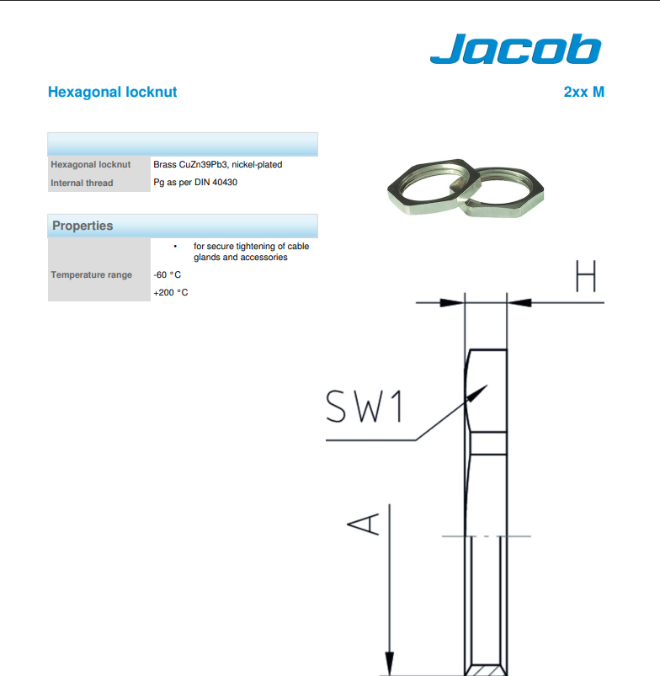
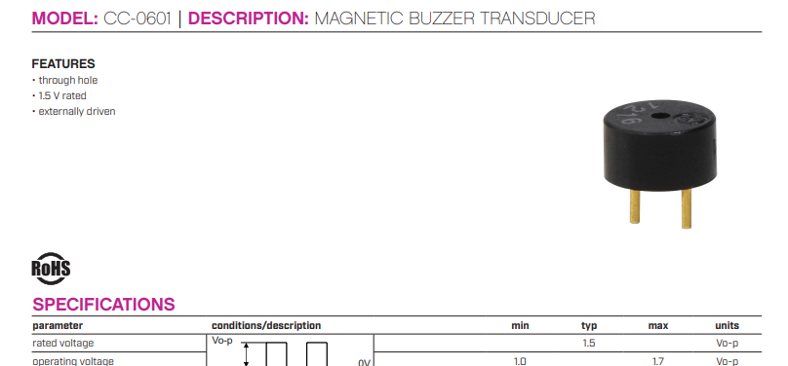
Product Catalogues (PC)
Richly formatted technical documents that are extensively used in industrial settings.
A product catalogue lists every item—from simple fasteners (Stainless-steel bolts [grade, size, strength]) to complex electromechanical assemblies
Key Characteristics
Highly variable in source and structure
Rich technical specifications
Enhanced with images and tables for full context

Slide 3
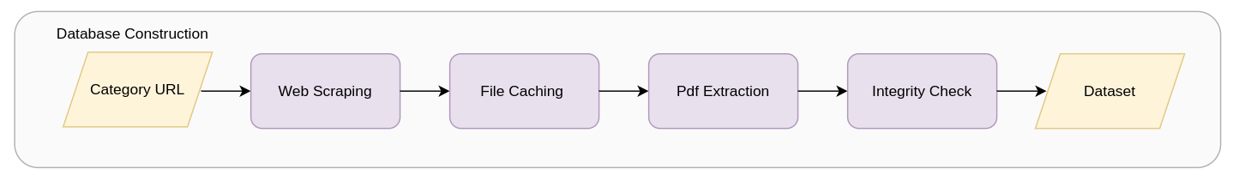
Dataset – Origin & Labelling
We used a web crawler to scrape Digikey PDFs.
After downloading and processing the dataset, perform thorough integrity checks.
Documents are labeled according to the category from which they were downloaded.

Slide 4
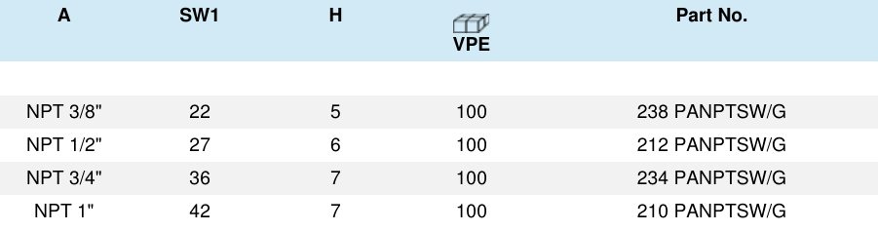
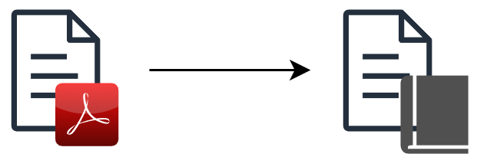
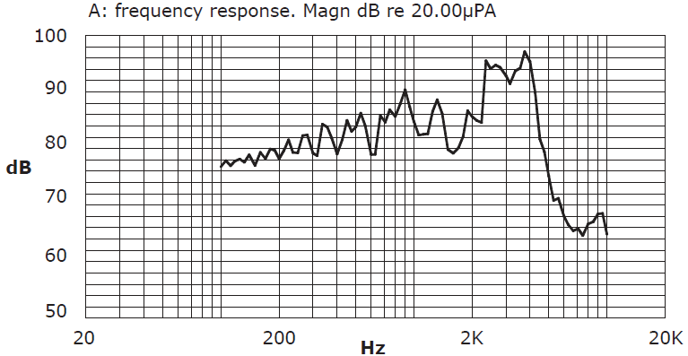
TTI.txt – Transforming PDFs into Structured Text
TTI.txt – Our custom tool, Tables, Text, and Images to .txt, converts all content into plain text format.
}
Images and tables preserve engineering-critical context

Slide 5
Text – Optical Character Recognition (OCR)
Library | Strengths | Weaknesses | Verdict
PyPDF2 | Reliable with basic text | Fails on tables and multi-column layouts | ❌ Too brittle for complex PDFs
PyTesseract | Works on scanned/low-quality pages | High table/column errors | ❌ High effort, low reward
PDFPlumber | Preserves text, line breaks, and tables | Minor formatting errors | ✅ Best balance of accuracy & usability
MuPDF (fitz) | Consistent column order; great with multi-columns | Poor table support | ⚠️ Good layout, lacks table parsing
Notes:
PyPdf : (Misaligned reading)
Pytessearct : needs heavy cleanup by hand
Final Decision: PDFPlumber chosen
Best trade-off between accuracy and usability
Achieved >95% correct word identification across document types
Residual noise (≤5%) filtered in preprocessing using regex and token cleanup
Strategic Fit for BoW Indexing
Robust raw text capture supports high-recall token coverage
Slight formatting loss acceptable for BoW model goals

Slide 6






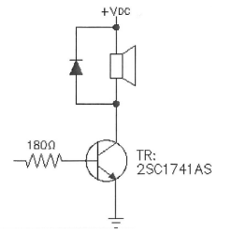

Images – Extraction & Processing
Extract images from pdf
Pre-filter images (size > 1,000 total pixels)
Filter Images: MobileNetv2 classifier – Logos, Banners and non-product images are discarded
Transcribe the images with the help of llama-3.1-8B-vision-378
×
“ The image shows a circuit diagram with various components connected together. The components visible in the image are: …”
×
Notes:
Im re-doing this slide.
How to extract images
How to filter them
How to transform into text

Slide 7
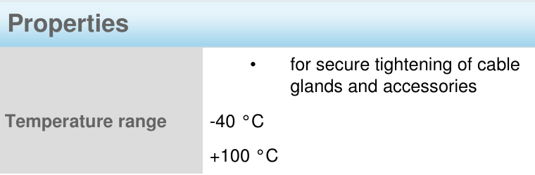
Tables – Where the fun begins
Extract tables from PDFs and tackle their unique structural challenges
Categorize tables into “Excel-like” or “Questionnaire-like” formats
Apply the appropriate model—TableGPT2 for Excel-style tables and Qwen2.5-7B for questionnaire tables
Excel-like table example
Questionnaire-like table example
… **Row 1:**- **Internal Thread:** Refers to a threading feature found …
This product is designed to operate reliably across a wide temperature range. The operating temperature range extends from - 40 C to 100 C …
Notes:
Challenges that tables present
How to extract them – how to filter them
The two kinds of tables we encounter then
What table-to-text we use, depending on the context
Problems: loong training and poor formatting kills you. Literature on tables assumes excel-like tables
Not the same, QA, than explaining.
Why QA you “know” what you are looking for, sort-of
Categorize tables into “Excel-like” or “Questionnaire-like” formats
Extract tables from PDFs and tackle their unique structural challenges
Apply the appropriate model—TableGPT2 for Excel-style tables and Qwen2.5-7B for questionnaire tables

Slide 8
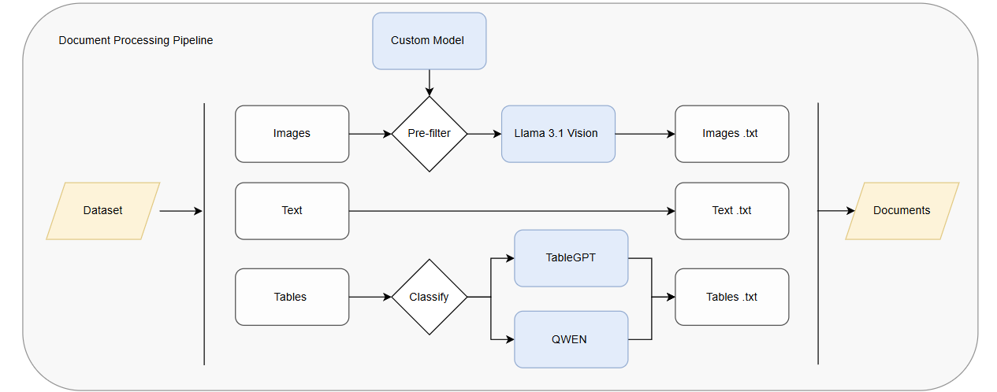
TTI.txt Overview – In case you missed something
Unified representation: How can multi-modal documents–specifically product catalogues containing text, tables, and images–be represented in a single vector space without losing semantic content?
Notes:
Tables :
Problems: loong training and poor formatting kills you. Literature on tables assumes excel-like tables
Not the same, QA, than explaining.
Why QA you “know” what you are looking for, sort-of
Dataset constrains:
not much
Computing power constrains:
A lot
Later ii will talk what we could do differently, and future work

Slide 9
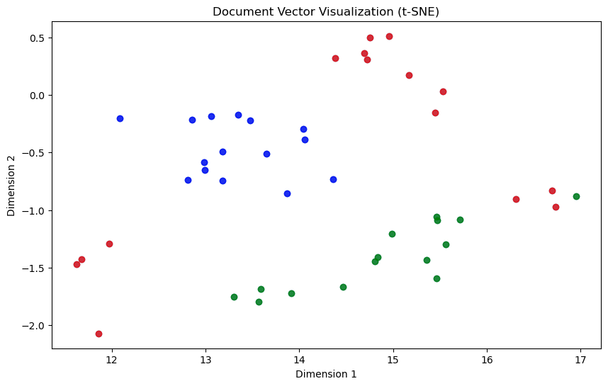
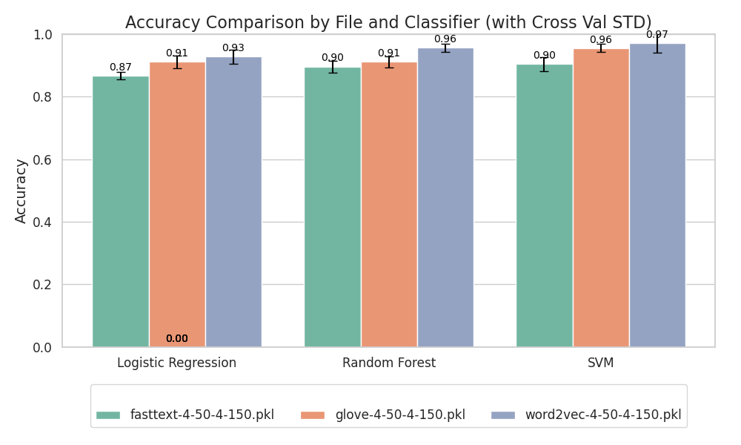
Capturing Semantics – Vector Space Models (VSM)
Evaluated GloVe, Word2Vec, and FastText embeddings
Implemented both clustering on VSM and direct classification, achieving similar performance
Research Internship II: Categorization of Textual Industrial (Technical) Reports
Notes:
Difference in embedding strategies
Results of both clustering and classifiying approaches (lightly)

Slide 10
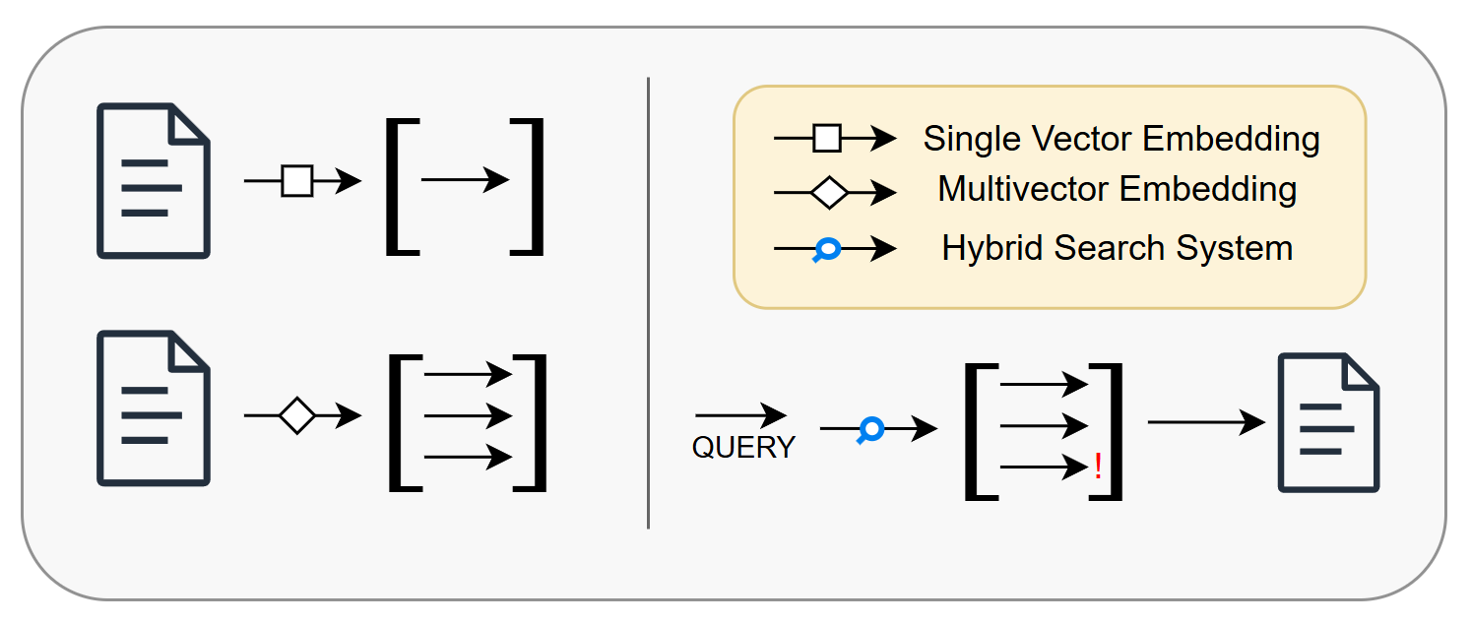
Vector Representation – Single Vector vs Multivectors
Embedding granularity: Is a single vector more effective than multiple segment-level vectors for a given document?
Notes:
Research Question 1: Does this affect ? Theoretically it gives you more granularity
expansion:
weighted multivector embedding
multimodal vector embedding

Slide 11
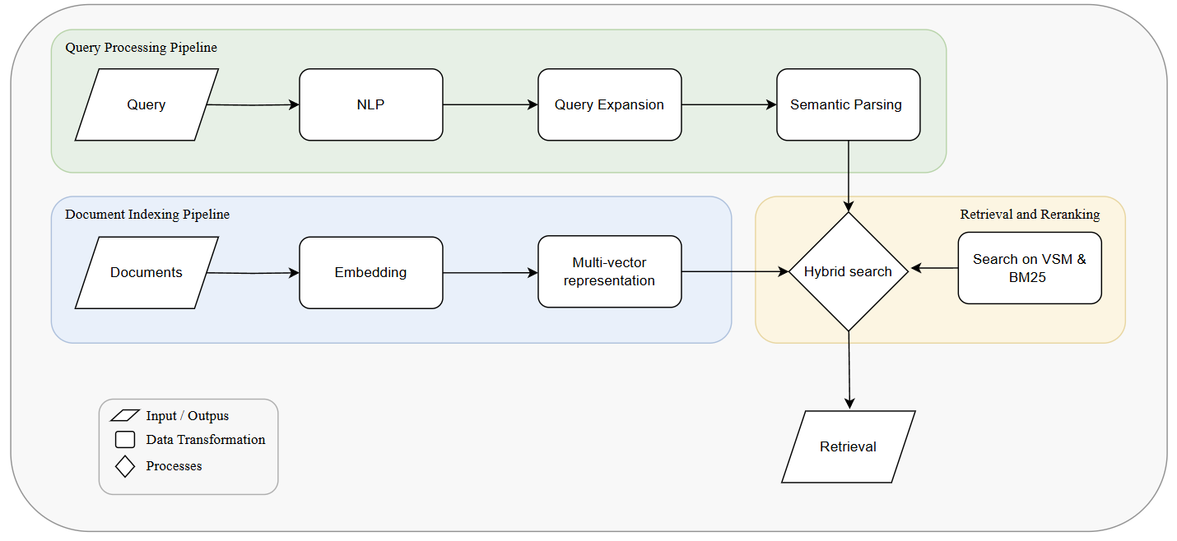
Semantic Search Exploration – SSE Overview
Notes:
Whats next?
Look into how the queries are understood – Intelligent Semantic Search
Look at how documents are retrieved – Hybrid retrieval

Slide 12
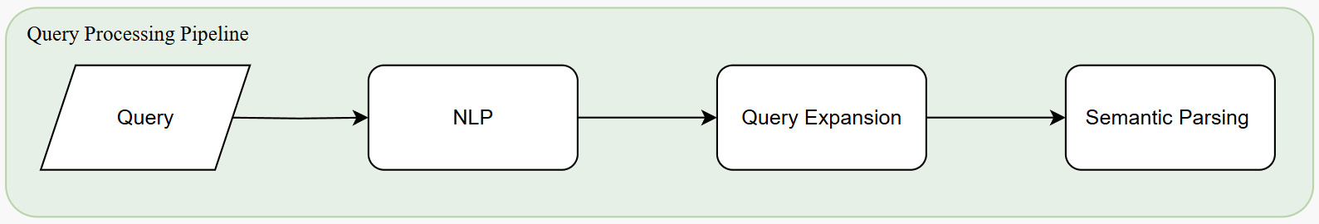
Intelligent Semantic Search – Query understanding
Preprocessing: NLP techniques for cleaning the text, standard work
Query Understanding: Mostly user-based, context dependent
Semantic Query expansion: comment on strategies, results, limitations and future expansions
Semantic Parsing: Wish we could have done it. Cool concept. Limitations on testing

Slide 13
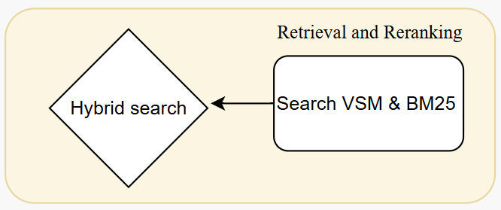
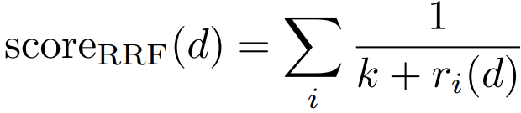
Hybrid Search – The last piece of the puzzle
Search Strategies:
Vector Space Model (VSM) with Cosine Similarity
Measures the angle between query and document vectors to determine relevance.
Lexical Matching with Okapi BM25
A probabilistic ranking method based on term frequency and inverse document frequency.
Hybrid Retrieval Approaches:
Linear Score Combination Combines BM25 and dense vector similarity: score_hybrid(q, d) = λ · score_BM25q, d) + (1 − λ) · sim_dense(q, d)
Reciprocal Rank Fusion (RRF) Aggregates rankings from multiple retrieval methods by rewarding higher-ranked results from each.
Re-Ranking Pipeline First retrieve candidates using BM25, then refine the ranking using dense vector similarity (VSM).
Search strategy: Does a hybrid approach outperform a simple retrieval method on our catalogue dataset?
Notes:
Before we embedded multi-vectors or single vectors wit word2vec – why? What does this accomplish?
We can also search, not vector based, but lexically – BM25 okapi
Vector Space Model (VSM) with Cosine Similarity
Measures the angle between query and document vectors to determine relevance.
What are the benefits of each model? What if we combine them?
- Vsm cosine similarity search
+
- Bm25 lexical search
=
- Hybrid Linear fusion
- RRF
- ReRanking strategies

Slide 14
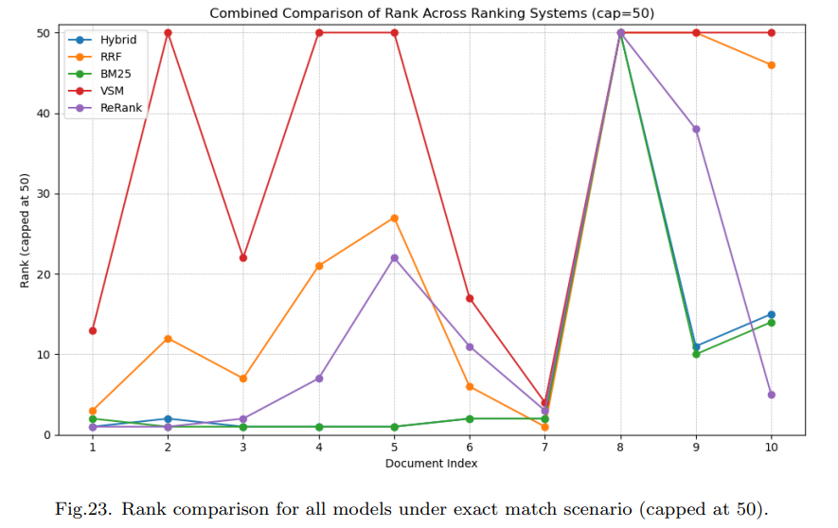
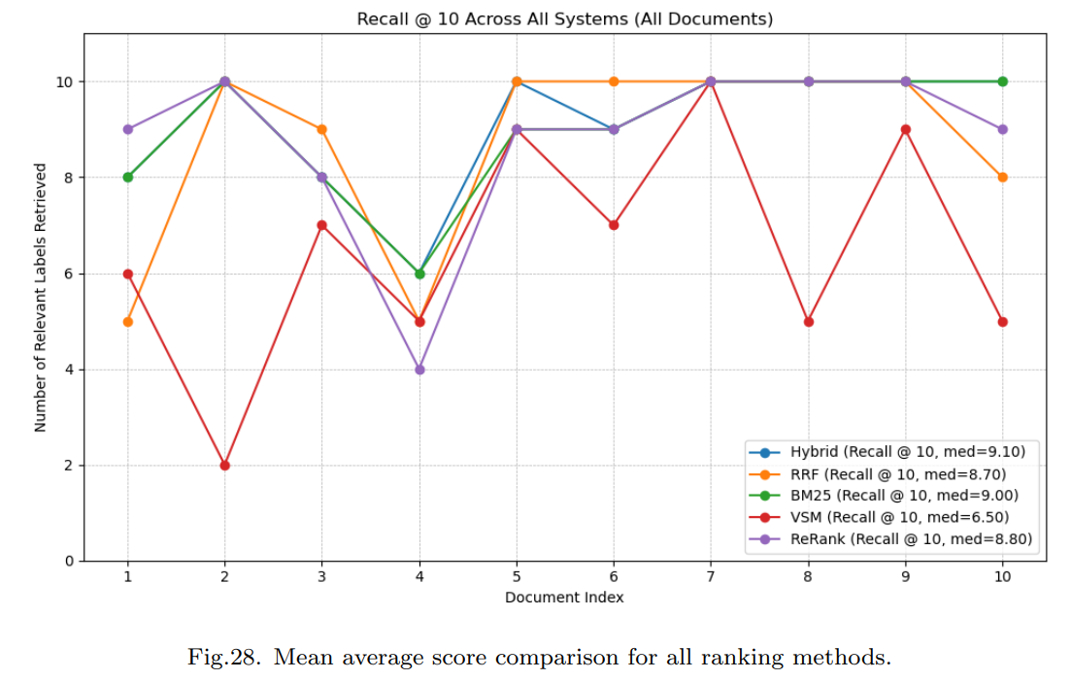
Hybrid Search – Results
Document match search: Document retrieval
Semantic match scenario: Class Recall @ k =[5,10,20]
Dataset specificity: How do corpus characteristics and intended use cases influence which retrieval strategies work best?
Notes:
Effects of score normalization
Effect of parameter tuning
Overall results

Slide 15
Conclusion
Presented a Text, Tables and Images to text tool (TTI.txt)
Generated a pipeline for Semantic Search Evaluation (SSE)
For our specific use case, Product Catalogues (PCs), hybrid retrieval improves results under the semantic match evaluation.
Depending on your dataset and intended use case, you will need to evaluate and adapt:
1. Image classifier to filter images in your corpus
2. The embedding model to use
3. Hybrid retrieval hyperparameters (in our case was 0.7 BM25 / 0.3 VSM)
4. Score Normalization values
5. Generate own set of testing
Notes:
Very very dataset dependent. Not all tencical documents are the same
Also, even having a “fixed” dataset type, very very dependent on use case scenario.
-This is why we provide the foundation to test a wide variety of different combinations, from embedding style
(multi vs single)
word2vec vs fasttext vs other
query expansion options
classifiers that search for the optimal hyperparamenters (decision tree, LR ….)
Manual evaluation is a pain, some more thought should be given. Or just generate a benchmark somehow

Slide 16
Future Work – What I would do differently
Notes:
If I would start over I would do a coiple of thinks differently.
GNN based ranking. Seems cool, didn’t do it because It meant reprocessing
Semantic Parsing would be interesting to see
Multimodal vectors, embedding images onto a image “search”
Tradeoffs :
Model size and dataset constrains

Slide 17
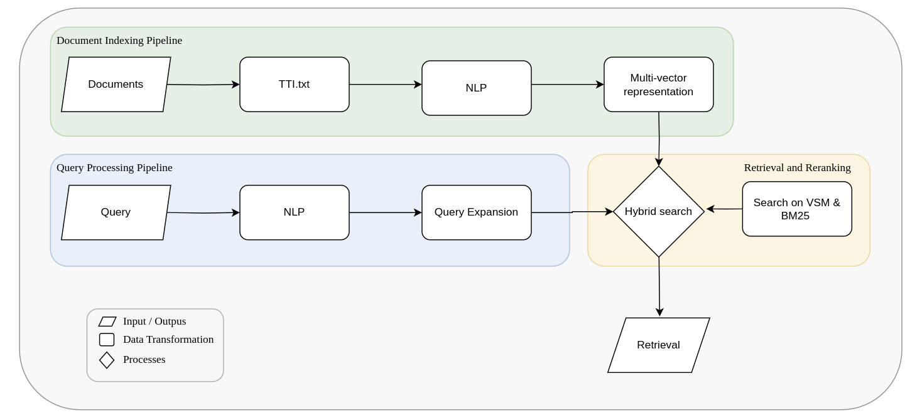
Recap

Slide 18
AN INTELLIGENT SEMANTIC SEARCH SYSTEM FOR DIGITAL PRODUCT-PART DESGIN CATALOGUES IN MANUFACTURING
Tables-Text-Images to text (TTI.txt) & Semantic Search Exploration (SSE)
Pablo De Vicente Abad
Promotor: Moharram Challenger
Co-Promotor: Alireza Khalilipour
Modelling Intelligent Complex Software and Systems - MICCS-Lab. University of Antwerp, Belgium
Notes:
Two parts.
1. The TTI.txt tool (how to deal with the product part design catalogues)
2. SSE- Semantic Search Exploration (what is an intelligent Semantic Search System)

