Slide 1
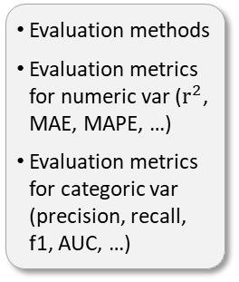
DEVELOPMENT PHASE
PRODUCTION PHASE
Set up
Data Quality
EDA
Variables Transform
Modelling
Evaluation
Production
Defining objetives, levers, and Kpis
Creating directory and environment for the Project
Data importation
General quality data analysis
Data types
Basic statistics
Zeros and missing values
Outliers
Statistical analysis
Graphical analysis
Data understanding
Business problem understanding
Preparation of the variables for modelling
Creation of new variables
Variable selection
Class balance
Supervised ML
Unsupervised ML
Forecasting
Deep Learning
…
Evaluation methods
Evaluation metrics for numeric var ($r^{2}$, MAE, MAPE, …)
Evaluation metrics for categoric var (precision, recall, f1, AUC, …)
Final model training and pipeline
Code cleaning
Retraining code
Deployment code
Final product

