Slide 1
PABLO ELUSTONDO · PORTFOLIO PROTOTYPE
AI Shop See products. Decide with evidence.
Native iPhone app · AI analysis · Human review
Notes:
[Sources]
- /Users/paboelustodo/-PROJECTS/aishop/README.md
- https://github.com/pabloelustondo/aishop

Slide 2
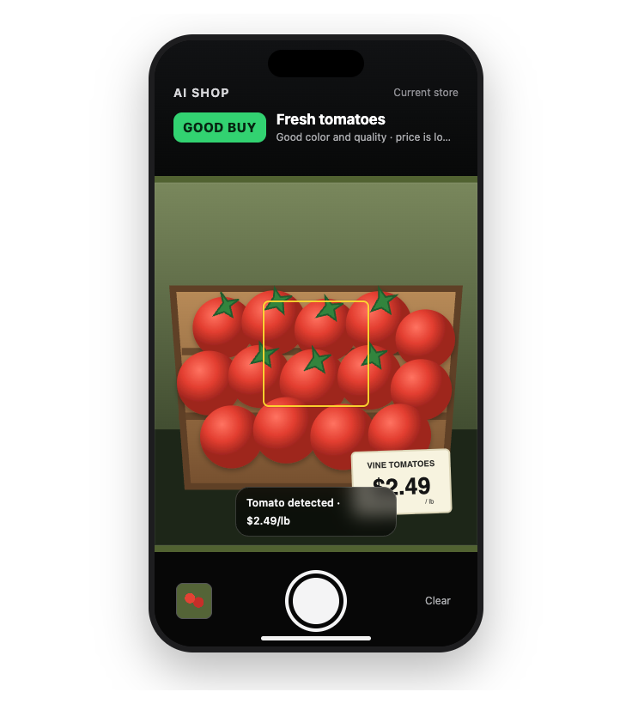
A shopping image becomes a clearer decision.
THE IDEA
Prices, quality and availability vary from store to store. AI Shop uses the camera as a second pair of eyes—identifying products, visible evidence and uncertainty while leaving the final choice to the person.
2
Notes:
[Sources]
- /Users/paboelustodo/-PROJECTS/aishop/docs/02-intent/intent.md
- /Users/paboelustodo/-PROJECTS/aishop/docs/06-solution-design-and-architecture/mockups/ai-shop-camera-mockup.png

Slide 3
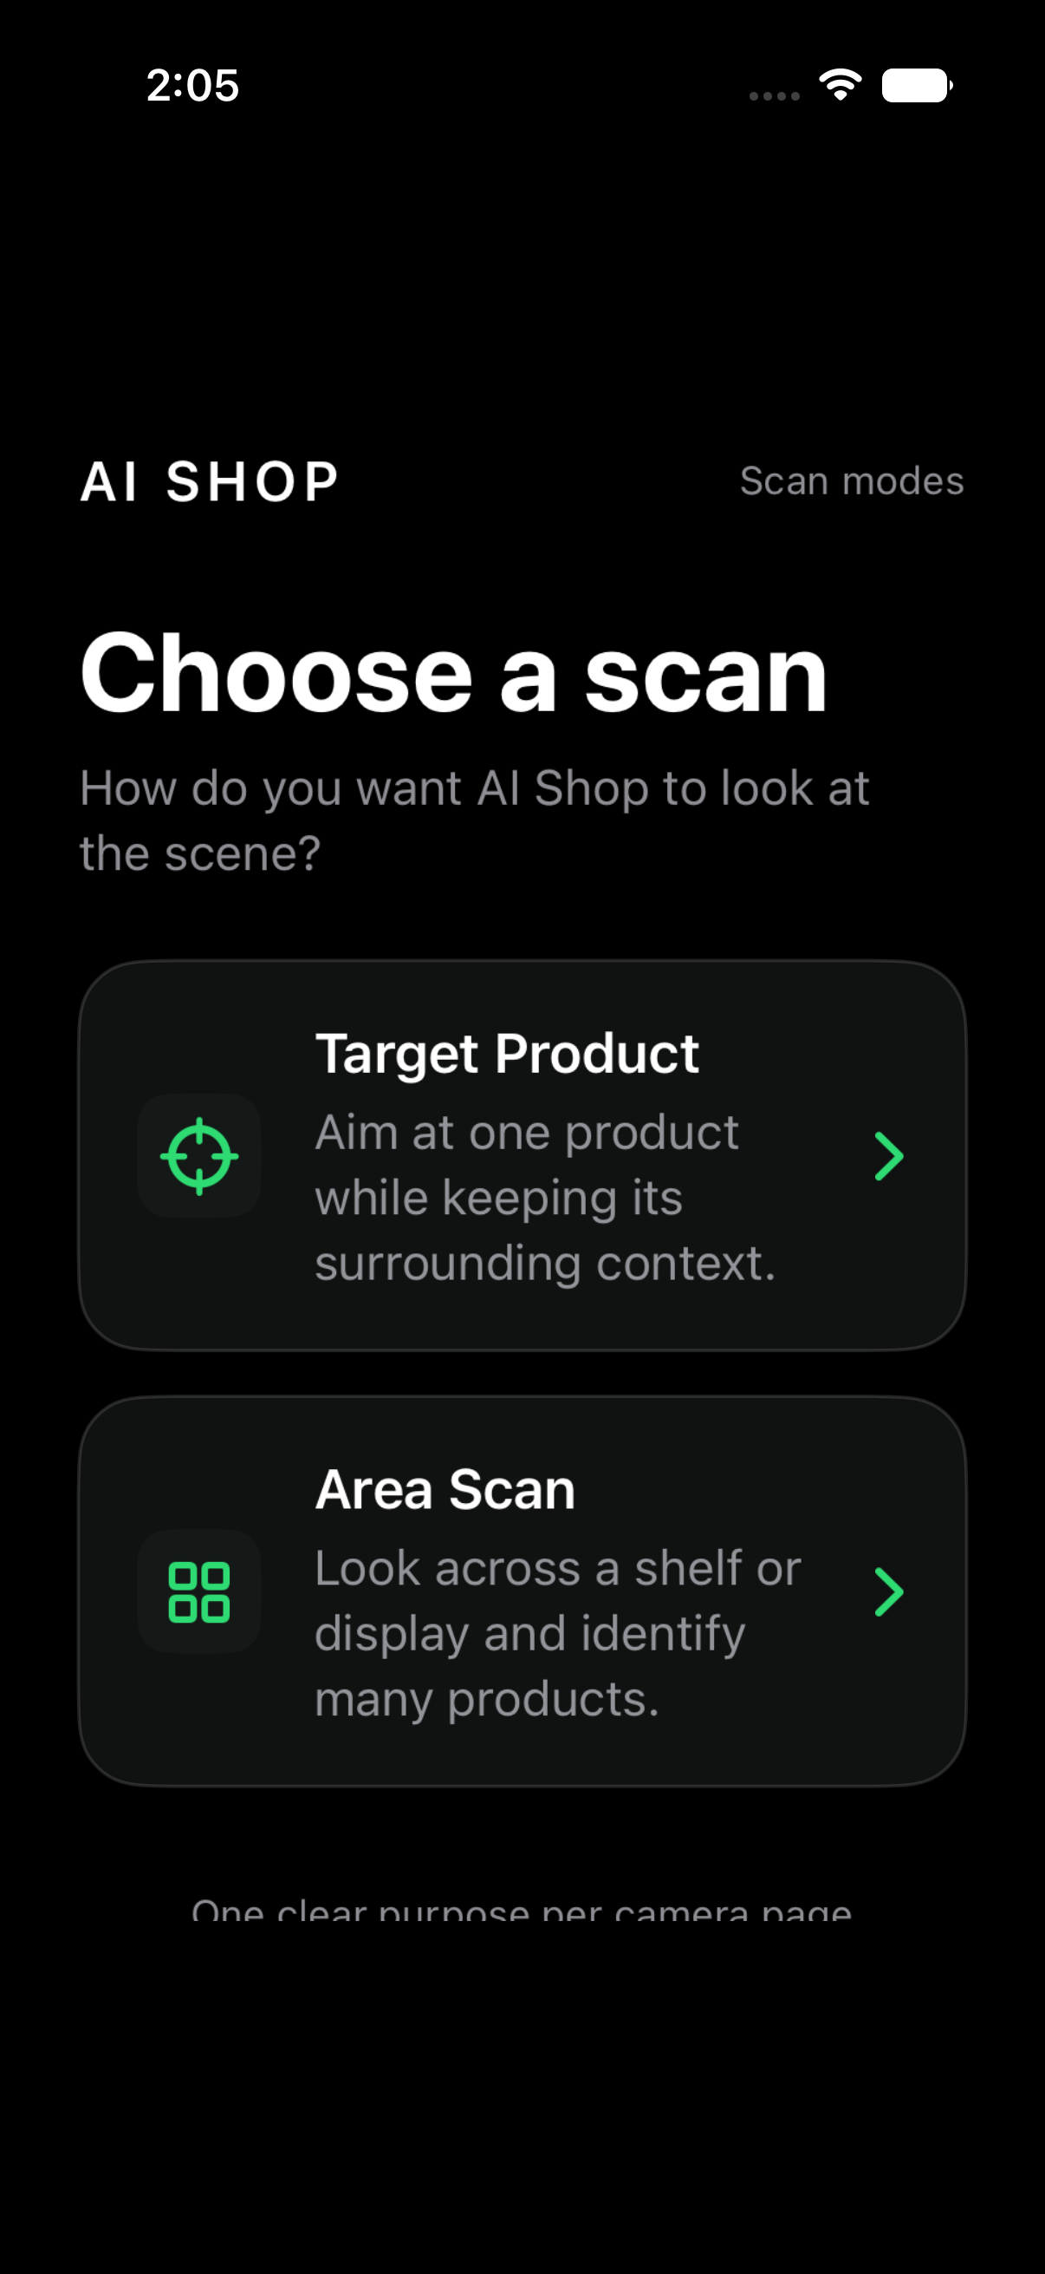
Choose what matters before taking the picture.
CHOOSE THE ANALYSIS
Target Product focuses on one selected item and its surrounding evidence. Area Scan looks across a shelf or display and organizes multiple visible products.
3
Notes:
[Sources]
- /Users/paboelustodo/-PROJECTS/aishop/docs/03-system-model-and-use-cases/use-case-02-target-product-scan.md
- /Users/paboelustodo/-PROJECTS/aishop/docs/03-system-model-and-use-cases/use-case-03-area-scan.md
- /private/tmp/aishop-step3-mode-selection.png

Slide 4
Use AI Shop in three simple steps.
01 · CHOOSE
02 · CAPTURE
03 · REVIEW
Set the intent
Select one product for depth or a visible area for breadth.
Frame the evidence
Keep the product, packaging and price context clear in one image.
Read the result
Review findings, uncertainty and the next action—then decide for yourself.
4
Notes:
[Sources]
- /Users/paboelustodo/-PROJECTS/aishop/docs/03-system-model-and-use-cases/use-case-02-target-product-scan.md
- /Users/paboelustodo/-PROJECTS/aishop/docs/03-system-model-and-use-cases/use-case-03-area-scan.md

Slide 5
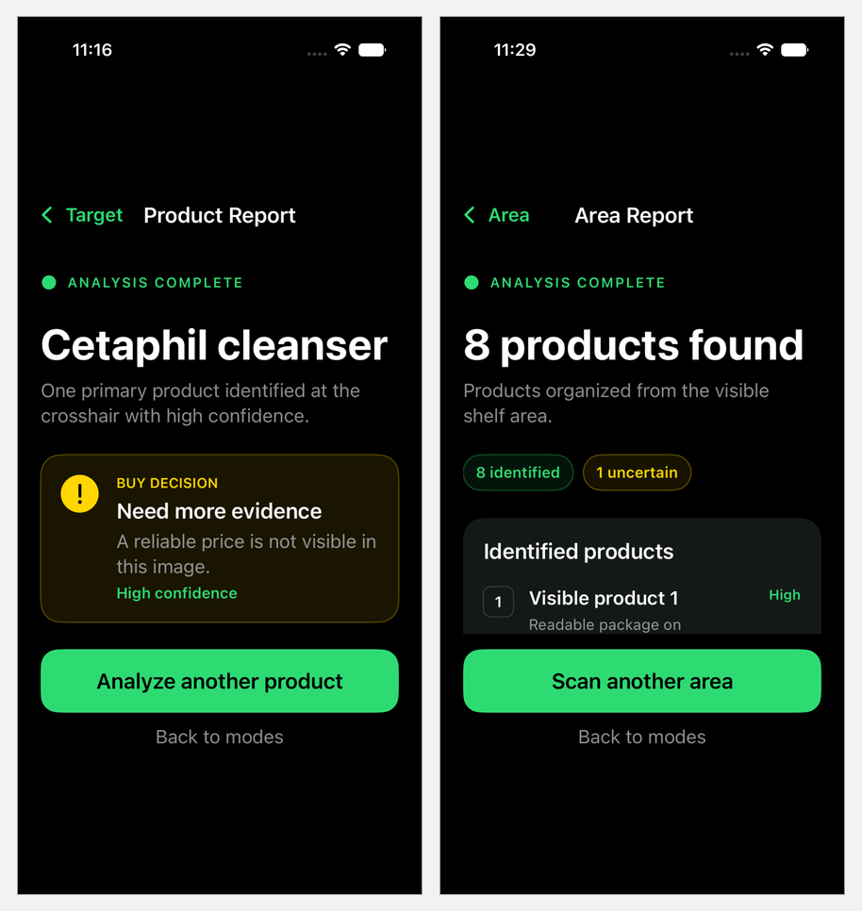
The response changes with the question.
DEPTH OR BREADTH
Target Product explains one selected item, including confidence and missing information. Area Scan creates a structured list of visible products and flags anything that needs another look.
5
Notes:
[Sources]
- /Users/paboelustodo/-PROJECTS/aishop/docs/03-system-model-and-use-cases/use-case-02-target-product-scan.md
- /Users/paboelustodo/-PROJECTS/aishop/docs/03-system-model-and-use-cases/use-case-03-area-scan.md
- /private/tmp/aishop-target-report.png
- /private/tmp/aishop-area-report-fixed.png

Slide 6
AI findings remain evidence—not the final authority.
MACHINE INTERPRETATION
The server retains the original image, image hash, scan mode and initial structured findings. The initial findings remain unchanged.
HUMAN DISPOSITION
An authorized reviewer compares the evidence with the report and records Verified, Corrected or Rejected as a separate, attributable decision.
6
Notes:
[Sources]
- /Users/paboelustodo/-PROJECTS/aishop/docs/02-intent/intent-03-auditable-retail-shelf-inspection.md
- /Users/paboelustodo/-PROJECTS/aishop/docs/06-solution-design-and-architecture/architecture-02-audit-storage-and-human-review.md

Slide 7
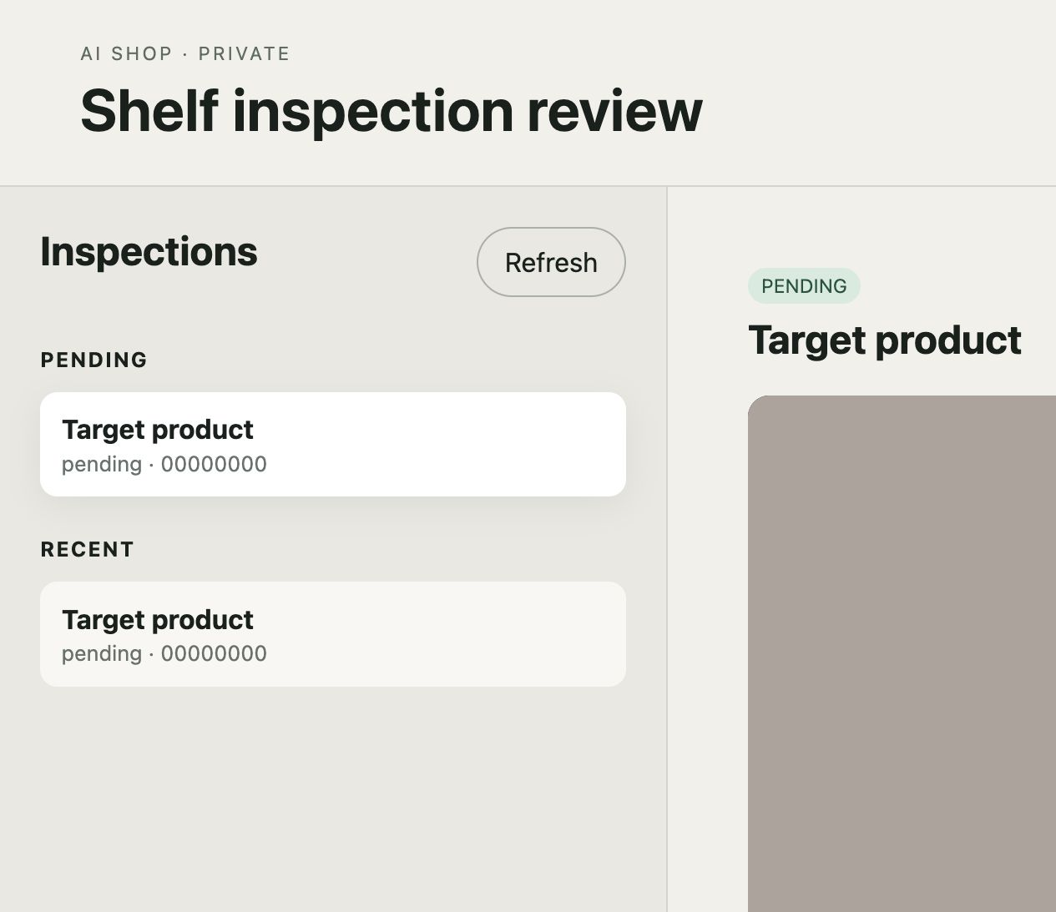
Review keeps evidence and decisions together.
AUDITABLE BY DESIGN
Pending and recent inspections stay visible. Reviewers can open the original image, inspect the initial AI output, add notes and retain an attributable decision history.
7
Notes:
[Sources]
- /Users/paboelustodo/-PROJECTS/aishop/dashboard/index.html
- /Users/paboelustodo/-PROJECTS/aishop/docs/03-system-model-and-use-cases/use-case-04-submit-and-review-shelf-inspection.md
- /private/tmp/aishop-dashboard-desktop.png

Slide 8
Specifications guide every agent-assisted change.
INTENT FIRST
Use cases and architecture define behavior and boundaries.
COMPONENT-SCOPED TASKS
Each sprint task changes one named component and its tests.
HUMAN APPROVAL
Governed documents require review before coding, commit, deployment or release.
8
Notes:
[Sources]
- /Users/paboelustodo/-PROJECTS/aishop/AGENTS.md
- /Users/paboelustodo/-PROJECTS/aishop/docs/00-sdlc2-governance/sdlc2-workflow.md
- /Users/paboelustodo/-PROJECTS/aishop/docs/07-planning/sprints/sprint-003/03-sprint-plan-tasks.md

Slide 9
Today’s prototype is a foundation for a commercial retail product.
VALIDATED DIRECTION
Native camera capture, Target and Area reports, protected server-side AI, durable evidence and authenticated human review.
COMMERCIAL PATH
Product catalogs, store and price context, team workflows, analytics, retention and security policies, and production-grade operations.
9
Notes:
[Sources]
- /Users/paboelustodo/-PROJECTS/aishop/README.md
- /Users/paboelustodo/-PROJECTS/aishop/docs/05-viable-proof-of-concept/proof-of-concept-01-camera-to-shopping-recommendation.md
- /Users/paboelustodo/-PROJECTS/aishop/docs/05-viable-proof-of-concept/proof-of-concept-02-auditable-shelf-review.md
Commercial-path items are a forward-looking product concept, not current shipped capabilities.

Slide 10
OPEN SOURCE
Explore the code
github.com/pabloelustondo/aishop
Native iOS · Firebase API · Review dashboard
Specifications, tests and SDLC2 governance included
Notes:
[Sources]
- https://github.com/pabloelustondo/aishop

