Slide 1
AI SHOP · TECHNICAL CASE STUDY
SDLC2 for AI-assisted delivery
Governance · traceability · human authority · operational learning
Notes:
[Sources]
- /Users/paboelustodo/-PROJECTS/aishop/docs/00-sdlc2-governance/sdlc2-workflow.md
- /Users/paboelustodo/-PROJECTS/aishop/AGENTS.md

Slide 2
AI compresses execution time. It does not resolve ambiguity.
THE ACCELERATION
Agents can translate intent into plans, code, tests and diagnostics at a speed that changes the economics of iteration.
THE CONTROL PROBLEM
The same speed magnifies unclear authority, scope drift, hidden assumptions, accidental cross-component changes and premature claims of ‘done’.
2
Notes:
[Sources]
- /Users/paboelustodo/-PROJECTS/aishop/docs/00-sdlc2-governance/README.md
- /Users/paboelustodo/-PROJECTS/aishop/docs/00-sdlc2-governance/sdlc2-workflow.md

Slide 3
SDLC2 is controlled transformation—not ceremony.
AUTHORITY
Humans own intent, approval, accepted risk and release. Agents never self-approve.
SCOPE
Use cases, architecture and component-scoped tasks bound the change.
EVIDENCE
Observable proof determines progress. Build, review, deployment and operation remain separate states.
3
Notes:
[Sources]
- /Users/paboelustodo/-PROJECTS/aishop/docs/00-sdlc2-governance/sdlc2-workflow.md
- /Users/paboelustodo/-PROJECTS/aishop/docs/00-sdlc2-governance/document-review.md

Slide 4
Twelve lifecycle areas form one learning loop.
UNDERSTAND · 01–03
Context & Domain Intent System Model & Use Cases
PROVE & DESIGN · 04–06
Benchmarks & Success Viable Proof of Concept Architecture
CONTROL CHANGE · 07–09
Planning Specifications as Code Build & Test
REVIEW & LEARN · 10–12
Review & Release Operational Reality Insights & Learning → 01
4
Notes:
[Sources]
- /Users/paboelustodo/-PROJECTS/aishop/docs/README.md
- /Users/paboelustodo/-PROJECTS/aishop/docs/01-context-and-domain-analysis/README.md
- /Users/paboelustodo/-PROJECTS/aishop/docs/12-observability-insights-and-learning/README.md

Slide 5
Documents are decision interfaces between humans and agents.
CONTROLLED INPUTS
Intent defines why. Use cases define behavior. Architecture defines ownership and trust boundaries. Sprint plans define scope, evidence and exclusions.
EXECUTABLE CONSTRAINTS
Contracts, schemas, invariants, acceptance examples and tests make specifications agent-ready. Documents govern work; they do not silently authorize production or risk.
5
Notes:
[Sources]
- /Users/paboelustodo/-PROJECTS/aishop/docs/02-intent/README.md
- /Users/paboelustodo/-PROJECTS/aishop/docs/03-system-model-and-use-cases/README.md
- /Users/paboelustodo/-PROJECTS/aishop/docs/08-specifications-as-code/README.md

Slide 6
Approval is bound to the exact revision—not the idea.
01 · AGENT DRAFT
02 · HUMAN REVIEW
03 · EXECUTION GATE
Visible revision
The file exists unstaged, reviewer initials are blank, and the provided link opens the exact proposal.
Identity + exact bytes
A registered human enters initials and stages the complete reviewed contents. Partial staging is not approval.
Proceed while valid
Coding proceeds only while governed documents remain approved. Any edit invalidates approval and resets the gate.
6
Notes:
[Sources]
- /Users/paboelustodo/-PROJECTS/aishop/docs/00-sdlc2-governance/document-review.md
- /Users/paboelustodo/-PROJECTS/aishop/AGENTS.md

Slide 7
AGENTS.md is the repository’s durable operating contract.
MANDATORY CONTEXT
Read governance before plans, docs, code, tests or releases.
NON-NEGOTIABLES
Exact approval, ≤50-line authored files, human-staged deletions, no force-push.
AUTONOMOUS ZONE
Inside approved scope: implement, build, test, diagnose and perform reversible checks.
EXPLICIT CONSENT
Ask before scope change, production risk, secrets, money, security or irreversible action.
7
Notes:
[Sources]
- /Users/paboelustodo/-PROJECTS/aishop/AGENTS.md
- /Users/paboelustodo/-PROJECTS/aishop/docs/00-sdlc2-governance/README.md

Slide 8
Granular approval makes bounded agent autonomy possible.
01 · SPRINT PLAN
02 · PLAN TASKS
03 · BUILD + VALIDATE
Authorize the increment
Goal, in-scope behavior, exclusions, success evidence and decision gates are reviewed first.
Constrain the edits
A separate approved document orders the work. Every task names exactly one component and its tests.
Evidence
Execute in approved scope. Cross-component checks are read-only; fixes require a new task and approval.
8
Notes:
[Sources]
- /Users/paboelustodo/-PROJECTS/aishop/docs/00-sdlc2-governance/sdlc2-workflow.md
- /Users/paboelustodo/-PROJECTS/aishop/docs/07-planning/sprints/sprint-003/03-sprint-plan-tasks.md

Slide 9
A green build is not a release—and a release is not reality.
DEFINITION
Planned Human-approved
CONSTRUCTION
Implemented Tested
DELIVERY
Reviewed · committed · merged Deployed · released
REALITY
Observed with real users, data, cost and consequences Learning returned to Step 01
9
Notes:
[Sources]
- /Users/paboelustodo/-PROJECTS/aishop/docs/09-build-and-test/README.md
- /Users/paboelustodo/-PROJECTS/aishop/docs/10-review-and-release/README.md
- /Users/paboelustodo/-PROJECTS/aishop/docs/11-operational-reality/README.md

Slide 10
AI Shop evolves by resolving one uncertainty at a time.
SPRINT 001
SPRINT 002
SPRINT 003
Secure camera-to-AI proof
Native iPhone capture, server-side OpenAI credential and a physical-device camera-to-result loop.
Depth and breadth
Target Product and Area Scan create mode-specific structured reports while communicating uncertainty.
Auditable inspection
Exact JPEG, SHA-256, immutable AI findings, private storage and attributable review.
10
Notes:
[Sources]
- /Users/paboelustodo/-PROJECTS/aishop/docs/07-planning/sprints/sprint-001/01-sprint-plan.md
- /Users/paboelustodo/-PROJECTS/aishop/docs/07-planning/sprints/sprint-002/01-sprint-plan.md
- /Users/paboelustodo/-PROJECTS/aishop/docs/07-planning/sprints/sprint-003/01-sprint-plan.md
Current repository history maps these increments to commits 945d600, 2c73777 and 98df9f9.

Slide 11
Governed component boundaries become architecture.
AI Analysis
Adapter
OpenAI API
external
Mobile Capture
Client
Inspection API
Evidence Store
Review
Dashboard
Inspection Record
Store
Invariant: original evidence and initial AI findings remain immutable; human review is separate and attributable.
11
Notes:
[Sources]
- /Users/paboelustodo/-PROJECTS/aishop/docs/06-solution-design-and-architecture/components/component-architecture.md
- /Users/paboelustodo/-PROJECTS/aishop/docs/06-solution-design-and-architecture/architecture-02-audit-storage-and-human-review.md

Slide 12
Fourteen tasks. Six owned components. One ordered system.
CONTRACT & MODEL · T1–2
Inspection API submission contract AI Adapter target-position behavior
CAPTURE & EVIDENCE · T3–4, 6, 13
Original iPhone JPEG bytes Hash, private storage, retrieval and bucket
RECORDS & API · T5, 7–9, 11–12, 14
Immutable records, reviewer operations, failure semantics, Firestore and JPEG compatibility
REVIEW & VALIDATION · T10 + GATE
Private dashboard Read-only cross-component validation Any fix becomes a new task
12
Notes:
[Sources]
- /Users/paboelustodo/-PROJECTS/aishop/docs/07-planning/sprints/sprint-003/03-sprint-plan-tasks.md
- /Users/paboelustodo/-PROJECTS/aishop/docs/06-solution-design-and-architecture/components/component-architecture.md

Slide 13
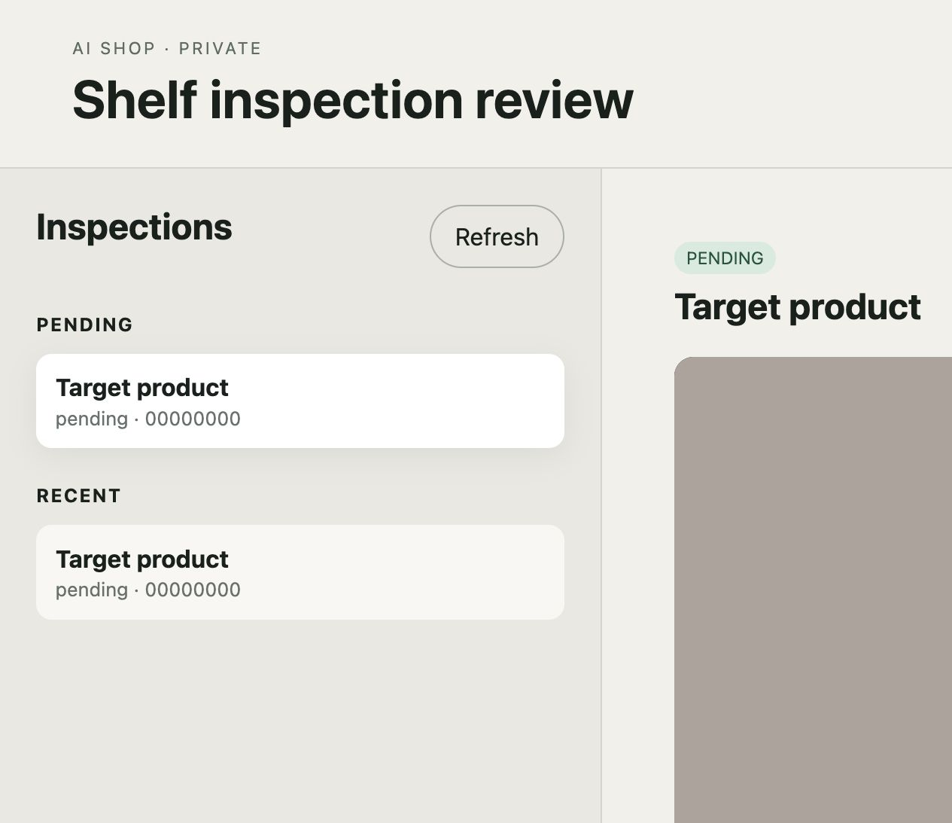
The audit record preserves both evidence and disagreement.
AN EVIDENCE MODEL, NOT JUST A UI
Each scan connects the exact original JPEG and SHA-256 with immutable initial findings. An authorized reviewer records Verified, Corrected or Rejected separately—with identity, note and server time. Unauthorized access and distinct failure modes are tested.
13
Notes:
[Sources]
- /Users/paboelustodo/-PROJECTS/aishop/docs/05-viable-proof-of-concept/proof-of-concept-02-auditable-shelf-review.md
- /Users/paboelustodo/-PROJECTS/aishop/docs/06-solution-design-and-architecture/architecture-02-audit-storage-and-human-review.md
- /private/tmp/aishop-dashboard-desktop.png

Slide 14
The method reduces risk by making friction explicit.
WHAT IT PREVENTS
Scope drift, agent self-approval, stale approvals, partial staging, cross-component blast radius, invisible assumptions and status inflation.
WHAT IT COSTS
More small documents, disciplined staging, slower starts and a real human bottleneck. The rigor should be proportionate—but consequential agent-assisted change benefits from it.
14
Notes:
[Sources]
- /Users/paboelustodo/-PROJECTS/aishop/docs/00-sdlc2-governance/document-review.md
- /Users/paboelustodo/-PROJECTS/aishop/docs/00-sdlc2-governance/sdlc2-workflow.md
SDLC2 is the methodology used and evolved in this repository; this deck does not present it as a universal industry standard.

Slide 15
PUBLIC CASE STUDY
Inspect the method in the repository
github.com/pabloelustondo/aishop
Intent · use cases · architecture · sprint controls
Native iOS · Firebase API · evidence store · review dashboard
Notes:
[Sources]
- https://github.com/pabloelustondo/aishop
- /Users/paboelustodo/-PROJECTS/aishop/README.md

