Slide 1
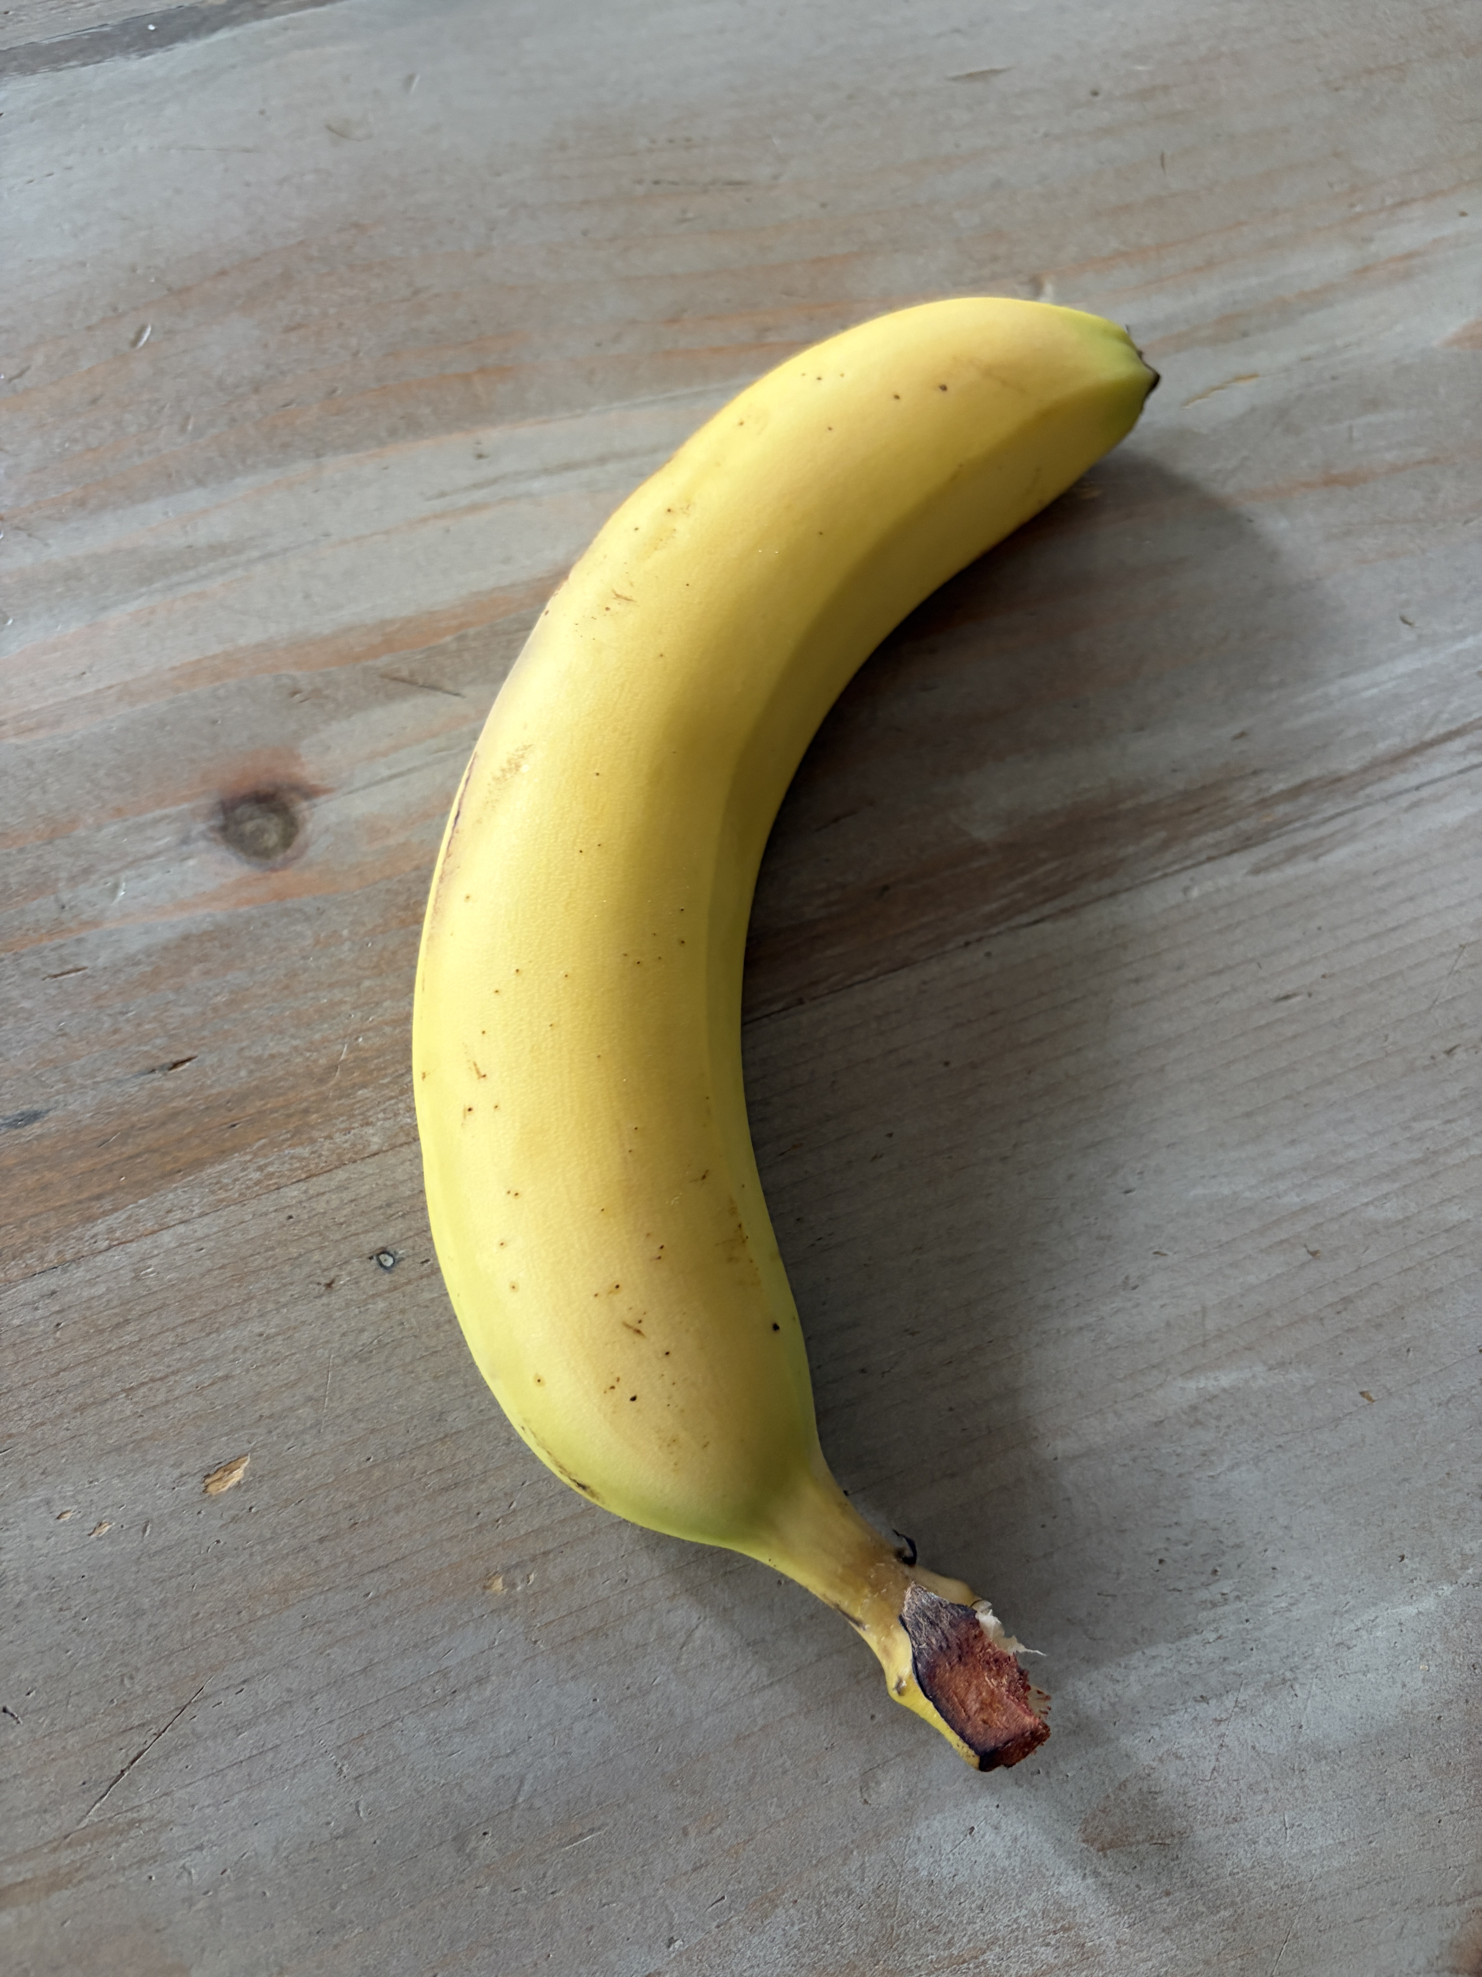
CODE WALKTHROUGH
Finding a known product
Can we raise a useful signal while the video is still playing?
One target. One arriving frame.
Evidence you can inspect.
Product intent
AIShop / Sprint 001
01
Notes:
For Pablo’s human code review: understand the experiment, follow the execution, then open the exact files and evidence behind it.
This portrait revision follows the 21 September visual and navigation criteria. Pictures show appearance; UML 2 diagrams show structure and behavior. Short tables and one measured chart are deliberate exceptions.
The source bytes read on 21 September match the R11 working-tree snapshot, based on HEAD 90a5f8b and sprint base cbc68ad. Much of the implementation is not in that GitHub commit. The saved Mac run is dated 20 September. Physical-iPhone acceptance remains pending.
A separate documentation patch adds source introductions without changing implementation statements. It has not been applied to the Drive files because the connector rejected write access.
Fine print
Product intent: https://github.com/pabloelustondo/aishop/blob/34f246b/ios/AIShop/01-docs/02-intent/intent.md
Reference: https://drive.google.com/file/d/1LF4-wPIU6RYOBK9V3S405TrdGhd86uz4/view
Source snapshot: https://drive.google.com/file/d/1ii_sO0b-T-r6IDZMFgUMMAui8UwM6BVg/view
UML notation: https://www.omg.org/spec/UML/2.5.1/About-UML

Slide 2
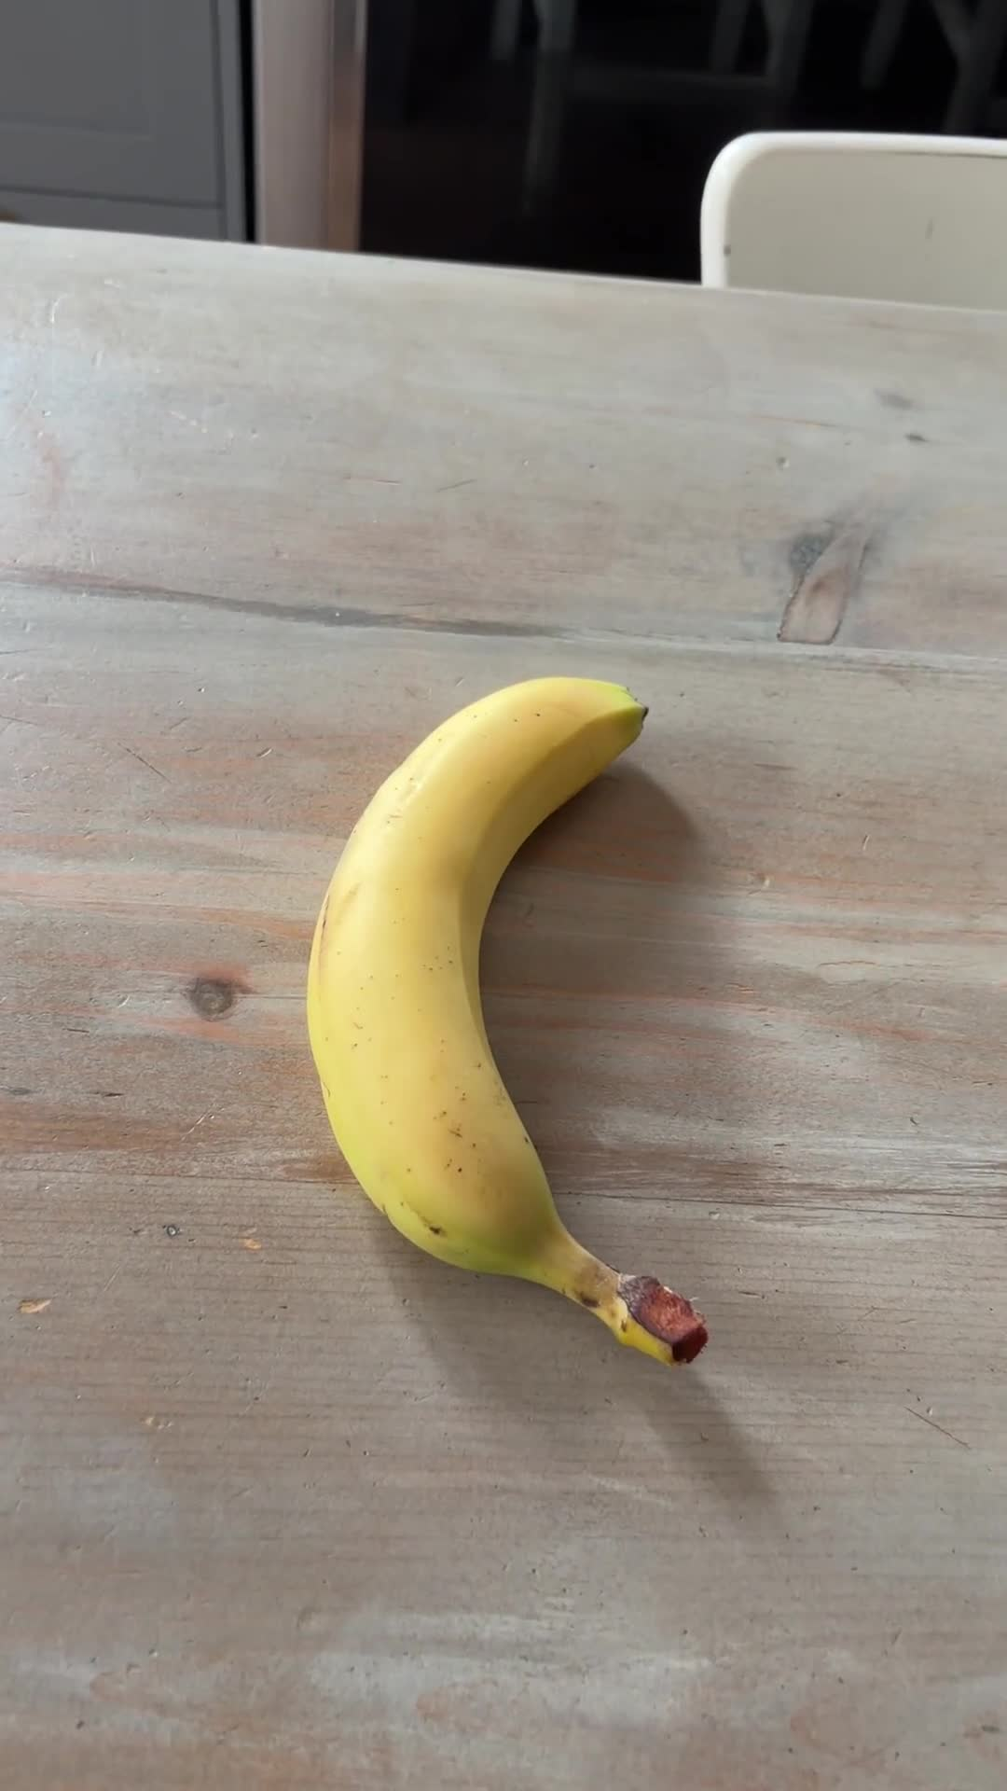
THE EXPERIENCE
A possible match
with evidence
A known reference meets frames arriving from a video.
Known reference
Arriving frame
Possible match
Keep the strongest frame.
Explain the result from the session log.
CandidateAnalysisPipeline.swift · run(onUpdate:)
ios/AIShop/AIShopVision/Sources/AIShopVision/CandidateAnalysisPipeline
AIShop / Sprint 001
02
Notes:
The increment is a provisional signal before playback finishes, supported by inspectable evidence. The report grows from recorded events during the run. It does not require another video pass after Stop.
This sprint uses one local target and prerecorded fixtures. The signal is not a product-identity guarantee or a calibrated probability. There is no object detector or live camera in this experiment.
Fine print
Pipeline: https://drive.google.com/file/d/14M5TR7ay3bKgzb_pcc_dNRO4go1F7fsy/view?usp=drivesdk
Intent: https://github.com/pabloelustondo/aishop/blob/34f246b/ios/AIShop/01-docs/02-intent/intent.md

Slide 3


THE EXPERIENCE
One experiment,
two outcomes
Select a fixture, watch the signal, then inspect the saved session.
Banana present
No banana
Expect an opening in
the annotated interval.
Expect zero false
candidate openings.
Fixture definitions and hashes
AIShop / Sprint 001
03
Notes:
The positive and control fixtures use the same pipeline. The evaluator knows the expected zones. Production scoring does not receive those annotations.
A candidate episode is a sighting over time, not a count of unique physical products.
Fine print
Diagnostic fixtures: https://drive.google.com/file/d/1SipNb8yZeYdV-rSrrNZ-2FfQYIRiFsBN/view?usp=drivesdk
Annotations: https://drive.google.com/file/d/1lq1K9Y8fA9MSrPMJdSlNin74RBdW_UzX/view
Harness: https://drive.google.com/file/d/1i6zZ-yxCdc8PqkUY3d4HawzS8vxqQCP8/view?usp=drivesdk

Slide 4
UML DEPLOYMENT
How to check the sprint
Each host proves a different part of the experiment.
«device» Mac
«executionEnvironment» macOS
Real Vision + fixed fixtures
Saved scoring and pipeline gate
«device» Simulator host
«executionEnvironment» iOS Simulator
App startup + harness setup
Saved app tests; no real-Vision acceptance
«device» Physical iPhone
«executionEnvironment» iOS
Playback + signal + exported evidence
Manual acceptance still pending
AIShop / Sprint 001
04
Notes:
These UML nodes distinguish execution environments rather than imply that tests ran on a phone. Real-Vision evidence comes from the saved macOS run. Simulator tests cover app wiring and resource setup.
The iPhone session is pending. A complete review includes that limitation, even though source code is available for inspection.
Fine print
Mac gate: https://drive.google.com/file/d/1G7UaQ3bd2oePjI2dLO3TS7BMBO50kQ0K/view
App tests: https://drive.google.com/file/d/1c9iIimH8VLP8gruQfwAFxX0RrtewKodp/view
Manual runbook: https://drive.google.com/file/d/1zb0O0CZdWipehcKvMou47Pcx7a5Avqax/view

Slide 5
UML COMPONENT
The analysis boundary
The host supplies inputs. The pipeline owns analysis and evidence.
«component»
App harness / test host
uses
AIShopVision
«component»
CandidateAnalysisPipeline
«component»
Target catalog
«component»
Frame stream
«component»
Scorer + episode state
«component»
Recorder + report
«component» Offline evaluator
Reads saved evidence + annotations
AIShop / Sprint 001
05
Notes:
Dependencies point from the coordinator toward its services. The lower two component boxes group closely related responsibilities to keep the overview readable. Later pages name every underlying source file.
The offline evaluator is a separate package target. It reads completed logs and annotations. It does not feed expected answers into production scoring.
The app and integration test host reuse the same pipeline.
Fine print
Manifest: https://drive.google.com/file/d/16kZWAT__6SRWLn35EKFh0rrcozpP1n5b/view?usp=drivesdk
Coordinator: https://drive.google.com/file/d/14M5TR7ay3bKgzb_pcc_dNRO4go1F7fsy/view?usp=drivesdk
Evaluator: https://drive.google.com/file/d/1VWx2MUWLFW-lPTrljIPkzhYV1U7e6aoU/view?usp=drivesdk

Slide 6
UML PACKAGE
The folders you will open
Review scope: the iPhone sprint. Paths start at the repository root.
ios/AIShop/AIShop/
App host, diagnostics, and existing application code
ios/AIShop/AIShopVision/Sources/
Shared pipeline, evaluation target, and CLI
ios/AIShop/AIShopVision/Tests/
Component tests, integration tests, and fixtures
ios/AIShop/AIShopTests/
App startup and diagnostic setup tests
ios/AIShop/scripts/ + e2e/ios/
Bundle packaging, macOS gate, and verification
ios/AIShop/AIShop.xcodeproj/
Target membership, build phases, and launch scheme
Added / modified labels compare the reviewed working tree
with sprint base cbc68ad. They do not imply a commit.
AIShop / Sprint 001
06
Notes:
This is the complete set of iPhone source, test, script, and project areas involved in the review. Subsequent pages list all 43 added or modified source/configuration/script files observed relative to sprint base cbc68ad. Binary fixtures are identified separately.
Existing application neighbors appear later with their responsibilities. Server and dashboard are separate applications outside this iPhone sprint. Their code is not claimed as part of the reviewed implementation.
The browser links open Drive working-tree files. Repository-relative paths let you navigate the same locations in your Mac checkout.
Fine print
Source snapshot: https://drive.google.com/file/d/1ii_sO0b-T-r6IDZMFgUMMAui8UwM6BVg/view
iPhone root: undefined
Package: https://drive.google.com/drive/folders/1xisMPlUCh6-jAh4EmAI6w5yE8aUfgZyJ

Slide 7
UML PACKAGES AND ARTIFACTS
The app owns the screen
Startup chooses a route. Diagnostics owns this experiment’s UI.
ios/AIShop/AIShop/App/
«artifact» modified
AIShopApp.swift
Chooses diagnostic or ordinary application content
Read: AppStartup
«artifact» added
ApplicationBootstrap.swift
Keeps diagnostic startup ahead of Firebase/Auth
Read: isVisionDiagnostic()
ios/AIShop/AIShop/Diagnostics/
«artifact» added
DiagnosticFixture.swift
Selection names, URLs, and expected hashes
Read: inputs(in:)
«artifact» added
VisionHarnessModel.swift
Run state, playback, update delivery, and report saving
Read: start()
«artifact» added
VisionDiagnosticHarness.swift
SwiftUI controls, signal, report, and log sharing
Read: body
AIShop / Sprint 001
07
Notes:
Open these files in order if starting from the app. AIShopApp.swift is modified relative to the sprint base. The bootstrap and diagnostics files are added.
AppConfiguration.swift remains beside the changed app files and is unchanged. Debug-only declarations exclude diagnostics from Release.
The documentation patch adds a short introduction before each implementation, naming responsibility and the reading entry point.
Fine print
App: https://drive.google.com/file/d/1Yn_RiyuDQsIXyxboOGWOS5Iw_xvWUX6z/view?usp=drivesdk
Bootstrap: https://drive.google.com/file/d/1mKFo4gPb8aCVD3my1tH4E17GcbkzQGKL/view?usp=drivesdk
Model: https://drive.google.com/file/d/1vt_1-VAPTHjzlXDFcHeqeiLXp2myTA08/view?usp=drivesdk
View: https://drive.google.com/file/d/1i6zZ-yxCdc8PqkUY3d4HawzS8vxqQCP8/view?usp=drivesdk
Fixtures: https://drive.google.com/file/d/1SipNb8yZeYdV-rSrrNZ-2FfQYIRiFsBN/view?usp=drivesdk

Slide 8
UML ACTIVITY
Startup selects the route
The diagnostic decision happens before ordinary services exist.
ApplicationBootstrap.isVisionDiagnostic()
[Debug diagnostic]
[ordinary / Release]
Open diagnostic
screen
Firebase + AuthSession
Normal app content
Inside the diagnostic model
let result = try await pipeline.run {
[weak self] update in
await self?.receive(update, token: token)
}
VisionHarnessModel.swift · start()
ios/AIShop/AIShop/Diagnostics
AIShop / Sprint 001
08
Notes:
The diagnostic-screen action opens VisionDiagnosticHarness. The launch switch is available only in Debug. ApplicationBootstrap.normalSession invokes normal initialization only for the ordinary route. This separation avoids creating Firebase or Auth before diagnostics chooses its local path.
The excerpt from VisionHarnessModel.start() preserves the statements and wraps the capture list for display. Before this call, start constructs a timestamp-paced stream and target catalog. Updates arrive during the run; PipelineResult arrives after it finishes.
Opening the normal app icon without the diagnostic argument chooses the ordinary route.
Fine print
Bootstrap: https://drive.google.com/file/d/1mKFo4gPb8aCVD3my1tH4E17GcbkzQGKL/view?usp=drivesdk
Actual call: https://drive.google.com/file/d/1vt_1-VAPTHjzlXDFcHeqeiLXp2myTA08/view?usp=drivesdk
Startup tests: https://drive.google.com/file/d/1SHcAow4_9oreGvLI9xuH-aVWqZ-VUfum/view?usp=drivesdk

Slide 9
UML ARTIFACTS AND ACTIVITY
The reference becomes a feature
One local target is loaded once and reused by the scorer.
ios/AIShop/AIShopVision/
«artifact» added
Package.swift
Declares production, evaluator, CLI, and test targets
Read: targets
Sources/AIShopVision/
«artifact» added
VisionFeatureAdapter.swift
Apple Vision feature-print boundary
Read: featurePrint(for:)
LocalTargetCatalog/
«artifact» added
LocalTargetCatalog.swift
Loads, hashes, and caches the reference
Read: loadTarget()
Load reference bytes + orientation
featurePrint(for:)
Cache TargetDescriptor.feature
AIShop / Sprint 001
09
Notes:
Read Package.swift for boundaries, then LocalTargetCatalog.loadTarget() and VisionFeatureAdapter.featurePrint(for:). The catalog hashes the reference and caches its descriptor. The adapter preserves image orientation and uses Vision revision 2 with scaleFill.
ImageFeaturePrint.distance(to:) compares compatible feature representations. It does not classify a banana or locate an object. No annotation enters either production component.
Fine print
Manifest: https://drive.google.com/file/d/16kZWAT__6SRWLn35EKFh0rrcozpP1n5b/view?usp=drivesdk
Catalog: https://drive.google.com/file/d/1O9QFLGbAxh0-a7v41gT-3cI11m5XNmqT/view?usp=drivesdk
Adapter: https://drive.google.com/file/d/1gsg9q4uKodYz18YD5lON1XWTuWm4xvea/view?usp=drivesdk

Slide 10
UML ARTIFACTS AND ACTIVITY
Video becomes sampled work
Timestamps identify frames. Sample slots identify eligible observations.
Sources/AIShopVision/VideoFixtureFrameStream/
«artifact» added
FrameStream.swift
Producer contract, frame data, events, and summary
Read: FrameStream / VideoFrame
«artifact» added
VideoFixtureFrameStream.swift
Incremental AVFoundation decoding and replay
Read: run(observer:consume:)
Decode a frame with its original timestamp
Select an eligible sample slot at 2 FPS
Deliver VideoFrame to the consumer
frameID = fixtureID + original PTS value / timescale
AIShop / Sprint 001
10
Notes:
The activity abbreviates the eligible-frame path. produce also records every received frame, skips those before the next sampling time, applies the track transform, and accounts for dropped work.
VideoFrame.timestamp is media time in seconds. sampleIndex is the eligible slot rather than the raw decoded-frame index. A missing slot matters to episode opening.
The current fixture videos are upright. Their success does not verify every rotated-video case.
Fine print
Stream contract: https://drive.google.com/file/d/1wE9Z43msZwnxCUKyNkrb9HOQYTGhJq6a/view?usp=drivesdk
Decoder: https://drive.google.com/file/d/1XhzGrIh_cYvOyCGV2IpiNo3uR3XfOG1z/view?usp=drivesdk
Stream tests: https://drive.google.com/file/d/1E4s8PvxdU2gVmmdwiUjOXDBrBdayEB28/view?usp=drivesdk

Slide 11
UML ACTIVITY
Replay under load
Two execution modes share the sampling contract.
[deterministic]
[timestampPaced]
Decode eligible frame
Decode, then wait
for media time
await consume(frame)
Yield into newest(1) buffer
Advance after analysis
Replace old pending frame
and record a drop if needed
One active consumer plus one pending frame in paced mode.
Report history and saved images have separate lifetimes.
VideoFixtureFrameStream.swift · run(observer:consume:)
ios/AIShop/AIShopVision/Sources/AIShopVision/VideoFixtureFrameStream
AIShop / Sprint 001
11
Notes:
The branches describe the two loop strategies. Deterministic execution does not advance to the next eligible sample until the consumer returns. Timestamp-paced execution has a detached producer and an AsyncThrowingStream bufferingNewest(1). Replacement produces a frameDropped event.
The stream still performs cancellation/error cleanup. This diagram focuses on backpressure. It does not imply that the whole session has bounded memory.
Fine print
Stream mode implementation: https://drive.google.com/file/d/1XhzGrIh_cYvOyCGV2IpiNo3uR3XfOG1z/view?usp=drivesdk
Slow-consumer test: https://drive.google.com/file/d/1E4s8PvxdU2gVmmdwiUjOXDBrBdayEB28/view?usp=drivesdk

Slide 12

PICTURE: THE ACTUAL SCORING INPUT
Two views of one frame
The lower distance wins. The crop is fixed, not a detected box.
Whole frame
Central 60% × 60%
distance = min(whole, crop)
CandidateScorer.swift · measure(_:)
ScoringProfile.swift · sprint001
Sources/AIShopVision/CandidateScorer/ · both added
AIShop / Sprint 001
12
Notes:
The images reuse the same 25-second fixture frame deliberately so the two scorer inputs are directly comparable. The crop takes the central 60 percent of width and height.
CandidateScorer.measure returns wholeDistance, cropDistance, and processingLatency. CandidateFrameScore derives the minimum distance, variant, and similarity. The similarity transform is not a probability.
The saved 25-second sample uses the central crop with distance 0.3489357531. ScoringProfile records the frozen support threshold 0.4293864220380783.
Fine print
Scorer: https://drive.google.com/file/d/1rJrhximOmw3ViR7iRNxbwKZ4d73rnt5X/view?usp=drivesdk
Profile: https://drive.google.com/file/d/1SiHsgWtxUrL8l7Uoy-UWPB0vD3U_SAYA/view?usp=drivesdk
Saved trace: https://drive.google.com/file/d/1bmFRmY7DbulEx3t8704Nz6ieZQ-wfC1u/view

Slide 13
UML STATE MACHINE
A sighting has a lifecycle
Two consecutive eligible supporting samples open an episode.
Quiet
miss or
missing slot
support / remember score
Pending
next eligible sample
[supports] / open
Open
possible match
[gap ≥ 1.5 s] / close
Closed
episode retained
Support updates the open episode. End, stop, cancel, or error
also closes it. The aggregator can begin another sighting.
CandidateEpisodeAggregator.swift · consume(_:)
ios/AIShop/AIShopVision/Sources/AIShopVision/CandidateEpisodeAggregator
AIShop / Sprint 001
13
Notes:
This diagram follows one sighting through conceptual states, not a Swift state enum. Quiet and Pending describe support tracking; Open describes the active episode; Closed describes the retained episode. Final is the end of this sighting, not the aggregator or video. The aggregator can start another sighting. Pending support discarded at session end is omitted.
consume checks a closing gap before processing a new score. Missing slots and unsupported samples reset pending support. While active, supporting samples update lastSupportedAt and may replace the best frame. A lower distance wins; ties preserve the earlier best frame.
A new score can close an old episode and start a new pending sequence in the same call. finish handles end, stop, cancellation, and error. Sightings do not count unique products.
Folder Sources/AIShopVision/CandidateEpisodeAggregator contains this added source file.
Fine print
Aggregator: https://drive.google.com/file/d/1901X7Y9Sns2jesyFvKskqVa1Iz2sUymo/view?usp=drivesdk
Boundary tests: https://drive.google.com/file/d/18TZJ2u0vJMbHwNg1l890KIw9LlkHwgNl/view?usp=drivesdk

Slide 14
UML SEQUENCE
The pipeline calls the parts
One eligible frame: measure first, then update episode state.
Sources/AIShopVision/CandidateAnalysisPipeline/
«artifact» added
CandidateAnalysisPipeline.swift
Coordinates a single analysis session
Read: execute(onUpdate:)
«artifact» added
PipelineRecorder.swift
Serializes events with live report reduction
Read: append(...) / record(_:)
pipeline
scorer
aggregator
measure(frame)
CandidateFrameScore
consume(score)
[EpisodeChange]
AIShop / Sprint 001
14
Notes:
Lifeline aliases map to CandidateAnalysisPipeline, CandidateScorer, and CandidateEpisodeAggregator. This sequence names actual operations and separates callers from return values. The frame stream invokes the pipeline’s consume closure. The pipeline logs the sampled frame, calls scorer.measure, and records the score before calling aggregator.consume.
The aggregator returns changes. It does not call the recorder. The next page follows what the pipeline does with those returned changes.
Some logging and failure branches are omitted here to keep this interaction readable. Both source files are added relative to the sprint base.
Fine print
Coordinator: https://drive.google.com/file/d/14M5TR7ay3bKgzb_pcc_dNRO4go1F7fsy/view?usp=drivesdk
Recorder: https://drive.google.com/file/d/1yc9kgqlS7J_iKg-L20lnnNtlkYbAlGSP/view?usp=drivesdk
Scorer: https://drive.google.com/file/d/1rJrhximOmw3ViR7iRNxbwKZ4d73rnt5X/view?usp=drivesdk
Aggregator: https://drive.google.com/file/d/1901X7Y9Sns2jesyFvKskqVa1Iz2sUymo/view?usp=drivesdk

Slide 15
UML SEQUENCE
Evidence precedes the UI update
The pipeline retains the image before recording its episode change.
pipeline
image store
recorder
host
retain(image, id:)
write returns
record(change)
log + report updated
await onUpdate(PipelineUpdate(...))
CandidateAnalysisPipeline.swift · episode-change loop
ios/AIShop/AIShopVision/Sources/AIShopVision/CandidateAnalysisPipeline
AIShop / Sprint 001
15
Notes:
The image store is RetainedImageStore; the recorder is PipelineRecorder. This is the image-bearing opening or best-frame-change path. A close event does not retain another image. When an opening’s best sample is the previous frame, the pipeline retrieves previousFrame rather than assuming the newest frame is best.
PipelineRecorder appends the event and reduces it into the live report under one lock. The host receives its update after that evidence step.
This is a sequence diagram: participants sit beside one another and time moves down. The four participants keep the diagram within portrait reading width.
Fine print
Actual order: https://drive.google.com/file/d/14M5TR7ay3bKgzb_pcc_dNRO4go1F7fsy/view?usp=drivesdk
Image storage: https://drive.google.com/file/d/11MaGlbs5PJ2W1nLkT2Jhw40DaaIsqW1K/view?usp=drivesdk
Recorder: https://drive.google.com/file/d/1yc9kgqlS7J_iKg-L20lnnNtlkYbAlGSP/view?usp=drivesdk

Slide 16
UML OBJECT DIAGRAM
The 24.5-second sample
Recorded values connect the concept to actual Swift data.
frame : VideoFrame
timestamp = 24.5 s
sampleIndex = 49
image = decoded CGImage
score : CandidateFrameScore
wholeDistance = 0.50505
cropDistance = 0.37509
distance = 0.37509
change : EpisodeChange
kind = opened
episode.startedAt = 24.0 s
episode.openedAt = 24.5 s
episode.bestTimestamp = 24.0 s
Open the recorded score and episode event
AIShop / Sprint 001
16
Notes:
Object names and types use UML instance notation. Values come from the saved positive trace. Distances shown here are rounded for reading.
The first support arrived at 24.0 seconds. The second at 24.5 opens the episode, while the earlier frame remains best because its distance is lower. At 25.0 seconds a new best replaces it.
PipelineUpdate carries the current frame, score, activeEpisode, signal, and report metrics to the host.
Fine print
Trace: https://drive.google.com/file/d/1bmFRmY7DbulEx3t8704Nz6ieZQ-wfC1u/view
Frame: https://drive.google.com/file/d/1wE9Z43msZwnxCUKyNkrb9HOQYTGhJq6a/view?usp=drivesdk
Score: https://drive.google.com/file/d/1rJrhximOmw3ViR7iRNxbwKZ4d73rnt5X/view?usp=drivesdk
Episode: https://drive.google.com/file/d/1901X7Y9Sns2jesyFvKskqVa1Iz2sUymo/view?usp=drivesdk

Slide 17
UML SEQUENCE
UI isolation and work ownership
Main-actor state stays with the harness model.
model
@MainActor
pipeline
detached worker
stream
paced producer
run(onUpdate:)
run(observer:consume:)
eligible frame via buffer
await receive(update, token:)
The generation token rejects obsolete runs.
VisionHarnessModel.swift · receive(_:token:)
ios/AIShop/AIShop/Diagnostics
AIShop / Sprint 001
17
Notes:
The model is main-actor isolated. CandidateAnalysisPipeline.run starts execute on a detached worker. Paced replay additionally creates a producer task and bounded pending buffer.
The frame handoff is abbreviated: the pipeline’s consumer iterates the AsyncThrowingStream; the producer does not directly mutate the UI. The await to receive returns to the main actor.
The model checks the generation token and running phase before publishing. Stop pauses playback and requests stream stop. Cancellation and producer cleanup are handled by pipeline and stream.
Fine print
Model: https://drive.google.com/file/d/1vt_1-VAPTHjzlXDFcHeqeiLXp2myTA08/view?usp=drivesdk
Pipeline: https://drive.google.com/file/d/14M5TR7ay3bKgzb_pcc_dNRO4go1F7fsy/view?usp=drivesdk
Stream: https://drive.google.com/file/d/1XhzGrIh_cYvOyCGV2IpiNo3uR3XfOG1z/view?usp=drivesdk

Slide 18
UML PACKAGES AND ARTIFACTS
Evidence has separate owners
The event log, live report, and image bytes have different jobs.
Sources/AIShopVision/
SessionLog/
«artifact» added
LogValue.swift
Typed JSON values, event envelope, and payload conversion
Read: SessionEvent
«artifact» added
SessionLog.swift
Ordered JSONL writing and strict reading
Read: append(...) / decode(_:)
SessionReportBuilder/
«artifact» added
SessionReportBuilder.swift
Live reduction and report reconstruction
Read: consume(_:) / replay(logURL:)
«artifact» added
RetainedImageStore.swift
Validated local JPEG persistence
Read: retain(_:id:)
All four files are added relative to the sprint base.
AIShop / Sprint 001
18
Notes:
LogValue.swift defines data. SessionLog.swift owns ordered persistence and validation. SessionReportBuilder.swift reduces events into report values. RetainedImageStore.swift saves selected pixels separately.
PipelineRecorder joins log append and live reduction under its lock. Log replay rebuilds the report without replaying video. It cannot reconstruct images whose files are missing.
Fine print
Log values: https://drive.google.com/file/d/1p434lAX6Ng7a1YLruLPuEgccp8N2TGf1/view?usp=drivesdk
Log: https://drive.google.com/file/d/116AOtiYIxeoCES-j_RvsmOzyyj4DaWNc/view?usp=drivesdk
Report: https://drive.google.com/file/d/1oj6uY_Dlu9ourdUFF1gz6MzhuevJl1Is/view?usp=drivesdk
Images: https://drive.google.com/file/d/11MaGlbs5PJ2W1nLkT2Jhw40DaaIsqW1K/view?usp=drivesdk

Slide 19
UML ACTIVITY
One event order, two consumers
PipelineRecorder keeps persistence and live reduction together.
Acquire recorder lock
same event
SessionLog.append(...)
SessionReportBuilder.consume(event)
Release lock
PipelineRecorder.swift · append(...)
ios/AIShop/AIShopVision/Sources/AIShopVision/CandidateAnalysisPipeline
AIShop / Sprint 001
19
Notes:
The recorder lock covers append and report reduction, so concurrent inference/stream events see the same ordering in JSONL and the live builder.
If writing or reduction fails, the error propagates. This ordering is not a transactional rollback mechanism: a write can precede a later failure. Invalid evidence must remain visibly invalid.
Pipeline finish adds terminal evidence and summary, then closes the log.
Fine print
Recorder: https://drive.google.com/file/d/1yc9kgqlS7J_iKg-L20lnnNtlkYbAlGSP/view?usp=drivesdk
Log tests: https://drive.google.com/file/d/1vOHV30-0p1gfcaAXOvZCrVypEMrllAKS/view?usp=drivesdk
Replay tests: https://drive.google.com/file/d/1jgTAaRAP42QjJgkCGWM8Ul5428Ch0w-u/view?usp=drivesdk

Slide 20
UML CLASS DIAGRAM
The records carry meaning
Identity, media time, and payload fields make a run inspectable.
VideoFrame
id : String
timestamp : Double {seconds}
sampleIndex : Int {eligible slot}
image : CGImage
SessionEvent
sessionID / sequence
kind : SessionEventKind
frameID / timestamp {optional}
fields : [String : LogValue]
SessionReport
counts + episodes + termination
mean / p95 scoring latency
AIShop / Sprint 001
20
Notes:
The class diagram selects review-relevant attributes rather than reproduce each complete declaration. Optionality is explicit on event frame identity and time because session-level events do not always belong to a frame.
SessionReport latency means scorer execution time in seconds. It is not end-to-end perceived response time. Counts distinguish received, skipped, dropped, and analyzed work.
Full fields and validations are linked below.
Fine print
VideoFrame: https://drive.google.com/file/d/1wE9Z43msZwnxCUKyNkrb9HOQYTGhJq6a/view?usp=drivesdk
Event envelope: https://drive.google.com/file/d/1p434lAX6Ng7a1YLruLPuEgccp8N2TGf1/view?usp=drivesdk
Report contract: https://drive.google.com/file/d/1oj6uY_Dlu9ourdUFF1gz6MzhuevJl1Is/view?usp=drivesdk

Slide 21
UML ACTIVITY
Termination keeps its reason
An interrupted or failed run must not look like a valid empty result.
Stream terminates
[exhausted]
[stop / cancel]
[error]
Finalize report
Zero episodes may
be valid
Finalize with
interrupted reason
Attempt error + close
Rethrow failure
Setup or storage failure can prevent a complete log.
The evaluator rejects invalid or incomplete gate evidence.
CandidateAnalysisPipeline.swift · execute(onUpdate:) error path
ios/AIShop/AIShopVision/Sources/AIShopVision/CandidateAnalysisPipeline
AIShop / Sprint 001
21
Notes:
Normal exhaustion can legitimately yield no episodes, as in the control fixture. Stop and cancellation preserve a different termination reason. An active episode closes when the session ends.
After logging initializes, runtime failure attempts to record error, close active state, and finish evidence before rethrowing. Earlier setup or storage errors may prevent completion. The error branch does not promise a valid report for every failure.
The evaluator requires complete, compatible, normally exhausted evidence for a fixture gate.
Fine print
Pipeline: https://drive.google.com/file/d/14M5TR7ay3bKgzb_pcc_dNRO4go1F7fsy/view?usp=drivesdk
Evidence validation: https://drive.google.com/file/d/1VWx2MUWLFW-lPTrljIPkzhYV1U7e6aoU/view?usp=drivesdk
Cancellation tests: https://drive.google.com/file/d/1RMKz3RX4UsbsP6_XFTOn6i7DcID52tZW/view?usp=drivesdk

Slide 22
UML OBJECT DIAGRAM
The experiment is frozen
The profile travels with the evidence so runs can be compared.
sprint001 : ScoringProfile
id = sprint001-mac-r2-20260920
maximumDistance = 0.4293864220380783
sampleFPS = 2
openingSamples = 2
closingGap = 1.5 seconds
visionRevision = 2
cropAndScale = scaleFill
centralCropFraction = 0.6
Why freeze it?
A phone run must test the same decision rule.
Retuning on the phone would change the experiment.
ScoringProfile.swift · sprint001
ios/AIShop/AIShopVision/Sources/AIShopVision/CandidateScorer
AIShop / Sprint 001
22
Notes:
These are experimental settings, not general accuracy guarantees. Some choices, including two-hit opening and parts of feature/crop configuration, also appear as implementation constants. Editing the profile alone is not a complete reconfiguration mechanism.
FixtureEvaluator validates profile compatibility. Calibration is a separate explicit operation, never part of the regression gate.
Fine print
Profile: https://drive.google.com/file/d/1SiHsgWtxUrL8l7Uoy-UWPB0vD3U_SAYA/view?usp=drivesdk
Calibration script: https://drive.google.com/file/d/17k_pAegwXQoF4aGWexoarbjGjs76zE_Q/view?usp=drivesdk
Evaluator: https://drive.google.com/file/d/1VWx2MUWLFW-lPTrljIPkzhYV1U7e6aoU/view?usp=drivesdk

Slide 23
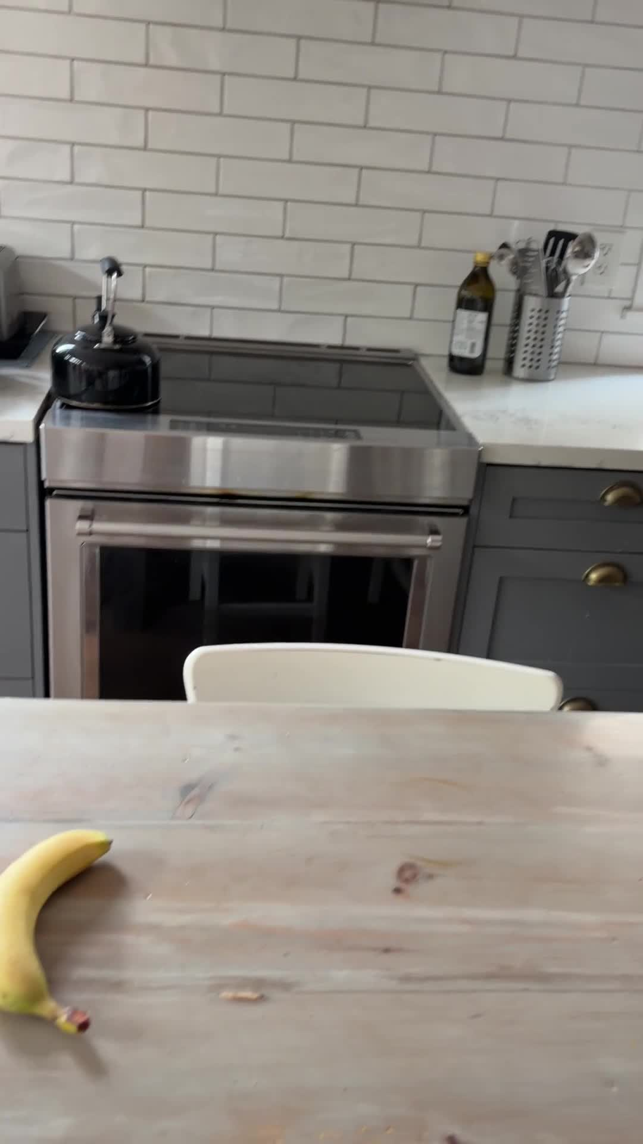
PICTURES AND MEASURED TIMELINE
Visibility precedes the signal
Positive Mac run, 20 September 2026.
18.0 s
Context just before the annotated
expected interval begins at 18.3 s.
24.5 s
The second supporting sample
opens the episode.
25.0 s
A lower distance replaces
the episode’s best frame.
6.2 seconds from annotated visibility to opening
AIShop / Sprint 001
23
Notes:
The frames are extracted from the actual fixture for visual context. The annotation, not the first displayed image, fixes expected visibility at 18.3 seconds. First support is 24.0, opening 24.5, best frame 25.0, last support 26.0, and gap closure 27.5 seconds.
The 6.2-second response delay is an important result despite the passing fixture gate. It is different from the few-millisecond scoring latency.
Fine print
Annotations: https://drive.google.com/file/d/1lq1K9Y8fA9MSrPMJdSlNin74RBdW_UzX/view
Positive evaluation: https://drive.google.com/file/d/1T4aHnpL8RDOXdyBqJ7aQzP1UyWFYgfBC/view
Episode report: https://drive.google.com/file/d/1BYeEZwW57BhgfX4I4Gp7RQiqzPRSH0mt/view
Source video: https://drive.google.com/file/d/1ugotSTVkWaQLHmXozepil3Psv317oOg6/view

Slide 24
MEASURED CHART
Five samples support a match
Lower feature distance is closer to the reference.
Support: 24.0, 24.5, 25.0, 25.5, 26.0 seconds
The observed margin is about 0.051.
It is a property of these samples, not a robustness guarantee.
Open the exact recorded distances
AIShop / Sprint 001
24
Notes:
A data chart is the deliberate visual exception here: it preserves the measured numeric relationship better than a UML diagram or a photo. The native editable chart uses nine-decimal-place workbook values; the linked JSONL retains exact values.
Five samples cross the frozen threshold. The nearest non-supporting positive sample is approximately 0.481, and the best is approximately 0.349. The minimum absolute decision margin is approximately 0.051. These observations do not establish out-of-sample recognition performance.
Fine print
Exact scores: https://drive.google.com/file/d/1bmFRmY7DbulEx3t8704Nz6ieZQ-wfC1u/view
Evaluation: https://drive.google.com/file/d/1T4aHnpL8RDOXdyBqJ7aQzP1UyWFYgfBC/view

Slide 25
PICTURES WITH MEASURED RESULTS
The saved fixture outcomes
The gate checks episode openings in fixed annotation zones.
Positive
1 episode
56 analyzed samples
Opening at 24.5 seconds
Control
0 openings
26 analyzed samples
Minimum distance ≈ 0.906
Positive evaluation
Control evaluation
AIShop / Sprint 001
25
Notes:
The repeated fixture images intentionally keep the results attached to the same experiment introduced at the beginning. Both saved Mac gates pass.
The evaluator judges opening timestamps, not frame-by-frame accuracy or every moment an episode remains active. There is one target and two fixtures. General accuracy, distractor resistance, and phone equivalence remain unproven.
Fine print
Positive: https://drive.google.com/file/d/1T4aHnpL8RDOXdyBqJ7aQzP1UyWFYgfBC/view
Control: https://drive.google.com/file/d/17iEwan4LpTMTUJQCKyzzhVNixNUqOD9j/view
Gate semantics: https://drive.google.com/file/d/1VWx2MUWLFW-lPTrljIPkzhYV1U7e6aoU/view?usp=drivesdk

Slide 26
UML PACKAGES AND ACTIVITY
Evaluation is outside inference
Expected answers belong to the evaluation target.
ios/AIShop/AIShopVision/Sources/
AIShopVisionEvaluation/
«artifact» added
FixtureEvaluator.swift
Validates logs, judges openings, and compares hosts
Read: evaluate(logURL:) / compare(...)
AIShopVisionEvaluate/
«artifact» added
main.swift
Parses command arguments and reports exit status
Read: top-level do block
Validate input hashes, profile, completion, and samples
Evaluate openings, then compare matching host evidence
Compare: 0 = agreement 2 = changed decisions 1 = failure
AIShop / Sprint 001
26
Notes:
evaluate checks the fixture outcome. compare first requires compatible, complete Mac and iPhone runs with matching frame identities and no dropped eligible samples. Only then does it compare distances and support decisions.
Exit 2 means phone outcomes pass but support decisions differ. It is a finding, not a passing calibration. Exit 1 indicates failed or invalid evidence. Synthetic phone labels in tests exercise this logic without supplying device evidence.
Fine print
Evaluator: https://drive.google.com/file/d/1VWx2MUWLFW-lPTrljIPkzhYV1U7e6aoU/view?usp=drivesdk
CLI: https://drive.google.com/file/d/1AKTpMBAjYYoaOnltXDhGP6CHvzTdtZog/view?usp=drivesdk

Slide 27
UML PACKAGE AND TEST ARTIFACTS
Tests for the analysis components
Each file is added relative to the sprint base.
ios/AIShop/AIShopVision/Tests/AIShopVisionTests/
«artifact» added
VisionFeatureAdapterTests.swift
Real extraction, EXIF handling, invalid image
«artifact» added
LocalTargetCatalogTests.swift
Stable target identity and cached extraction
«artifact» added
VideoFixtureFrameStreamTests.swift
Deterministic replay, slow consumer, and stop
«artifact» added
CandidateScorerTests.swift
Finite real scores and raw calibration evidence
«artifact» added
CandidateEpisodeAggregatorTests.swift
Opening, missed slots, threshold, ties, and gaps
«artifact» added
CandidateAnalysisPipelineTests.swift
Live-before-EOF updates, replay, stop, and failure
AIShop / Sprint 001
27
Notes:
These tests live in the package test target. Start at each test method name to see the promised behavior, then follow its fixture setup into the implementation.
Some tests use constructed scores to isolate temporal or log rules. Tests claiming real feature extraction run the actual Vision implementation on macOS. Do not treat all tests as recognition benchmarks.
Fine print
VisionFeatureAdapterTests.swift: https://drive.google.com/file/d/1HThCNRuyHtscmMLhCi9AgGhNNsOMCVZt/view?usp=drivesdk
LocalTargetCatalogTests.swift: https://drive.google.com/file/d/1UxbrjxFIhbM-Z_DMGnUPku5Kr8TWq3ed/view?usp=drivesdk
VideoFixtureFrameStreamTests.swift: https://drive.google.com/file/d/1E4s8PvxdU2gVmmdwiUjOXDBrBdayEB28/view?usp=drivesdk
CandidateScorerTests.swift: https://drive.google.com/file/d/1p1L5S4Ly2U3wP6CWUucKIJAaP4eu9-e8/view?usp=drivesdk
CandidateEpisodeAggregatorTests.swift: https://drive.google.com/file/d/18TZJ2u0vJMbHwNg1l890KIw9LlkHwgNl/view?usp=drivesdk
CandidateAnalysisPipelineTests.swift: https://drive.google.com/file/d/1H_VNhhlPiBlO-zrPzliUY60ZcEnxE5Ki/view?usp=drivesdk

Slide 28
UML TEST ARTIFACTS
Tests for evidence and the app
Integration checks connect component contracts to saved evidence.
AIShopVision/Tests/AIShopVisionTests/
«artifact» added
SessionLogTests.swift
Order, corruption, incomplete evidence, and write errors
«artifact» added
SessionReportBuilderTests.swift
Live report equals replay; images remain separate
«artifact» added
FixtureEvaluatorTests.swift
Annotation boundaries and rejected evidence
«artifact» added
PipelineIntegrationSuite.swift
Both fixtures, repeats, cancellation, and comparison
«artifact» added
FixtureResources.swift
Named lookup of package test resources
«artifact» added
FixtureResourcesTests.swift
Reference hash, decoding, and resource packaging
ios/AIShop/AIShopTests/
ApplicationBootstrapTests.swift · startup isolation
VisionHarnessModelTests.swift · fixture setup
Both app test files added. Use the diagnostic Xcode scheme.
AIShop / Sprint 001
28
Notes:
PipelineIntegrationSuite connects the production pipeline to the evaluator and saved artifacts. FixtureResources is support code, not a test case. The test introductions in the patch state what each file proves and where its evidence stops.
ApplicationBootstrapTests includes a host-level assertion that requires the diagnostics scheme. VisionHarnessModelTests checks setup and resource identities. The remaining pre-existing app tests are unchanged by this sprint.
Fine print
SessionLogTests.swift: https://drive.google.com/file/d/1vOHV30-0p1gfcaAXOvZCrVypEMrllAKS/view?usp=drivesdk
SessionReportBuilderTests.swift: https://drive.google.com/file/d/1jgTAaRAP42QjJgkCGWM8Ul5428Ch0w-u/view?usp=drivesdk
FixtureEvaluatorTests.swift: https://drive.google.com/file/d/1jZk28R69sRybwzYDM96lnF_eeeoADQNq/view?usp=drivesdk
PipelineIntegrationSuite.swift: https://drive.google.com/file/d/1RMKz3RX4UsbsP6_XFTOn6i7DcID52tZW/view?usp=drivesdk
FixtureResources.swift: https://drive.google.com/file/d/1BcaKRLUpMthH-rS_kdGDvNiJSvNua7GE/view?usp=drivesdk
FixtureResourcesTests.swift: https://drive.google.com/file/d/1CxEOuSkWSbS77Tl3CLVHbmN5Z-olRJTr/view?usp=drivesdk
App startup: https://drive.google.com/file/d/1SHcAow4_9oreGvLI9xuH-aVWqZ-VUfum/view?usp=drivesdk
Harness setup: https://drive.google.com/file/d/1KPBLjeiDriored4Cd7zoH6mSceEHCURE/view?usp=drivesdk

Slide 29
UML ARTIFACTS
Build and verification tools
Scripts and project configuration are also part of the review.
e2e/ios/
«artifact» added
run.zsh
Runs Swift tests and keeps the evidence directory
«artifact» added
required-tests.txt
Required test-name inventory checked against the transcript
«artifact» added
verify-results.rb
Rejects failed, skipped, missing, or incomplete tests
«artifact» added
calibrate-scorer.rb
Explicit threshold selection, separate from regression
«artifact» added
verify-app-bundle.rb
Checks Debug fixture hashes and Release exclusion
ios/AIShop/scripts/
«artifact» added
copy-vision-fixtures.sh
Copies only the approved inputs into Debug resources
Read: build-phase script
AIShop / Sprint 001
29
Notes:
All six files shown are added relative to the sprint base. run.zsh executes the offline macOS gate; verify-results.rb ensures a successful shell status does not conceal incomplete tests. required-tests.txt is configuration, not executable code.
calibrate-scorer.rb is deliberately separate. The gate does not select its own threshold. copy-vision-fixtures.sh controls the app bundle, and verify-app-bundle.rb independently checks the result.
The code-comment patch preserves shebang lines and every executable statement.
Fine print
run.zsh: https://drive.google.com/file/d/10Y8fOEfpG-f4NUULUA1dT3xoUAs-2to1/view?usp=drivesdk
required-tests.txt: https://drive.google.com/file/d/1C0viIjgbVD-62GKbrhfGIAjdulFmdClt/view?usp=drivesdk
verify-results.rb: https://drive.google.com/file/d/1yl03h9aBriFDmPgJWTNt9v7Oi-fGhVLb/view?usp=drivesdk
calibrate-scorer.rb: https://drive.google.com/file/d/17k_pAegwXQoF4aGWexoarbjGjs76zE_Q/view?usp=drivesdk
verify-app-bundle.rb: https://drive.google.com/file/d/1xJafUe0eSHiZp3XQBDHca8y8XXhicrfE/view?usp=drivesdk
Packaging: https://drive.google.com/file/d/1n4RudQ84f06JgtH8OJGcHytnscH0rsjA/view?usp=drivesdk

Slide 30
UML PACKAGES AND ARTIFACTS
Project files and input artifacts
Build wiring decides what the app can include and launch.
ios/AIShop/AIShop.xcodeproj/
«artifact» modified
project.pbxproj
Target membership, package linkage, and fixture build phase
xcshareddata/xcschemes/
«artifact» added
AIShop-VisionDiagnostics.xcscheme
Debug diagnostic launch arguments and test host
AIShopVision/Tests/AIShopVisionTests/Resources/
banana.JPG
Reference image
video_with_banana_trimmed.mov
Positive video
video_without_banana_trimmed.mov
Control video
annotations.json
Evaluation zones; excluded from the app
AIShopTests/video_with_banana.MOV
AIShopTests/video_without_banana.MOV
Original inputs; outside the app bundle.
Exact input hashes and reviewed paths
AIShop / Sprint 001
30
Notes:
project.pbxproj is modified; the diagnostics scheme is added. The resource folder contains the banana reference, two trimmed movies, and annotations. These are input artifacts rather than source code.
The original videos are AIShopTests/video_with_banana.MOV and video_without_banana.MOV. The base branch did not contain these inputs. The review snapshot places the runtime fixtures in package test resources.
Package.swift owns resource copying for tests. The Debug app build copies only reference plus trimmed videos. Release excludes diagnostics and fixtures.
Resource paths and hashes come from the verified R11 snapshot. No binary input was changed in this documentation revision.
Fine print
Project: https://drive.google.com/file/d/1jo7_m2i5YTkt6zw6TWajf1ggpfidgDWg/view?usp=drivesdk
Scheme: https://drive.google.com/file/d/1DjYdomtt-x1Ykvw7-r5tSvAg9SpQcaER/view?usp=drivesdk
Annotations: https://drive.google.com/file/d/1lq1K9Y8fA9MSrPMJdSlNin74RBdW_UzX/view
Input snapshot: https://drive.google.com/file/d/1ii_sO0b-T-r6IDZMFgUMMAui8UwM6BVg/view

Slide 31
UML ARTIFACTS AND DEPENDENCIES
Files produced by a run
A session’s evidence must stay together.
One session output directory
«artifact» generated output
session.jsonl
Pipeline + SessionLog persist ordered events
«artifact» generated output
report.json
Harness or test host saves PipelineResult.report
«artifact» generated output
images/*.jpg
RetainedImageStore saves selected frame pixels
«component» FixtureEvaluator
Reads saved log + annotations
Saved Mac session
Saved report
Saved evaluation
AIShop / Sprint 001
31
Notes:
The dependency arrow shows the evaluator consumes the session evidence; the evaluator does not own production image capture. Its generated evaluation output is separate from the pipeline’s session log.
On the app, the parent is Documents/VisionDiagnostics/<fixture>-<run UUID>/. On the macOS gate, run.zsh prints a temporary evidence directory. The retained Mac examples live under docs/09-build-test-document/basic-video-stream-object-recognition/artifacts/evidence/.
A log export alone does not include report.json and images. Preserve those separately from the app container during the phone session.
Fine print
Harness output path: https://drive.google.com/file/d/1vt_1-VAPTHjzlXDFcHeqeiLXp2myTA08/view?usp=drivesdk
Mac gate script: https://drive.google.com/file/d/10Y8fOEfpG-f4NUULUA1dT3xoUAs-2to1/view?usp=drivesdk
Log: https://drive.google.com/file/d/1bmFRmY7DbulEx3t8704Nz6ieZQ-wfC1u/view
Report: https://drive.google.com/file/d/1BYeEZwW57BhgfX4I4Gp7RQiqzPRSH0mt/view
Evaluation: https://drive.google.com/file/d/1T4aHnpL8RDOXdyBqJ7aQzP1UyWFYgfBC/view

Slide 32
UML PACKAGE MAP
Existing application neighbors
These iPhone folders remain outside the new analysis pipeline.
AIShop/Analysis/ {unchanged}
Existing server analysis requests and report models
AIShop/Auth/ {unchanged}
Firebase session and sign-in integration
AIShop/Camera/ {unchanged}
Existing live capture and image-processing support
AIShop/UI/ {unchanged}
Existing camera, navigation, and report screens
AIShop/Support/ {unchanged}
Application configuration assets and build settings
AIShop/App/AppConfiguration.swift and existing app tests
are also unchanged. Server and dashboard are separate apps.
AIShop / Sprint 001
32
Notes:
All existing Swift source files in these application folders were read and compared with the sprint base. They are unchanged. This page explains their roles so the reviewer can distinguish new on-device analysis from the existing server-driven app.
Support holds configuration rather than Swift implementation. It appears because it is part of the app boundary. Secrets/configuration values are not reproduced in the deck.
Scope is this iPhone sprint. Other repository applications, including server and dashboard, have their own code and review scope.
Fine print
Application folder: https://drive.google.com/drive/folders/1wj2m_abT1EciOoBW_BPAtXi6NaiwLAre
Analysis folder: https://drive.google.com/drive/folders/1H-jScLpi-NxejNjoqNQzxVHW5TW6XoBs
Camera folder: https://drive.google.com/drive/folders/1LtXd7pu93hxYx_Qek_kFM5eDNey7wnfZ
UI folder: https://drive.google.com/drive/folders/13sCt7R3YVfMqHdPCR9oabZK_PpOFB46d
Auth folder: https://drive.google.com/drive/folders/1t-Q6bjDt5wFKLaxfCB0ZZUMc-bwkM4U5

Slide 33
REVIEW TABLE
Where to look hardest
These limits remain visible during human code review.
Finding | Code / evidence to inspect
6.2-second signal delay | Saved annotation and opening time; CandidateScorer
Paced drops block comparison | VideoFixtureFrameStream and FixtureEvaluator
Rotation is not established | Track transform plus current upright fixture set
Session resources keep growing | Latency samples and retained image directory
Phone acceptance is pending | Diagnostic scheme, startup, and manual export
One target and two fixtures establish a narrow experiment.
They do not establish general recognition accuracy.
AIShop / Sprint 001
33
Notes:
A table is a deliberate exception: the reviewer needs a compact mapping from each concern to where it can be investigated. These are not newly reproduced runtime defects.
The saved delay is measured. The dropped-frame mismatch follows from paced buffering and comparator validation. The existing upright fixtures do not establish rotated-video correctness. The bounded queue does not bound report-history memory or image files.
The diagnostic scheme and one app test depend on the special launch route. No real iPhone run has been performed during this revision.
Fine print
Delay: https://drive.google.com/file/d/1T4aHnpL8RDOXdyBqJ7aQzP1UyWFYgfBC/view
Stream: https://drive.google.com/file/d/1XhzGrIh_cYvOyCGV2IpiNo3uR3XfOG1z/view?usp=drivesdk
Comparator: https://drive.google.com/file/d/1VWx2MUWLFW-lPTrljIPkzhYV1U7e6aoU/view?usp=drivesdk
Report lifetime: https://drive.google.com/file/d/1oj6uY_Dlu9ourdUFF1gz6MzhuevJl1Is/view?usp=drivesdk
Images: https://drive.google.com/file/d/11MaGlbs5PJ2W1nLkT2Jhw40DaaIsqW1K/view?usp=drivesdk
Scheme: https://drive.google.com/file/d/1DjYdomtt-x1Ykvw7-r5tSvAg9SpQcaER/view?usp=drivesdk

Slide 34
UML ACTIVITY
The physical-iPhone check
Still pending. Use the same inputs and frozen profile.
Launch AIShop-VisionDiagnostics on the iPhone
Run “Banana present” and “No banana” to exhaustion
Observe signal, playback, responsiveness, and report
Preserve both logs, reports, and retained images
Evaluate fixtures, then compare matching host samples
Existing commands and manual runbook
AIShop / Sprint 001
34
Notes:
These physical-device steps have not been executed here. Choose the diagnostic Xcode scheme, which supplies the special Debug launch route. The ordinary icon does not supply those arguments.
Use identical fixture bytes, reference, profile, and source revision. Run both fixtures to completion; exercise Stop separately because interrupted evidence is not a completed fixture gate.
The share control exports the session log. Preserve report.json and images from the app container too. Run the existing evaluator before the host comparator. Paced runs with dropped eligible frames are rejected for comparison.
Record device model, OS, build, and findings. The linked runbook contains the exact existing commands.
Fine print
Runbook: https://drive.google.com/file/d/1zb0O0CZdWipehcKvMou47Pcx7a5Avqax/view
Scheme: https://drive.google.com/file/d/1DjYdomtt-x1Ykvw7-r5tSvAg9SpQcaER/view?usp=drivesdk
CLI: https://drive.google.com/file/d/1AKTpMBAjYYoaOnltXDhGP6CHvzTdtZog/view?usp=drivesdk

Slide 35
REVIEW NAVIGATION
The route back to the code
Concept, responsible file, exact evidence, then human judgment.
App and startup
Reference and sampled video
Scoring and episodes
Pipeline and persisted evidence
Tests and host comparison
Reviewed source hashes
Reusable rules in root governance
The code introductions and existing-governance updates
are in the companion patch for local application.
AIShop / Sprint 001
35
Notes:
Navigation pages and links cover all 43 added/modified source, configuration, and script files compared with sprint base cbc68ad. A companion CSV records exact repository paths, roles, source hashes, and slide numbers. Existing application source folders are explicitly identified as unchanged. Input and output artifacts have their own pages.
The source-doc patch contains comment-only changes in 40 source/script files and focused changes in root governance. Drive rejected writes to the existing source file, so these source introductions are delivered for local application rather than claimed as already synced. No commit, push, or staging was performed.
Runtime tests were not rerun on this Linux presentation host. The saved Mac evidence is retained as historical evidence with its host and date.
Fine print
App and startup: https://drive.google.com/file/d/1vt_1-VAPTHjzlXDFcHeqeiLXp2myTA08/view?usp=drivesdk
Reference and sampled video: https://drive.google.com/file/d/1XhzGrIh_cYvOyCGV2IpiNo3uR3XfOG1z/view?usp=drivesdk
Scoring and episodes: https://drive.google.com/file/d/1901X7Y9Sns2jesyFvKskqVa1Iz2sUymo/view?usp=drivesdk
Pipeline and persisted evidence: https://drive.google.com/file/d/14M5TR7ay3bKgzb_pcc_dNRO4go1F7fsy/view?usp=drivesdk
Tests and host comparison: https://drive.google.com/file/d/1RMKz3RX4UsbsP6_XFTOn6i7DcID52tZW/view?usp=drivesdk
Reviewed source hashes: https://drive.google.com/file/d/1ii_sO0b-T-r6IDZMFgUMMAui8UwM6BVg/view

