Slide 1
AI SHOP · VISTA · SDLC2
VISTA Agentic Visual
Products Recognition
From Shelf Photo to Item Report
User Journey, Architecture, and Implementation
A real application evaluated through a complete software lifecycle
000
Notes:
Editable text companion. The full presenter notes are attached to the following image slide.

Slide 2
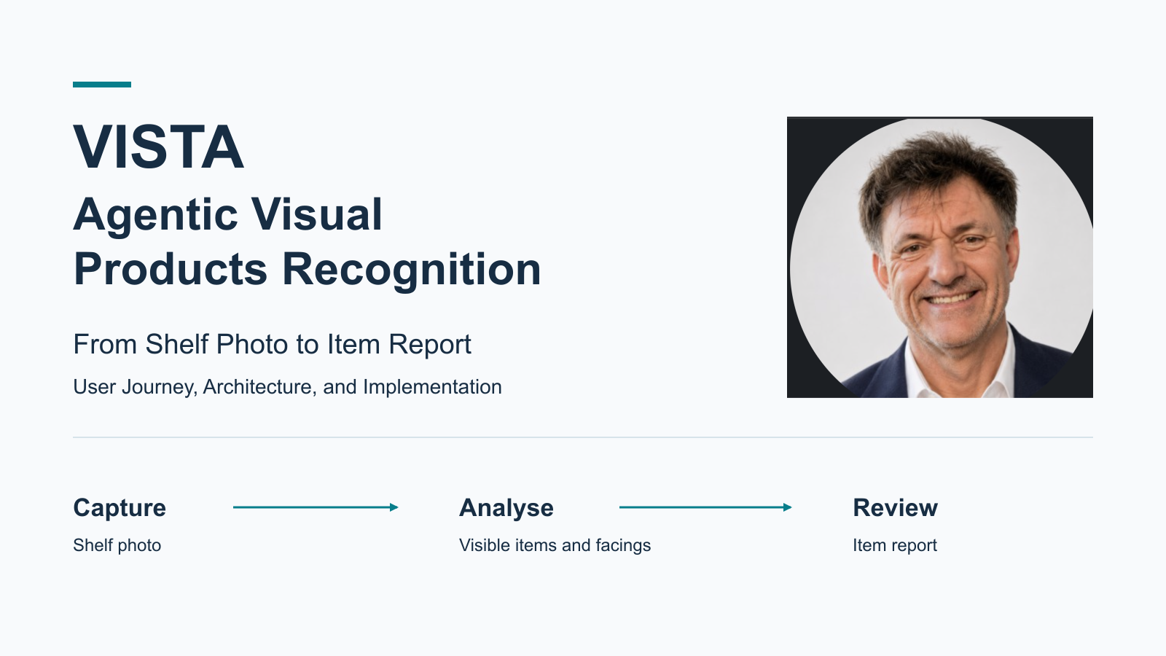
Notes:
# 000 — VISTA Agentic Visual Products Recognition
Welcome to the technical introduction to VISTA's image uploader and analyser.
We will follow a shelf photo from the user's upload to a reviewable item report.
The story connects the user journey, the architecture, and the implementation.
Start with the short business refresher on the next slide.
Then explain how the interface, server, storage, and AI work together.
Use the broader VISTA overview as background for the wider product vision.
The cover's three words—Capture, Analyse, Review—introduce the user journey.
They are a conceptual sequence; the component and API details follow later.

Slide 3
00
Understand What Is on the Shelf
Capture shelf photos as evidence for inspection.
Identify visible products and count their facings.
Help teams understand shelf presence and changes over time.
Support inventory decisions, brand presentation, and sales.
This module turns an uploaded photo into a reviewable item report.
EDITABLE TEXT
Notes:
Editable text companion. The full presenter notes are attached to the following image slide.

Slide 4
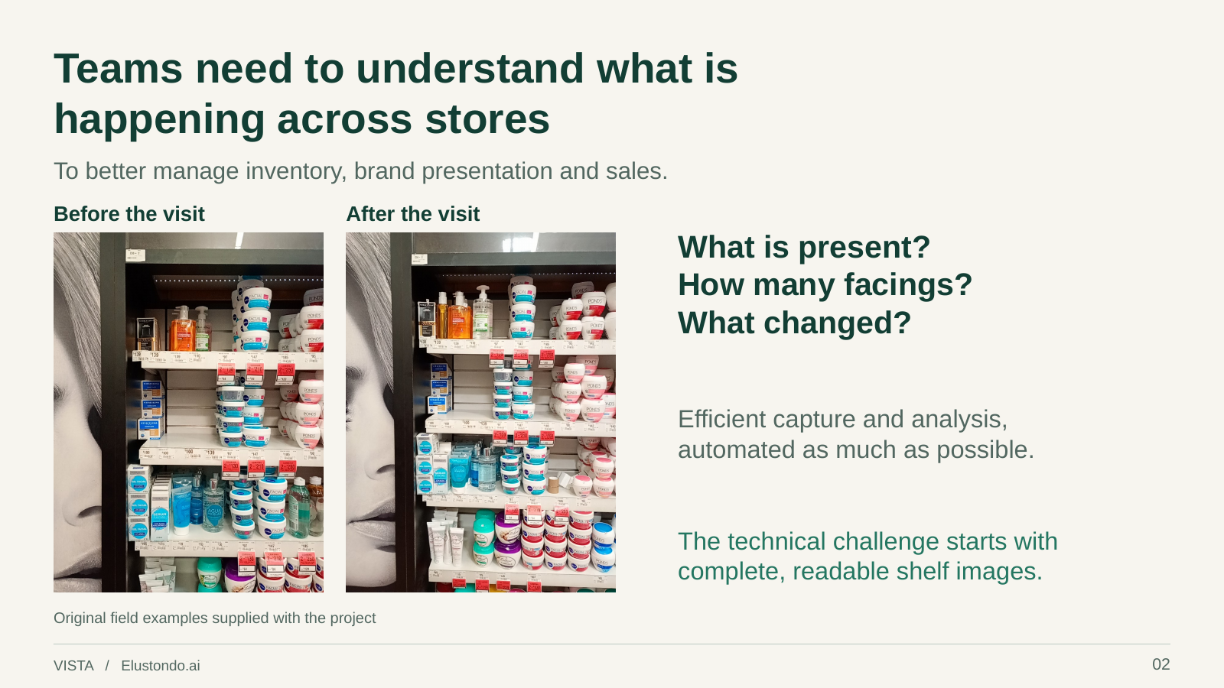
Notes:
# 00 — Business Context: Understand What Is on the Shelf
## One-minute introduction
VISTA helps retail teams understand what is happening on store shelves.
They need to know which products are visible, how many facings each has,
and what changes between observations, to support inventory decisions,
brand presentation, and sales.
Look at the two shelf photos: they make the business question concrete.
A person captures shelf evidence so it can be analysed and reviewed.
The aim is to reduce manual inspection effort while retaining the image
that lets someone check the findings.
The module we are about to explore handles one part of that bigger story.
A user uploads a shelf photo, the server coordinates AI analysis,
and the browser presents identified products and visible facing counts.
A facing is a visible product front, not the stock hidden behind it.
The observations can be uncertain and need review.
Keep that user journey in mind as we move into the architecture:
photo in, reviewable item report out.
## Reading context and scope
The broader introduction is the [VISTA LinkedIn overview](../../VISTA-Linkedin-Overview-Presentation.pdf).
This technical guide assumes that background; this slide is a brief refresher.
Selected visual: PDF page 2, “Teams need to understand what is happening across stores”.
It uses original field examples and connects the images to the business questions.
Comparisons across visits describe the wider business intent, not a claim that
this uploader module already performs automatic change detection.
## Visual walkthrough
Point to the before-and-after photos, then the three questions on the right.
Close with the need for readable shelf images and move to slide 01's architecture.
The visual retains its original PDF footer number, 02; this guide numbers it 00.

Slide 5
005
AI Shop Through the 12-Step SDLC2 Lifecycle
AI Shop is both a working application and an SDLC2 case study.
Understand
Evaluate
Build
Operate and Learn
1. Business and Technical Context
4. Benchmarks and Test Strategy
7. Planning
10. Deployment, Infrastructure, and Operational Reality
2. Intent
5. High-Level Architecture
8. Low-Level Design and Specifications
11. Review, Human QA, and Release
3. Use Cases and System Model
6. Working Proof of Concept
9. Build, Code, and Test
12. Observability and Learning
EDITABLE TEXT
Notes:
Editable text companion. The full presenter notes are attached to the following image slide.

Slide 6
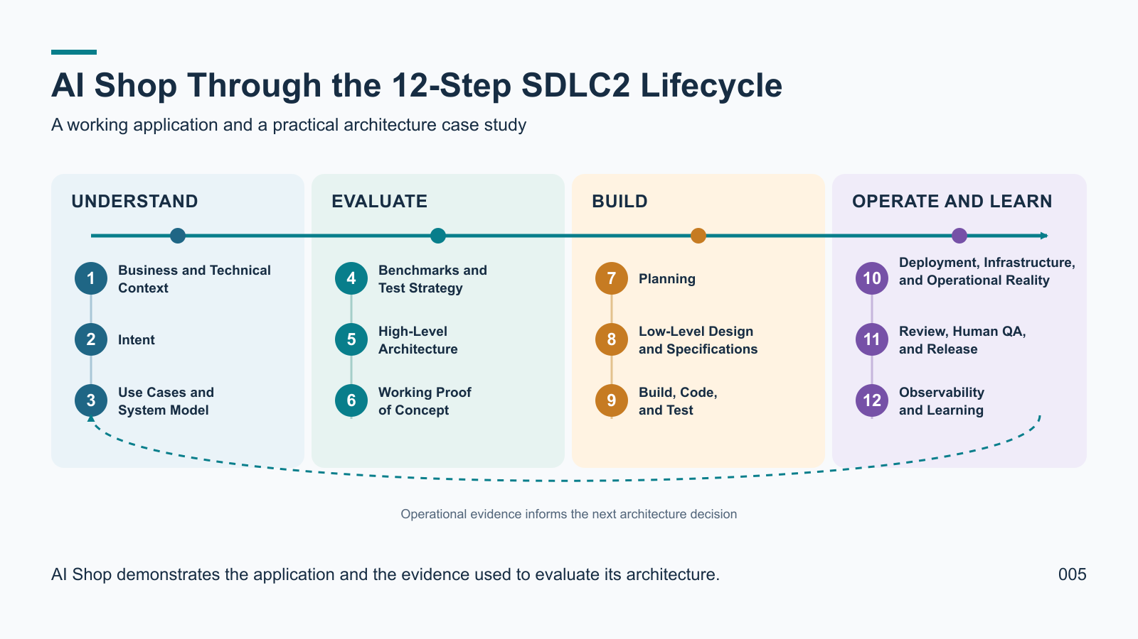
Notes:
# 005 - AI Shop Through the 12-Step SDLC2 Lifecycle
AI Shop has two connected purposes.
It is a real application for analysing shelf images and producing item reports.
It is also a case study showing how SDLC2 evaluates and develops an AI architecture.
This slide introduces the twelve steps lightly.
The remainder of the presentation uses concrete AI Shop evidence to examine them.
The steps form a lifecycle, but learning can send the team back to an earlier decision.
## Understand
Business and Technical Context establishes the retail problem and technical environment.
Intent states the outcome the application should create for its users.
Use Cases and System Model identify the people, system boundaries, and important interactions.
## Evaluate
Benchmarks and Test Strategy define how usefulness, accuracy, and reliability will be judged.
High-Level Architecture assigns responsibilities across the browser, server, storage, and AI.
The Working Proof of Concept tests whether that architecture can produce useful evidence.
## Build
Planning turns the validated direction into small, reviewable increments.
Low-Level Design and Specifications define interfaces, records, states, and component behaviour.
Build, Code, and Test implements those decisions and checks each increment.
## Operate and Learn
Deployment, Infrastructure, and Operational Reality expose the system to real constraints.
Review, Human QA, and Release confirm that the result is useful and ready for its audience.
Observability and Learning turn runtime evidence, defects, and feedback into better decisions.
## Transition to the technical story
The next slides move from the framework into the actual Items Vision implementation.
They follow a shelf photo from the browser to the server, storage, AI analysis, and report.
Later sections return to benchmarks, tests, deployment evidence, human review, and learning.
The purpose is not to claim that a diagram proves the architecture.
The purpose is to show how decisions and evidence accumulate across the lifecycle.
## Visual direction
Show one continuous horizontal lifecycle divided into four clearly labelled phases.
Place three numbered steps in each phase and retain the full step names.
Use a return path from step 12 toward the beginning to represent continued learning.
Keep the composition readable as an overview rather than a detailed process diagram.

Slide 7
01
VISTA Agentic Visual Products Recognition
From image to item report
Upload a shelf photo through the browser interface.
The server checks access, saves the image, and coordinates analysis.
AI identifies products and counts visible facings.
Read progress and the saved report in the browser.
Review the observations: recognition can be uncertain.
EDITABLE TEXT
Notes:
Editable text companion. The full presenter notes are attached to the following image slide.

Slide 8
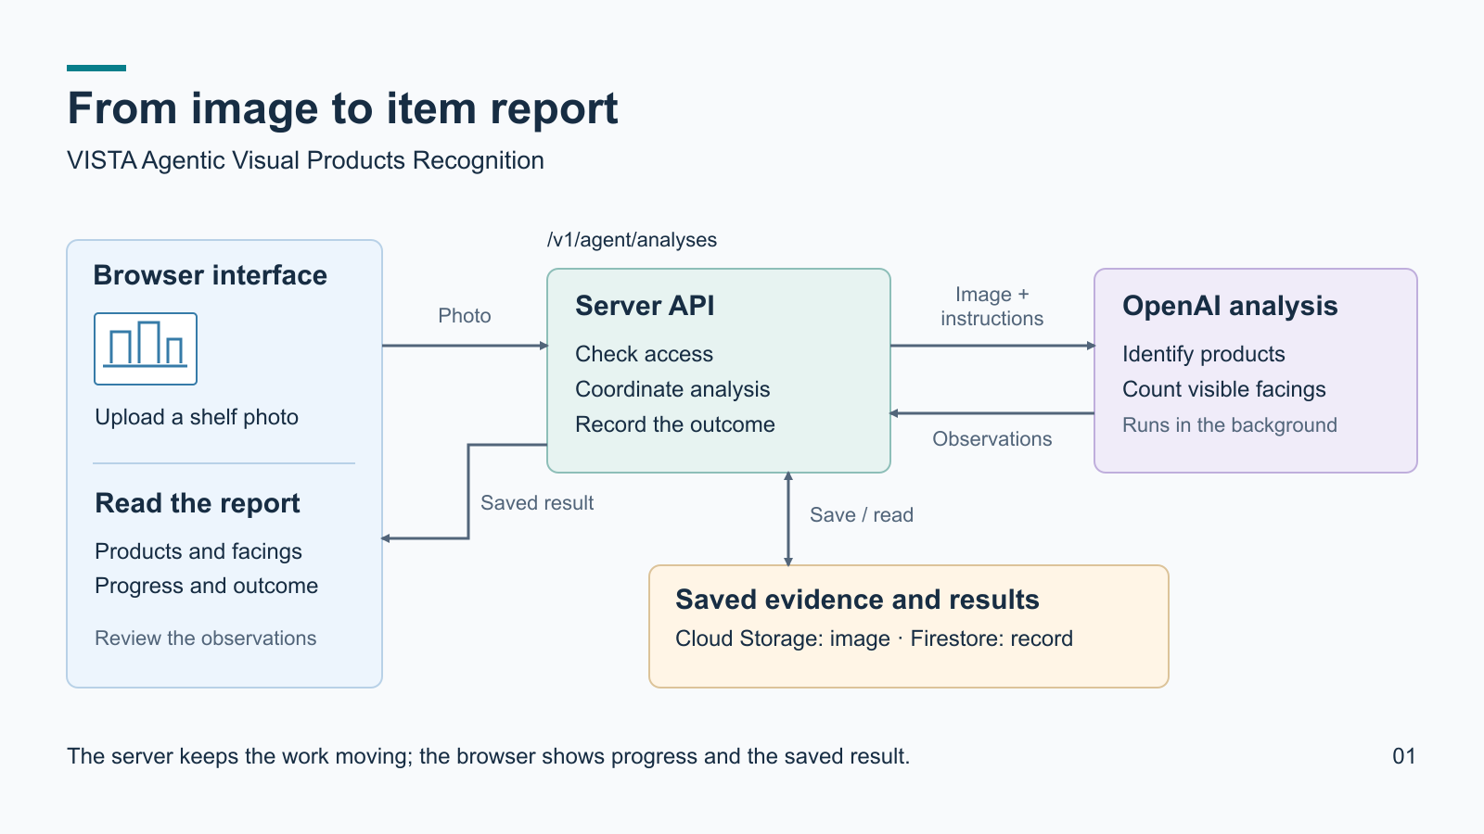
Notes:
# 01 — Intent: Items Vision — From Image to Item Report
VISTA Agentic Visual Products Recognition is the presentation title.
It explains AI Shop's image uploader and analyser implementation.
The intended outcome is simple: understand how a photo becomes an item report.
The audience should follow the story without needing to read source code.
## The endpoint: the server's front door
The API entry point is `/v1/agent/analyses`.
An endpoint is an address where the interface asks the server to do something.
`POST /v1/agent/analyses` uploads an image and creates its analysis record.
`POST /v1/agent/analyses/{id}/run` requests analysis of a saved image.
`GET /v1/agent/analyses/{id}` retrieves its recorded status and result.
Upload, analysis, and reading results have distinct responsibilities.
## The user interface: what the person sees
The browser's Agent page lets an authorised user sign in and upload a JPEG photo.
It guides the user through uploading, waiting, and reading the result.
The report shows identified products and their visible facing counts.
A facing is a visible product front; it does not reveal stock hidden behind it.
The interface also offers retry or refinement where the record allows it.
The Agent uses visual evidence and learned product knowledge to identify and count visible items.
## The server side: where the work is coordinated
The server checks identity and permission before accepting a request.
Cloud Storage holds the source image; Firestore holds status and reports.
The server submits the image and analysis instructions to OpenAI.
The background implementation collects the result through server-side tasks.
The browser reads progress; it does not have to keep the AI request alive.
Success and failure are recorded so the user can see what happened.
Model observations remain subject to uncertainty and human review.
## Presentation Agenda
The sections take inspiration from SDLC2 and follow the presentation's own flow.
1. Context and Domain: the shelf-photo problem and why item recognition matters.
2. Intent: what the system should achieve and what the audience will understand.
3. System and Use Cases: follow one user's photo from upload to report.
4. Success Criteria: explain how we assess useful, accurate, and reliable results.
5. Visual Example: show the uploaded image, interface states, and resulting report.
6. Solution Architecture: map the interface, endpoints, storage, AI, and data flow.
7. Low-Level Design and Code: connect key requests and processing steps to code.
8. Operational Reality: show what is implemented, deployed, and verified in use.
9. Observability and Learning: explain diagnostics, failures, and lessons learned.
10. Future Steps: roadmap.
## Visual walkthrough
Start with the user uploading a photo through the browser interface.
Follow the request to the server, which coordinates storage and AI analysis.
The server keeps the source image and analysis record, then saves the outcome.
Return to the browser, where the user reads status and the saved item report.
The diagram simplifies the flow; collection tasks and individual API calls come later.
The SVG is the editable visual source; the PNG is its presentation render.

Slide 9
02
Two Product Use Cases Share One Vision Foundation
AI Shop shopping experience
VISTA shelf inspection
The AI Shop iPhone app scans products for shoppers.
The web Agent manually analyses shelf photographs and videos today.
Image processing can occur on the iPhone and through server-side AI.
The intended VISTA iPhone app will capture evidence during store inspections.
Results help shoppers make better-informed decisions.
Results identify shelf products and count visible facings.
Both experiences reuse common server capabilities while serving different users.
EDITABLE TEXT
Notes:
Editable text companion. The full presenter notes are attached to the following image slide.

Slide 10
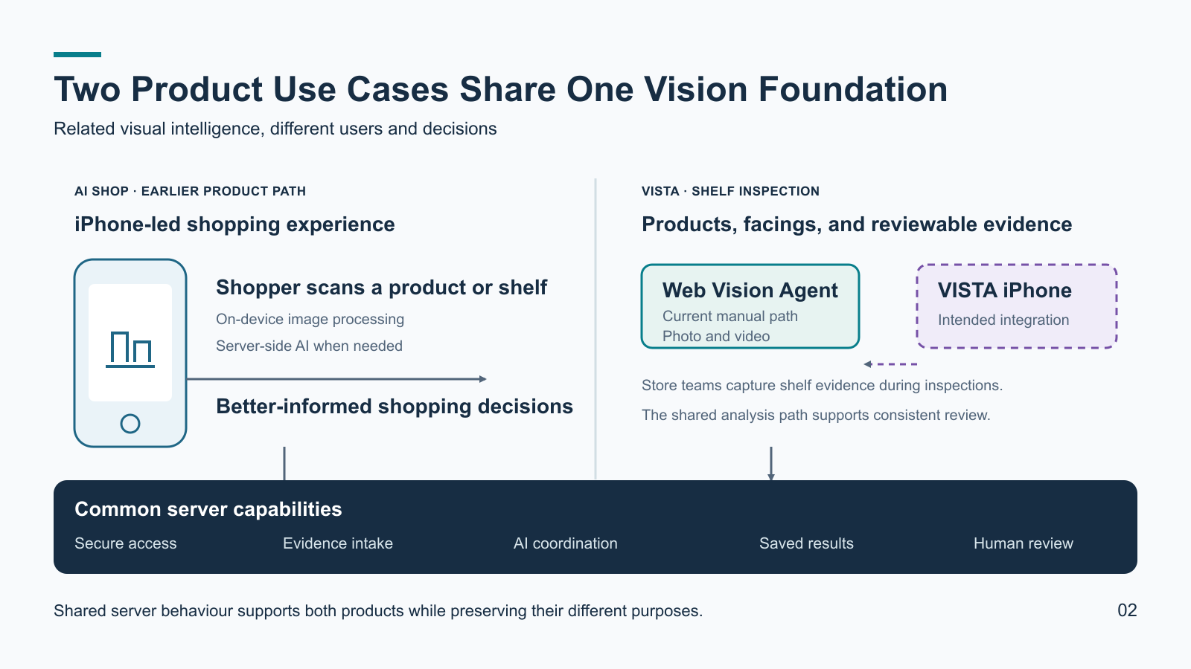
Notes:
# 02 - Main Use Cases and System Model
AI Shop and VISTA are related iPhone-led product experiences.
They serve different people and decisions while sharing much of the server foundation.
This slide introduces those use cases before the presentation explains implementation details.
## Use case 1: AI Shop shopping experience
A shopper uses the AI Shop iPhone app while considering a product or shelf.
The phone captures visual evidence and can perform part of the image processing locally.
Server-side AI adds capabilities that are better protected, coordinated, or processed remotely.
The result helps the shopper make a better-informed purchasing decision.
This is the earlier AI Shop product path.
Its iPhone client and individual server endpoints remain relevant to the complete product intent.
Later slides should state which functions are implemented and which remain immature.
## Use case 2: VISTA shelf inspection
A retail team uses VISTA to inspect products and presentation across store shelves.
The goal is to identify visible products, count facings, and retain evidence for review.
Today, a person can upload a shelf photograph or video manually through `agent.html`.
The web Agent provides the more robust current analysis and review workflow.
The intended destination is integration with the separate VISTA iPhone application.
That application would capture shelf evidence during an inspection and use the same server capabilities.
The presentation must label this integration as intended until end-to-end evidence confirms it.
## Shared system model
Both use cases need secure access, image intake, AI coordination, and result handling.
The server protects provider credentials and centralises reusable analysis behaviour.
Shared capabilities reduce duplicated implementation across AI Shop and VISTA.
The products can still use different prompts, records, interfaces, and decision outputs.
Common infrastructure does not make the two products identical.
AI Shop supports shopper decisions.
VISTA supports shelf and store inspection work.
## Transition
The next slides can follow each user path in more detail.
The Low-Level Design and Architecture section will focus on the web Vision Agent.
It will also show how the earlier endpoints and iPhone clients relate to the common server.
## Visual direction
Place the shared vision service as one horizontal foundation.
Above it, show the AI Shop iPhone shopper path and the VISTA inspection path.
Within VISTA, distinguish the current manual web Agent from the intended iPhone integration.

Slide 11
03
What AI Shop Must Improve
AI Shop must outperform useful human workflows, not merely return an AI response.
Shopping assistance
Product identification
Shelf inspection
Reach a decision with less image handling, repeated context, and conversation.
Make a complex scene faster to understand while showing uncertainty honestly.
Keep the source image, AI findings, corrections, reviewer, and timing connected.
The application should reduce effort without weakening human judgment.
EDITABLE TEXT
Notes:
Editable text companion. The full presenter notes are attached to the following image slide.

Slide 12
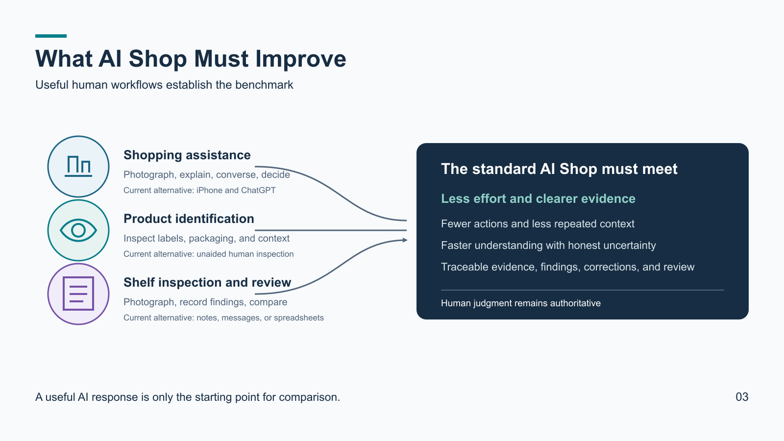
Notes:
# 03 - What AI Shop Must Improve
Benchmarks begin with the useful processes people already have.
An AI response alone does not establish that AI Shop improves those processes.
The repository documents three practical baselines.
## Manual shopping assistance
A shopper can already photograph a product and ask ChatGPT for advice.
That process can consider quality, price, preferences, and purchase context.
Its friction comes from moving between tools and repeatedly explaining the situation.
AI Shop should require fewer actions and reuse relevant shopping context.
The recommendation should become clear faster and with less reading or typing.
## Human product identification
A person can inspect labels, packaging, and surrounding context directly.
Human judgment needs no application, server, or network connection.
Dense scenes still take time and can hide small or obscured products.
AI Shop should organise visible products while declaring uncertain identification.
## Manual shelf inspection and review
An inspector can photograph a shelf and record observations in notes or a spreadsheet.
A second person can compare those findings with the original photograph.
The manual process becomes difficult when evidence, findings, and corrections separate.
AI Shop should preserve one traceable relationship across those materials.
Reviewer identity, decisions, corrections, and timing should remain attributable.
## Benchmark principle
The application should reduce manual effort without replacing human authority.
Each product use case needs its own comparison with the process it intends to improve.
AI Shop shopping support and VISTA inspection therefore share methods but not one score.
## Evidence boundary
These documents define comparison standards rather than measured acceptance thresholds.
The presentation should not claim that AI Shop already beats every baseline.
Later slides will show current recognition evidence and the remaining verification work.
## Visual direction
Show three existing human workflows feeding one evaluation question.
Make the outcome about reduced effort, preserved evidence, and human authority.
Avoid model names and implementation details on this slide.

Slide 13
031
One Shelf, Three Different Readings
The same dense shelf produced three incompatible descriptions.
Provisional GPT reference: 42 product groups and 94 visible units.
Agent first run: 23 rows, 62 facings, and 3 uncertain entries.
Independent visual read: about 57 facings plus 21 stacked units.
These totals answer different counting questions.
They cannot be converted into an accuracy percentage.
A human-verified reference and an agreed counting contract must come first.
EDITABLE TEXT
Notes:
Editable text companion. The full presenter notes are attached to the following image slide.

Slide 14
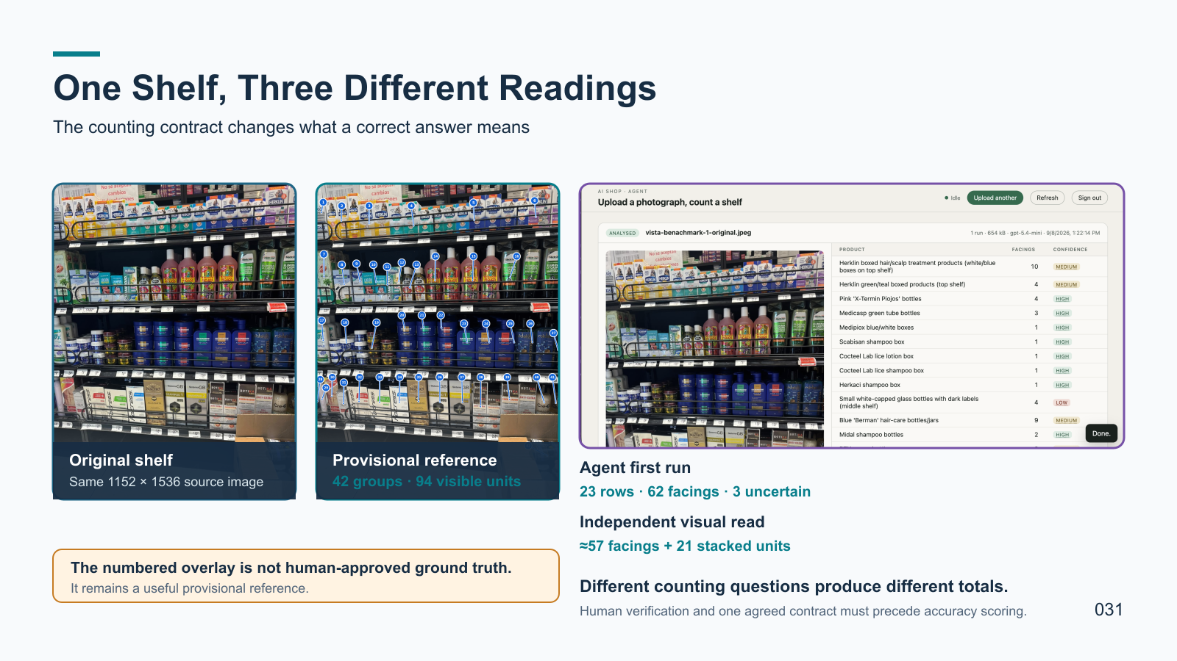
Notes:
# 031 - One Shelf, Three Different Readings
This slide uses the actual dense pharmacy shelf and recorded analysis artifacts.
The concrete disagreement explains why benchmark design matters.
## The original evidence
All three readings use the same 1152 by 1536 shelf photograph.
It contains small labels, occlusion, stacked products, edge cropping, and a carton.
Those conditions make both identification and counting difficult.
## Reading 1: provisional reference
The numbered overlay maps 42 product groups across four shelf regions.
Its associated GPT report counts 94 visible physical units.
This reference was obtained by hand from GPT and is not human-approved ground truth.
## Reading 2: Agent first run
The deployed Agent returned 23 product rows totalling 62 facings.
It also recorded three uncertain entries.
The run completed and produced a reviewable report, but benchmark parity was not demonstrated.
Some products were missed, grouped differently, or given an incorrect brand name.
## Reading 3: independent visual review
A separate shelf-by-shelf reading estimated about 57 front facings.
It also identified 21 units stacked behind those fronts.
That reading remained a model-assisted opinion rather than verified ground truth.
## Why the totals disagree
The provisional reference counts visible physical units.
The Agent contract asks for front facings.
The independent reading reports both measures separately.
Product grouping and identity depth also differ across the readings.
Dividing 62 by 94 would produce a misleading number, not an accuracy score.
The comparison must first fix the counting rule and required identification level.
A human reviewer must then validate the reference against the source photograph.
## Visual direction
Show the actual photograph, numbered overlay, and Agent screenshot prominently.
Use the real totals as evidence, with a warning that they answer different questions.
Keep the conclusion simple: define and verify the reference before scoring the model.

Slide 15
032
Vision Quality and System Reliability Need Different Tests
Vision quality
System reliability
Freeze the source image, prompt, schema, and human-verified reference.
Prove access control, upload, durable progress, and saved evidence.
Change one model, reasoning, context, or image setting at a time.
Test refresh, refinement, retry, and failure diagnostics.
Score identification, omissions, counts, inventions, and uncertainty.
For video, preserve frame provenance and prevent duplicate counts.
Record latency, usage, cost, retries, and review effort.
Release decisions require evidence from both test paths.
EDITABLE TEXT
Notes:
Editable text companion. The full presenter notes are attached to the following image slide.

Slide 16
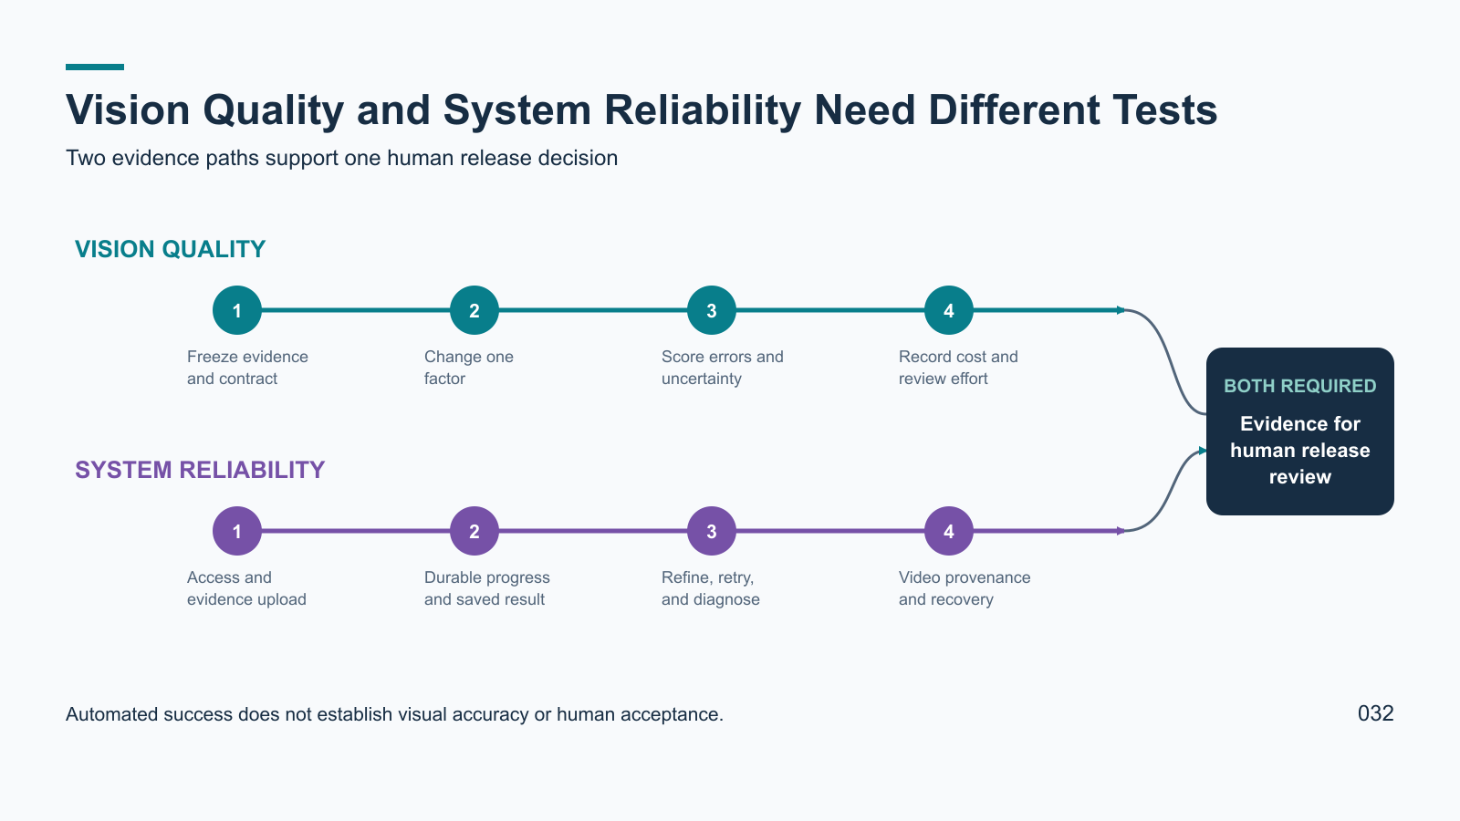
Notes:
# 032 - Vision Quality and System Reliability Need Different Tests
AI Shop can complete a request while producing a poor visual interpretation.
It can also identify products well while the surrounding application fails.
The test strategy therefore needs two connected but distinct paths.
## Vision-quality experiments
Start with the same original image and a human-verified reference inventory.
Freeze the counting contract, identity depth, prompt, output schema, and reference revision.
Change one factor at a time so the comparison can support a causal conclusion.
Possible factors include model, reasoning setting, context, image detail, and prompt wording.
Record identification errors, missed products, incorrect counts, and invented products.
Score responsible uncertainty separately from confident incorrect identification.
Retain requested and returned model identifiers, usage, latency, cost, and retries.
Include human review time because cheap output can become expensive to correct.
Repeat promising settings and then test them on unseen images.
## System-reliability tests
Verify authentication and the separation of each account's analyses.
Confirm that uploads preserve the original source evidence.
Exercise recorded progress, browser refresh, terminal states, and result retrieval.
Refinement and retry must create traceable runs without erasing earlier evidence.
Failures should retain safe diagnostic references without exposing private input.
Video adds its own requirements.
The system must handle upload interruption, frame extraction, analysis, and playback.
Sampled frames represent one continuous scan rather than independent photographs.
The result should retain frame provenance and avoid counting the same facing twice.
Refresh, task replay, and reconnection should not create duplicate analyses or runs.
## Release boundary
Automated tests, manual QA, and model-quality benchmarks answer different questions.
No single green check proves visual accuracy, deployment, or human acceptance.
A release decision needs evidence from both quality and reliability paths.
## Visual direction
Show two test rails running in parallel toward one evidence-based release decision.
Use distinct colours for visual interpretation and application reliability.
Join the rails only at the final decision gate.

Slide 17
04
Shared Vision Architecture
Three entry paths use related server capabilities for different decisions.
Current product paths
Intended integration
Shared server foundation
AI Shop iPhone scans products to support shopping decisions.
VISTA iPhone would capture shelf evidence during store inspections.
Secure intake protects access and provider credentials.
Web Vision Agent manually accepts shelf photographs and videos for inspection reports.
Server processing preserves evidence, tracks work, and obtains AI findings.
Clients retrieve reports and show uncertainty for human review.
The clients need not use one identical endpoint or return one identical report.
EDITABLE TEXT
Notes:
Editable text companion. The full presenter notes are attached to the following image slide.

Slide 18
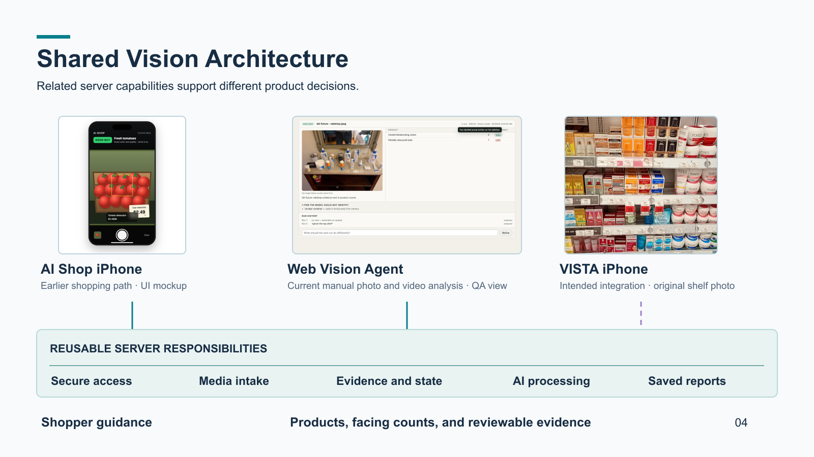
Notes:
# 04 - Shared Vision Architecture
This is the first architecture map after the benchmark and test-strategy section.
Keep it at system level. Endpoint contracts and worker internals come later.
## Three entry paths
AI Shop iPhone supports a shopper looking at a product or shelf.
Its earlier path can process an image on the phone and request server-side AI.
The phone does not hold the provider credential.
This path has its own interface and shopping-oriented result.
The web Vision Agent is the more robust current manual shelf-analysis entry.
An authorised person uploads a photograph or video through `agent.html`.
The page shows progress and a saved report of products, visible facings, and uncertainty.
The screenshot on this slide is a recorded QA fixture, not a live acceptance claim.
The separate VISTA iPhone app is intended to capture inspection evidence in stores.
The shelf photograph illustrates the inspection input, not a completed iPhone integration.
Do not imply a proven end-to-end VISTA-to-Agent route.
## Shared foundation
The reusable server responsibilities are secure intake, evidence handling,
AI coordination, recorded status, and report retrieval.
The server verifies access and keeps provider credentials away from clients.
For the Agent, source media is private and Firestore stores analysis state and results.
Video analysis prepares representative frames and treats them as one shelf scan.
Background tasks and provider collection can continue after the page refreshes.
The web page reads that durable server state rather than owning the long-running work.
The older iPhone route and the newer Agent route do not have to share one URL,
payload contract, prompt, or record type to share architectural capabilities.
AI Shop aims at a shopping decision. VISTA aims at inspectable shelf evidence.
Human review remains important because image recognition and counts can be uncertain.
## What the diagram means
Solid connectors mark paths described by current project evidence.
The dashed VISTA connector marks intended integration.
The lower rail is a responsibility map, not a literal request trace.
It does not claim that every path already uses every Agent-specific service.
## Source anchors
- `docs/06-solution-design-and-architecture/high-level-architecture.md`
- `docs/06-solution-design-and-architecture/components/component-architecture.md`
- `docs/guides/vision-agent-api/01-architecture.md`
- `docs/guides/vision-agent-api/12-architecture-implementation.md`
- `docs/guides/items-vision/02-user-journey/02-notes.md`
- `docs/09-build-and-test/sprint-009-browser-evidence/sprint009-agent-1440.png`
- `docs/TesstData/WhatsApp Image 2026-09-06 at 14.41.26.jpeg`

Slide 19
08
Vision Agent API Contract
The Agent owns shelf-analysis records behind Firebase access control.
Photograph
Video
Reading
`POST /v1/agent/analyses` accepts one JPEG and creates a record.
`POST /v1/agent/video-uploads` reserves an upload and returns a Storage session URI.
`GET /v1/agent/analyses/{id}` restores server-owned progress and the report.
`run=true` or `POST /v1/agent/analyses/{id}/run` starts an eligible analysis.
The client sends bytes to Storage, then calls `POST /v1/agent/video-uploads/{id}/complete`.
Original evidence has a source route, but video download has a known live failure.
Agent ownership and Admin cross-user reads use different authorization claims.
EDITABLE TEXT
Notes:
Editable text companion. The full presenter notes are attached to the following image slide.

Slide 20
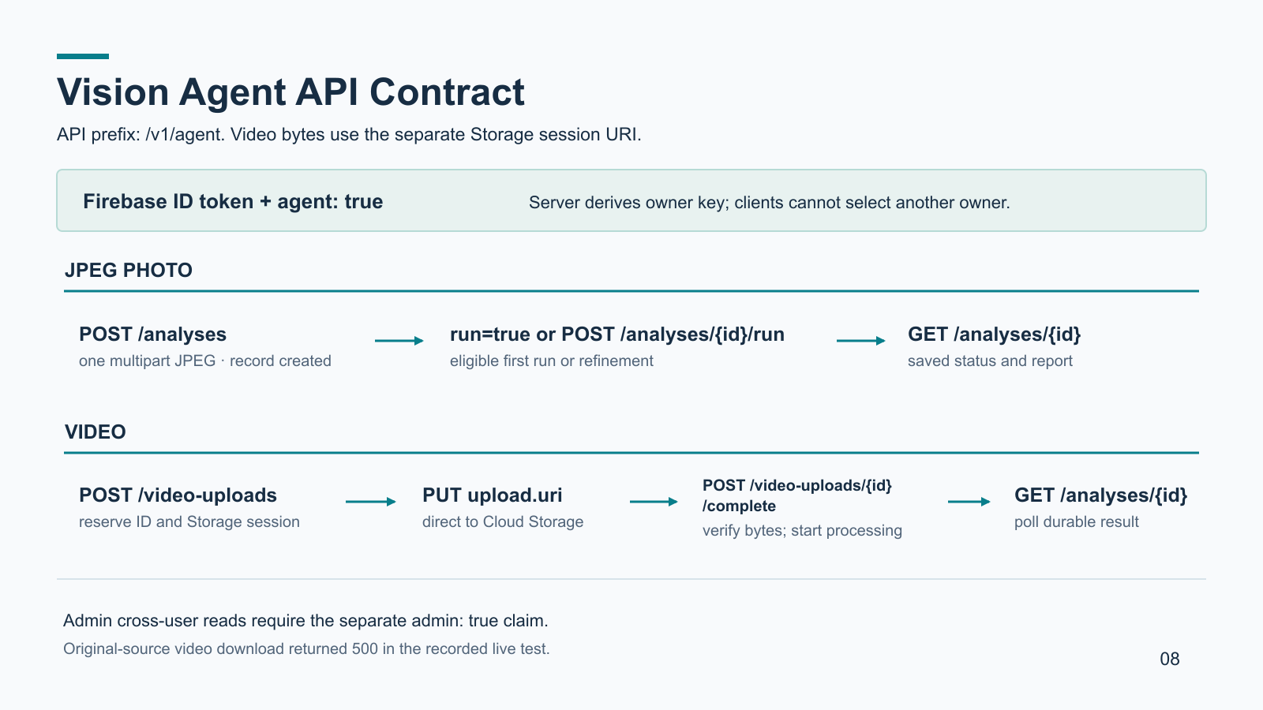
Notes:
# 08 - Vision Agent API Contract
This slide opens the Low-Level Design and Architecture section.
It describes the newer web Vision Agent's public contract, not every AI Shop API.
The earlier AI Shop iPhone endpoint and VISTA package-ingest route are distinct.
## Access and identity
The application supplies a Firebase ID token on Agent requests.
The server requires the literal `agent: true` custom claim.
It verifies the token and hashes the UID to derive an owner key.
The caller cannot supply another owner's key for Agent operations.
Admin cross-user reads require the independent `admin: true` claim.
Neither app client holds the OpenAI credential or Firebase Admin credentials.
## Photograph contract
`POST /v1/agent/analyses` receives multipart form data containing one JPEG field `file`.
It creates an uploaded analysis record, returning its analysis ID.
An optional `run=true` form field can initiate the first analysis after upload.
Alternatively, the client calls `POST /v1/agent/analyses/{id}/run`.
Refining an analyzed photograph requires a meaningful context note.
The initial run and refinement return a current record, not necessarily a final report.
## Video contract
`POST /v1/agent/video-uploads` reserves a record using filename, media type,
byte length, and the allowed browser Origin.
Its response includes a temporary Storage session URI.
The client uploads bytes directly to that URI without the Firebase bearer token.
The URI itself grants upload capability and must not be logged or shared.
A 308 Storage response means resumable progress, not a redirect.
After Storage confirms completion, `POST /{id}/complete` verifies the object
and begins server-side processing. A processing response is not an AI result.
## Reading and errors
`GET /v1/agent/analyses/{id}` returns the durable status and eventual report.
The same ID links source evidence, runs, diagnostics and saved findings.
GET calls observe work; they do not start model processing.
The Agent list is owner-scoped; the Admin list is cross-user and paginated.
The source route is intended to return original bytes, but the September 15
video test returned HTTP 500 with an empty body. Do not claim playback works.
API errors normally include code, message, retryable and requestId.
HTTP 200 on a mutable route still requires inspection of its outcome and state.
## Sources
- `docs/guides/vision-agent-api/02-endpoints.md`
- `docs/guides/vision-agent-api/03-authentication.md`
- `docs/guides/vision-agent-api/07-images-and-runs.md`
- `docs/guides/vision-agent-api/developer-guide.md` (draft, September 15 tests)
- `server/src/agent-api-handler.js`

Slide 21
081
Vision Agent Video Processing Pipeline
A completed upload becomes a server-owned background analysis.
The client reserves a record, sends video bytes to Storage, and confirms completion.
Cloud Tasks invokes a video worker with owner, analysis, and attempt identifiers.
FFmpeg extracts representative JPEG frames from the original source.
One background model request treats the frames as a single shelf scan.
A collector settles the report in Firestore; the client reads it through GET.
Frame timestamps remain evidence for review and cross-frame counting.
EDITABLE TEXT
Notes:
Editable text companion. The full presenter notes are attached to the following image slide.

Slide 22
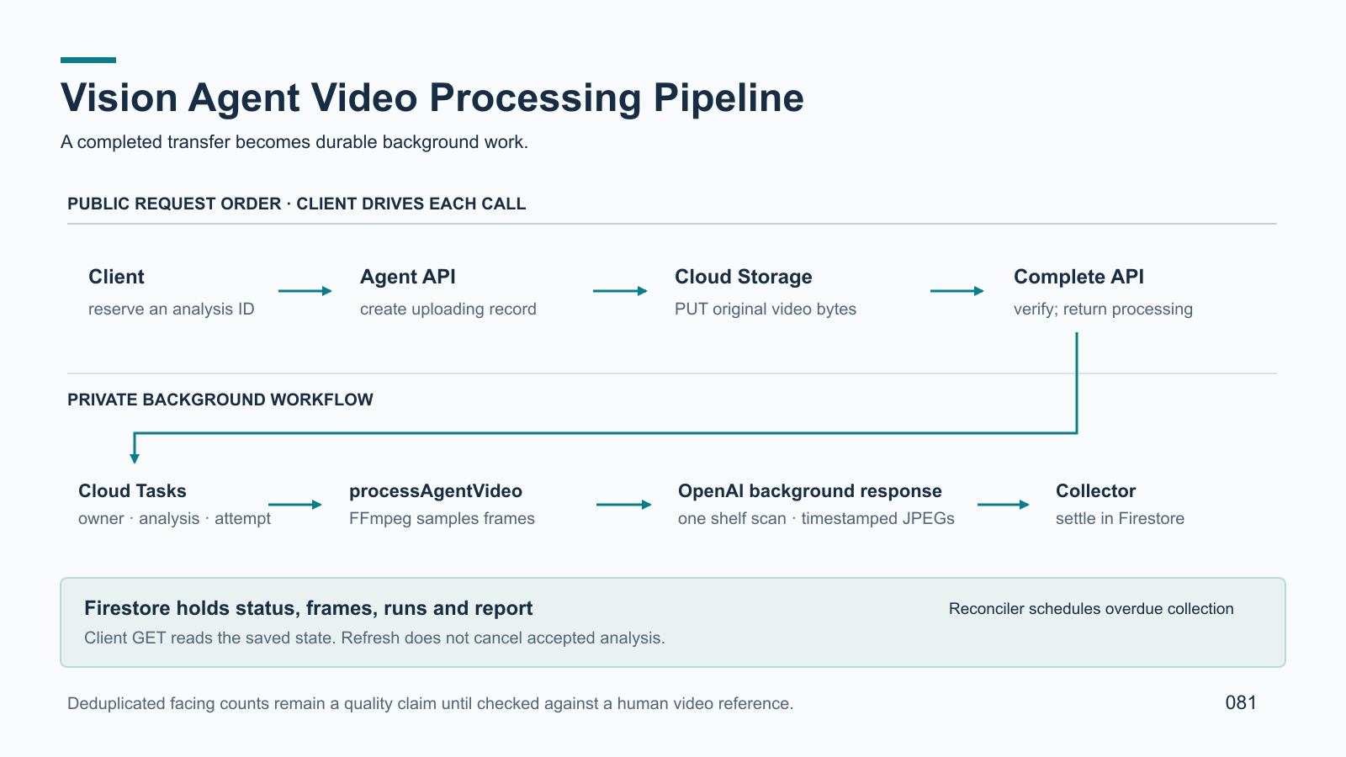
Notes:
# 081 - Vision Agent Video Processing Pipeline
This slide follows the public route map into the server's asynchronous implementation.
The focus is the newer Vision Agent video path, not the older iPhone request path.
## Upload and handoff
The client reserves a new analysis ID through `POST /v1/agent/video-uploads`.
The server creates an uploading Firestore record and a resumable Storage session.
The video bytes travel directly to private Cloud Storage via the session URI.
Storage may answer 308 with the acknowledged byte range during an incomplete transfer.
The client must not call complete until Storage has accepted the final bytes.
`POST /v1/agent/video-uploads/{id}/complete` checks object media type and size,
transitions the record to processing, and queues background work.
A 200 processing response confirms neither worker delivery nor model quality.
## Video worker
Cloud Tasks dispatches `processAgentVideo` with ownerKey, analysisId and attemptId.
The worker reads the original video from Storage and validates its content.
FFmpeg selects representative JPEG frames; frame paths include the attempt ID.
The current source snapshot sets a budget of at most 12 representative frames.
The server retains frame provenance including timestamps for later inspection.
It sends a single multi-image request rather than independent per-frame counts.
The prompt asks for one shelf inventory across the clip and cross-frame deduplication.
That is an intended counting rule; its accuracy still needs human validation.
## Model response and settlement
The server starts an OpenAI background response and saves its response identifier.
`collectAgentAnalysis` retrieves provider status through a private task.
The collector writes the finished report or failure to Firestore.
`reconcileAgentAnalyses` schedules overdue collection attempts.
It does not sweep every stalled upload or video-processing state.
Only server components write Firestore; OpenAI never connects to it.
The client polls GET detail to display uploading, processing, analyzing,
analyzed, failed or cancelled states and the saved report when available.
Refresh does not cancel accepted background analysis.
Refresh during an unfinished byte transfer remains a separate recovery problem.
## Trust and deployment boundaries
The public API is in Toronto (`northamerica-northeast2`).
Video worker, collector and scheduler are in Montréal (`northamerica-northeast1`).
Private function invocation is IAM-controlled, not a browser API.
Task delivery and deployed revision need operator evidence before acceptance claims.
## Sources
- `docs/guides/vision-agent-api/04-video-reservation.md`
- `docs/guides/vision-agent-api/05-storage-transfer.md`
- `docs/guides/vision-agent-api/06-completion-and-reads.md`
- `docs/guides/vision-agent-api/12-architecture-implementation.md`
- `server/src/firebase.js`, `server/src/agent-video-media.js`

Slide 23
082
Vision Agent Durable State and Recovery
Versioned records and attempt IDs protect long-running video work.
Normal video progress moves through uploading, processing, analyzing, and analyzed.
Failed and cancelled are recorded outcomes that remain visible on GET.
Session renewal applies only while the upload record is uploading.
Cancellation uses the latest record version; restart starts a new video attempt.
Restart requires complete source evidence and re-extracts frames.
Old workers and model runs must not settle a newer attempt.
EDITABLE TEXT
Notes:
Editable text companion. The full presenter notes are attached to the following image slide.

Slide 24
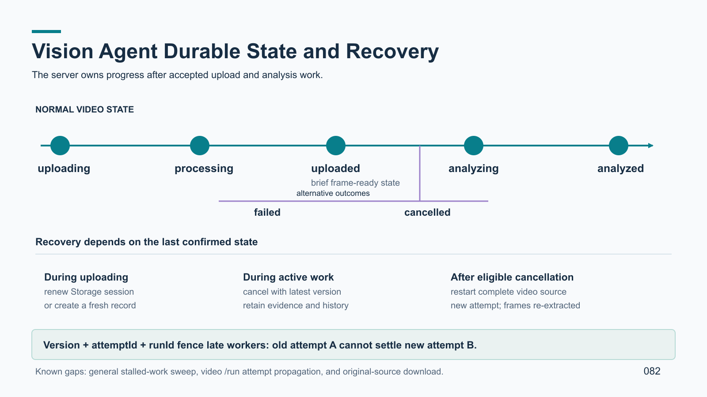
Notes:
# 082 - Vision Agent Durable State and Recovery
This slide explains how the Agent prevents stale asynchronous work from
overwriting a cancelled or restarted analysis.
It also separates recovery of unfinished byte transfer from processing recovery.
## Durable states
Video reservation creates an uploading analysis record.
After source verification, complete moves it to processing.
The worker may briefly mark uploaded after frame preparation.
Background model work marks analyzing, then analyzed with a report.
Failed and cancelled are recorded terminal outcomes.
GET detail exposes the current state and safe diagnostics.
The browser can restore that state after refresh without re-creating the record.
## Version and attempt fences
Each persisted transition increments a record version.
The client should GET the latest version before versioned cancel or restart.
A stale version can return an outcome of changed even with HTTP 200.
Each video attempt has an attempt ID carried to the worker and task payload.
Frame paths include that ID. Provider runs have their own run identifiers.
Store transitions check attempt and run identity before accepting late results.
Cancellation clears the active attempt; restart creates a new attempt.
Late work from the cancelled attempt must not settle the restarted record.
## Recovery operations
`POST /v1/agent/video-uploads/{id}/session` renews an uploading Storage session.
It does not promise to retain bytes from the previous session.
If the first transfer never finished, the client may need to select the file again.
`POST /v1/agent/analyses/{id}/cancel` retains evidence and history.
Cancellation requests best-effort task/provider cleanup after state settlement.
Running external work might still cost money.
For a cancelled video whose source is complete, `POST /{id}/restart`
re-enters processing with a new attempt and re-extracts frames.
It is not a generic image restart or repair for missing upload bytes.
A fresh start after an incomplete upload is client orchestration with a new ID.
## Current gaps
The reconciler only reschedules overdue provider collection.
It is not a stalled-upload or processing sweeper.
Video retry/refinement through the public `/run` route is an open attempt-ID gap.
The recorded live video source GET returned 500; do not promise playback.
The current browser recovery action needs its own hosted acceptance check.
## Sources
- `docs/guides/vision-agent-api/08-recovery.md`
- `docs/guides/vision-agent-api/11-limits-and-gaps.md`
- `docs/guides/vision-agent-api/12-architecture-implementation.md`
- `docs/guides/vision-agent-api/developer-guide.md` (draft)
- `server/src/agent-analysis-store.js`, `server/src/agent-api-handler.js`

