Slide 1
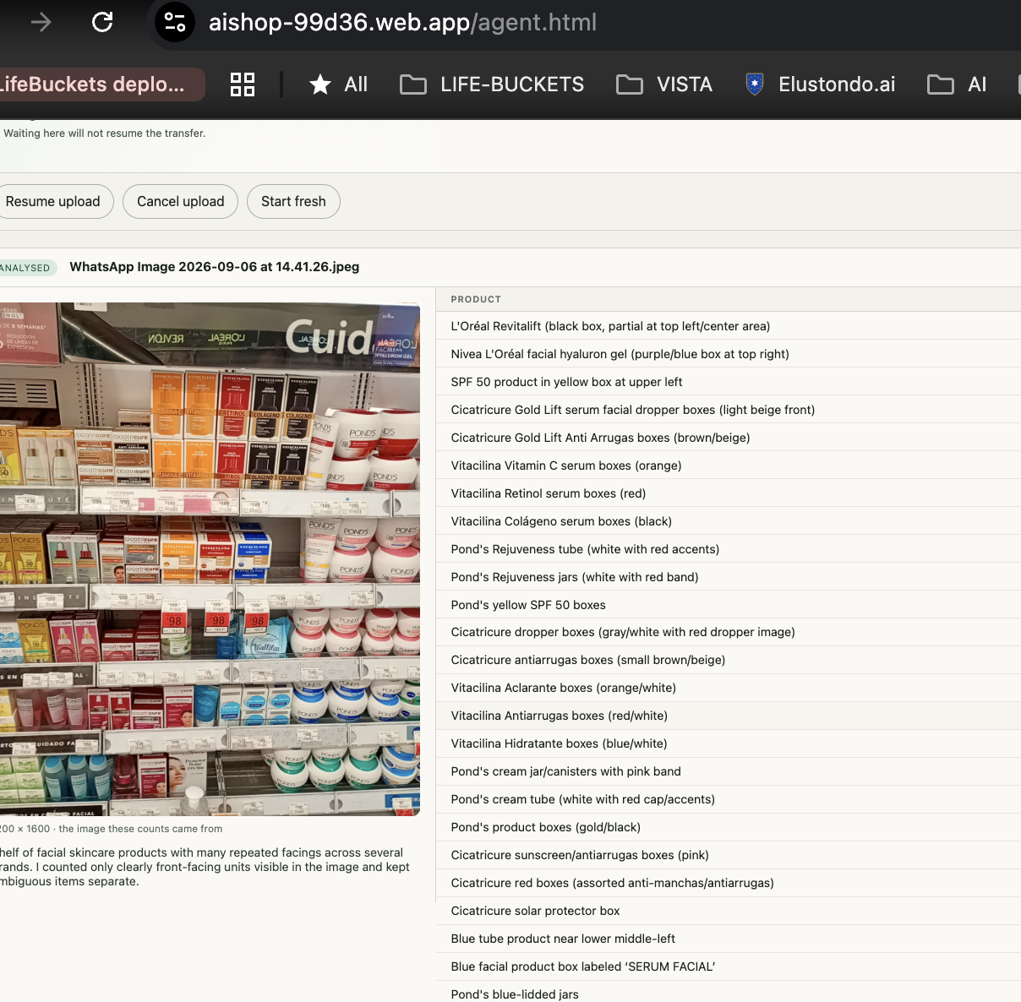
AI SHOP · LOW-LEVEL DESIGN
Vision Agent
Web UI
From hosted page to authenticated analysis workflow
Hosted Agent page · agent.html
Notes:
This presentation explains the static browser client published from 02-web-ui/. The browser selects evidence, transfers files, requests work, observes durable status, and renders results. Authorization, storage verification, background processing, and OpenAI calls remain server-side. Code entry point: 02-web-ui/agent.html. Client controller: 02-web-ui/scripts/agent.js.

Slide 2
Browser and server boundary
01
PUBLIC BROWSER
FIREBASE HOSTING
SERVER PLATFORM
Static web client
Hosting
Agent API
HTML · CSS · JavaScript
Firebase Auth session
02-web-ui/ assets
/v1/... rewrites
identity · roles · records
Durable services
Storage · Firestore · Tasks
Video bytes
temporary Storage session URI
OpenAI
external recognition model
Solid: authenticated application requests
Dashed: direct resumable video transfer
Notes:
firebase.json publishes 02-web-ui/ as the Hosting root. Static assets receive no-cache headers. The page loads Firebase App, Firebase Auth, and generated Firebase initialization. Relative /v1 routes reach the API through Hosting rewrites, but the API verifies every token and claim. Direct video upload is the exception: the browser uses a temporary Storage capability URI without attaching the Firebase bearer token.

Slide 3
Four hosted web applications
02
02-web-ui/
Firebase Hosting public root
Vision Agent
Admin All Runs
Inspection Review
Catalog Browser
agent.html
Upload and manage analyses
allruns.html
Read across owners
index.html
Review evidence packages
catalog.html
Browse static catalog
base.css
Firebase Auth
shared visual primitives
three authenticated applications
Each page has its own controller and API contract
Notes:
The Hosting root contains four related browser applications. agent.html is the Vision Agent. allruns.html is the administrator companion and requires admin: true. index.html reviews inspection and VISTA evidence packages. catalog.html reads static catalog JSON and product images. These pages share Hosting and base visual language, not one client controller or one API contract.

Slide 4
Vision Agent client structure
03
agent.html · visible browser page
Authentication
Upload composer
Transfer progress
Analysis cards
agent.js
DOM events and rendering
agent.css + base.css
events · rendering · transfer · polling
styles the visible page
ID token
API calls
Firebase Auth
Agent API
current user and ID token
authenticated analysis requests
Notes:
agent.html declares the authenticated and signed-out regions, upload form, progress, analysis cards, and empty state. agent.js sits between those visible regions and external services. It receives DOM events, updates the page, obtains the current Firebase ID token, and sends authenticated Agent API requests. Video functions also reserve sessions, transfer chunks, inspect progress, and recover. agent.css is page-specific while base.css provides shared styling primitives.

Slide 5
Authenticated Agent request
04
Person
agent.js
Firebase Auth
Hosting
Agent API
external to static page
external to static page
1 Trigger action
2 Request ID token
3 Return token
4 Send /v1 request + Bearer token
5 Rewrite request
6 Verify identity and role
7 Return data or safe error
Notes:
The HTML loads Firebase Auth before agent.js. start() observes onAuthStateChanged(). Before a protected request, authorized() gets the current user's ID token and sets the Authorization header. Hosting forwards the relative route to the API. The API verifies identity, custom claims, and ownership. request() parses the normal response envelope. Server failures retain a safe requestId for diagnosis.

Slide 6
Upload and observation lifecycle
05
Select and validate file
Photograph
Video
Recovery
POST JPEG
create record and start run
reserve record
transfer bytes · complete
resume · cancel · start fresh
Observe durable state
render → wait 15 s → GET again
Exit: analyzed · failed · cancelled · hidden page · observation ceiling
Notes:
upload() receives one file. JPEG handling posts multipart data and can start the first run. Video handling reserves an uploading record, transfers bounded chunks to Storage, and calls /complete. Interrupted transfers can retain a local session. The UI offers Resume upload, Cancel upload, or Start fresh. refresh() reads durable records. scheduleObservation() polls every 15 seconds and stops when work settles, the page hides, or ten minutes pass. Polling observes server work; it does not execute recognition.

