Slide 1
PABLO ELUSTONDO · PORTFOLIO PROTOTYPE
AI Shop
Find the right product. Decide with evidence.
Match needs · Compare prices · Review evidence
Notes:
[Sources]
- /Users/paboelustodo/-PROJECTS/aishop/README.md
- https://github.com/pabloelustondo/aishop

Slide 2

Shopping starts with the person—
not the product.
WHY AI SHOP
People know the outcome they want, but shelves make trade-offs hard. AI Shop identifies suitable products, surfaces visible options and price context, and explains what is still uncertain—while the shopper stays in control.
2
Notes:
[Sources]
- /Users/paboelustodo/-PROJECTS/aishop/docs/02-intent/intent.md
- /Users/paboelustodo/-PROJECTS/aishop/docs/06-solution-design-and-architecture/mockups/ai-shop-camera-mockup.png
- OpenAI ImageGen editorial beauty-aisle image, generated 2026-08-08 from user reference.

Slide 3
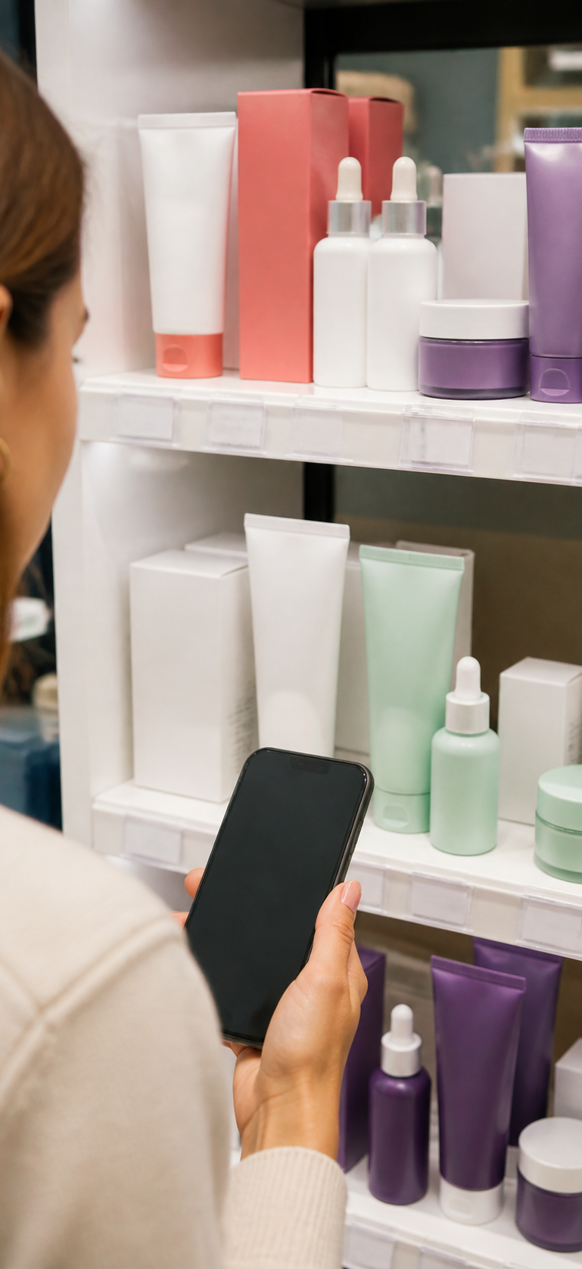
Find the best fit—
not just the first match.
NEEDS + PRICE CONTEXT
Target Product looks deeply at one option. Area Scan surveys alternatives across the shelf. Together they help shoppers compare visible features, price labels and availability against what they actually need.
3
Notes:
[Sources]
- /Users/paboelustodo/-PROJECTS/aishop/docs/03-system-model-and-use-cases/use-case-02-target-product-scan.md
- /Users/paboelustodo/-PROJECTS/aishop/docs/03-system-model-and-use-cases/use-case-03-area-scan.md
- /private/tmp/aishop-step3-mode-selection.png
- OpenAI ImageGen iPhone shelf-comparison image, generated 2026-08-08 from user reference.

Slide 4
A photo turns shelf choice into a guided decision.
01 · EXPRESS
02 · COMPARE
03 · DECIDE
Start with the need
Choose one product for depth or scan a shelf to discover options.
Capture useful context
Frame products, packaging, price labels and nearby alternatives.
Act with confidence
Review findings and uncertainty, compare options, then choose for yourself.
4
Notes:
[Sources]
- /Users/paboelustodo/-PROJECTS/aishop/docs/03-system-model-and-use-cases/use-case-02-target-product-scan.md
- /Users/paboelustodo/-PROJECTS/aishop/docs/03-system-model-and-use-cases/use-case-03-area-scan.md

Slide 5
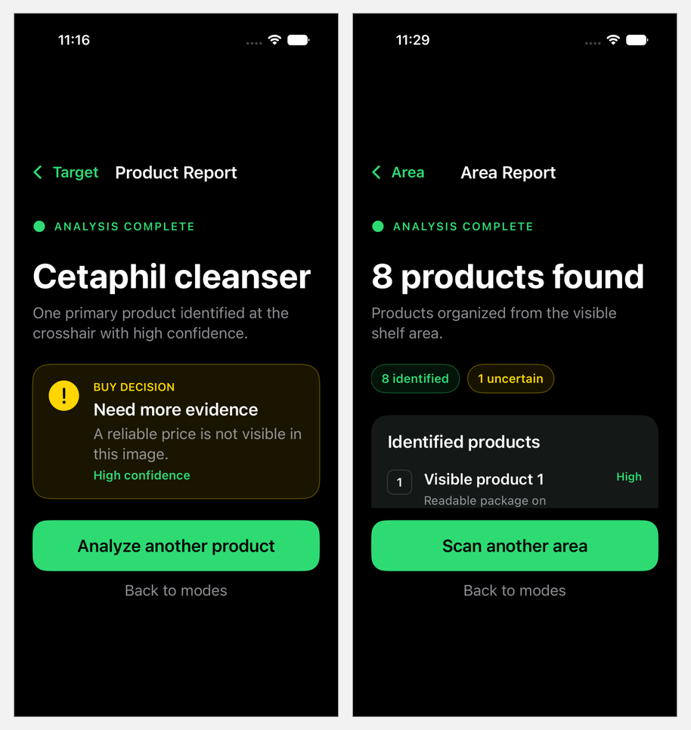
One product for depth.
A whole shelf for choice.
DEPTH + BREADTH
Target Product explains one option, including fit, confidence and missing price evidence. Area Scan organizes visible alternatives so the shopper can compare the shelf and decide what deserves a closer look.
5
Notes:
[Sources]
- /Users/paboelustodo/-PROJECTS/aishop/docs/03-system-model-and-use-cases/use-case-02-target-product-scan.md
- /Users/paboelustodo/-PROJECTS/aishop/docs/03-system-model-and-use-cases/use-case-03-area-scan.md
- /private/tmp/aishop-target-report.png
- /private/tmp/aishop-area-report-fixed.png

Slide 6
The iPhone, cloud and dashboard share one evidence trail.
01 · IPHONE APP
02 · FIREBASE + AI
03 · REVIEW WEB
Capture in context
The native camera sends the exact JPEG, scan mode and target metadata over HTTPS.
Analyze and preserve
The server stores private evidence, runs structured AI analysis and records immutable findings.
Verify and learn
The authenticated dashboard shows image and findings side by side and records human decisions.
6
Notes:
[Sources]
- /Users/paboelustodo/-PROJECTS/aishop/docs/06-solution-design-and-architecture/high-level-architecture.md
- /Users/paboelustodo/-PROJECTS/aishop/docs/06-solution-design-and-architecture/architecture-02-audit-storage-and-human-review.md
- /Users/paboelustodo/-PROJECTS/aishop/ios/AIShop/AIShop/Analysis/InspectionAPIClient.swift

Slide 7
AI findings remain evidence—not the final authority.
MACHINE INTERPRETATION
The original image and hash stay linked to the scan mode and structured findings. The first AI result remains unchanged.
HUMAN DECISION
An authorized reviewer compares evidence and findings, then records Verified, Corrected or Rejected as a separate, attributable decision.
7
Notes:
[Sources]
- /Users/paboelustodo/-PROJECTS/aishop/docs/02-intent/intent-03-auditable-retail-shelf-inspection.md
- /Users/paboelustodo/-PROJECTS/aishop/docs/06-solution-design-and-architecture/architecture-02-audit-storage-and-human-review.md

Slide 8
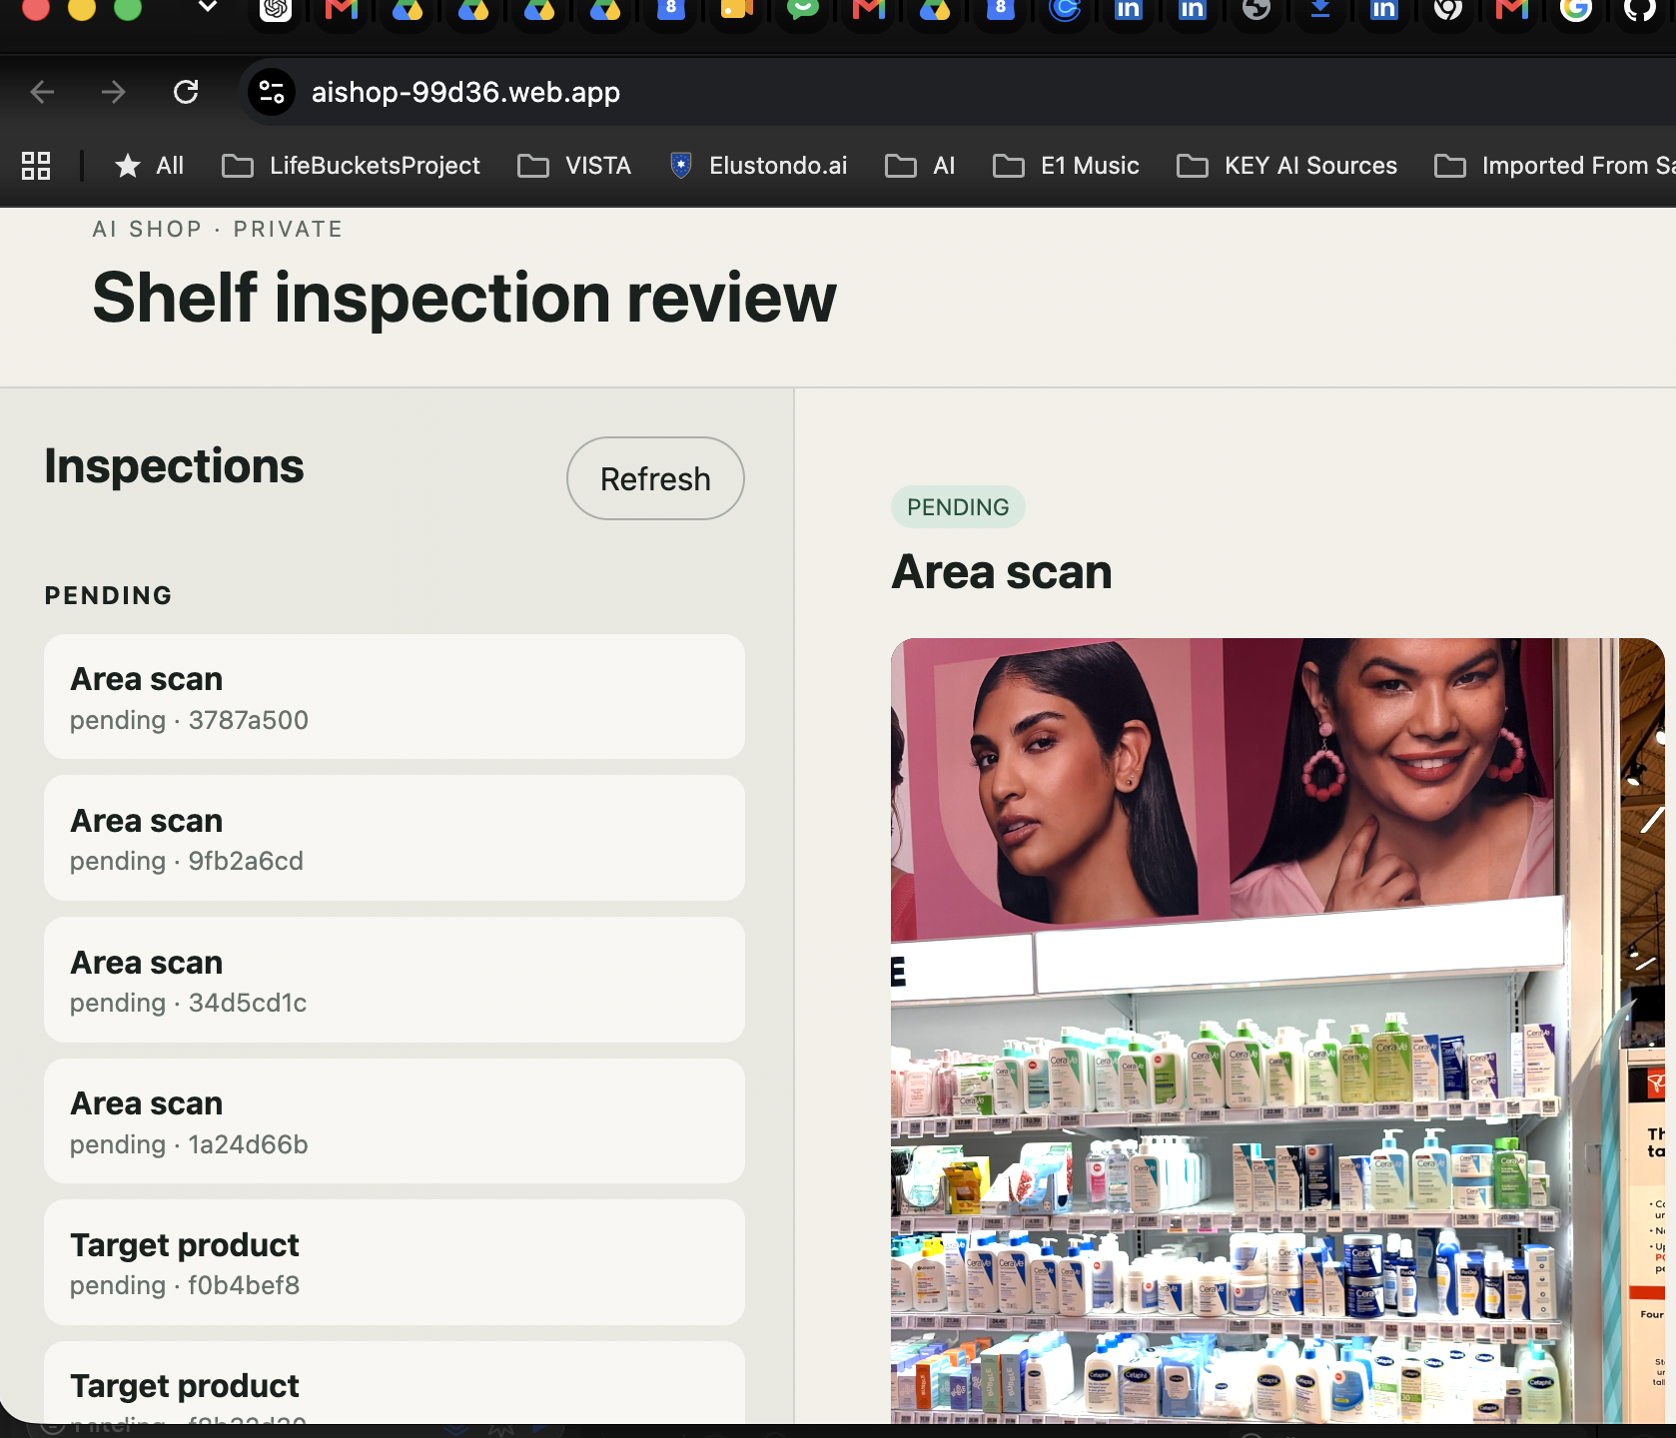
The dashboard keeps every
decision traceable.
AUDITABLE BY DESIGN
Reviewers open the original retail image beside the initial AI findings, add notes, and preserve an attributable decision history without changing the first result.
8
Notes:
[Sources]
- /Users/paboelustodo/-PROJECTS/aishop/dashboard/index.html
- /Users/paboelustodo/-PROJECTS/aishop/docs/03-system-model-and-use-cases/use-case-04-submit-and-review-shelf-inspection.md
- /private/tmp/aishop-dashboard-desktop.png
- User-provided live dashboard screenshot, supplied 2026-08-08.

Slide 9
Specifications guide every agent-assisted change.
INTENT FIRST
Use cases and architecture define behavior and boundaries.
COMPONENT-SCOPED TASKS
Each sprint task changes one named component and its tests.
HUMAN APPROVAL
Governed documents require review before coding, commit, deployment or release.
9
Notes:
[Sources]
- /Users/paboelustodo/-PROJECTS/aishop/AGENTS.md
- /Users/paboelustodo/-PROJECTS/aishop/docs/00-sdlc2-governance/sdlc2-workflow.md
- /Users/paboelustodo/-PROJECTS/aishop/docs/07-planning/sprints/sprint-003/03-sprint-plan-tasks.md

Slide 10
The prototype proves a path from shopping need to retail intelligence.
PROVEN TODAY
Native capture, Target and Area reports, private evidence, server-side AI and authenticated human review work end to end.
WHAT COMES NEXT
Product catalogs, live availability and price context, personalized needs, retailer workflows, analytics and production controls.
10
Notes:
[Sources]
- /Users/paboelustodo/-PROJECTS/aishop/README.md
- /Users/paboelustodo/-PROJECTS/aishop/docs/05-viable-proof-of-concept/proof-of-concept-01-camera-to-shopping-recommendation.md
- /Users/paboelustodo/-PROJECTS/aishop/docs/05-viable-proof-of-concept/proof-of-concept-02-auditable-shelf-review.md
Commercial-path items are a forward-looking product concept, not current shipped capabilities.

Slide 11
OPEN SOURCE
Explore the code
github.com/pabloelustondo/aishop
Native iOS · Firebase API · Review dashboard
Specifications, tests and SDLC2 governance included
Notes:
[Sources]
- https://github.com/pabloelustondo/aishop

