Slide 1







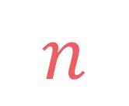
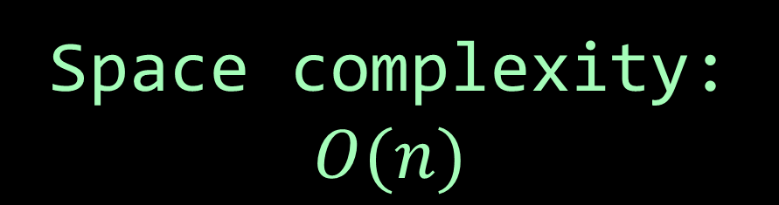
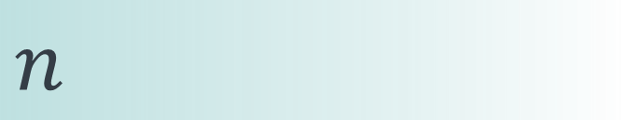

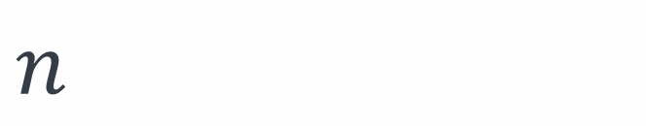
left
[4, 5, 1, 7, 2, 6, 3, 8]
no margin
Space complexity:
$$O(n)$$
list
list
list
list
mid
no margin
"string"
4 | 5 | 1 | 7 | 2 | 6 | 3 | 8
Space complexity:
$$O(n)$$
5
5
$
5
rec(n)
$$n$$
5
$$n$$
$$⇒$$
$$n$$
Time complexity:
$$O(n)$$
text
text
 |  |  | a
$$n$$
text
text
no margin
no margin
no margin
no margin
no margin
no margin
no margin
no margin

Slide 2
Partition problem

Slide 3

Given an array of strictly positive integers arr, we want to check if we can split it into two subsets that have the same sum of elements
$$arr\left[i\right]≥1$$

Slide 4
Given an array of strictly positive integers arr, we want to check if we can split it into two subsets that have the same sum of elements
4
5
3
2
5
1
input: arr = [4, 5, 3, 2, 5, 1]
output: true
explanation: we can split it into [4, 3, 2, 1] and [5, 5], because 4+3+2+1 = 5+5 = 10
4
5
3
2
5
1
4
5
3
2
5
1

Slide 5
Start with two empty sets, then for each element, try both possibilities, once by adding to the first set and once to the second set. After traversing all the elements, if both sets have the same sum, return true.

Slide 6
input: arr = [4, 5, 3, 2, 5, 1]
i
sum1
sum2
can(0, 0, 0)

Slide 7
input: arr = [4, 5, 3, 2, 5, 1]
i
sum1
sum2
can(0, 0, 0)
can(1, 4, 0)
can(1, 0, 4)

Slide 8
input: arr = [4, 5, 3, 2, 5, 1]
i
sum1
sum2
can(0, 0, 0)
can(1, 4, 0)
can(1, 0, 4)
can(2, 9, 0)
can(2, 4, 5)
can(2, 5, 4)
can(2, 0, 9)
.
.
.
.
.
.
.
.
.
.
.
.

Slide 9
input: arr = [4, 5, 3, 2, 5, 1]
i
sum1
sum2
can(0, 0, 0)
can(1, 4, 0)
can(1, 0, 4)
can(2, 9, 0)
can(2, 4, 5)
can(2, 5, 4)
can(2, 0, 9)
.
.
.
.
.
.
.
.
.
.
.
.

Slide 10





$$sum_{1}=sum_{2}$$
$$if i=\left|arr\right|$$
$$partition\left(i, sum_{1}, sum_{2}\right)=$$
$$partition\left(i+1, sum_{1}+arr\left[i\right], sum_{2}\right) \\ or partition(i+1, sum_{1}, sum_{2}+arr\left[i\right])$$
$$otherwise$$

Slide 11

def partition(arr, i=0, sum1=0, sum2=0): if i == len(arr): return sum1 == sum2 else: return partition(arr, i+1, sum1+arr[i], sum2)
or partition(arr, i+1, sum1, sum2+arr[i])
$$sum_{1}=sum_{2}$$
$$if i=\left|arr\right|$$
$$partition\left(i, sum_{1}, sum_{2}\right)=$$
$$partition\left(i+1, sum_{1}+arr\left[i\right], sum_{2}\right) \\ or partition(i+1, sum_{1}, sum_{2}+arr\left[i\right])$$
$$otherwise$$

Slide 12
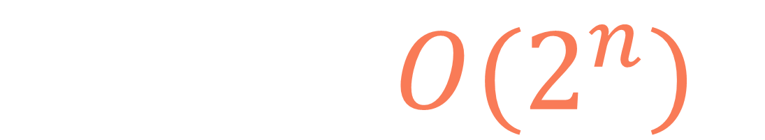
def partition(arr, i=0, sum1=0, sum2=0): if i == len(arr): return sum1 == sum2 else: return partition(arr, i+1, sum1+arr[i], sum2)
or partition(arr, i+1, sum1, sum2+arr[i])
$$T\left(n\right)=O(2^{n})$$

Slide 13
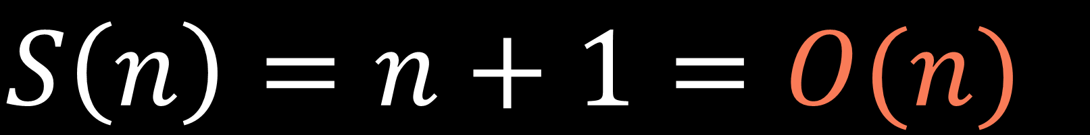
def partition(arr, i=0, sum1=0, sum2=0): if i == len(arr): return sum1 == sum2 else: return partition(arr, i+1, sum1+arr[i], sum2)
or partition(arr, i+1, sum1, sum2+arr[i])
$$S\left(n\right)=n+1=O(n)$$

Slide 14

$$s=sum(arr)$$

Slide 15

$$s=sum(arr)$$
if $s$ is odd, we can't partition

Slide 16

$$s=sum(arr)$$
if $s$ is odd, we can't partition
if $s$ is even, the two subsets must sum up to $\frac{s}{2}$ each because $\frac{s}{2}+\frac{s}{2}=s$

Slide 17

$$s=sum(arr)$$
if $s$ is odd, we can't partition
if $s$ is even, the two subsets must sum up to $\frac{s}{2}$ each because $\frac{s}{2}+\frac{s}{2}=s$
finding one subset that sums up to $\frac{s}{2}$ is enough, because remaining elements will form a second subset that sums up to $\frac{s}{2}$, which is what we want

Slide 18

Given an array of strictly positive integers $arr$ whose the total sum is $s$, can we find a subset that sums up to $\frac{s}{2}$?

Slide 19

Subset
sum

Slide 20
def partition(arr): s = sum(arr) if s%2 == 1: return False else: return subsets(arr, s//2) > 0

Slide 21







Non-optimized recursive solution:
$$n:\left|arr\right| \\ s:sum(arr)$$
$$T\left(n\right)=O\left(2^{n}\right)$$
$$S\left(n\right)=O\left(n\right)$$
Memoization solution:
$$T\left(n\right)=O\left(ns\right)$$
$$S\left(n\right)=O\left(ns\right)$$
Space-optimized tabulation solution:
$$T\left(n\right)=O\left(ns\right)$$
$$S\left(n\right)=O\left(s\right)$$

Slide 22
Partition problem

