Slide 1
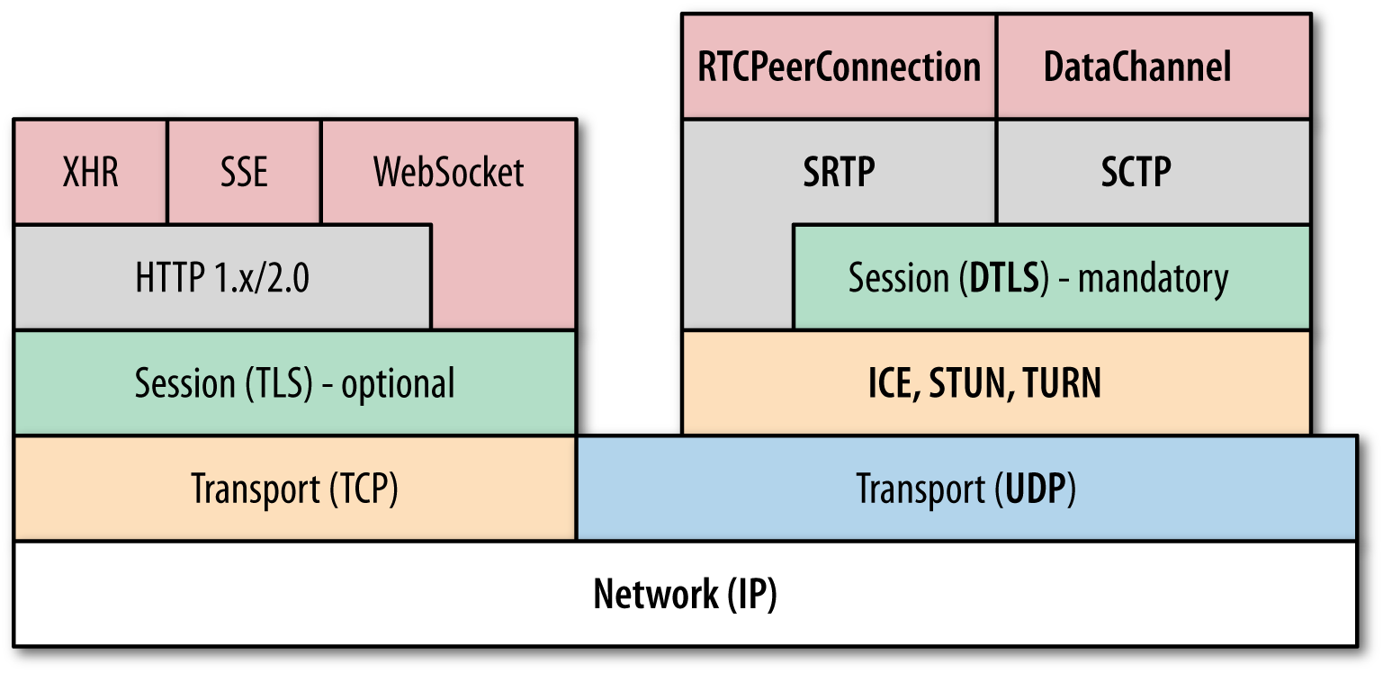
MPEG-DASH Player
Fragment
Loader
Discovery
PEER
Index
Cache
HCache
Channel
….
Channel
P2P Transport
P2P Transport
Browser
WebRTC

