Slide 1
Market Analysis Dashboard
Nifty50 Predictive Modeling & Sentiment Analysis

Slide 2
Agenda
Phase 1: Data Collection and Preprocessing
Phase 2: Exploratory Data Analysis
Phase 3: Logistic Regression Model
Phase 4: Machine Learning Models Comparison
Phase 5: Text Mining & Sentiment Analysis
Conclusions and Recommendations

Slide 3
Phase 1
Data Collection and Preprocessing

Slide 4
Dataset Overview
6 Major Global Market Indices:
• Nifty 50 (India)
• Dow Jones (USA)
• Nasdaq (USA)
• Hang Seng (Hong Kong)
• Nikkei 225 (Japan)
• DAX (Germany)
VIX Volatility Index included
Time period: January 2019 to April 2025
Missing values handled with linear interpolation

Slide 5
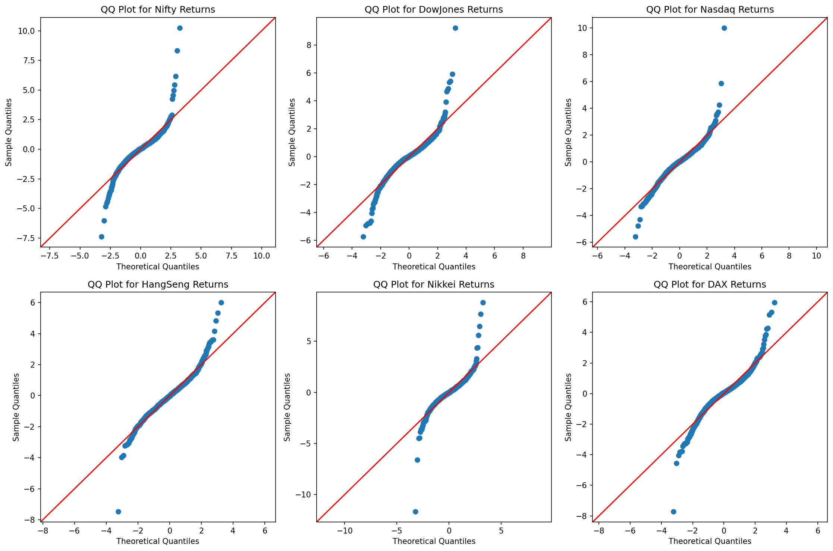
Normality Check - QQ Plots
QQ plots show daily returns approximately follow normal distribution

Slide 6
Phase 2
Exploratory Data Analysis

Slide 7
Phase 2 Objectives
Analyze 5-year performance of global indices
Examine correlations between markets
Study impact of COVID-19 pandemic
Investigate Nifty 50 daily movements
Identify relationships with global markets

Slide 8
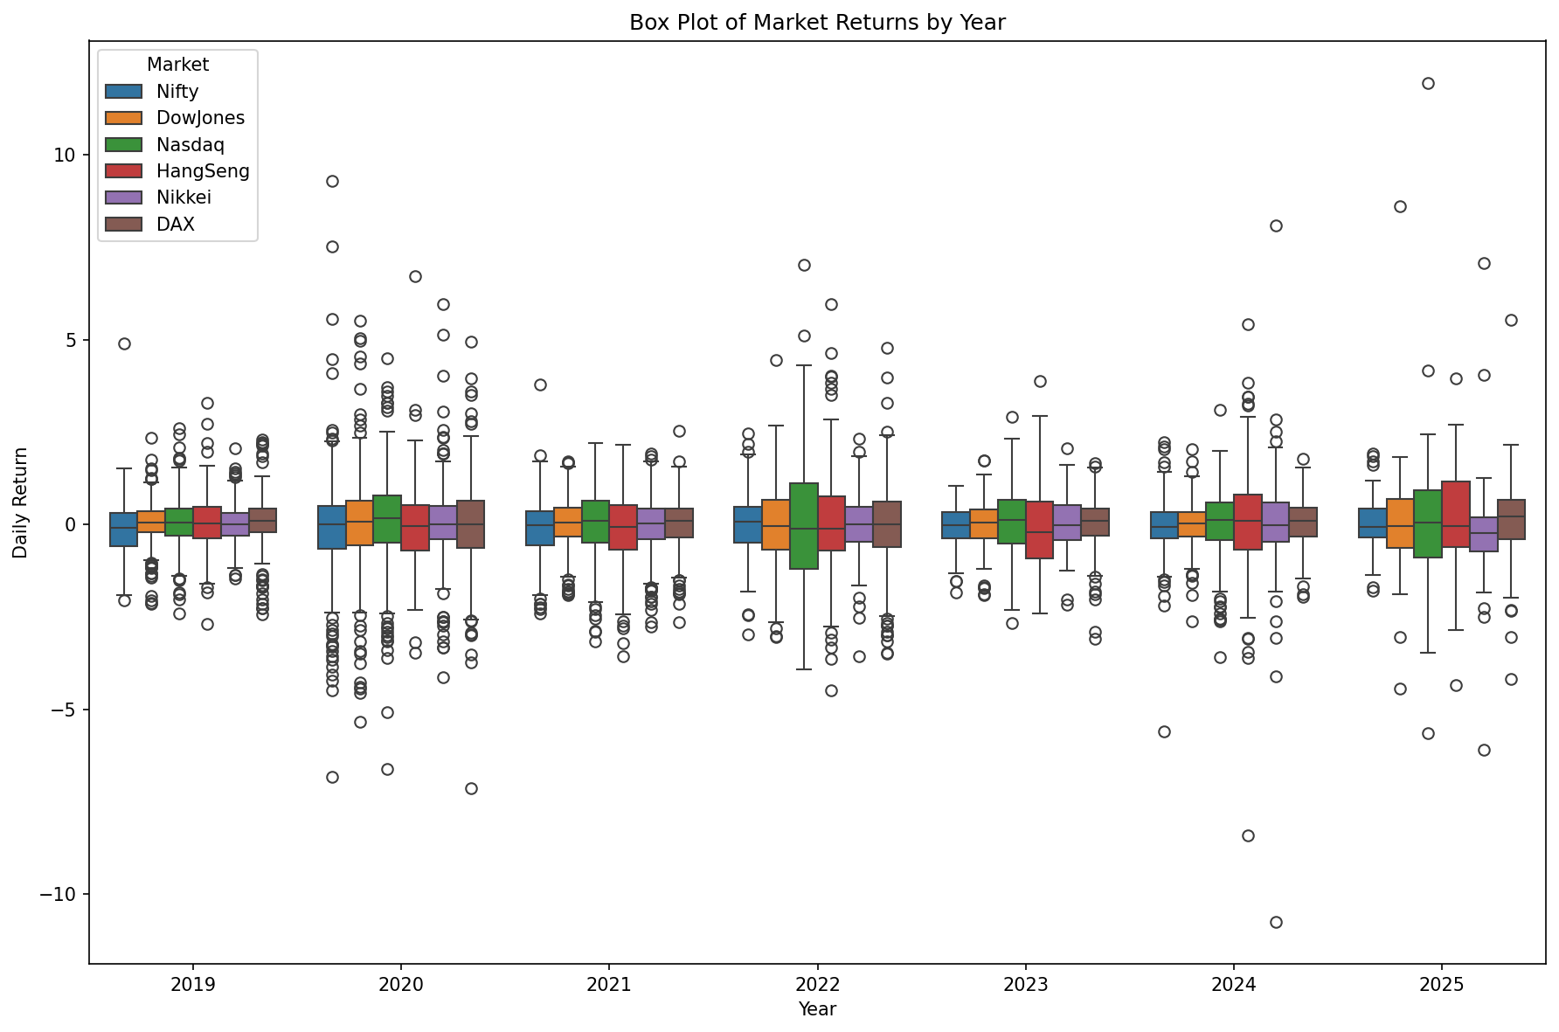
Daily Returns Distribution by Year
Box-whisker plots showing volatility patterns across years

Slide 9
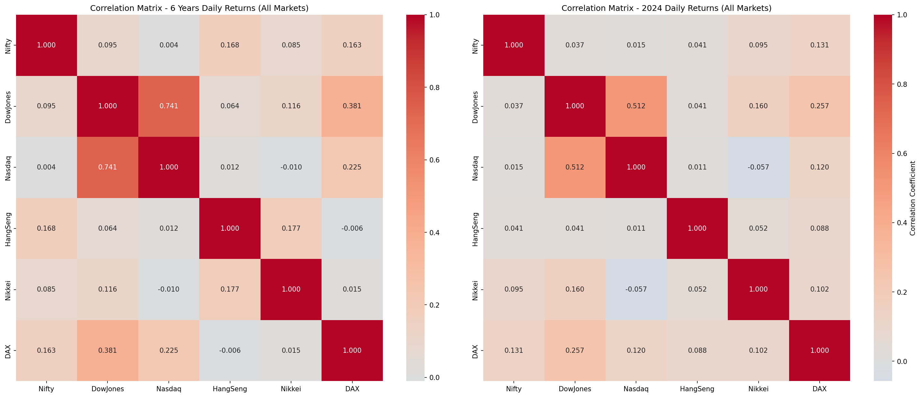
Market Correlation Analysis
Correlation matrix reveals strong relationships between markets

Slide 10
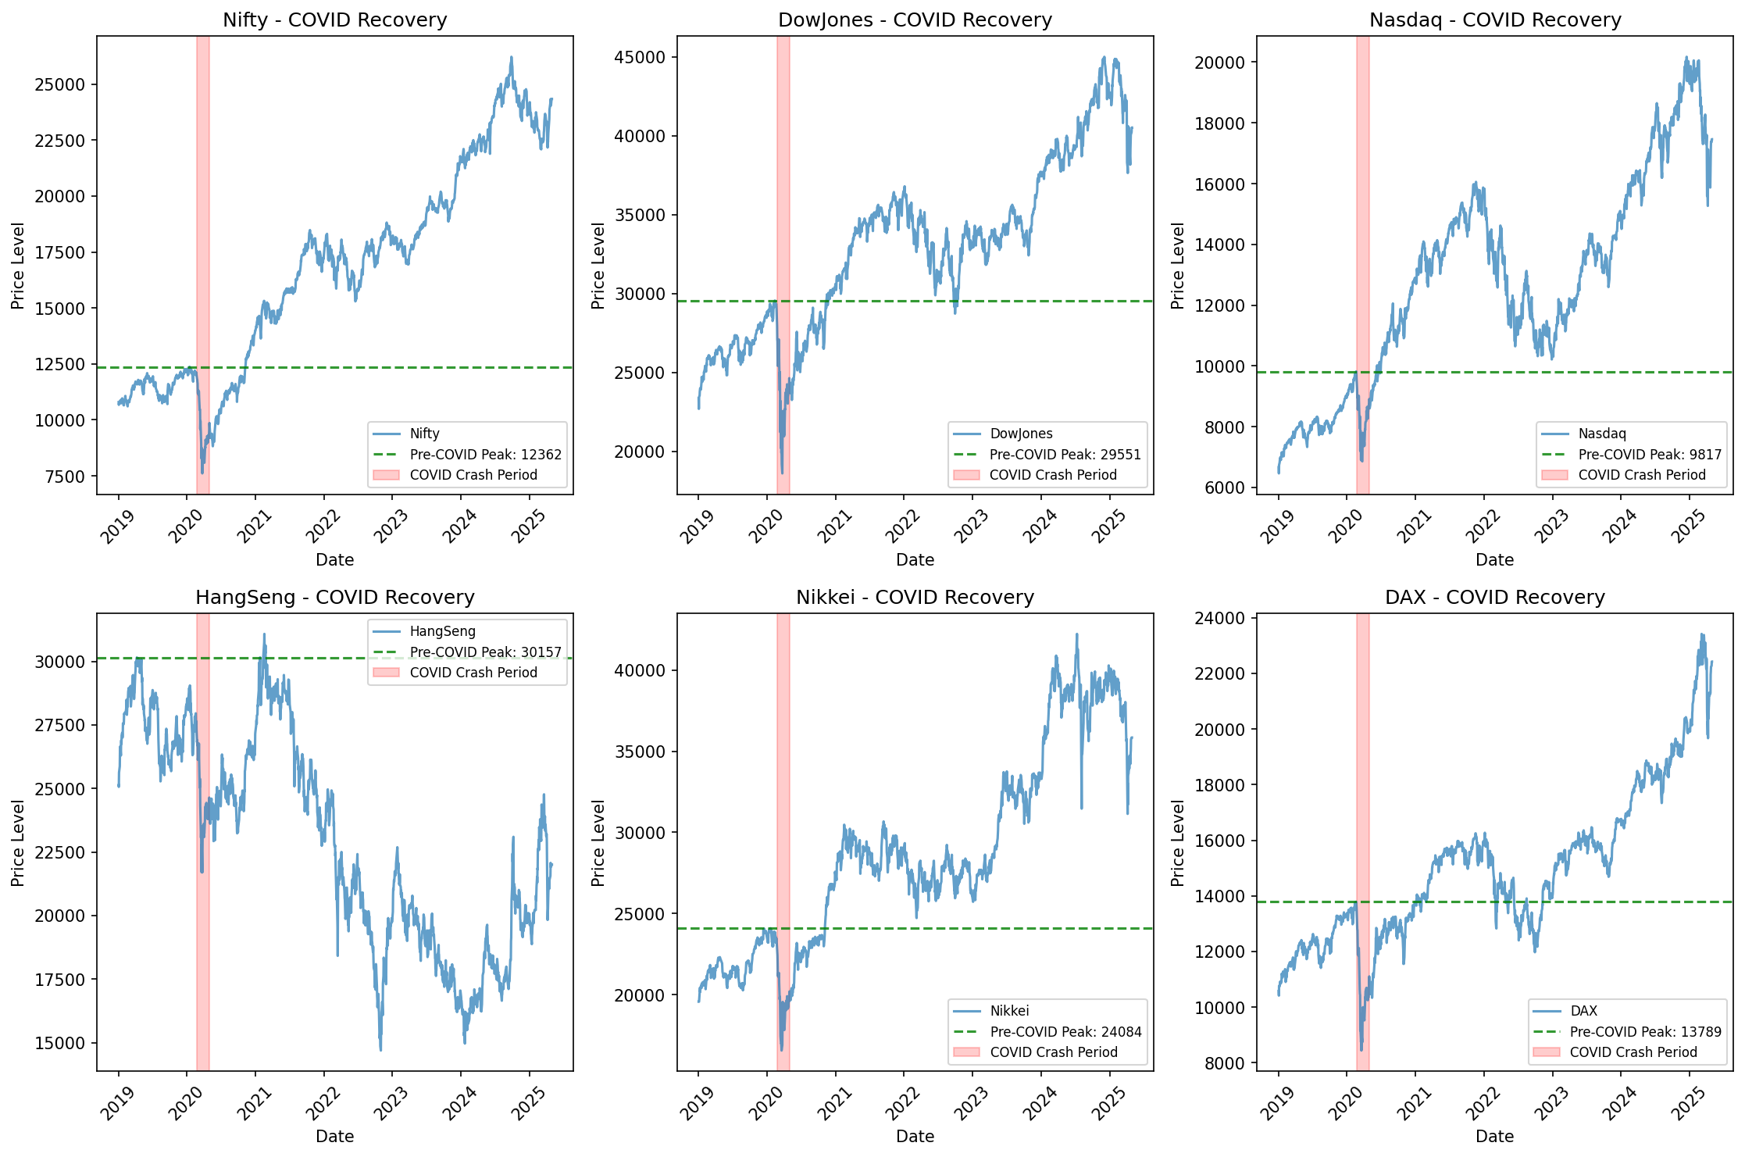
COVID-19 Impact Analysis
Market behavior during pandemic phases

Slide 11
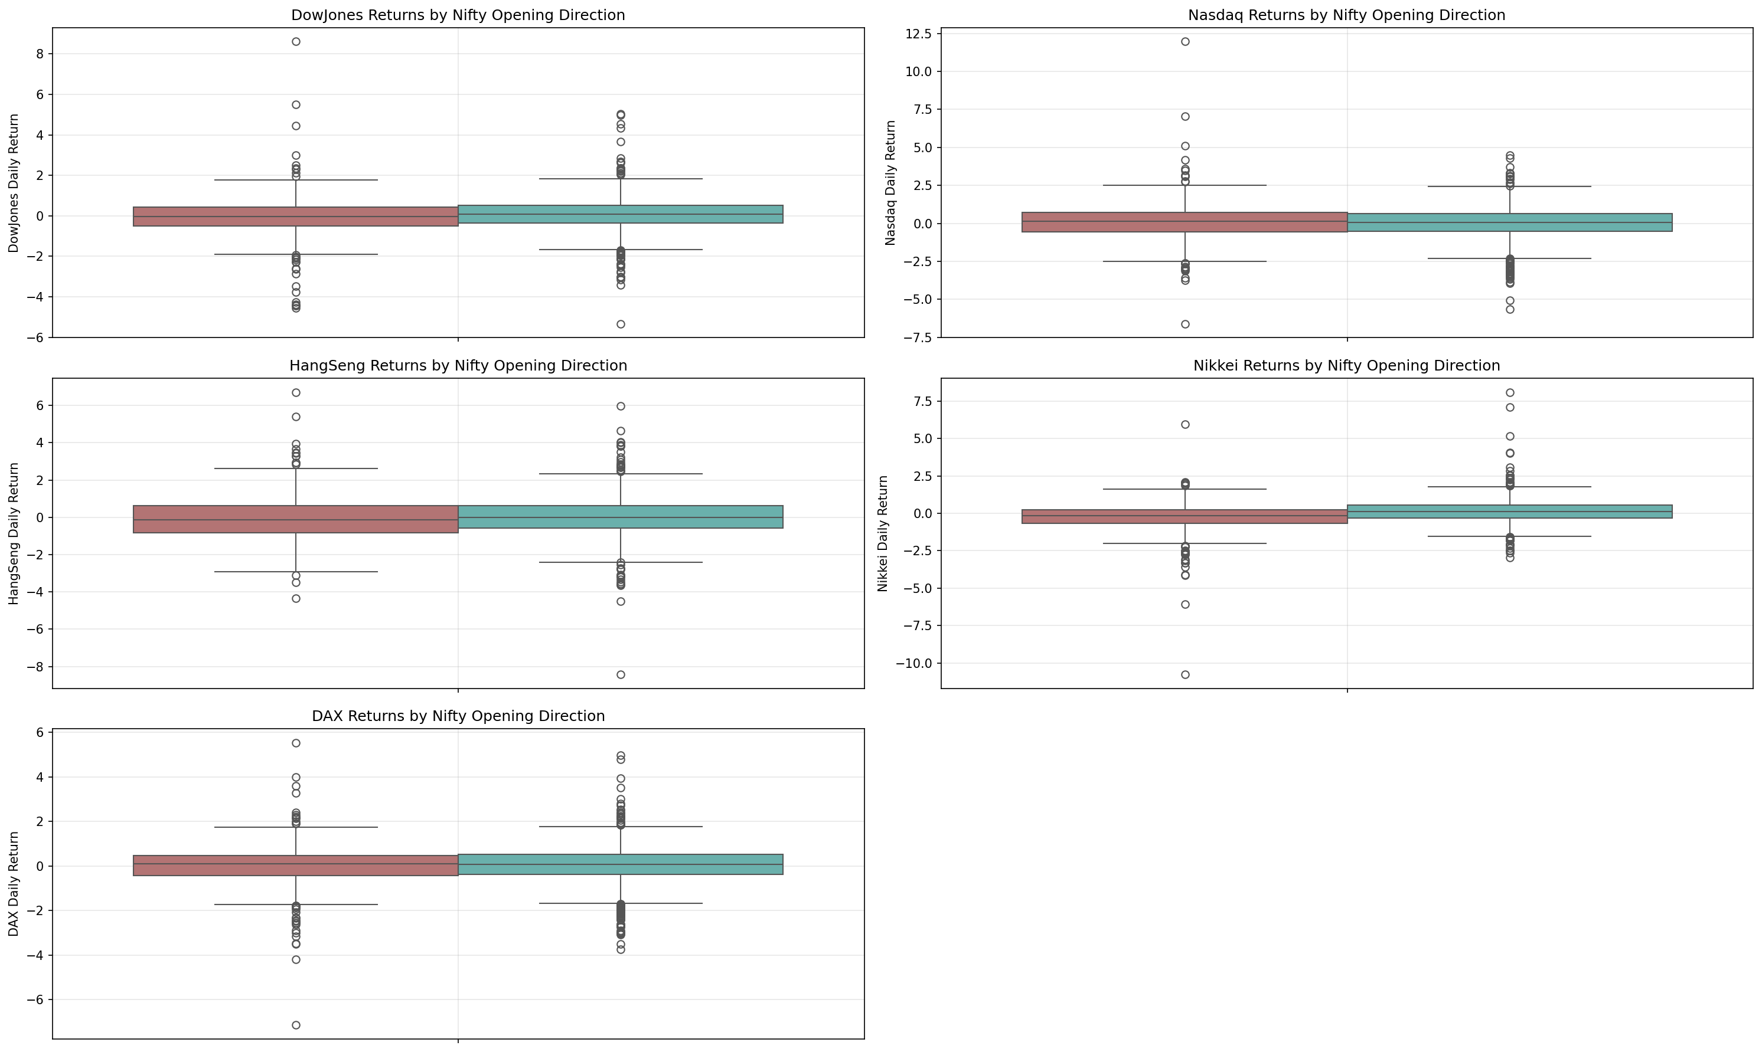
Global Indices vs Nifty Direction
Relationship between global markets and Nifty 50 movements

Slide 12
Phase 3
Binary Logistic Regression Model

Slide 13
Logistic Regression Approach
Objective: Predict Nifty 50 direction (Up/Down)
Initial Model: All 6 market return variables
VIF Analysis: Check for multicollinearity
Refined Model: 4 significant variables
• HangSeng_Return
• Nikkei_Return
• DAX_Return
• VIX_Return
Optimal threshold: 0.4753

Slide 14
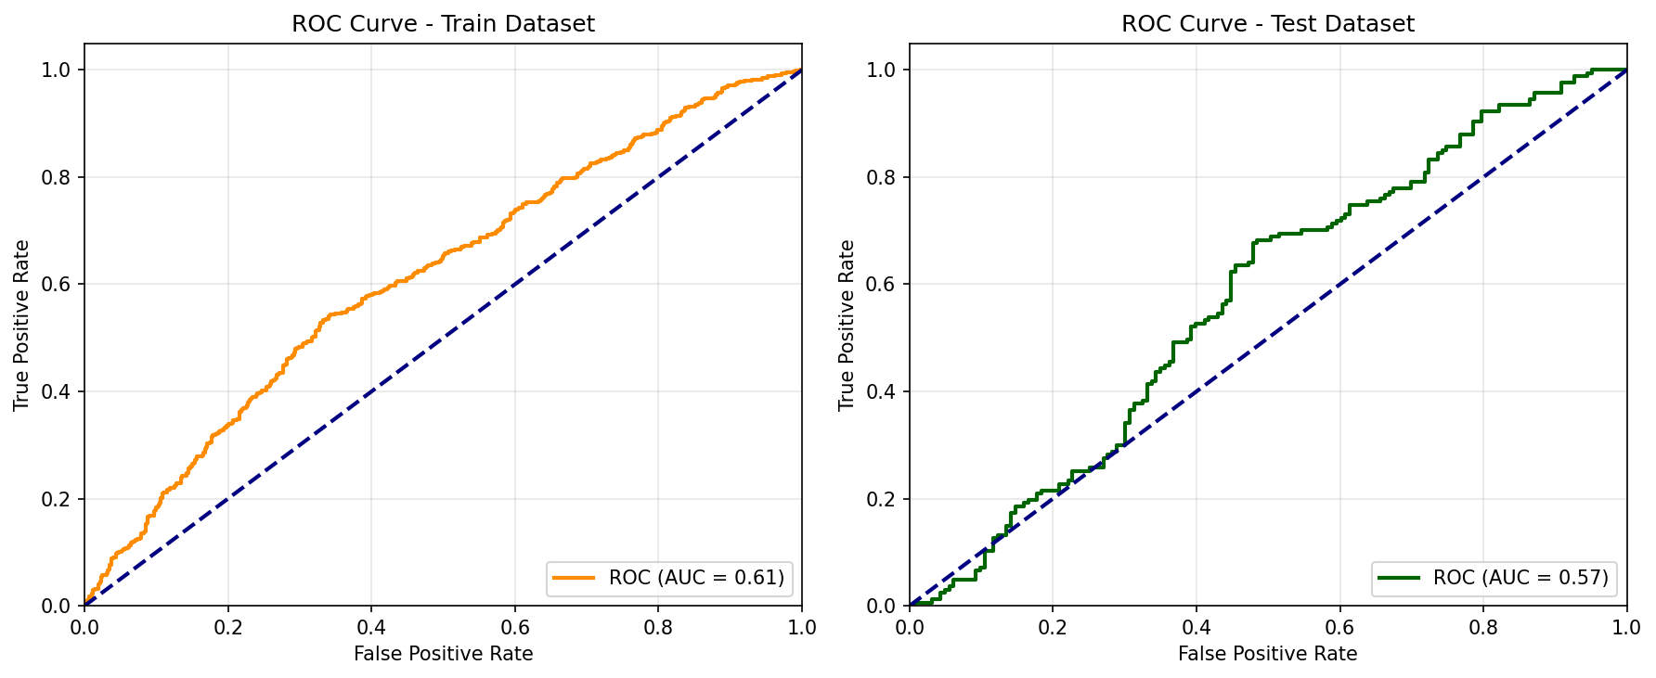
Logistic Regression - ROC Curves
Model performance on training and test datasets

Slide 15
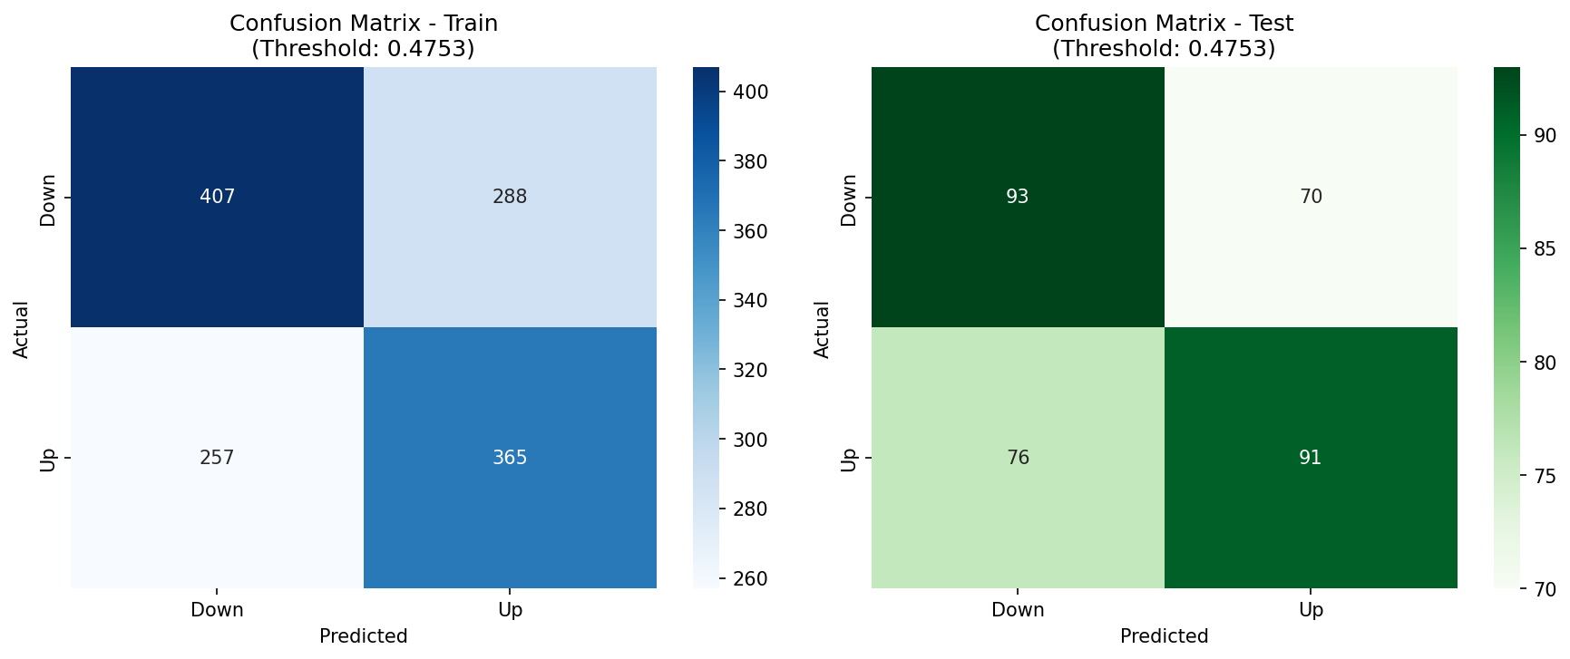
Logistic Regression - Confusion Matrices
Classification performance with optimal threshold

Slide 16
Phase 4
Machine Learning Models Comparison

Slide 17
Models Evaluated
1. Gaussian Naive Bayes
• Probabilistic classifier
• Fast training and prediction
2. Decision Tree Classifier
• Rule-based decisions
• Easy to interpret
3. Random Forest Classifier
• Ensemble of decision trees
• Robust and less prone to overfitting

Slide 18
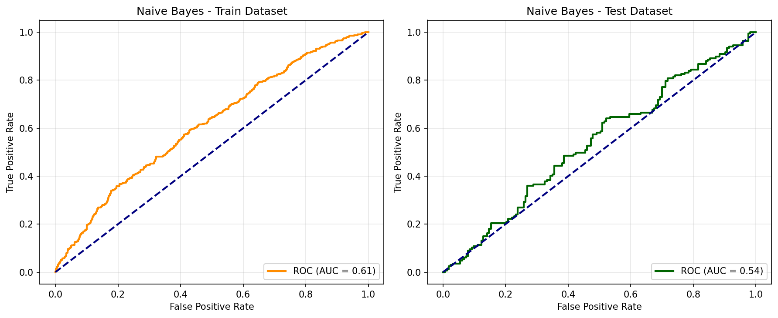
Naive Bayes - ROC Curves

Slide 19
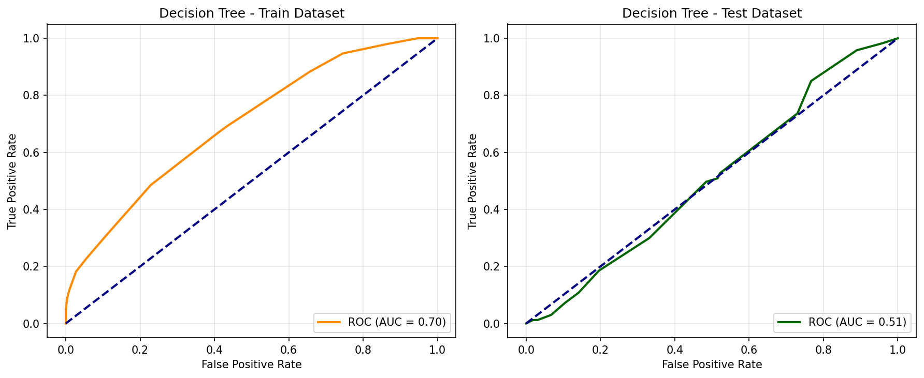
Decision Tree - ROC Curves

Slide 20
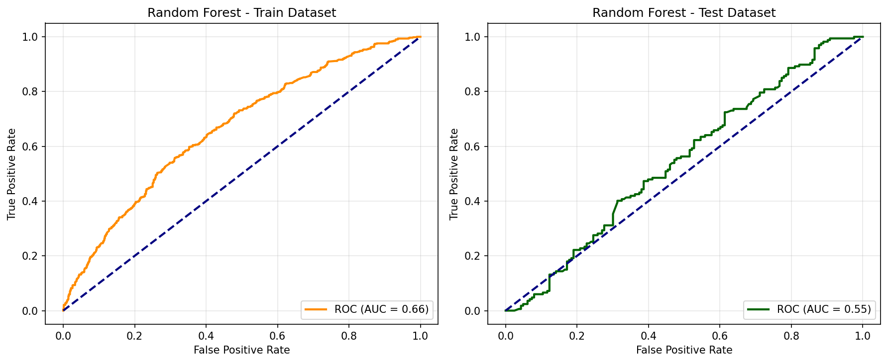
Random Forest - ROC Curves

Slide 21
Model Comparison
Model Performance Comparison (AUC Scores):
Gaussian Naive Bayes: Train=0.612, Test=0.540
Decision Tree Classifier: Train=0.698, Test=0.507
Random Forest Classifier: Train=0.664, Test=0.546

Slide 22
Phase 5
Text Mining & Sentiment Analysis

Slide 23
Text Analysis Approach
Data Source: Twitter/X posts about Nifty50
Text Preprocessing Pipeline:
• Lowercase conversion
• Remove mentions, hashtags, URLs
• Remove punctuation and digits
• Remove stopwords
• Remove domain-specific words
Analysis Methods:
• Word Cloud for topic identification
• VADER sentiment analysis

Slide 24
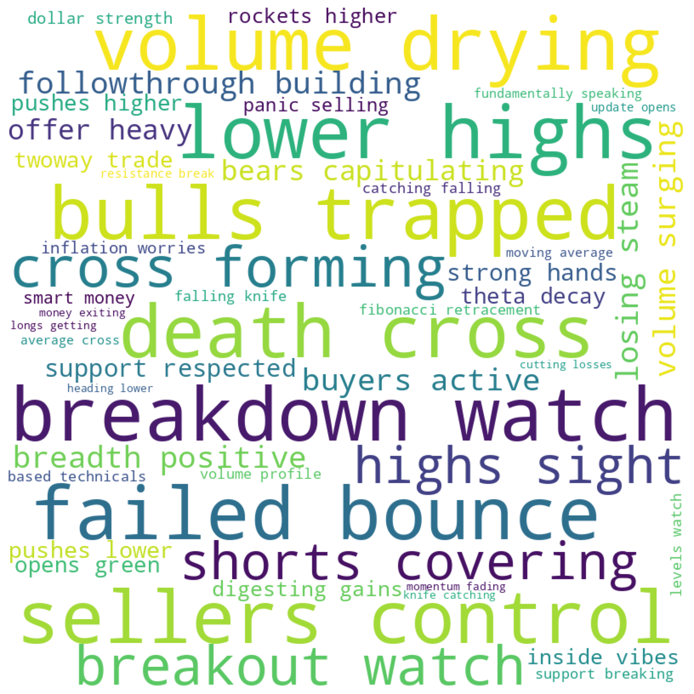
Word Cloud - Key Topics
Most frequent words in Nifty50 discussions

Slide 25
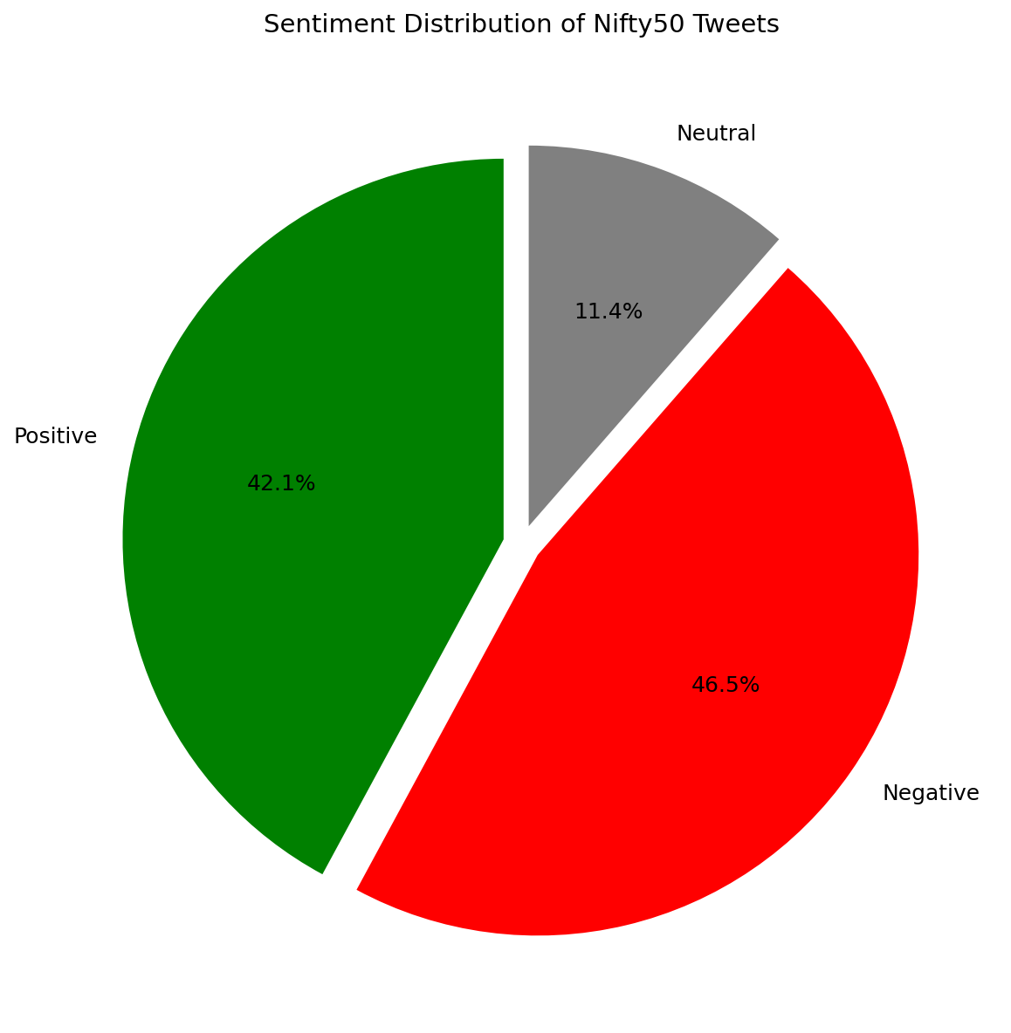
Sentiment Breakdown
Proportion of positive, negative, and neutral sentiments

Slide 26
Conclusions
Key Findings and Recommendations

Slide 27
Key Findings
Global markets show strong correlations
Significant predictors: HangSeng, Nikkei, DAX, VIX
Machine learning models show comparable performance
Random Forest slightly outperforms other models
Sentiment analysis reveals market mood
COVID-19 had significant impact on volatility

Slide 28
Recommendations
Use ensemble of multiple models for predictions
Monitor VIX for volatility signals
Consider sentiment analysis as additional feature
Regular model retraining with new data
Combine technical and sentiment indicators
Account for global market interdependencies

Slide 29
Thank You
Questions & Discussion

