Slide 1
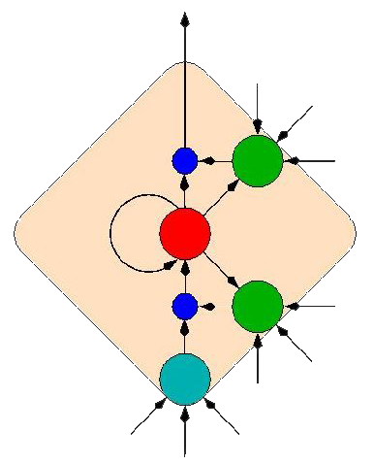
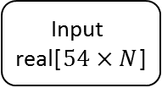

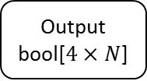
LSTM Layer
Output Layer
Input
real[$54×N$]
w
Output
bool[$4×N$]
sigmoid
b
4 neurons
$m$ cells
Image of LSTM cell: http://people.idsia.ch/~juergen/lstm/sld015.htm

