Slide 1
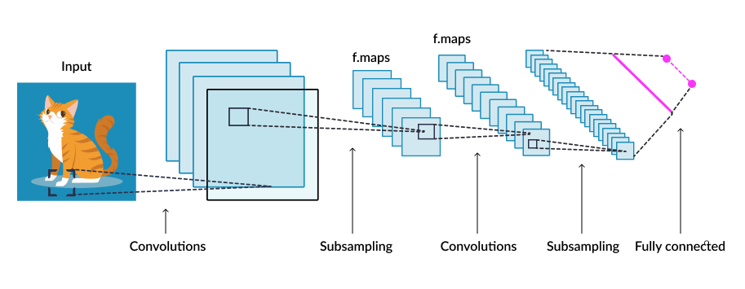
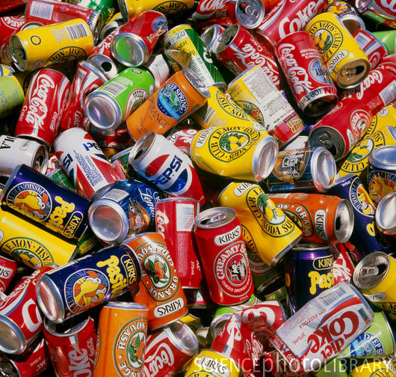

Slide 2


Slide 4
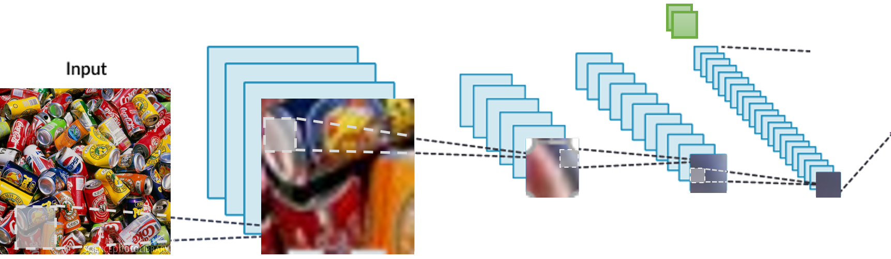

Slide 6
Feature extraction layer
Robot Coordinates
Image Features

Slide 7
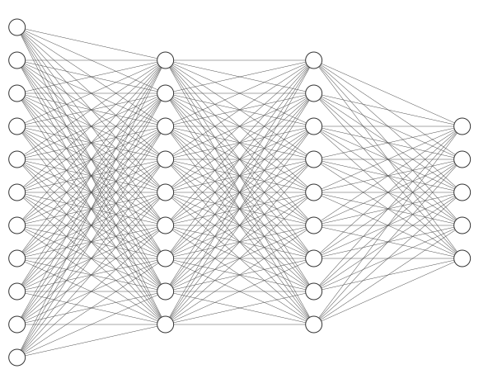
Decision Making layer
Robot Coordinates
North weight
South weight
East weight
Image Features
West weight
Pick weight

Slide 8
Select action
FEATURE EXTRACTION LAYER*
POLICY NET**
(DECISION MAKING LAYER)
ACTION
* The output of this layer gives information about the image and the robot coordinates
** This net is already pre-trained

