Slide 1
PyCSEP
Implementation test
The 10 years Italy experiment
Pablo Itu
15/10/20

Slide 2
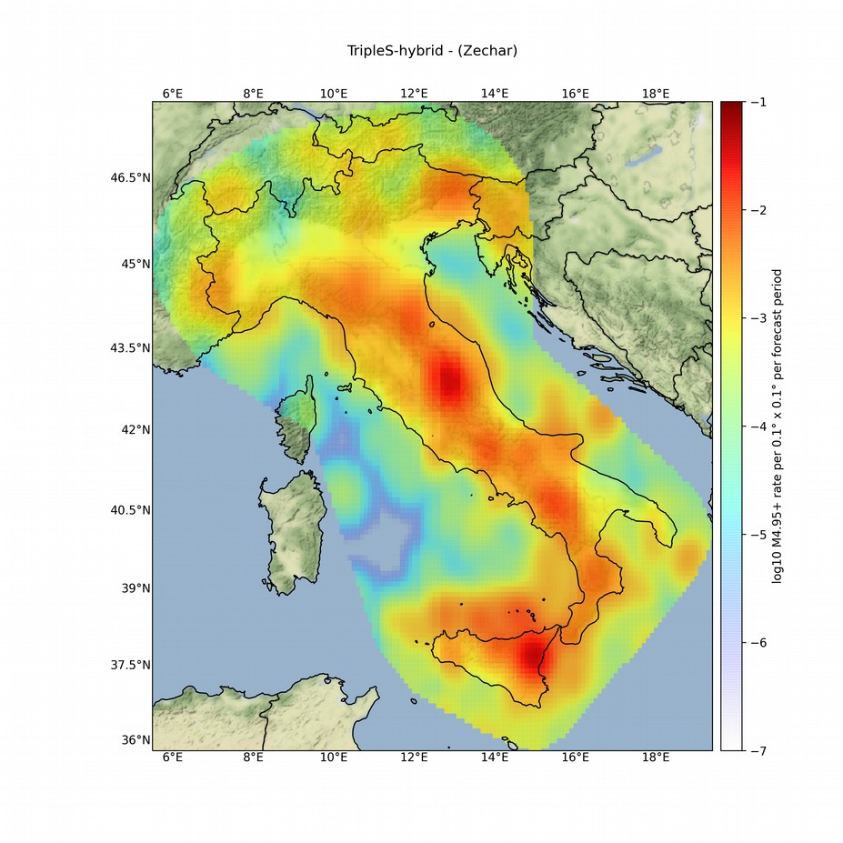
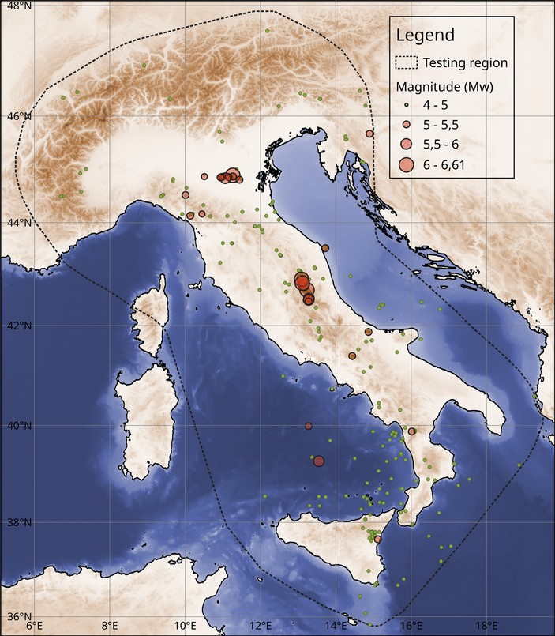
Catalog and Forecasts

Slide 3
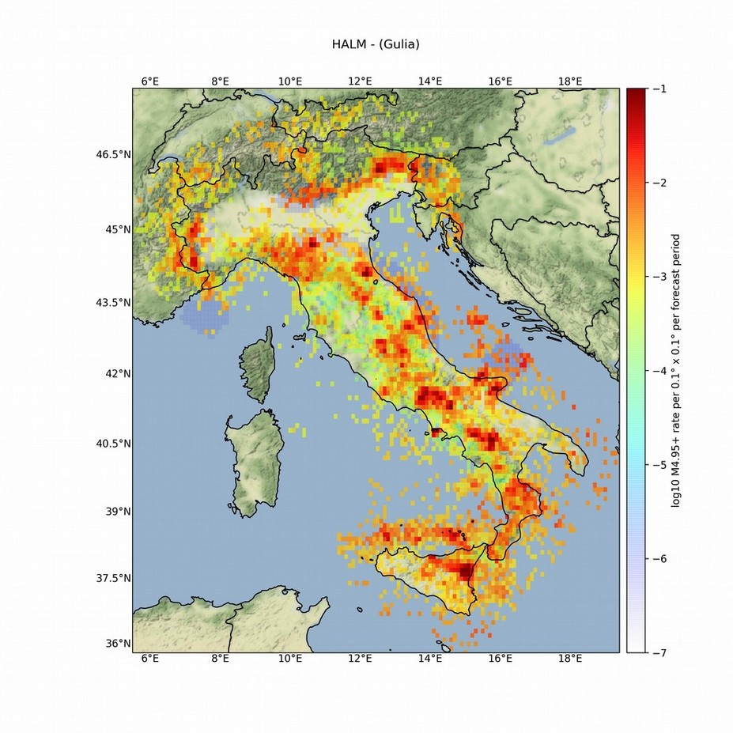

Catalog and Forecasts

Slide 4
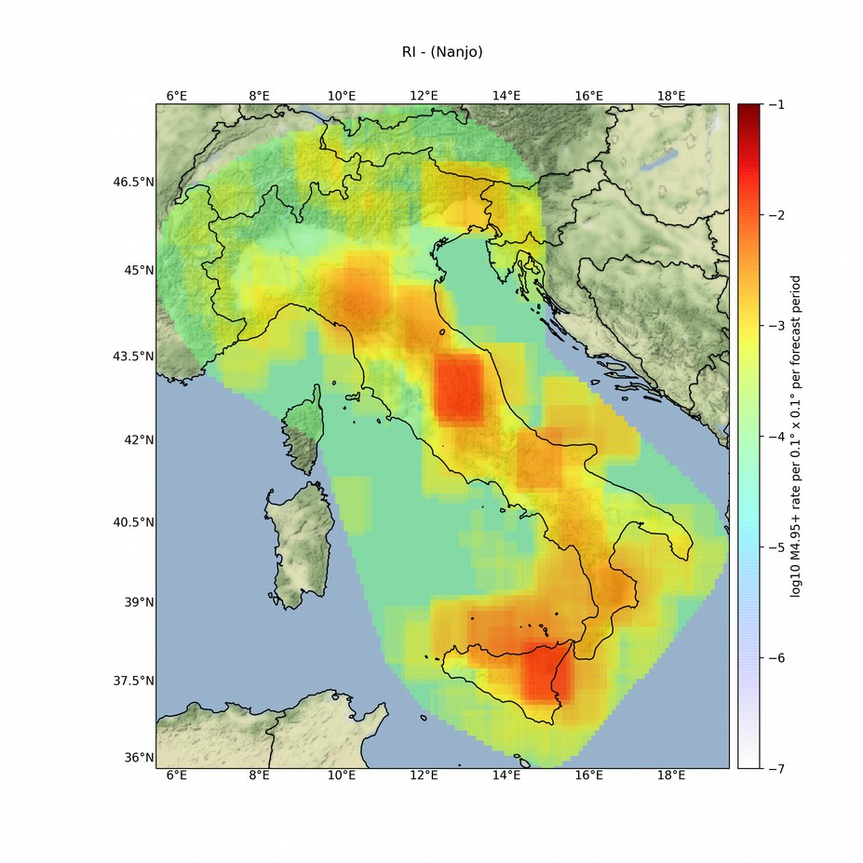
Catalog and Forecasts

Slide 5
Results

Slide 6
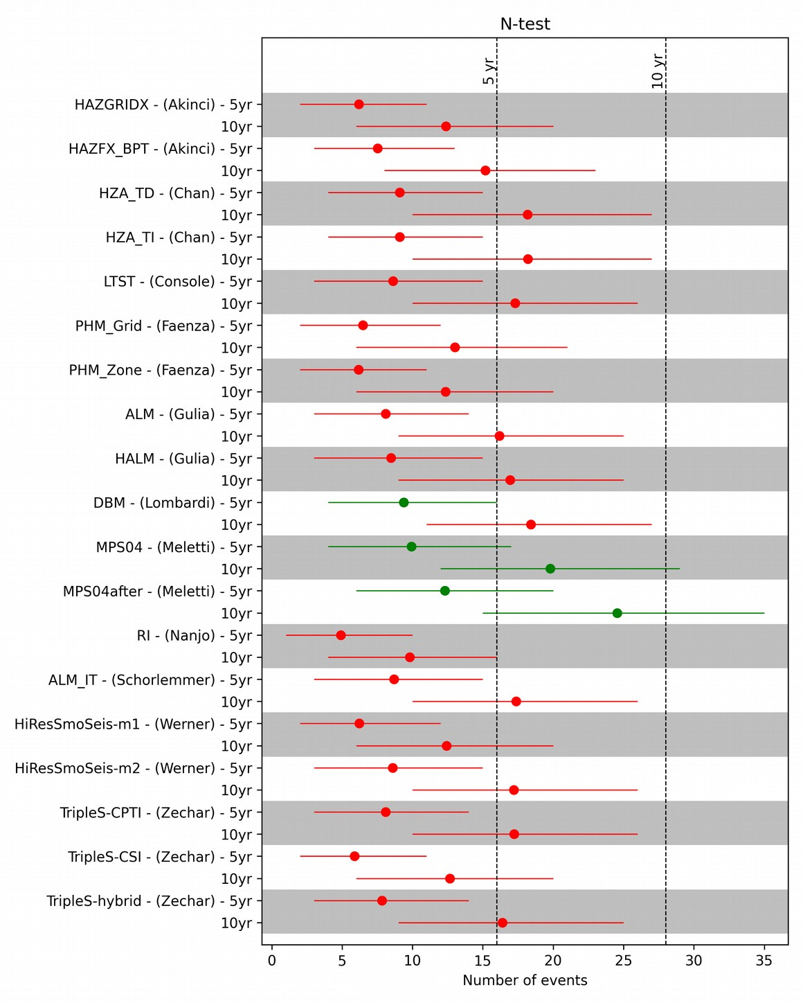
N-test

Slide 7
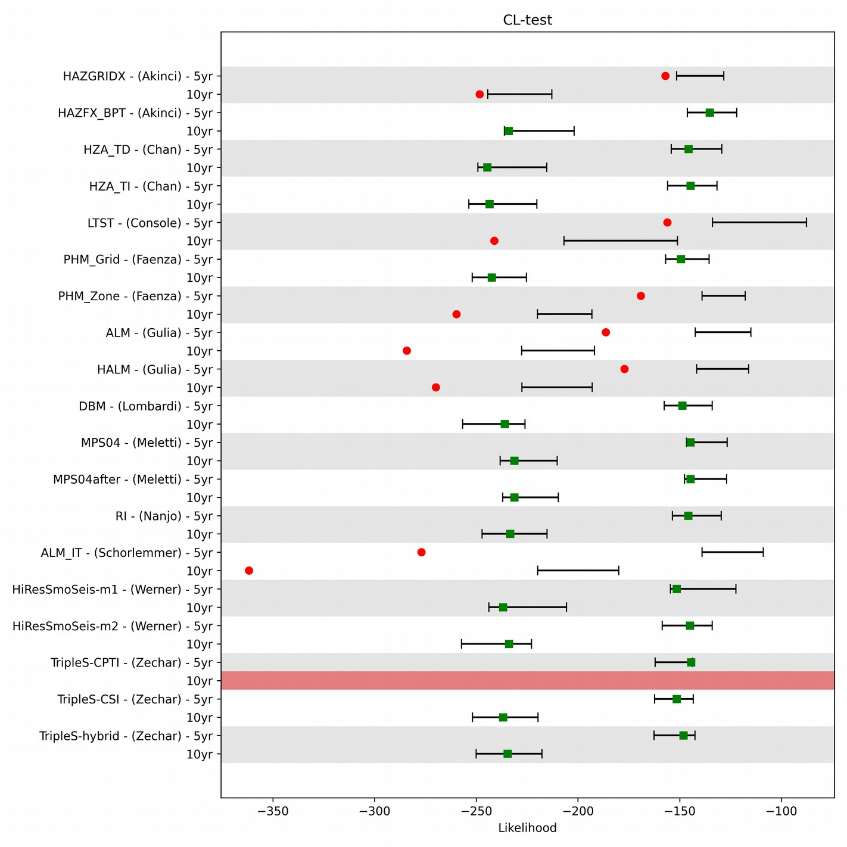
CL

Slide 8
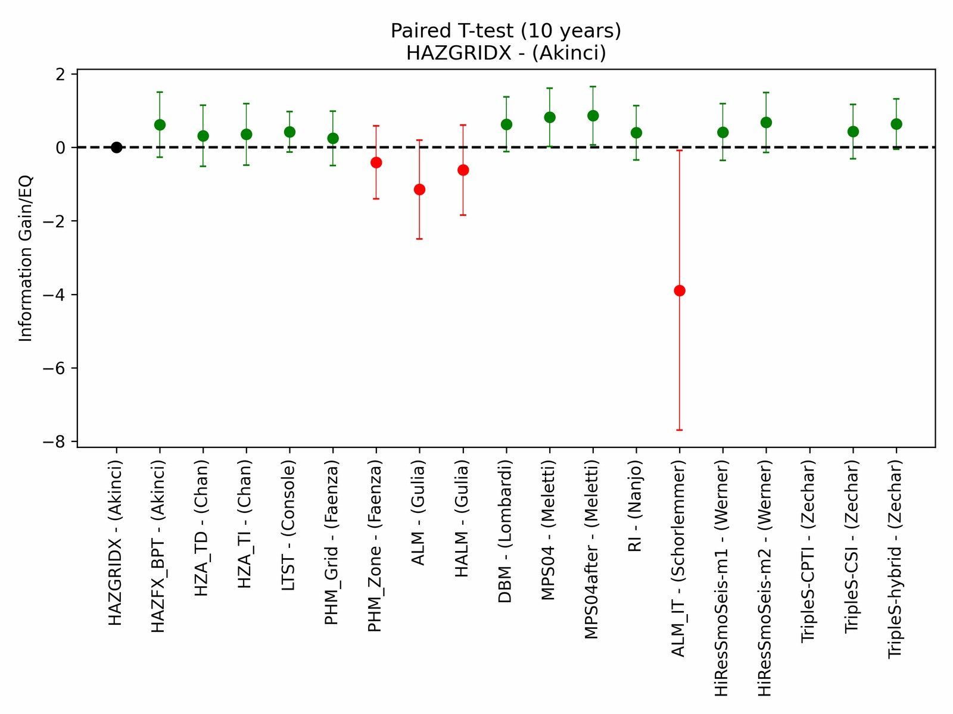
Paired T-test

Slide 9
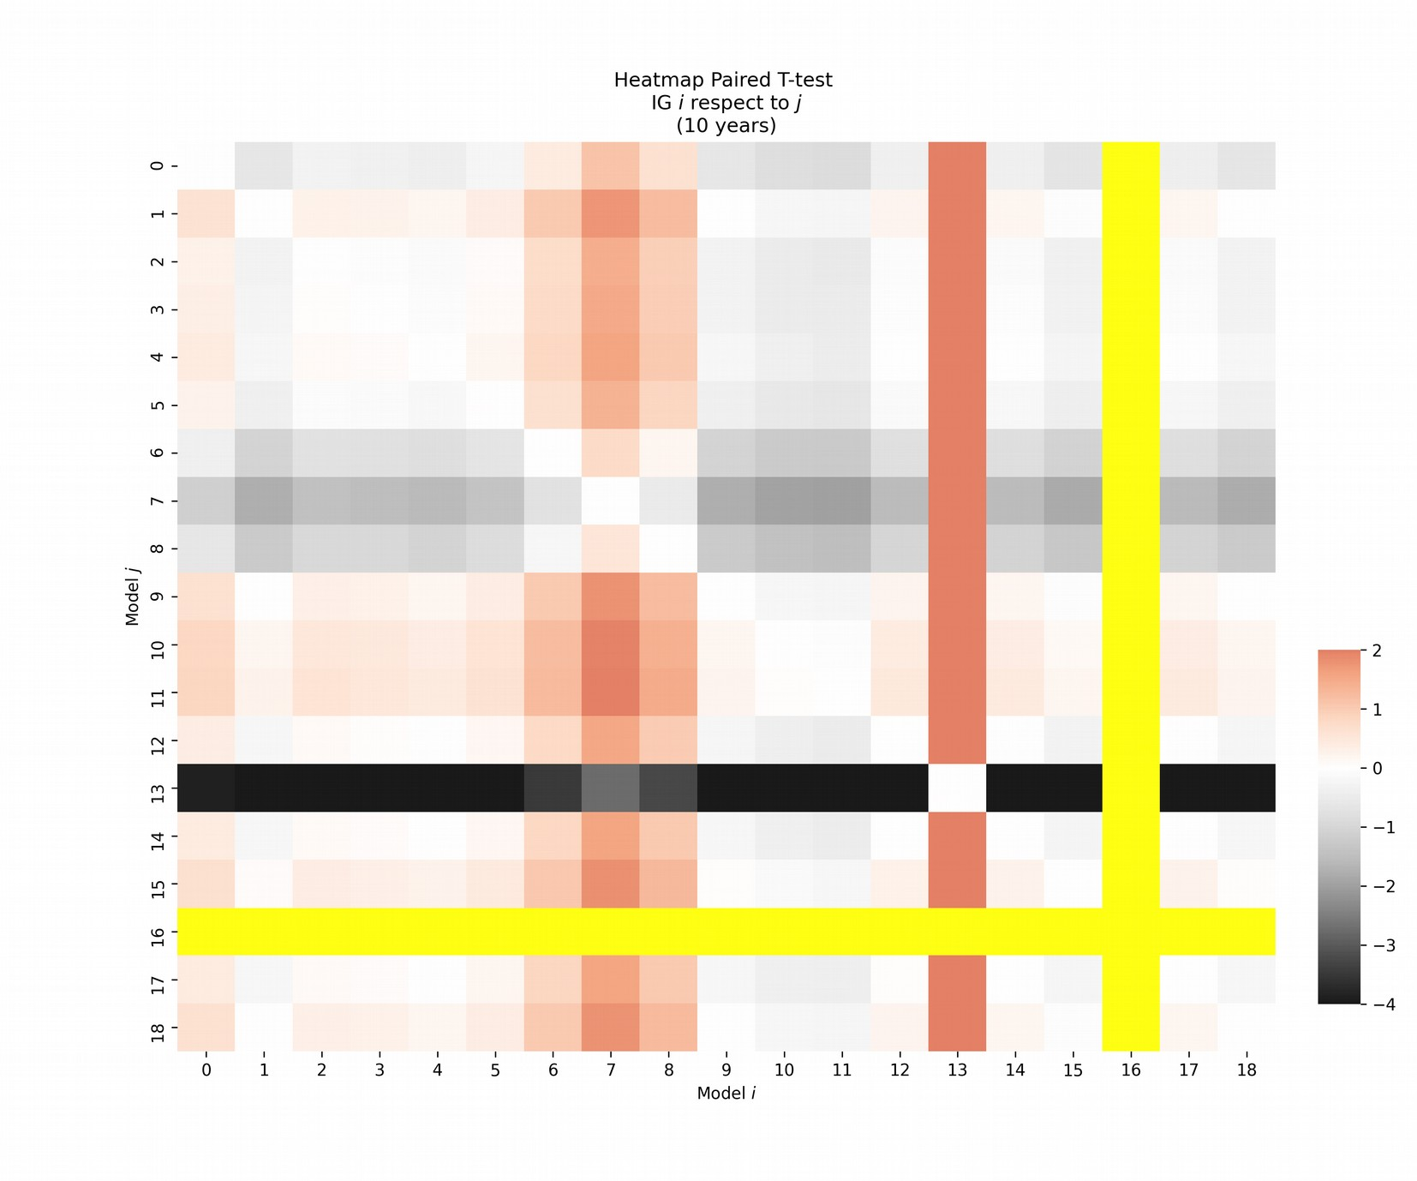
Paired T-test

Slide 10
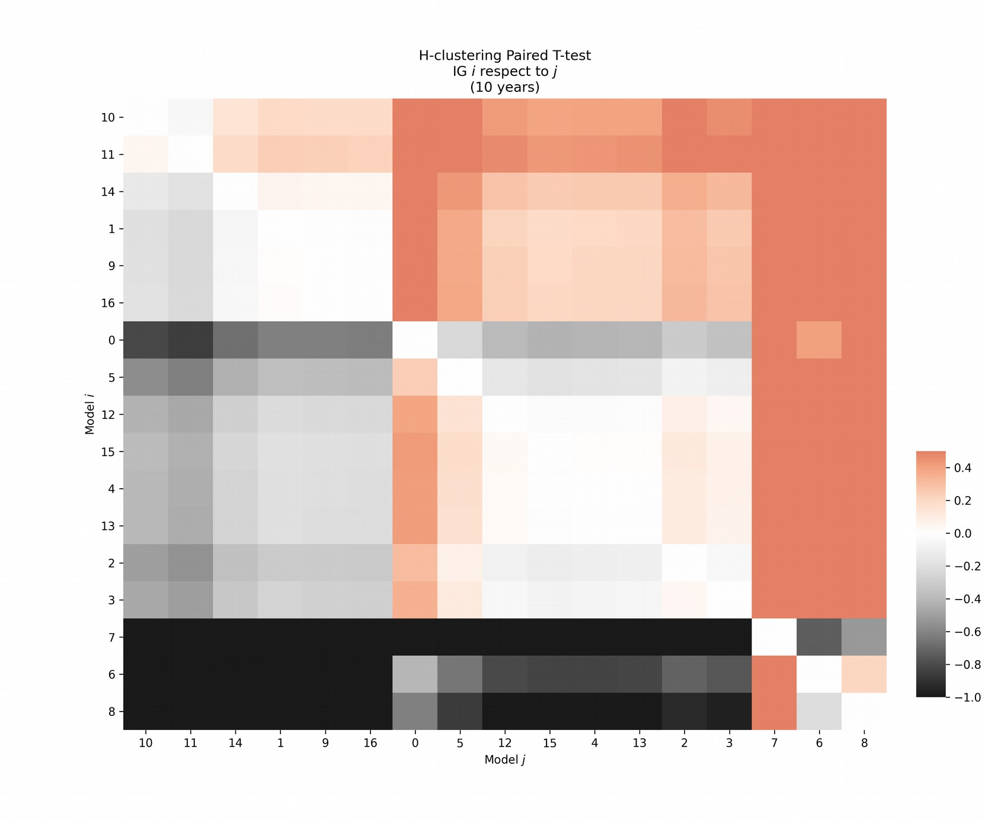
Paired T-test

Slide 11
asdad

