Slide 1
Final Project
Tips for an easy and pleasant implementation

Slide 2
Virtual Addresses ➔ Page + Displacement
Only one process is being executed, and that means that we are only considering one address space.
How big is the logical address space? This simulation is based on the fact that the address space of the process fills all the disk.
One of the arguments will be the disk size which we assume is entirely used to store the single process address space.
You will be given the logical address when you read or write.
The addresses are given as 32-bits by the simulator.
The size of the address space is the size of the disk. That means that only the pertinent lower bits of the address given to you by the simulator need to be considered.
Yes, I am repeating myself ☺

Slide 3
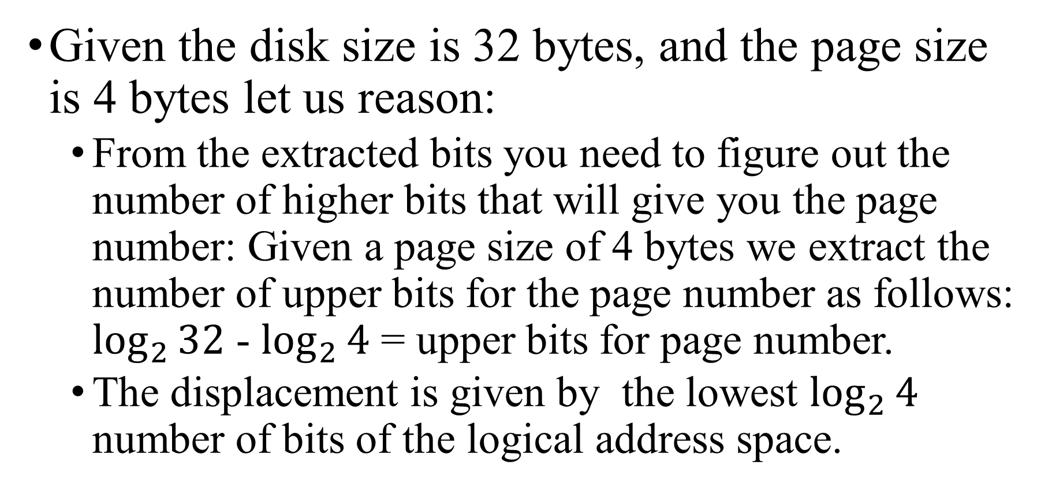
Virtual Addresses ➔ Page + Displacement (cont.)
Given the disk size is 32 bytes, and the page size is 4 bytes let us reason:
From the extracted bits you need to figure out the number of higher bits that will give you the page number: Given a page size of 4 bytes we extract the number of upper bits for the page number as follows: $\log_{2}{32}$ - $\log_{2}{4}$ = upper bits for page number.
The displacement is given by the lowest $\log_{2}{4}$ number of bits of the logical address space.

Slide 4
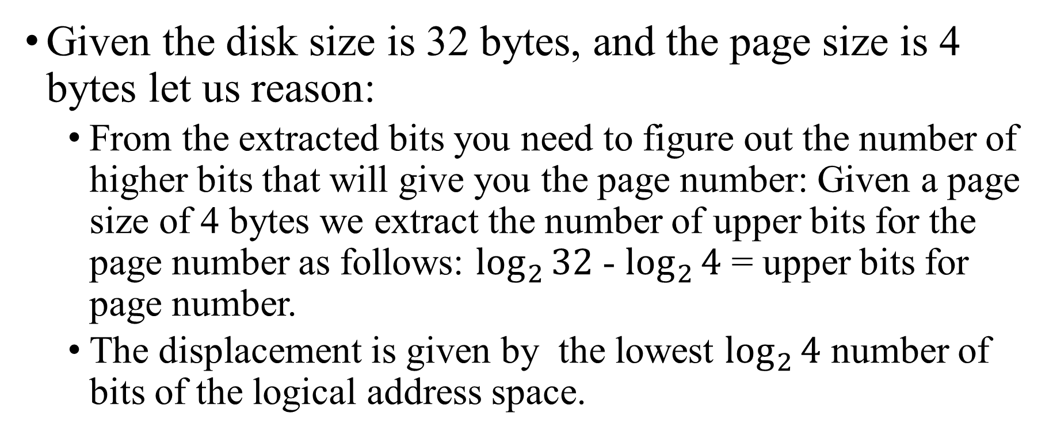
Virtual Addresses ➔ Page + Displacement (cont.)
Given the disk size is 32 bytes, and the page size is 4 bytes let us reason:
From the extracted bits you need to figure out the number of higher bits that will give you the page number: Given a page size of 4 bytes we extract the number of upper bits for the page number as follows: $\log_{2}{32}$ - $\log_{2}{4}$ = upper bits for page number.
The displacement is given by the lowest $\log_{2}{4}$ number of bits of the logical address space.

Slide 5
Virtual Addresses to Physical Addresses
You get a 32-bit logical address space; you extract the number of lower bits you need according to the size of the logical address space.
You figure out the page number of the logical address space (from the lower bits you extracted from the 32-bit logical address given to you by the simulator).
You assign the first free frame from memory to the number page you figured out.
You have a data structure that maps that page number to the frame number you used.
You must read that page from the disk and write that page in memory.
Now hurry up and implement MemMgrV0 and MemMgrV1 ☺. We will talk about the remaining simulations after that in the next class.

