Slide 1
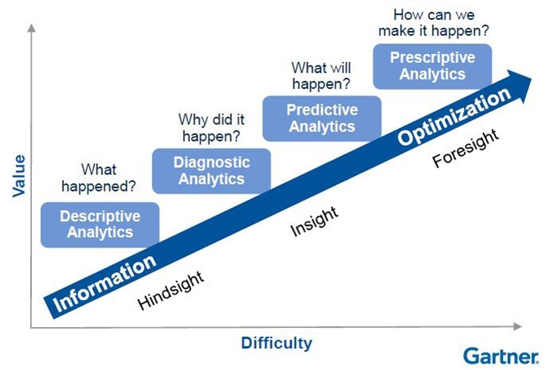
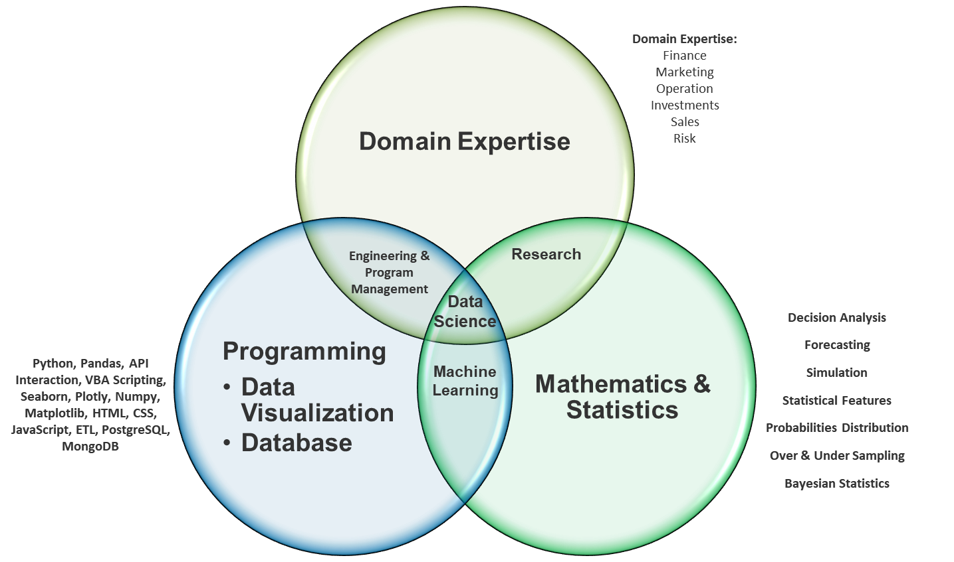
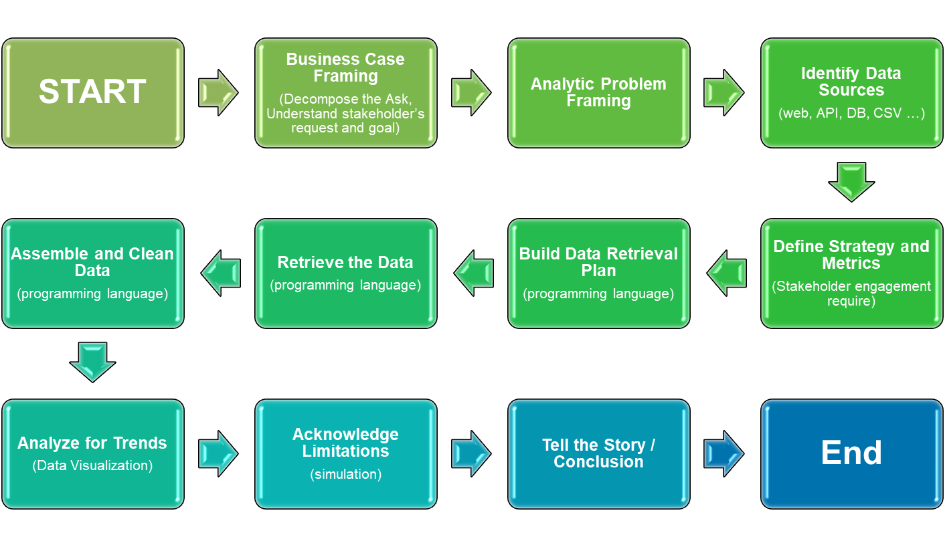
What can you do?
How is it accomplish?
What is the process?

Slide 2
What can you do?
How is it accomplish?
What is the process?

Slide 3
What can you do?
How is it accomplish?
What is the process?

Slide 4

Data Analytics - Capabilities

Slide 5
Analytics Framework

Slide 6
How is it accomplish?

