Slide 1
Adversarial Fake News Detection
Adversarial Neural Networks to improve performance of Fake News Detection systems
By Pablo Kvitca
DS 4440 – Practical Neural Networks – December 2020

Slide 2
Project Inspiration
Adversarial
Changes
Language: CH → EN
Text: Short → Long
LM: LSTM+CNN → BERT
No Images
EANN: Event Adversarial Neural Networks for Multi-Modal Fake News Detection
Wang Et Al
2018

Slide 3
Defining Fake News
Content that aims to deceive using false claims to steer opinion towards a useful point of view

Slide 4
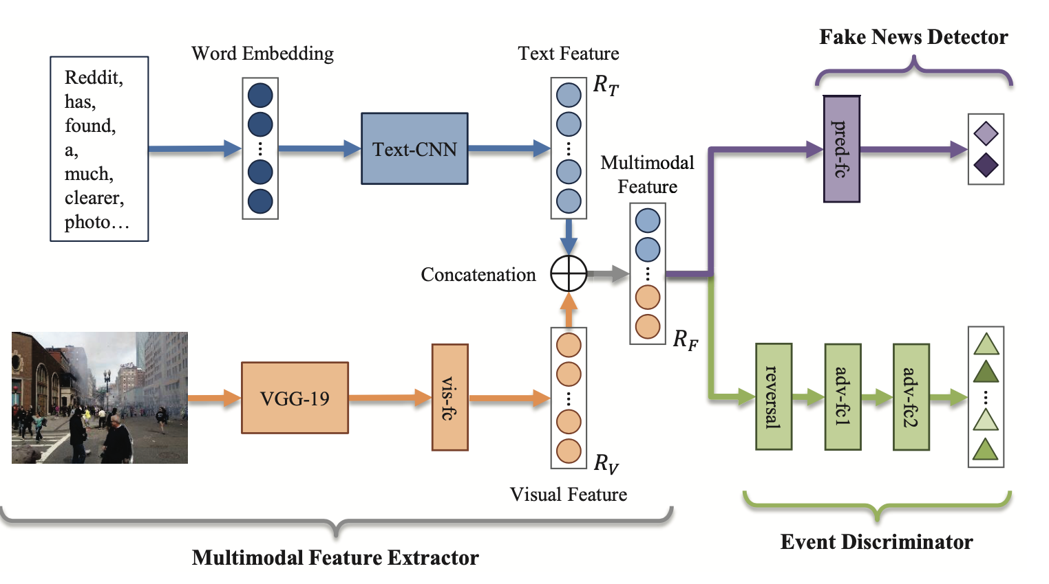
Event Adversarial Neural Networks (EANN)
Issue: models perform well on the dataset, poorly on production
Event-based nature of News
Re-training can only happen after an event
Models learn features for each past event, new events don’t perform well
Solution
Normalize against event-specific learning

Slide 5
Dataset – Fake News Corpus
Open Source
~ 9 million of news articles
Scraped from curated list of 1001 domains from http://www.opensources.co/
Intended for use in training deep learning algorithms for purpose of fake news recognition.

Slide 6
Dataset – Cleaning + Preprocessing
EVENTS → KEYWORDS
Some dataset rows/cols were out of place
Useful rows were about 5 million (out of 9 million)
Calculated frequency of keywords, tags, and authors
Added binary col for the top 100 keywords, tags, and authors
Collapsed content into single line (with line end token)
Joined title and content into single feature
Added col for the most common keyword for each article
Merged labels into binary: fake/real

Slide 7
Fake news Adversarial Neural Network
BERT TOKENIZER
TEXT FEATURE
input
Linear
Bitcoin,
&, Blockchain, Searches, Exceed, Trump! Blockchain, Stocks…
Softmax
Fake News
<CLS>
BERT LAYER
Pooled CLS Token
LeakyReLu
Linear
Linear
Softmax
Adversarial Detector

Slide 8
BERT TOKENIZER
TEXT FEATURE
input
Linear
Bitcoin,
&, Blockchain, Searches, Exceed, Trump! Blockchain, Stocks…
Softmax
Fake News
<CLS>
BERT LAYER
Pooled CLS Token
LeakyReLu
Linear
Linear
Softmax
Adversarial Detector
base
heads

Slide 9
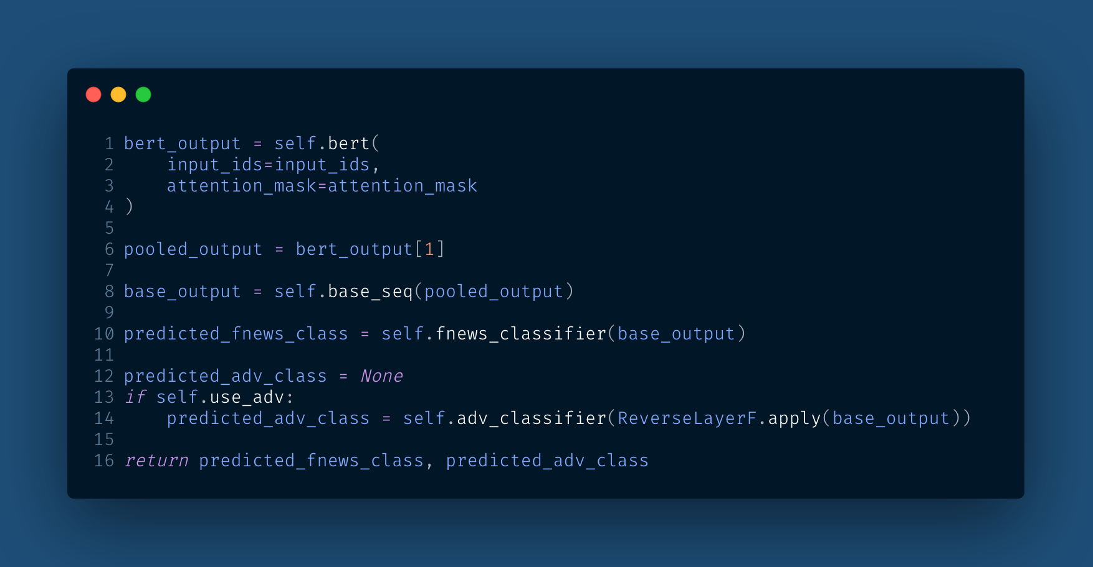
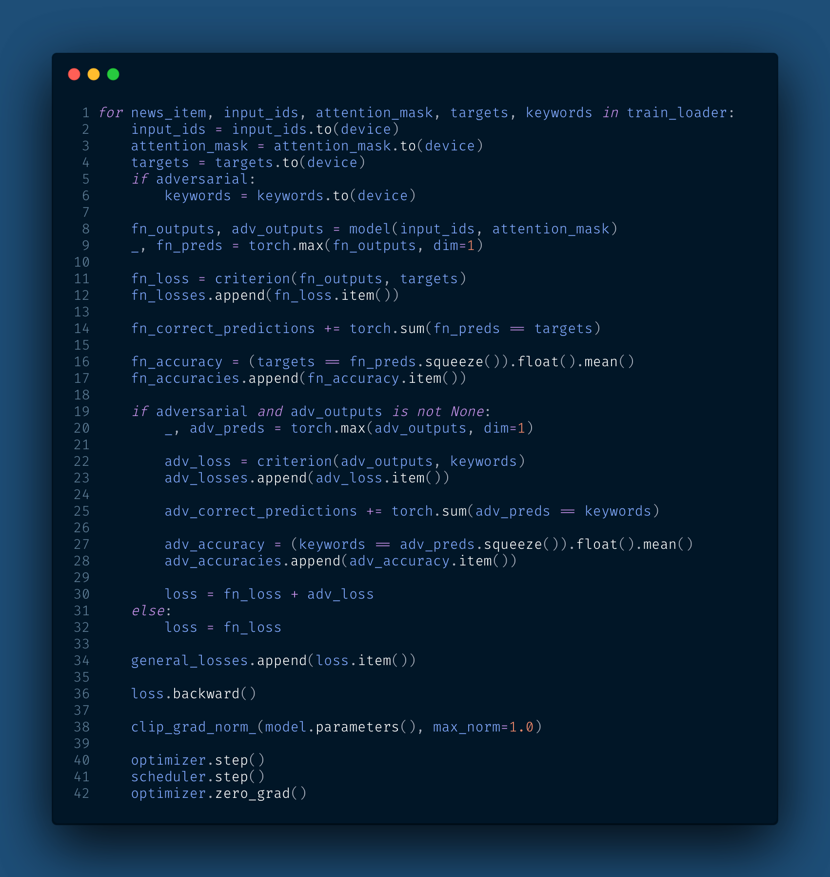
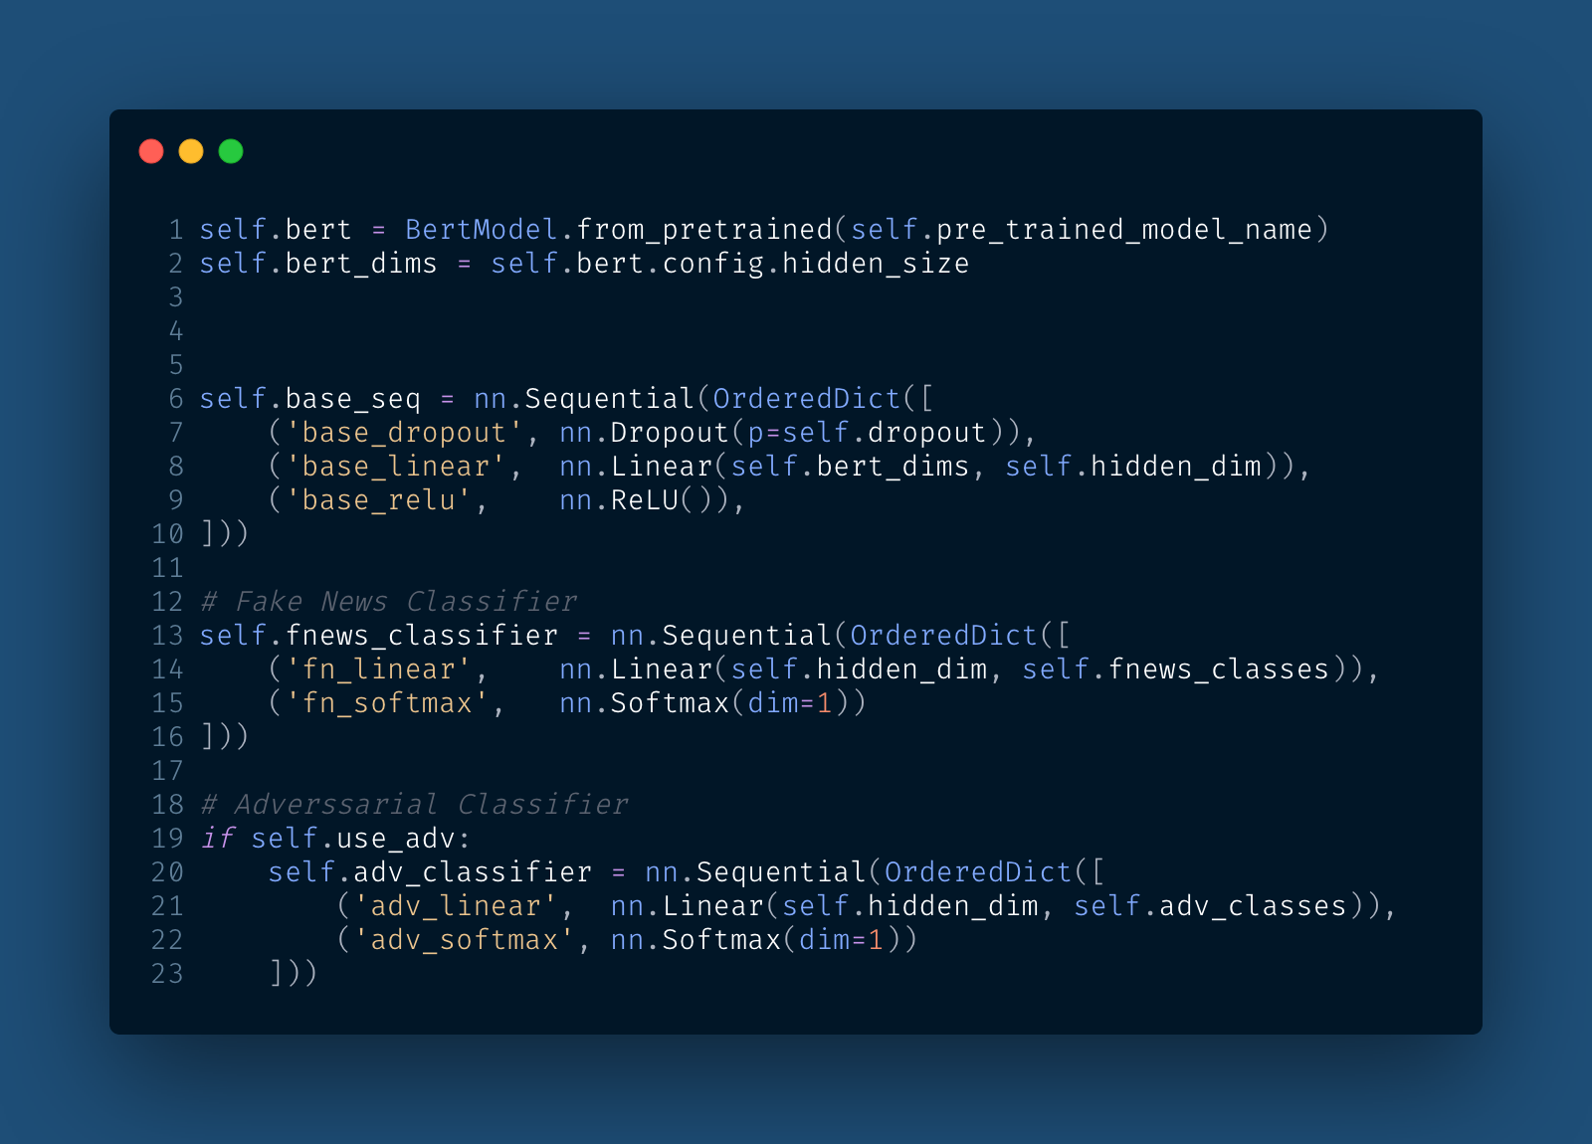

Slide 10
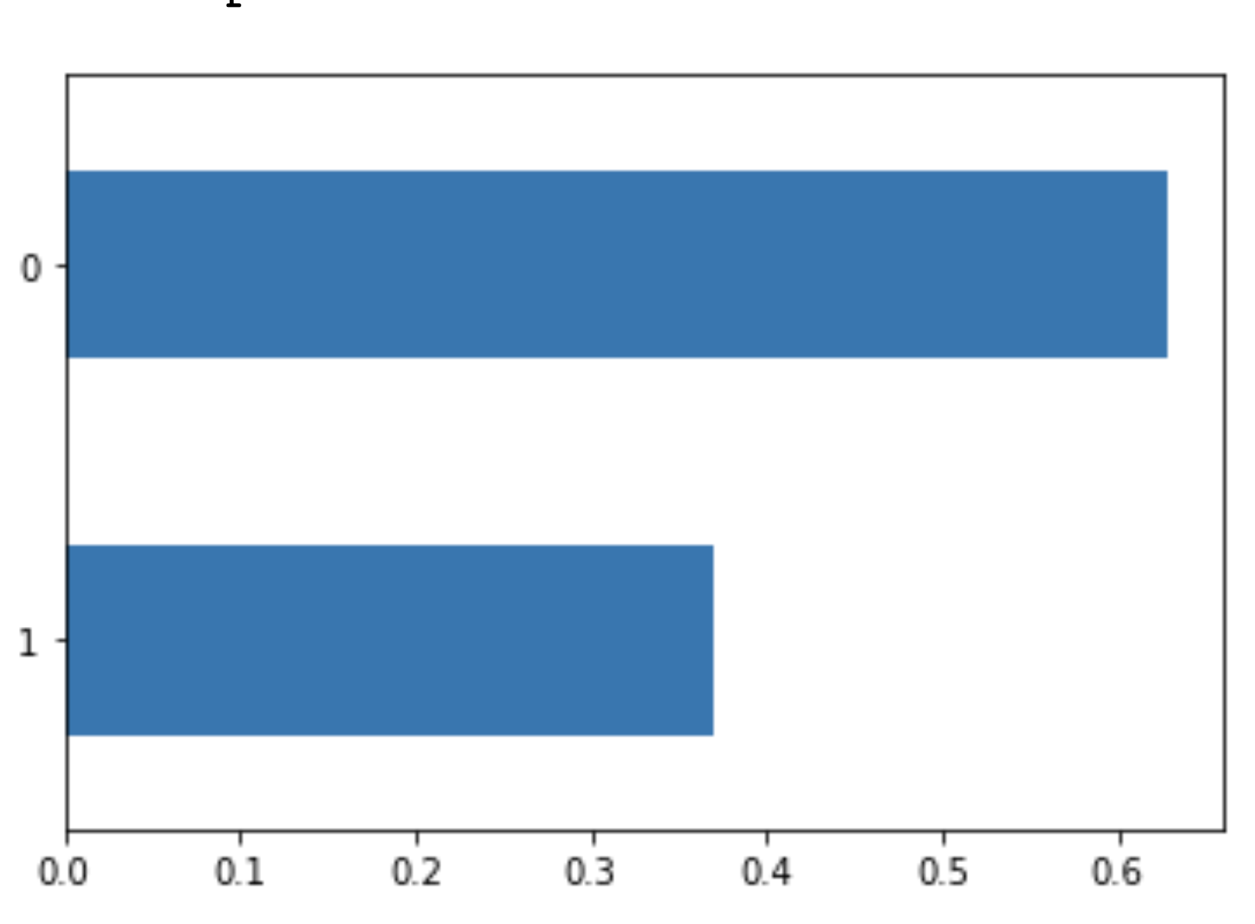
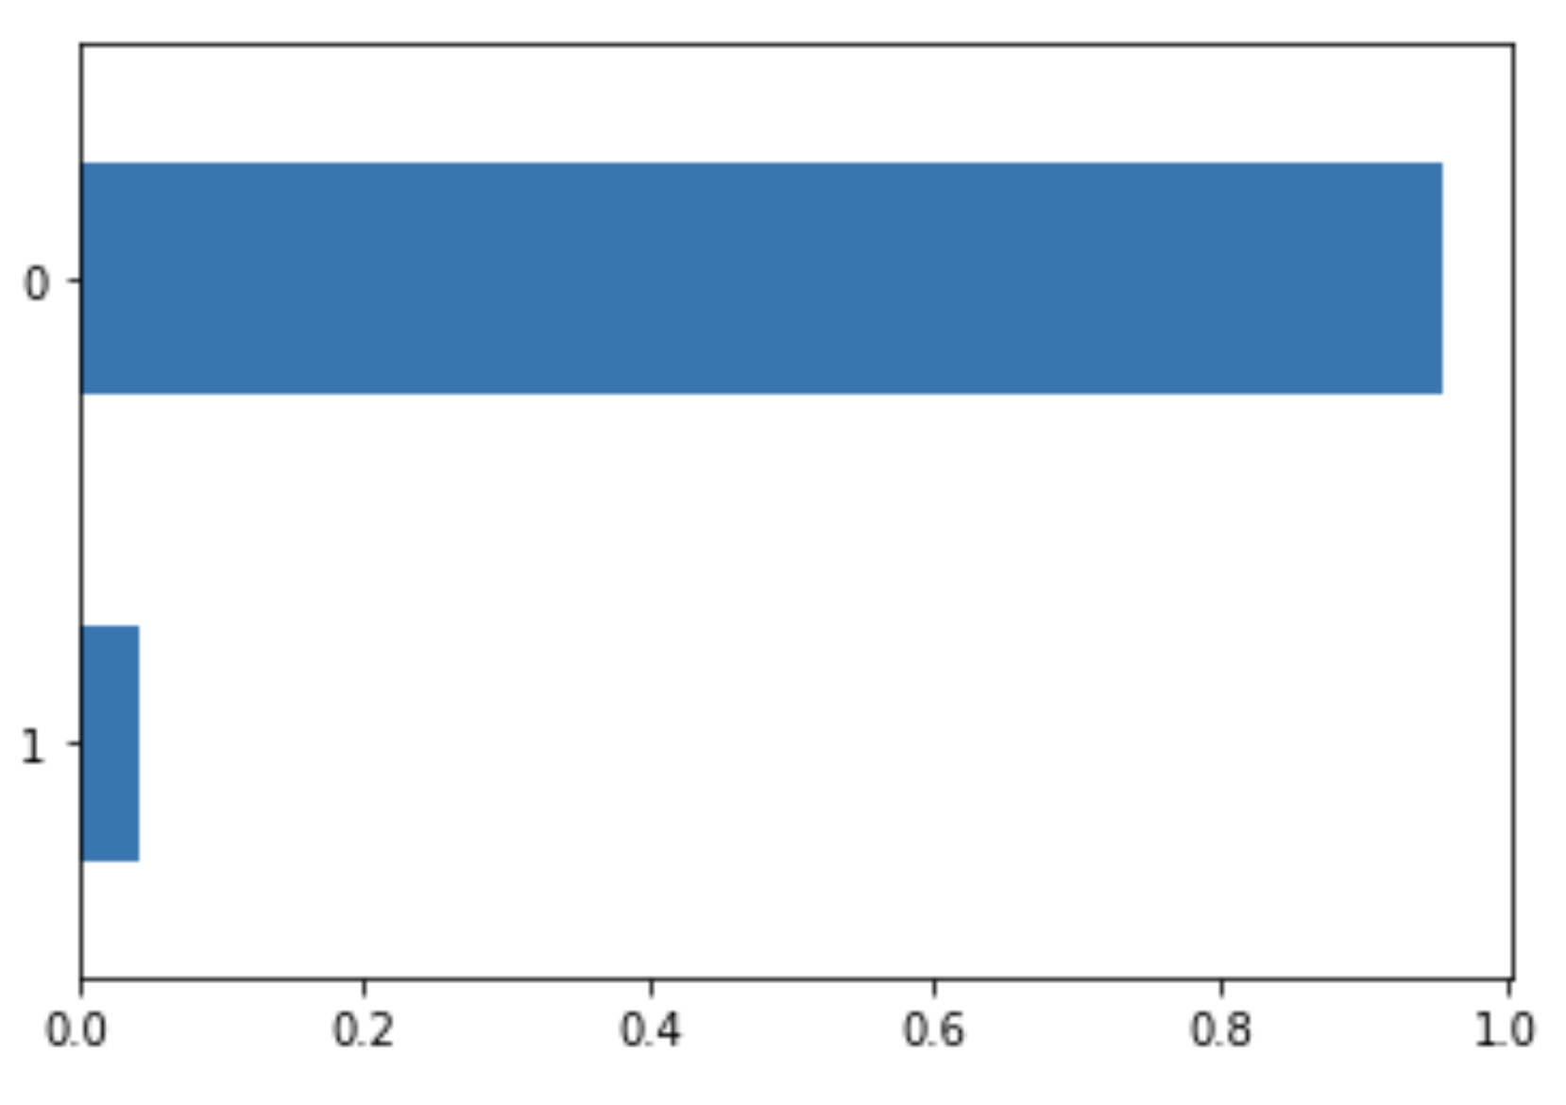
Issues So Far
Fake/Real distribution (unfiltered)
Dataset not labelled for events → keywords
Articles with common keywords have uneven distribution
CUDA Memory issues → Using CPU
Slow performance (1 epoch taking 7+ hours)
→ No performance results yet
Fake/Real distribution (filtered)

Slide 11
Next Steps
Improve training speed
Create performance metrics on the dataset
Bias/Error Analysis on specific keywords

Slide 12
QUESTIONS?

