Slide 1
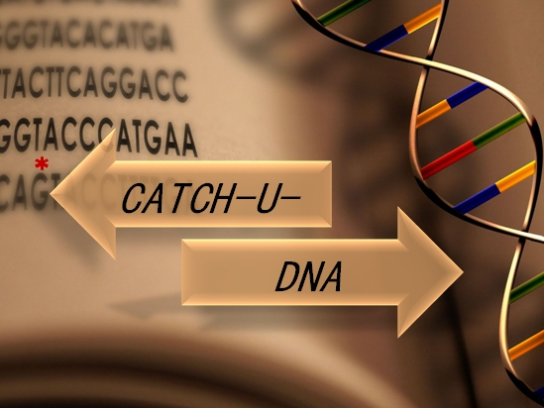

WP7. Dissemination
Heraklion 19/06/2017

Slide 2
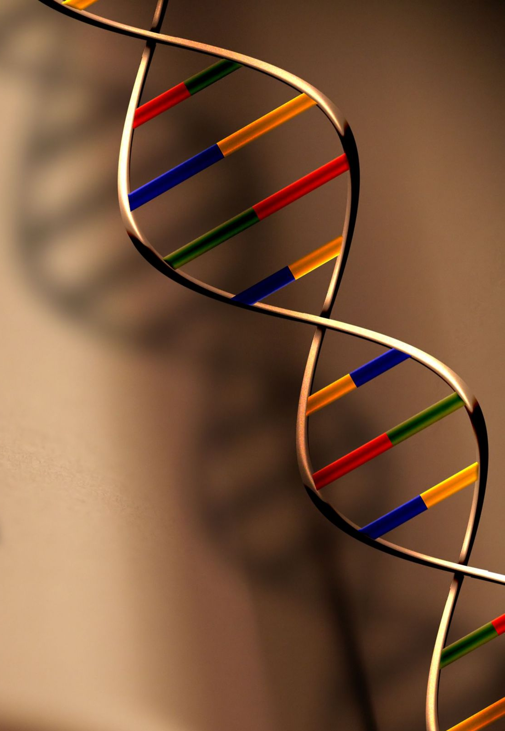
Outline
Objectives
Main achievements
Future plans
Questions

Slide 3

1. Objectives
Exploit and communicate the knowledge gained
Define an exploitation strategy

Slide 4
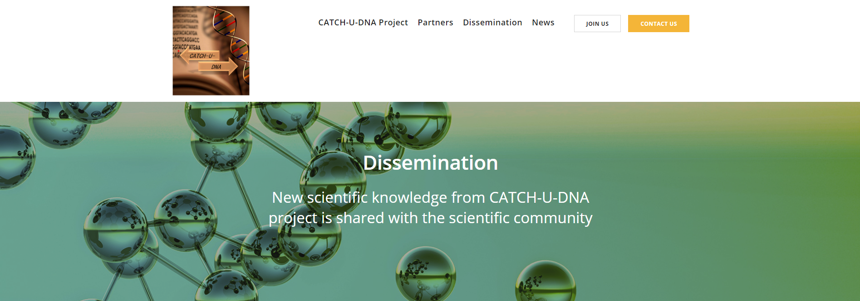
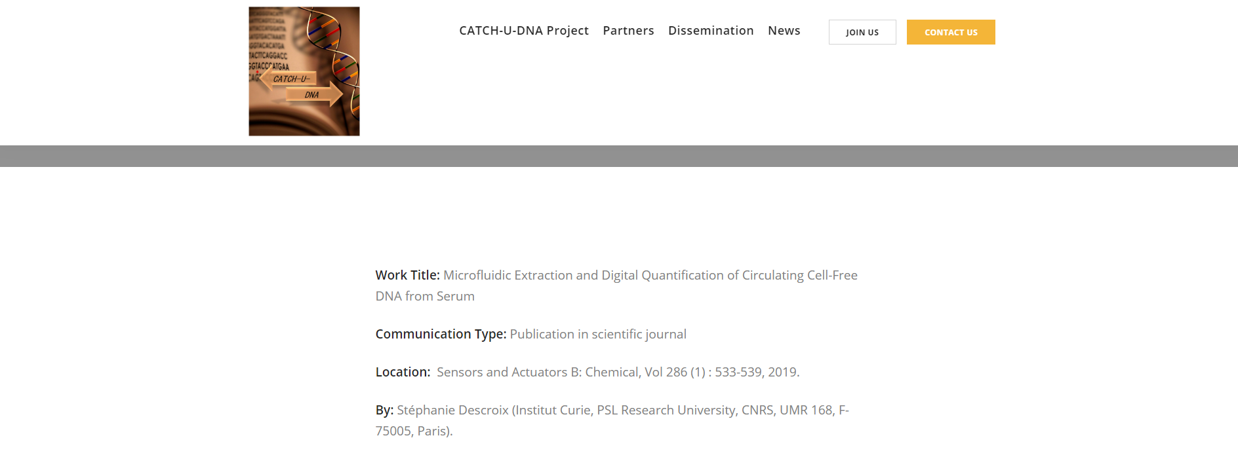
2. Main achievements
Website update and maintenance

Slide 5
2. Main achievements
Dissemination activities
3 Conference posters
5 Invited talks/lectures
1 Conference presentation
2 Industrial Fairs
2 Peer reviewed papers accepted

Slide 6
2. Main achievements
Intra-project staff exchanges
Source partner | Receiving Partner | Purpose | Date
FORTH, N. Naoumi | CURIE, France | Perform/optimize fluidized bed combined with LCR | July 2018
FORTH, V. Raptis | UAM, Spain | Simulation coordination | April 2019
FORTH, N. Naoumi | AWS, Spain | Training to use acoustic wave array sensor technology for further validation studies at FORTH | February 2019
AWS, A. Arnau Vives, J. Garcia | FORTH, Greece | Installation of AWS prototype | April 2019
JOBST, G. Jobst | AWS, Spain | Flow cell design for sensor array | May 2019
CURIE, M. Araya-Farias | FORTH, Greece | Testing of the 2nd generation of the fluidized bed | June 2019
UoC, S. Agelaki, K. Michaelidou | FORTH, Greece | Several visits to discuss NGS results of biopsy samples | Nov. 2018 - May 2019
UAM, Rafael Delgado Buscalioni | FORTH, Greece | Simulation coordination | February 2019

Slide 7
2. Main achievements
Intellectual Property Rights
Exploitable result description | Beneficiary | TRL
Use of highly dissipative particles for acoustic signal amplification & ultra-sensitive DNA detection; application to liquid biopsy & molecular diagnostics. | FORTH | 4
Use the microfluidic fluidized bed for sample preparation to extract & pre-concentrate cells, molecules or vesicles; application to biomedical or environmental fields. | Curie | 4
Novel characterization method for acoustic wave sensors arrays | AWS | 5
Flow cells for AWS sensors with extreme shear characteristics | JOBST | 7

Slide 8
2. Main achievements
Liquid Biopsy Market
Steadily growing market!!!!
Estimated market size: 3051 $ million (2025)
DRIVERS
Precision medicine growth
Potential to detect clonal mutations
RESTRAINTS
Regulatory policies
Clinical Guidelines
OPPORTUNITIES
Medication packages
Emerging markets
Non oncology diseases
Notes:
https://www.marketwatch.com/press-release/liquid-biopsy-market-size-will-increase-to-30511-million-us-by-2025-2019-04-24

Slide 9
2. Main achievements
Liquid Biopsy Market Segmentation
By application:
Diagnosis, Treatment Selection, Prognosis and Recurrence, Monitoring
By technology:
NGS (Illumina), ddPCR (Biorad), Others
By Business model:
Device, Service
By type of cancer:
ctDNA, CTC, cfDNA, Extracellular vesicles and others

Slide 10
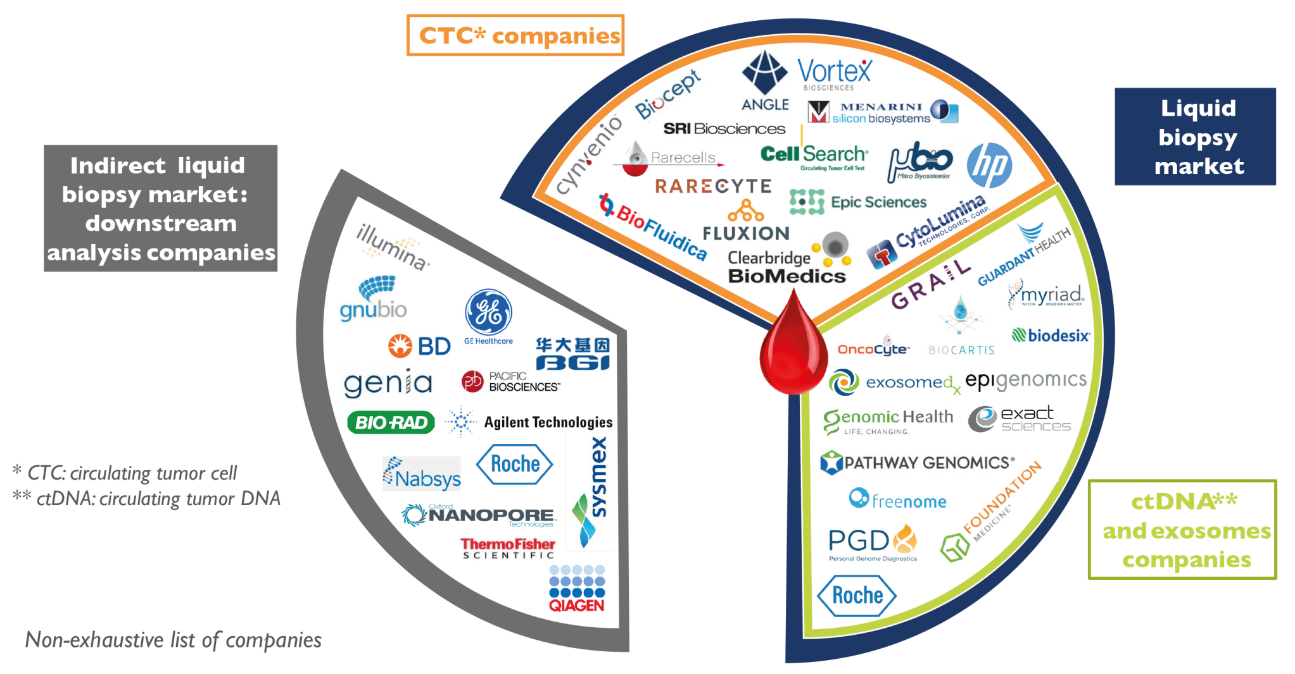
CATCH-U-DNA positioning in the Liquid Biopsy Market Ecosystem
2. Main achievements

Slide 11
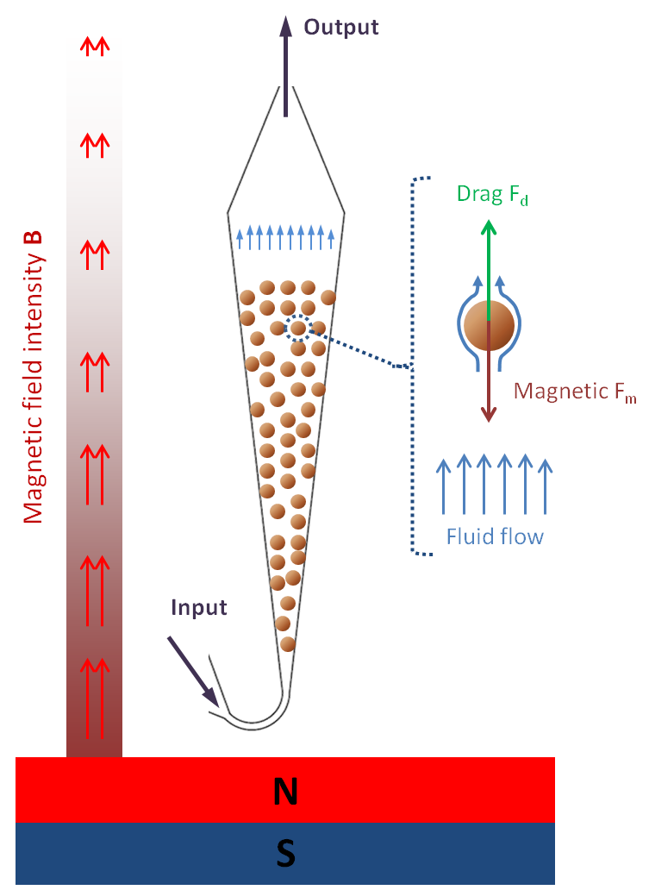
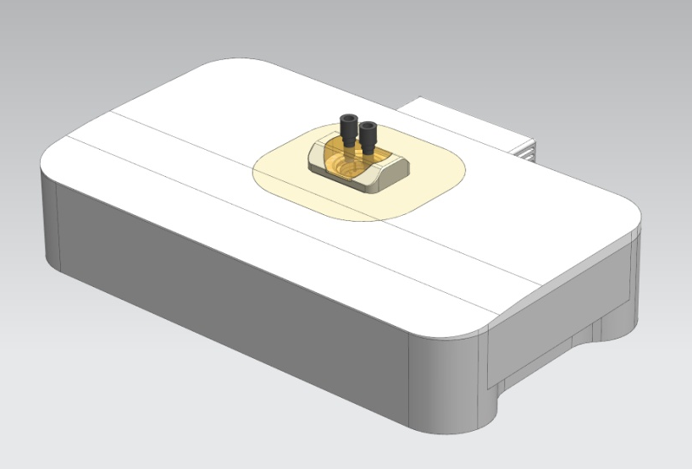
CATCH-U-DNA potential
2. Main achievements
Fluidized Bed
Hydrodynamic sensing
Highly efficient extraction of cfDNA or ctDNA
Mutation specific extraction
Can be combined with NGS or ddPCR
Ultra-sensitive detection (comparable to ddPCR, NGS)
Can be combined with available extraction kits
Suitable for standard biopsy

Slide 12
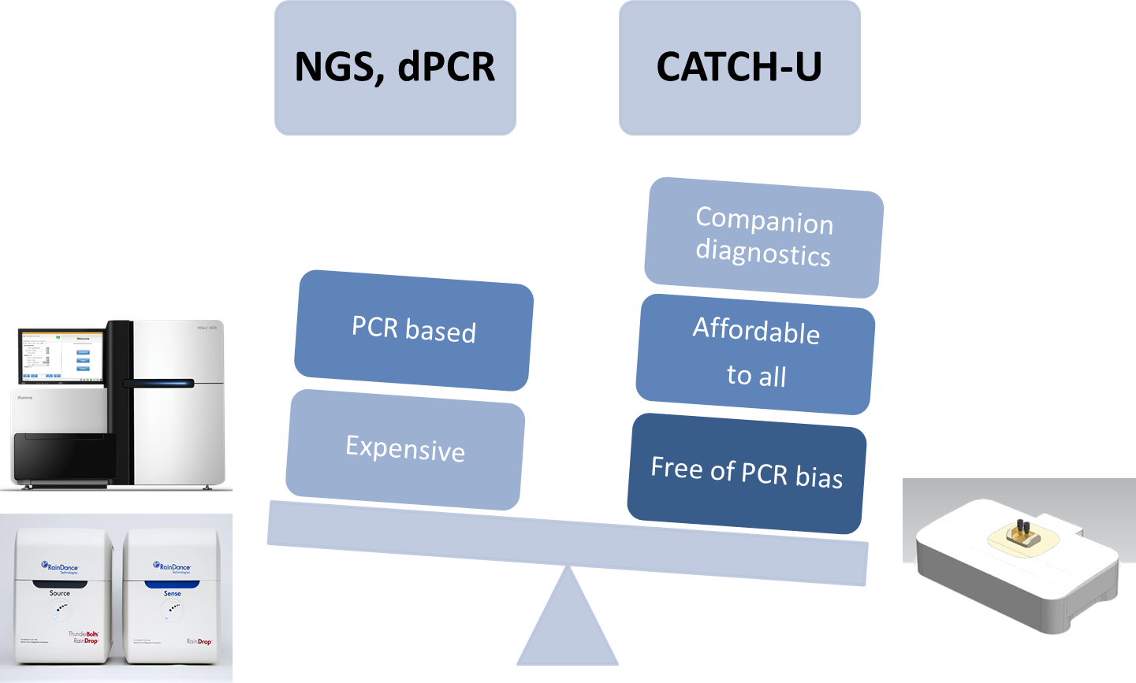
CATCH-U-DNA competitive advantages
2. Main achievements

Slide 13
3. Future Plans
Continuation of Dissemination activities
Elaborate technical presentation for presentation in technology transfer events and international trade fairs (after M24)
Get in touch with more end-users labs (M30)
Discussions about IP and commercial exploitation strategy between partners; set clear exploitation steps

Slide 14
Commercialization of CATCH-U-DNA product
3. Future Plans
Potential Scenario 1
AWS (through AWS Dx)
AWS Dx business is to provide integrated systems for point-of-care
Will produce and sell the instrument
Enter new markets
Licensing agreement & purchasing terms and conditions of individual components and know-how to be discussed with relevant partners
Potential Scenario 2
Strategic agreement with companies already active in healthcare to commercialize the CATCH-U-DNA product (sell patent(s), know how etc.)

Slide 15




3. Future Plans
Commercial/Industrial vehicle for exploitation (Potential Scenario 1)

Slide 16
4. Questions
Thank you!

