Slide 1
CATCH-U-DNA Dissemination Strategy WP 7
December 1st 2018
By: María Isabel Rocha (Maribel)

Slide 2
DISSEMINATION
AWS: Dissemination Coordinator
3 main activities:
Website
Communication of results
Conferences
Workshops
Articles
General Local News
Intellectual Property Rights (IPR) –patents-
Deliverables turned in August 2017

Slide 3
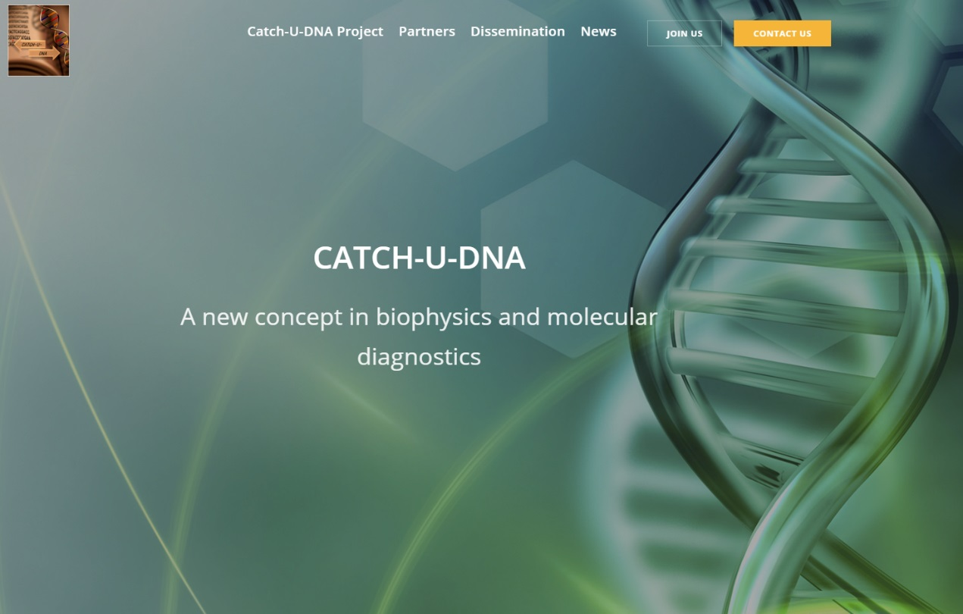
Project Website
www.catch-u-dna.com since July, 2017.
TABS:
CATCH-U-DNA Project
Partners
Dissemination
News
Join us
Contact

Slide 4
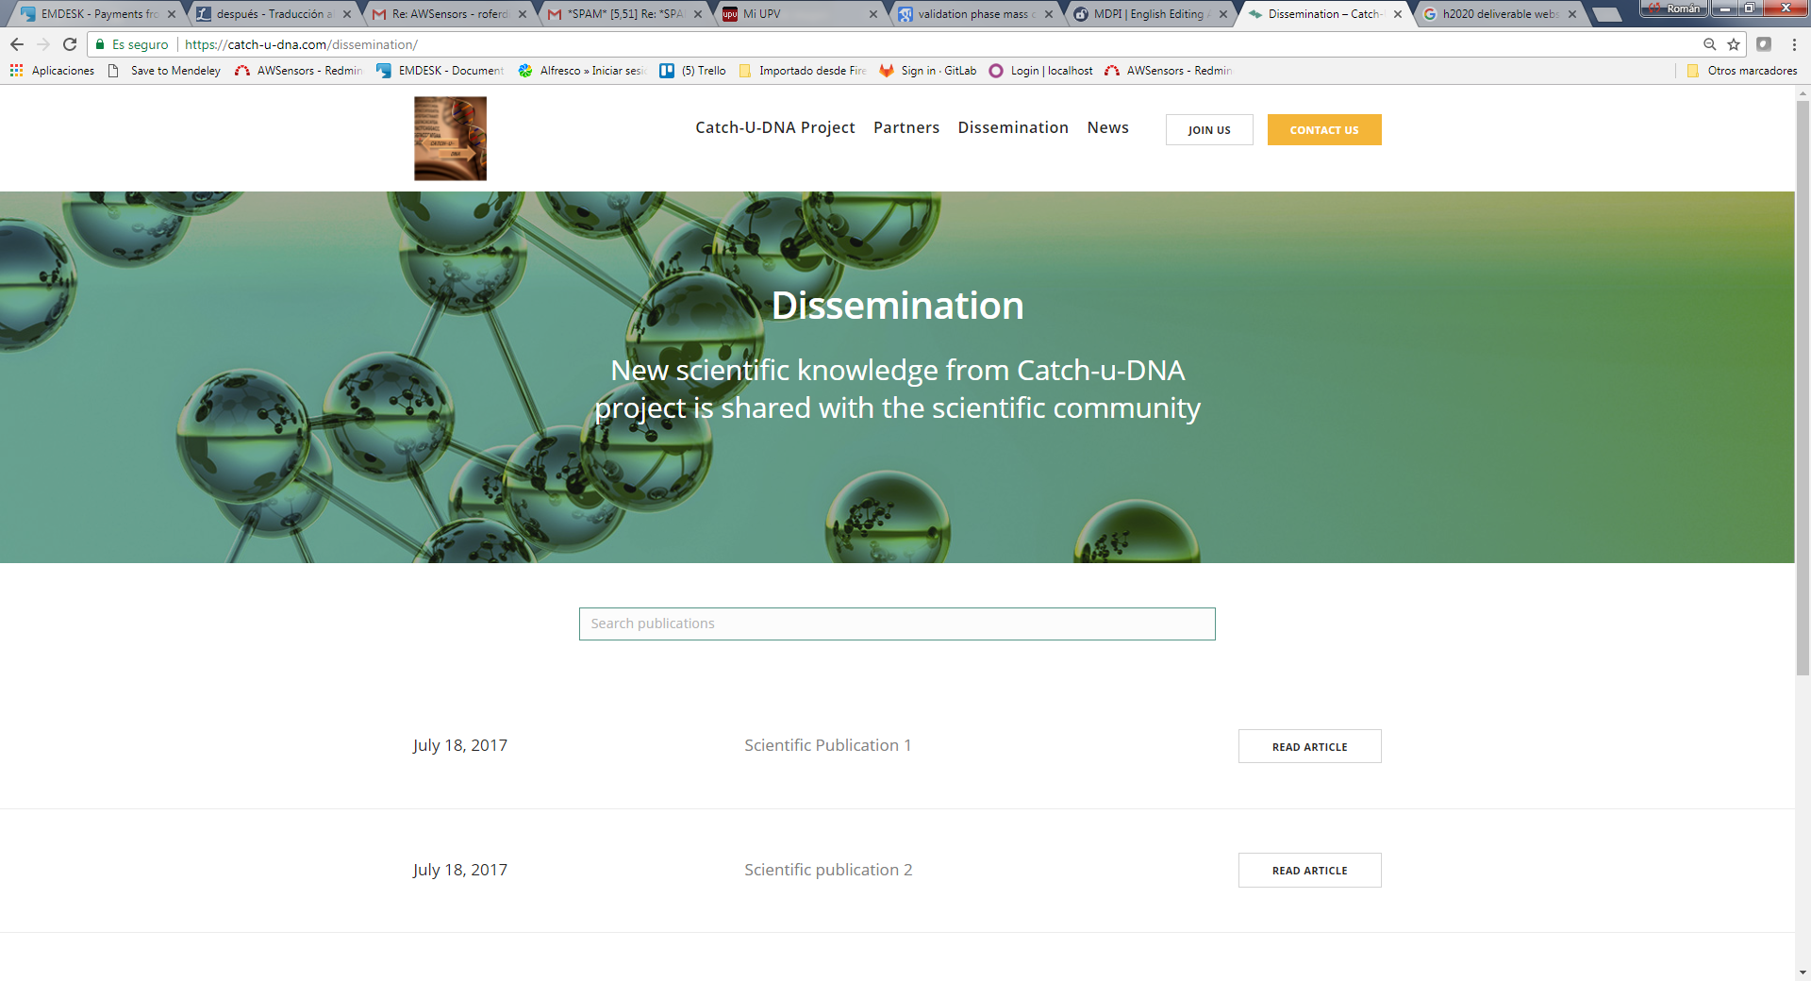
Project Website

Slide 5
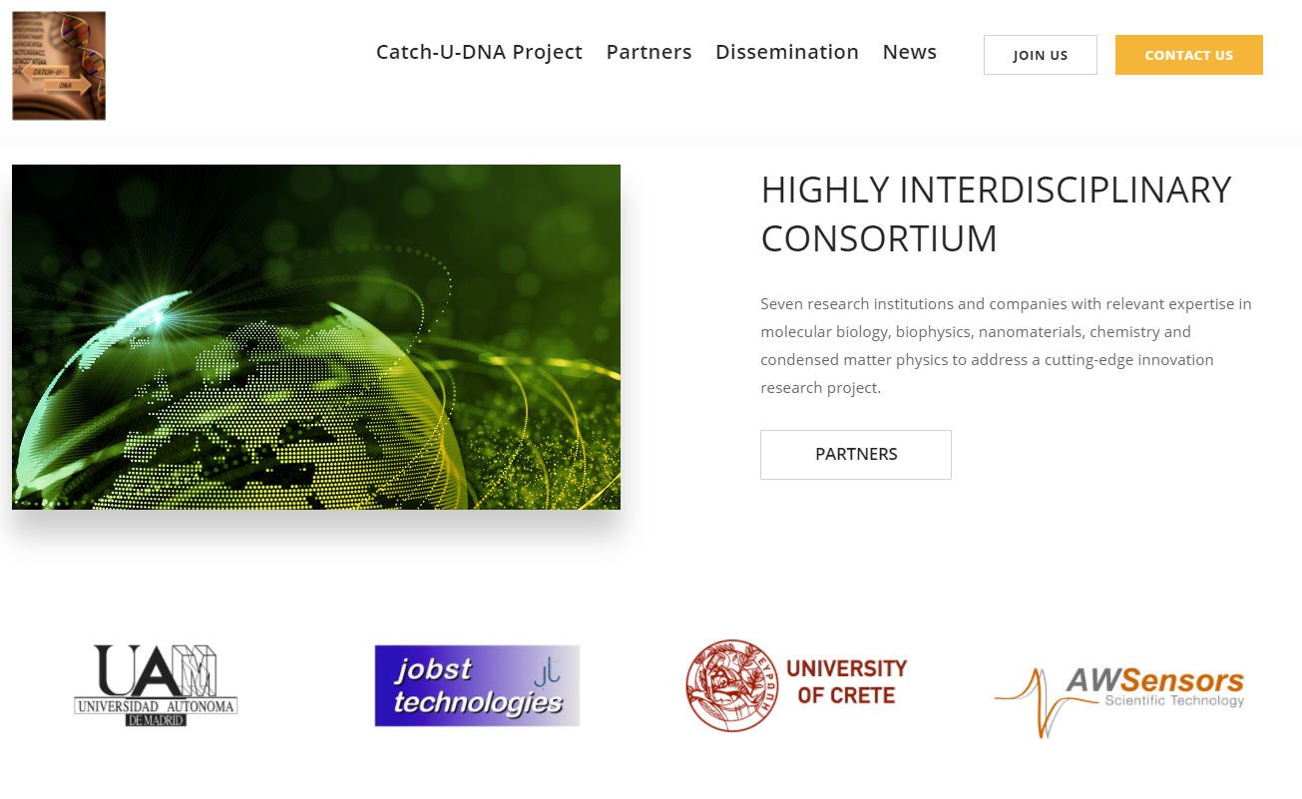
Planning
Planning of communication activities of each partner.
To estimate fulfillment of Project goals.
4 weeks to send to AWS? (Dec 29th 2018)

Slide 6
Communication process
A partner conducted a dissemination activity
Dissemination activities include:
Workshops
Local News
Press reports
Participation in congress, conferences or technological transfer events
Academic Publications
Patents
The partner writes an e-mail to mirocha@awsensors.com.
Maria Rocha publishes this event into the Project Website and registers it in a list.
Roman Fernandez receives the list for the Project Report.
Communication activity is disseminated and reported

