Slide 1


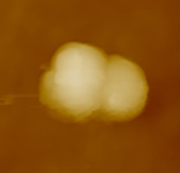
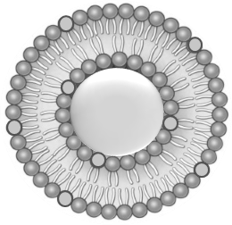
Preparation and Characterization of Lipid Coated Silica Nanoparticles
Raz Jelinek lab
The Department of Chemistry ​Ilse Katz Institute for Nanoscale Science & Technology
Ben-Gurion University of the Negev
Presented by: Daniel N. Bloch

Slide 2

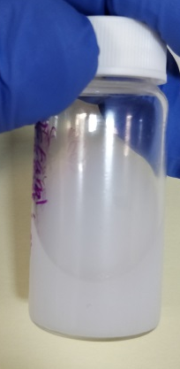
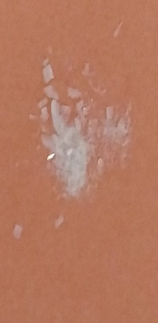
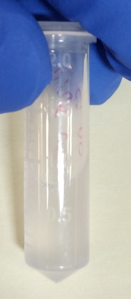
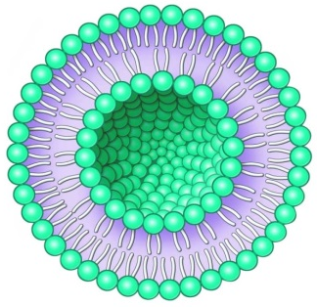
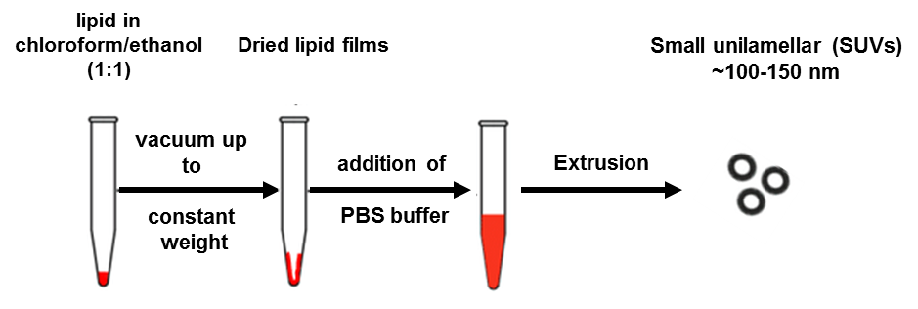
Preparation of Coated Silica Nanoparticles
Ethanol water Ammonium hydroxide
TEOS (silicon source)
Coated Silica Nano Particles
Stir for two hours
Dry under vacuum
Dissolve in lipids, vortex for half an hour
Rinse several times

Slide 3
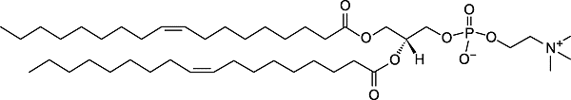
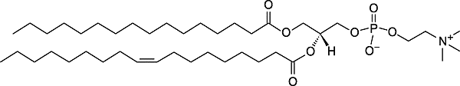
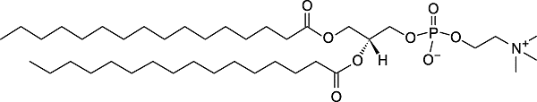
Lipid Compositions
Sample | Composition | mole ratio
1 | DOPC/POPC | 100/0
2 | DOPC/POPC | 70/30
3 | DOPC/POPC | 50/50
4 | DOPC/POPC | 30/70
5 | DOPC/POPC | 0/100
DOPC
POPC
Sample | Composition | mole ratio
1 | DOPC/DPPC | 100/0
2 | DOPC/DPPC | 70/30
3 | DOPC/DPPC | 50/50
4 | DOPC/DPPC | 30/70
5 | DOPC/DPPC | 0/100
DPPC

Slide 4
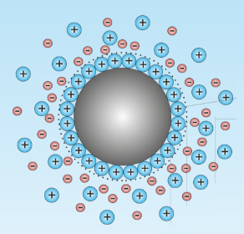
Proof for Coating- Zeta Potential
Determining the vesicles surface potential by Zeta Potential

Slide 5
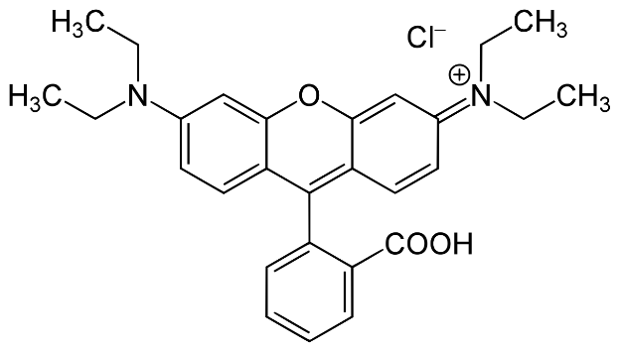
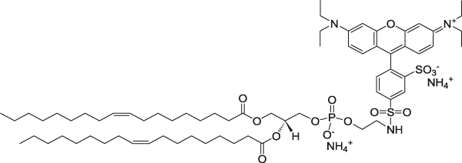
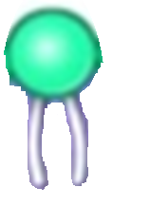
Proof for Coating by Rhodamin Emission
The amount of lipids in the coating is determined by Rhodamin emission
N_Rhodamin_PE dye
Located on bilayer membrane surface
So₃-
 | % Of the lipid in the coating DOPC/POPC composition | % Of the lipid in the coating DOPC/DPPC composition
100/0 | 61 | 64
70/30 | 62 | 48
50/50 | 53 | 71
30/70 | 38 | 58
0/100 | 77 | 26
Before cleaning free lipids in the solution
after cleaning free lipids in the solution

Slide 6
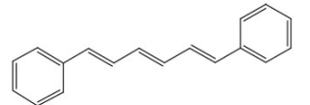
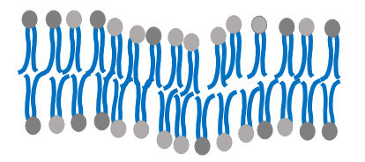
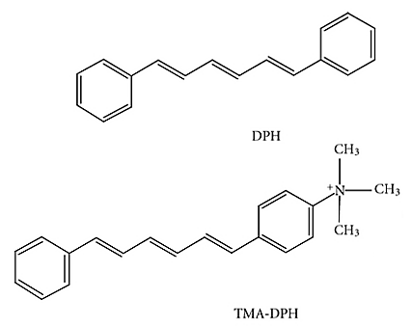
Fluorescence Anisotropy
Masurement of the bilayer fluidity through anisotropy of TMA-DPH and DPH probes
TMA-DPH
DPH
DPH
TMA-DPH
0
Fluid membrane
0.4
Rigid membrane

Slide 7
Fluorescence Anisotropy Results
TMA-DPH DOPC/POPC

Slide 8
Fluorescence Anisotropy Results
DPH DOPC/POPC

Slide 9
Fluorescence Anisotropy Results
TMA-DPH DOPC/DPPC

Slide 10
Fluorescence Anisotropy Results
DPH DOPC/DPPC

Slide 11
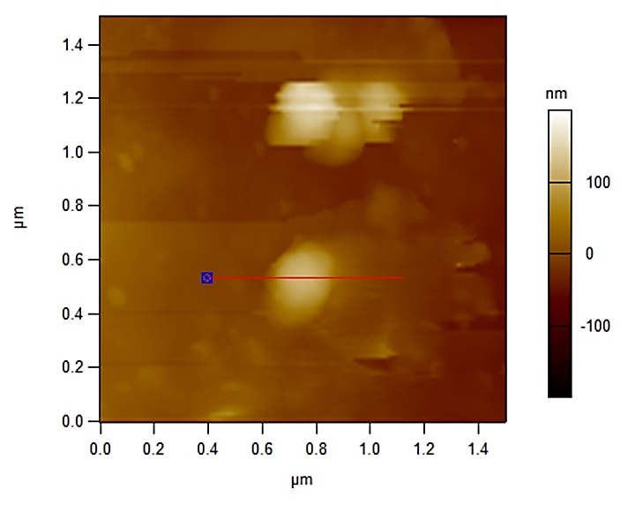

Characterization of coated nanoparticles Dimensions
AFM- DOPC/POPC Composition
Height Profile

Slide 12
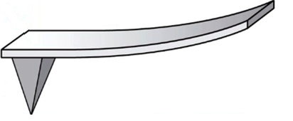
Silica Nano Particles Coating Thickness
Contact with the lipid layer:
The force increases
The distance does not change
Penetration of the lipid layer:
The force decreases
The distance decreases
Contact with the silica nanoparticle:
The force increases
The distance does not change

Slide 13
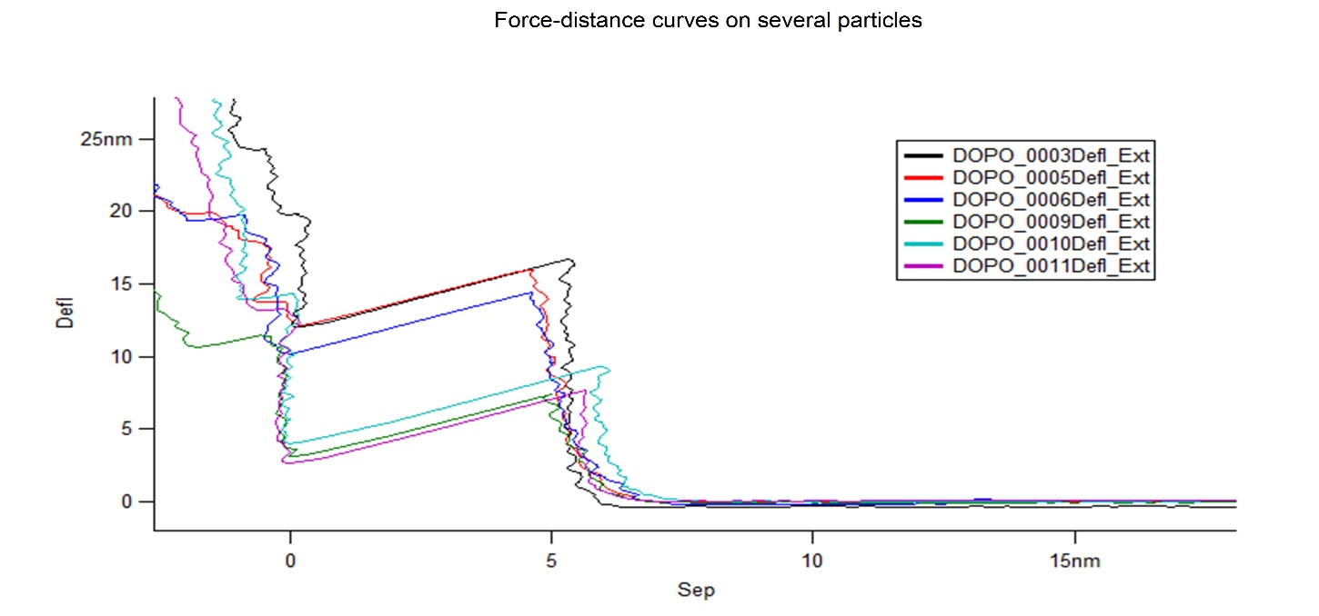
Silica Nano Particles Coating Thickness
DOPC/POPC composition
Force-Distance curves on several particles
5nm

Slide 14
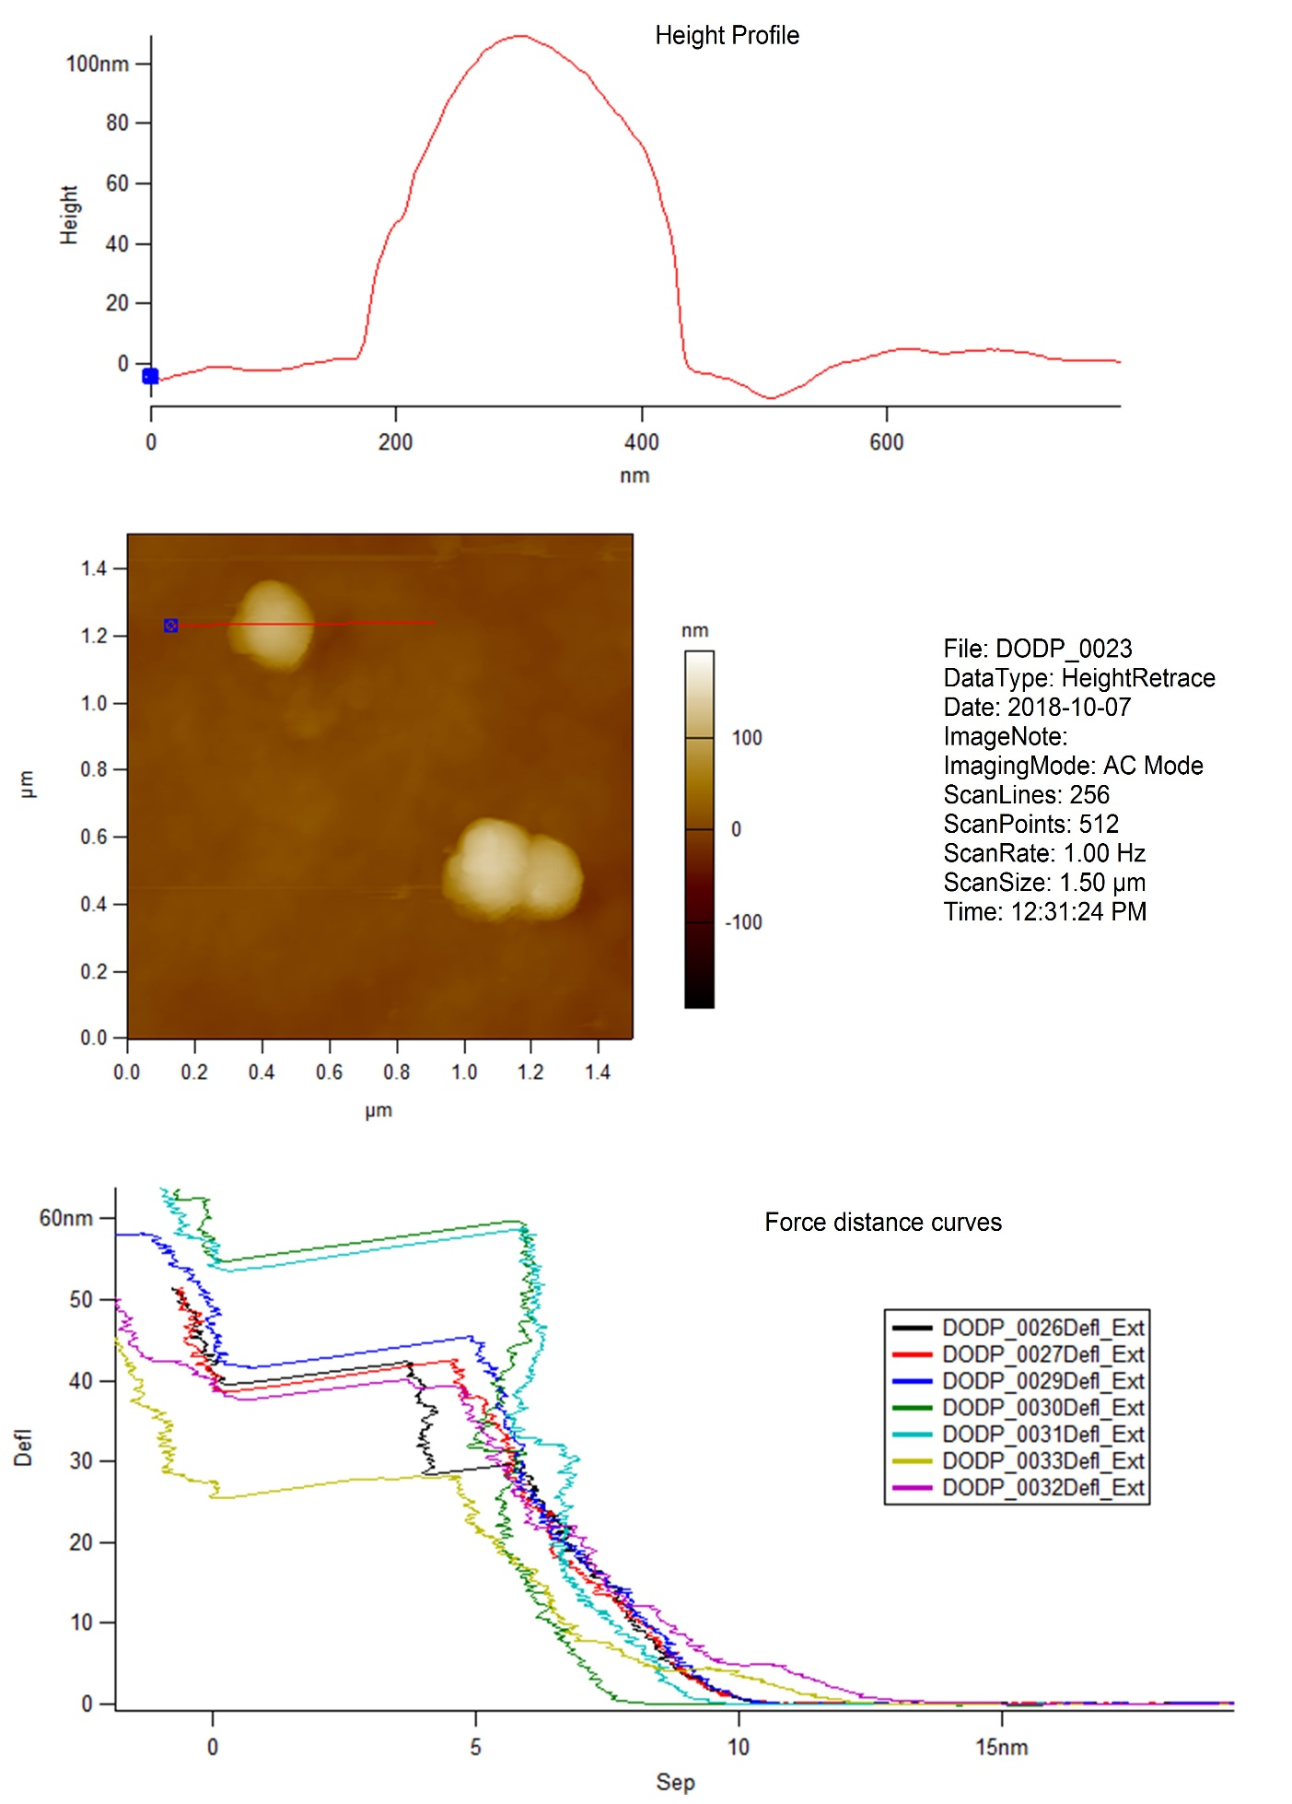
Characterization of coated nanoparticles Dimensions
DOPC/DPPC composition
Height Profile

Slide 15
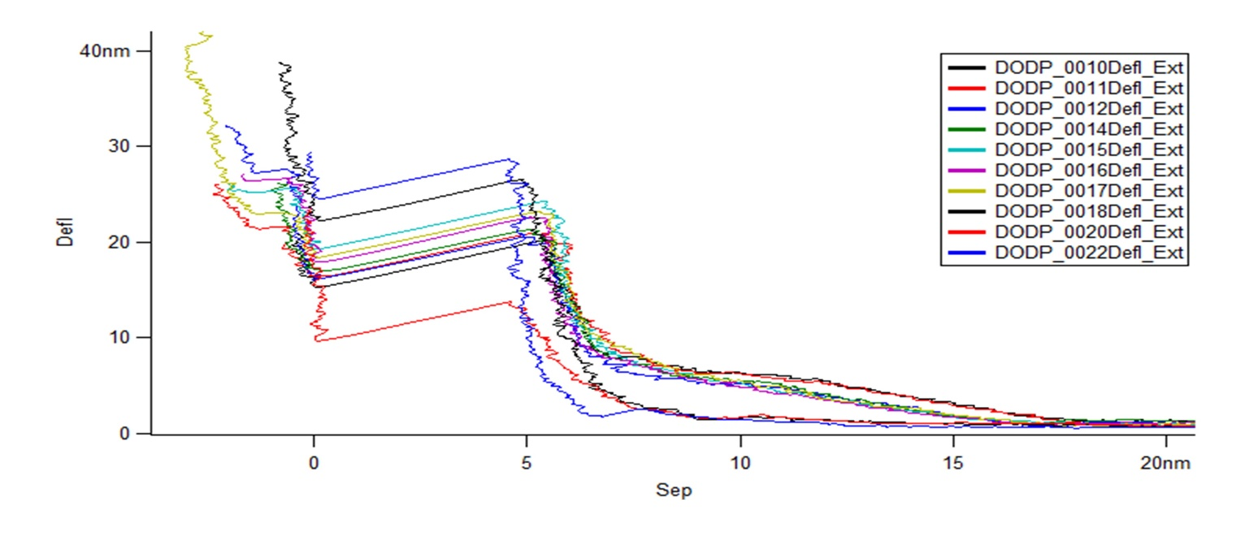
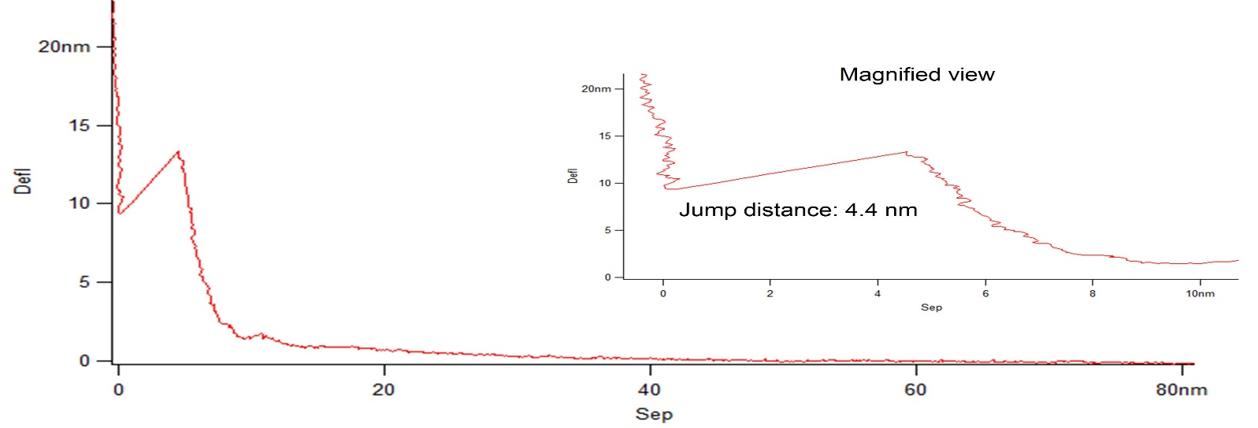
Silica Nano Particles Coating Thickness
DOPC/DPPC composition
Force-Distance curves on several particles
4.4nm
Magnified view

