Slide 1
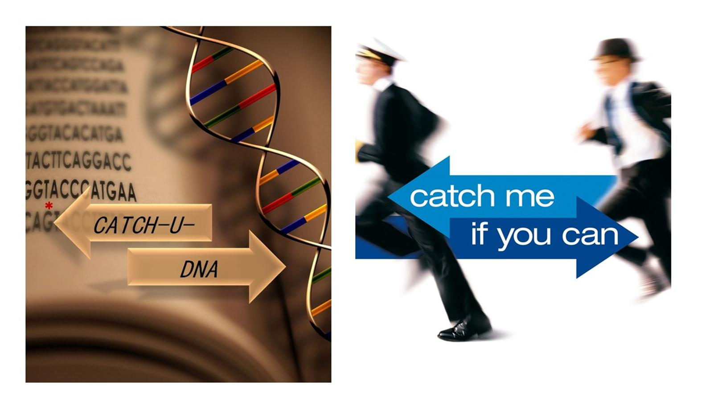
FORTH
Valencia, 21/05/2019

Slide 2
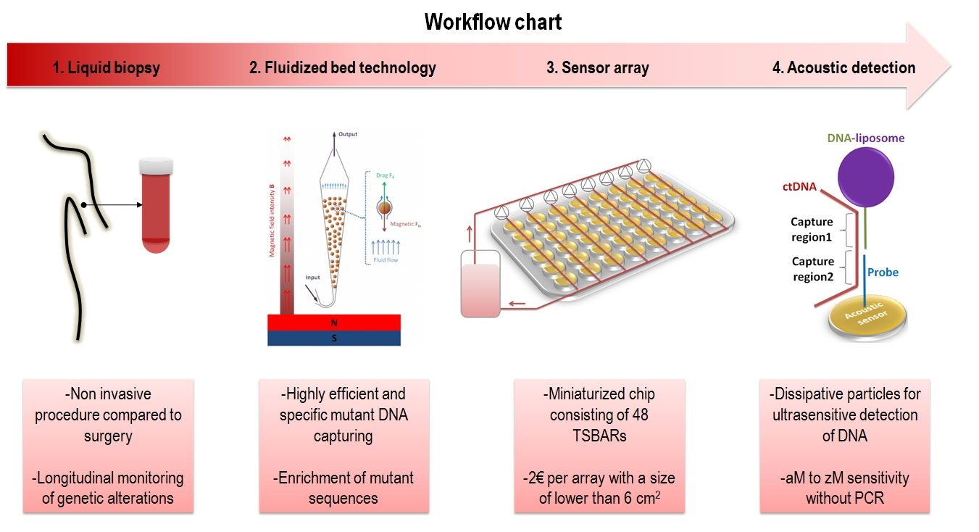

Protocol development
MUT:WT ?

Slide 3
ddPCR results (UoC) 66 samples – 1ml plasma
WT: 50-5000 copies
MUT: 2-50 copies

Slide 4
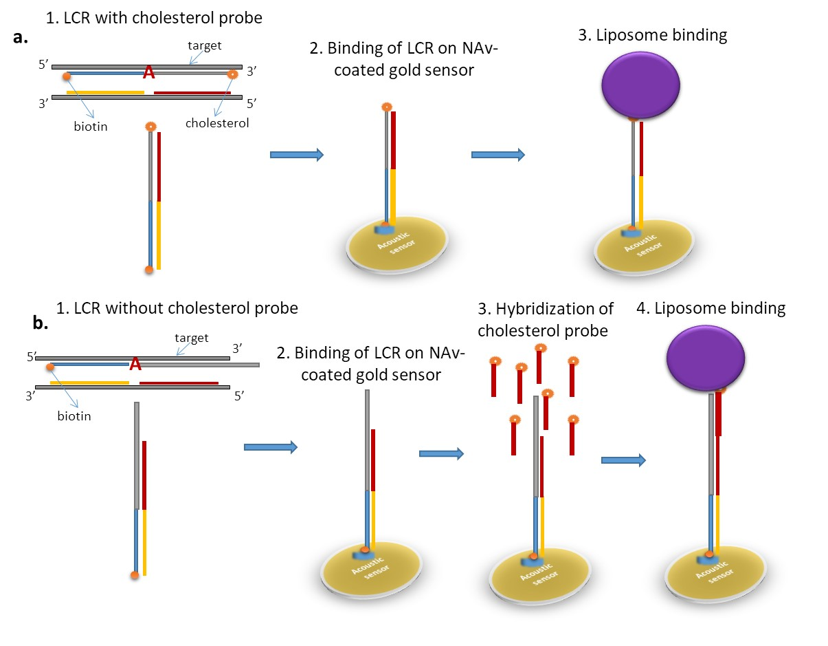
Progress 2018-2019
2. New (non-optimized) LCR protocol
(cycles, ligation temp, thermal cycler)
1. New (optimized) surface binding protocol
2018
99 cycles
75ºC
2019
30 cycles
65ºC
WT

Slide 5
Ongoing work
Increase MUT
Eliminate WT

Slide 6
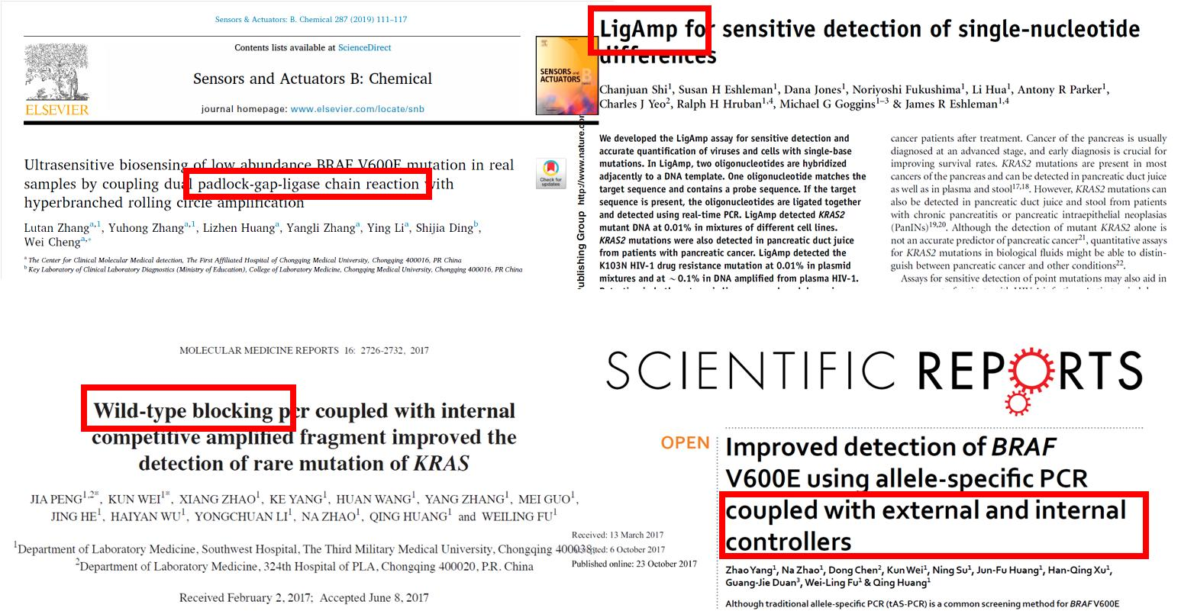

Slide 7
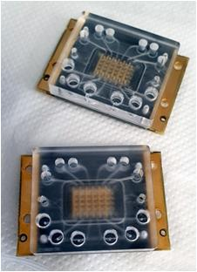
150 MHz array testing
Liposomes
Biotin-BSA
NAv
DNA

Slide 8
150 MHz array results (Protein layers)

Slide 9
DNA (bp) | 5 MHz | 150MHZ
50 | 5 pmoles/200ul (25nM) | 6 pmoles/60ul (100nM)
157 | 0.5 pmoles/200ul (2.25nM) | 0.5 pmoles/30ul (17nM)
150 MHz array results (DNA)

Slide 10
150 MHz array results (Liposomes)

