Slide 1

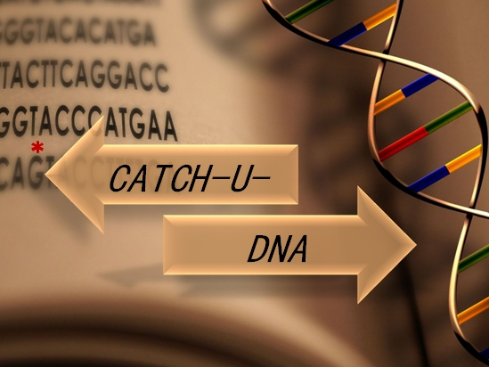
Nikoletta Naoumi
PhD candidate

Slide 2
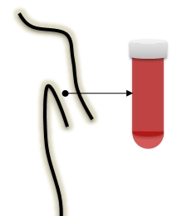
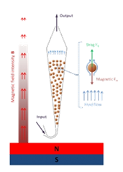

Objective-Concept
<0.1% mut:wt
Extraction of total cfDNA or ctDNA targets using the fluidized bed technology (Curie)
2. Amplify mutant targets obviatng PCR -> LCR
3. Surface immobilization
& detection
Liposomes
Mt target
Acoustic sensor
Notes:
Here is presented the main concept & methodology of the project
First is the extraction of total cell free or the enrichment of ctDNA targets of interest using the fluidized bed technology from curie. With high specificity since they are presented in heterogenous dna population and in less than this percentage compare to the wild type
2nd step is the amplification and enrichment of the mt targets in the wt population obviating any polymerization assay and by performing the Ligase Chain Reaction. Then the mt targets will selectively imobillize on the surface of the sensor triggering the binging of highly dissipative particles and followed by acoustic detection.

Slide 3
1. ctDNA extraction using the fluidized bed
<0.1% mut:wt
Extraction of total cfDNA using kits or the ctDNA using fluidized bed technology (Curie)
2. Amplify mutant targets obviatng PCR -> LCR
3. Surface immobilization
& detection
Liposomes
Mt target
Acoustic
sensor
Notes:
So, let’s focus here in the combination of LCR with the fluidize bed technology.

Slide 4

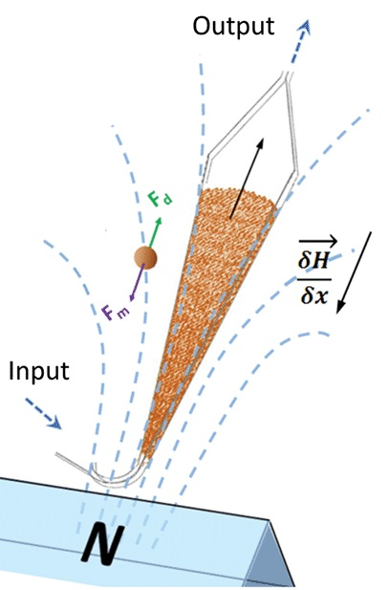

1. ctDNA extraction using the fluidized bed
i. Extraction of total cell free DNA
On beads LCR
ii. Target-specific enrichment
Release of the target
iii. On – chip LCR
LCR
Notes:
During July I visit this excellent lab of stephanie descroix and work with lucile and Mahn. It was our 1st attempt to merge the two technologies. This figure presents 3 main for ctDNA extraction using the fluidized bed followed by LCR. First approach is the extraction of total cell free DNA using positively caharged magnetic beads.
2nd approach is the enrichment of the specific targets of interest using magnetic beads which carry complementary to the target probes. Then, LCR can be performed either directly on beads with the the captured target or after the release of the target.
Last but not least is the to achieve on chip-LCR.
During my stay there we focused on the 2nd approach. Despite the fact that we deal with a lot of issues we manage to have some preliminary data.

Slide 5
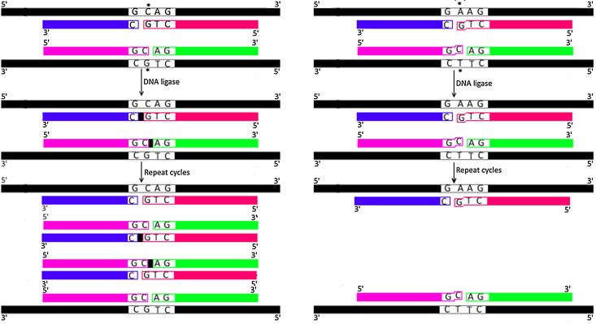
2. Amplification via Ligase Chain Reaction (LCR)
Perfect match
Mismatch
Exponentially amplified product
No amplified product
Notes:
I have also this slide in case you want to explain again the Ligase chain reaction assay.
Ligase Chain Reaction is a DNA template-dependent technique which leads to the amplification of the target by a thermostable DNA ligase and not with polymerase. During LCR the dsDNa target is denaturated in high temperature and hybridized in lower temperature with either 1 pair of probes (so amplify only the 1 strand of DNA or with 2 pair of probes enhancing both strands of DNA. Upon hybridization of the probes with the template, the ligase connects the two adjacent oligos only when there is perfect complementation like in this case, which is in the case of the mt target. If there is a mismatch in the ligation site like here which reflects the wt population, then it will not be ligated and amplified.

Slide 6
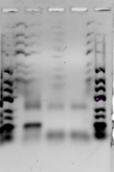
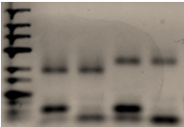
1st attempt merging the fluidized bed with LCR
Template; bio-BRAF
LCR product
1 2
Mt Wt Mt Wt
Mt Wt neg
Performing LCR in the presence of magnetic beads;
Functionalized with 20 nt b-probe
Not fuctionalized
100 bp
After capturing of the target on the fluidized bed followed by release and LCR
Successful detection of BRAF V600E point mutation after a. release of the target from the magnetic beads, b. in the presence of magnetic beads
Notes:
Here are presented some of the main results. In this picture firstly 2.5 pmol of single strand dna target mimicking the mt the the wt sequence of BRAF was captured in fluidized bed. The procudure perform in clean sample tris edta. After the capturing, the target was released from the beads via heat and about the 1.6 pmol were collected in a different tube where i performed LCR.
LCR products were analyzed in 2 % agarose gel. As you can see, there was successful amplification of only the mt target, after capturing and release from the fluidized bed.
However we couldn’t perform directly on beads LCR because our systems were not compatible. My LCR probes and the probes of the beads were complementary to the same region of the target, so there was competition between the probes.
Thus, I choose to perform LCR for the detection of 1 pmol biotinylated mt or wt target in the presence of 250 μγ of magnetic beads. Here the magnetic beads were fuctionalized with a random b-20nt probe. Here were not fuctionalized which means that the b-target will interact with the streptavidin coated beads. However in both cases the target was detected with specificity, which means that LCR can be combined and conducted in the presence of beads and there isn’t any interfering.

Slide 7
3. Surface immobilization
LCR
target
5’
A
3’
DNA-liposome
3’
5’
biotin
cholesterol
Ligated product
Acoustic
sensor
NAv-biotin interaction
Modified oligo with biotin & cholesterol;
direct immobilization on sensor surface

Slide 8
3. Surface immobilization; NAv-biotin interaction
Neutravidin + DNA + Liposomes
Biotinylated-BSA + NAv + DNA + Liposomes
Vs
Gold sensor
b-BSA
Liposomes 200nm
DNA
Gold sensor
Neutravidin (Nav)

Slide 9
Neutravidin (Nav) vs b-BSA+Neutravidin

Slide 10
Comparison of real time curves of high and low [NAv]
Low[NAv] characterized by better stability

Slide 11
Real time monitoring of LCR mix on NAv
Neutravidin
LCR: 99 cycles (50 min total duration)
200 nm POPC liposomes (0.5 mL* 0.2 mg/mL)
Negative control -> big ΔD & ΔF
Non specific interaction of liposomes with sensor surface
LCR mix causes detachment of the NAv Layer

Slide 12
Acoustic detection of BRAF-V600E
b-BSA / Neutravidin
LCR: 99 cycles (50 min total duration)
200 nm POPC liposomes (0.5 mL* 0.2 mg/mL)
Notes:
-31,3542 frequency
0,529917 dissipation

Slide 13
Control Wt:
High[NAv] 1.67E+08 molecules of Wt
Low[NAv] 1.67E+06
No need for negative control
LOD &error bars were partially improved by further optimization of substrate.
Current LOD is 1.67+05 DNA molecules carrying the BRAF V600E, decreased an order of magnitude.
Wt_control
Notes:
WT gives non-specific ligation however we have added more ammount tha the necessary
Mt:Wt is 1:1000 ~ 1:10000
-> so the 1.67E+0.8 molecules for the Wt as control are quite higher amount than the necessary

Slide 14
Conclusions
The big error bars are due to variation between different LCRs (eg instability of the cholesterol of the probe, fresh materials).
Current LOD of BRAF-V600E acoustic detection is the 1.67E+05 molecules initial target
LCR can be combined with fluidized bed technology

Slide 15
Future experiments
Design and synthesis of bigger DNA probes in order to produce > of 100 bp ds DNA molecules via LCR
Further optimization of LCR in order to decrease the LOD remaining the specificity of the assay (increase the No of cycles, remove the cholesterol probe)
Use more dissipative liposomes

Slide 16
1. LCR with cholesterol probe
a.
3. Liposome binding
target
2. Binding of LCR on NAv-coated gold sensor
5’
A
3’
3’
5’
biotin
cholesterol
Acoustic
sensor
Acoustic
sensor
1. LCR without cholesterol probe
3. Hybridization of cholesterol probe
4. Liposome binding
b.
target
3’
2. Binding of LCR on NAv-coated gold sensor
5’
A
3’
5’
biotin
Acoustic
sensor
Acoustic
sensor
Acoustic
sensor

Slide 17
A realistic scenario
200 * 1 mL serum samples (150 cancer patients
+ 50 wt population)
Focused on only 2 point mutations;
BRAF-V600E
1 KRAS
* Sequential extraction of point mutation from 1 mL of serum

Slide 18
Estimation of sample-validation time
ctDNA extraction from serum samples
2 x 1 mL of serum (2 to 4 hours ??)
Ligase Chain Reaction to amplify mt target & Liposome preparation
2.5 hours for LCR
Acoustic detection of LCRs using the AWS sensors and JOBST platforms
~ 2 - 2.5 hours
2.5 hours for Liposome preparation
12 hours / day in total
200 days !!

Slide 19
Estimation of sample-validation time
Sample preparation from Curie should start 1-2 months
earlier (at least 2 samples per day)
Massive production of eg 20-40 LCRs at once followed by
acoustic detection the following days
2 x acoustic assays per day
Could be decreased to 100 days??

