Slide 1
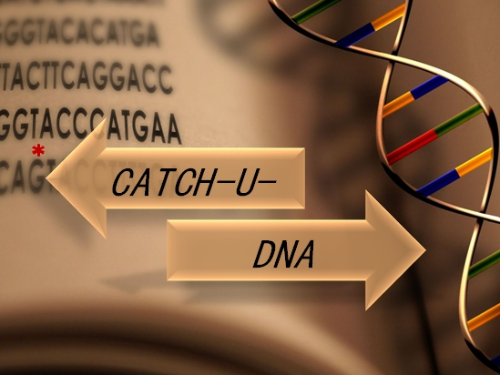

WP3 & WP4
Crete, Greece – 28/6/2019
Heraklion 28/06/2019

Slide 2
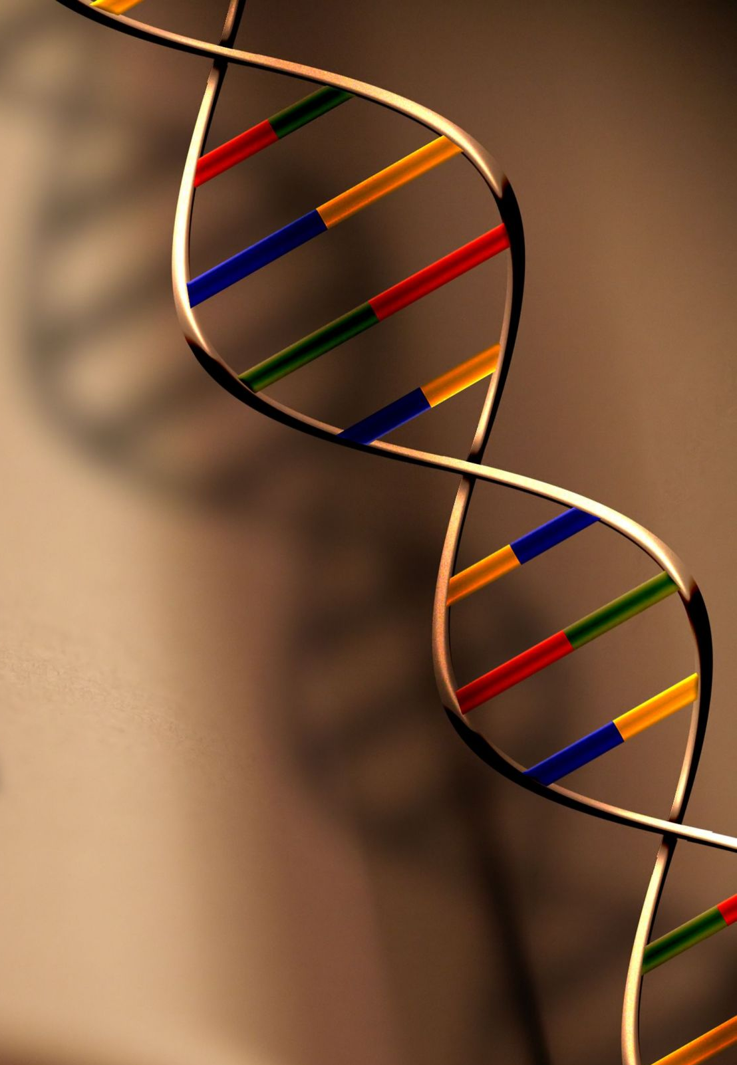
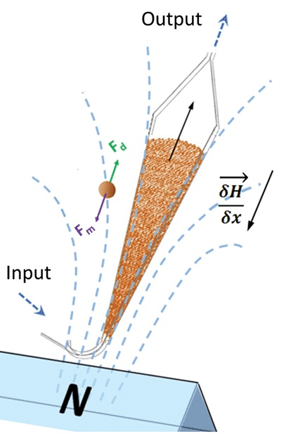
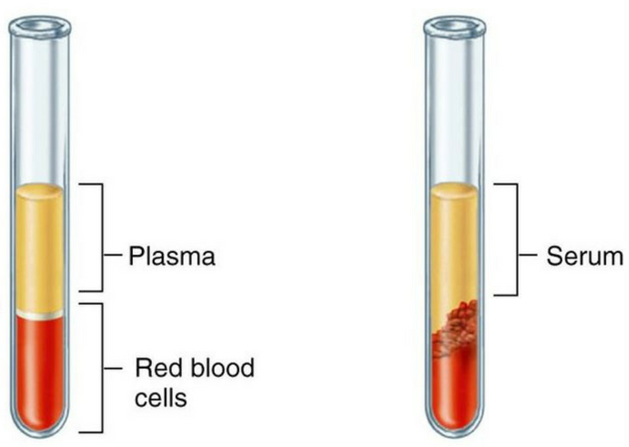
Objective-Concept
<0.1% mut:wt
1. Extraction of ctDNA targets
3. Surface immobilization
& detection
2. Amplify mutant targets obviating PCR -> LCR
Liposomes
Acoustic
sensor
Mt target
Review Meeting M24, Heraklion, 28/6/19
Notes:
using the fluidized bed technology (Curie)
Here is presented the main concept of the project. First step is the extraction of total cell free dna, or the enrichment of specific ctDNA targets using the fluidized bed technology from curie. 2nd step is the amplification of only the mt targets with high specificity since they are presented in very low amount compare to the wt population. The amplification will be achieved using a ligase based method, specifically LCR, thus obviating any polymerization assay. Then the amplified mt targets will selectively imobillize on the surface of the sensor triggering the binging of highly dissipative particles to achieve acoustic detection.

Slide 3
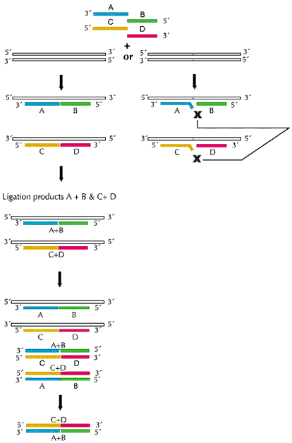
Ligase Chain Reaction (LCR)
Mt
Wt
Denaturation @ 92 ºC
Annealing & Ligation
@ 75 ºC – 65 ºC
Missmatch
No Ligation
No amplification
Review Meeting M24, Heraklion, 28/6/19
Exponentially amplified target
Notes:
Ligase Chain Reaction is a DNA template-dependent technique which leads to the amplification of the target by a thermostable DNA ligase and not with polymerase. During LCR the dsDNΑ target is denaturated in high temperature and hybridized in lower temperature with either 1 pair of probes (so amplify only the 1 strand of DNA or with 2 pair of probes enhancing both strands of DNA. Upon hybridization of the probes with the template, the ligase connects the two adjacent oligos only when there is perfect complementation like in this case, which is in the case of the mt target. If there is a mismatch in the ligation site like here which reflects the wt population, then it will not be ligated and amplified. If you use only the one pair of probes then only the 1 strand of dna is amplified in a linear way, and if you use 2 pair of probes, then both strands of DNA are amplified, leading to exponential amplification. In my case, during lcr I use oligonucleotide probes modified in their one end with biotin or cholesterol to produce mt dsDNA product modified at the 5’ end with a biotin and at the 3’ end with cholesterol

Slide 4
ddPCR results (UoC) 66 samples – 1ml plasma
UoC results of the analysis of KRAS G12D codon with ddPCR
MUT: 4-100 copies
WT: 100-10000 copies
Review Meeting M24, Heraklion, 28/6/19

Slide 5
Main results of WP4 of the 2018 review meeting
Review meeting 2018;
1. LCR with modified with biotin and cholesterol probes
2. b-BSA + NAv substrate
3. Acoustic LOD; 1.67E+ 06 after 99 cycles of exponential LCR
+ b-BSA
+ NAv
+ LCR
+ POPC
Review Meeting M24, Heraklion, 28/6/19
Notes:
Main results of WP4 that were presented Develop a protocol of LCR using modified
for direct immobilization on Nav-coated substrate
About this part descrive the picture. Using this method we manage a LOD down to 1.67E + 06 after 99 exponential cycles LCR

Slide 6
Acoustic LCR detection on optimized NAv substrate
Optimization of the NAv amount on b-BSA
LCR with cholesterol probe in the reaction;
99 cycles
60 min duration
Wt control; 1.67E + 06
LOD; 1.67E + 05 from 1.67E + 06
Good specificity
Low efficiency
1. LCR with cholesterol probe
target
3. Liposome binding
5’
A
3’
2. Binding of LCR on NAv-coated gold sensor
3’
5’
biotin
cholesterol
100bp
Acoustic
sensor
Acoustic
sensor
Review Meeting M24, Heraklion, 28/6/19
Notes:
By further optimizing the Nav substarte finding the optimal amount of nav addition,
Low efficiency
Good specificity
Cholesterol affect the efficiency

Slide 7
Development of a new LCR protocol and acoustic method
1. Further optimization of LCR;
Changing the annealing temperature (65 ºC from 75 ºC), number of cycles, thermal cycler
2. New surface binding protocol;
Design of new LCR probes in order to remove the cholesterol from the reaction
1. LCR without cholesterol probe
3. Hybridization of cholesterol probe
target
4. Liposome binding
5’
A
3’
2. Binding of LCR on NAv-coated gold sensor
3’
5’
biotin
120 bp
Acoustic
sensor
Acoustic
sensor
Acoustic
sensor
Review Meeting M24, Heraklion, 28/6/19
Notes:
Here is a different approach for the detection of lcr products via liposomes but removing the cholesterol from the reaction. In figure a is presented the current method that I use. As you see In figure b firstly LCR produces an assymetric biotinylated product but without cholesterol. The product is immobilized on nav followed by one step of hybridization of cholesterol probe with the ss region of the product followed by liposome binding

Slide 8
Acoustic detection of 30 cycles LCR - without cholesterol
LCR without the cholesterol probe in the reaction;
30 cycles (instead of 99)
35 min (instead of 60 min)
Wt control; 2x V600E copies
Better efficiency (LOD; 3340 mt copies)
by-products
Review Meeting M24, Heraklion, 28/6/19
Notes:
Overlap in the error bars
Background signal of non-specific by-products remains constant regardless the initial amount of wt copies -> blunt end ligation
Background signal of non-specific by-products remains constant regardless the initial amount of wt copies -> blunt end ligation

Slide 9
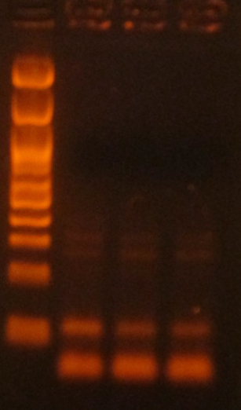

New Exponential LCR protocol; limitations
Mt Wt neg
50fg 100fg 0
Blunt-end
ligation
LCR
100 bp
Complementary
Missmatch
A
T
T
T
A
A
T
A
a. Target dependent ligation
b. Non-specific ligation
c. Blunt end Ligated product
b., c. -> by-products
Blunt-end ligation in more than >30 cycles
Review Meeting M24, Heraklion, 28/6/19

Slide 10
Progress September 2017- May 2019
December 2017; LCR on NAv -> NO
May 2018; LCR on b-BSA+NAv-> LOD 1.67E+06
December 2018; Optimization of NAv on b-BSA -> LOD 1.67E+05
December 2017; b-BSA+NAv substrare
May 2019; New LCR protocol and new acoustic method -> LOD 3340
Review Meeting M24, Heraklion, 28/6/19

Slide 11
ctDNA extraction using the fluidized bed
Review Meeting M24, Heraklion, 28/6/19

Slide 12
ctDNA extraction using the fluidized bed
i. Extraction of total cell free DNA
On beads LCR
ii. Target-specific extarction
Release of the target
iii. On – chip LCR
LCR
Review Meeting M24, Heraklion, 28/6/19
Notes:
An other step was to combine the LCR with an extraction method. During July I visit this excellent lab of stephanie descroix and work with lucile and Mahn. It was our 1st attempt to merge the two technologies. This figure presents 3 main for ctDNA extraction using the fluidized bed followed by LCR. First approach is the extraction of total cell free DNA using positively caharged magnetic beads.
2nd approach is the enrichment of the specific targets of interest using magnetic beads which carry complementary to the target probes. Then, LCR can be performed either directly on beads with the the captured target or after the release of the target.
Last but not least is the to achieve on chip-LCR.
During my stay there we focused on the 2nd approach. Despite the fact that we deal with a lot of issues we manage to have some preliminary data.

Slide 13
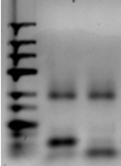
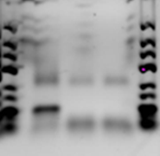
1st attempt merging the fluidized bed with LCR
LCR product
Mt Wt
Mt Wt neg
100 bp
100 bp
After capturing of the target on the fluidized bed followed by release and LCR
Performing LCR in the presence of magnetic beads
Successful detection of BRAF V600E point mutation after a. release of the target from the magnetic beads, b. in the presence of magnetic beads
Next step: Capturing of dsDNA target in plasma/serum using fluidized bed (Curie) followed by LCR and acoustic detection (FORTH)
Review Meeting M24, Heraklion, 28/6/19
Notes:
Here are presented some of the main results. In this picture firstly single strand dna target mimicking the mt the the wt sequence of BRAF was captured in fluidized bed. The procudure perform in clean sample tris edta. After the capturing, the target was released from the beads via heat and collected in a different tube where i performed LCR. As you can see, there was successful amplification of only the mt target, after capturing and release from the fluidized bed.
However we couldn’t perform directly on beads LCR because our systems were not compatible. My LCR probes and the probes of the beads were complementary to the same region of the target, so there was competition between the probes.
Thus, I perform LCR for the detection of mt or wt target in the presence of 250 μγ of magnetic beads. the target was detected with specificity, which means that LCR can be combined and conducted in the presence of beads and that there isn’t any interfering.
Next step is the capturing of dsDNA targets in plasma/serum uisng fluidized bed (Curie) followed by LCR

Slide 14
Validation of AWS platform
Review Meeting M24, Heraklion, 28/6/19

Slide 15
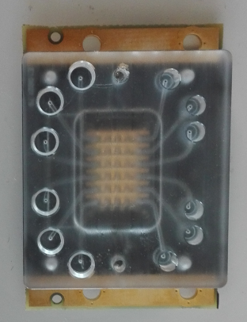
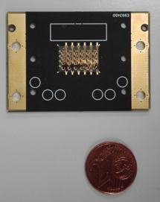
Validation of AWS platform
Advanced Wave Sensors (AWSensors)
Use of 24 array miniaturized HFF –QCM sensors
Total surface capacity; 2-3 uL
150 MHz
24 sensor array
Output
Input
Review Meeting M24, Heraklion, 28/6/19

Slide 16
Validation of AWS platform
1.
2.
3.
Review Meeting M24, Heraklion, 28/6/19

Slide 17
Comparison of the adsorption of b-BSA & NAv @ 150 MHz to 35 MHz
Review Meeting M24, Heraklion, 28/6/19

Slide 18
Detection of biotinynalted dsDNA on NAv coated sensors @ 150 MHz
Frequency (MHz) | 35 | 35 | 150 | 150
DNA (bp) | pmols | nM | pmols | nM
50 | 5 | 25 | 5 | 100
157 | 0,5 | 2,25 | 0,5 | 17
Concerning the total amount of DNA the detection limit is the same.
Longer DNA gives higher ratio values.
Review Meeting M24, Heraklion, 28/6/19

Slide 19
Detection of dsDNA following the addition of POPC liposomes @ 150 MHz
Review Meeting M24, Heraklion, 28/6/19

Slide 20
Validation of AWS platform
AWS platform behaves with the same pattern like QCM-D.
Large error bars probably are due to differences in the response of the individual sensors.
Next step: Acoustic detection of LCR using AWS platform
Review Meeting M24, Heraklion, 28/6/19

Slide 21
Conclusions
Improved LCR protocol
Current LOD; 3340 molecules of mt target
LCR compatible with the fluidized bed
AWS platform comparable with QCM-D
Review Meeting M24, Heraklion, 28/6/19
Notes:
improved in efficiency and duration but non-optimized in terms of specificity (non specific & blunt-end ligation).
Current acoustic detection limit of BRAF-V600E is the 3340 molecules of initial target using the 30 LCR cycles protocol and removing the cholesterol from the assay.
AWS platform has relatively the same response pattern as QCM-D concerning the adsorption of proteins, ds-DNA, and dsDNA-liposomes.

Slide 22
Future work
Shorter probes (~15 nt each)
LCR optimization;
dsDNA capturing on fluidized bed followed by LCR and acoustic detection
LCR on AWS platform
PNAs
Annealing T & time
Review Meeting M24, Heraklion, 28/6/19
Notes:
design of new shorter probes (~ 15 nt each), use of PNAs to block the wt sequence in order to increase the specificity of the assay.
Capturing of dsDNA mimicking BRAF sequence in
serum using the fluidized bed followed by LCR and
acoustic detection (currently performing at
FORTH)
Detection of LCR products using the AWS
platform.

Slide 23
Thank you ☺

