Slide 1
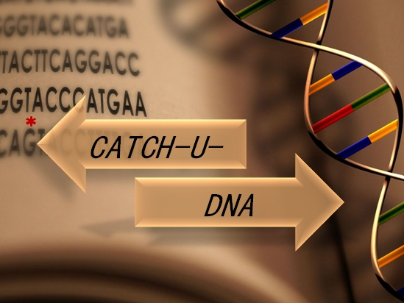

WP8

Slide 2
Objectives of WP8
Management of the Consortium
Management and mitigation of risks
Management of ethics
Timely completion of milestones and deliverables
Address reviewers comments from PPR1 (M12)
Duration WP8: from M1 to M36
CATCH-U-DNA M24-Review, 28/6/19

Slide 3
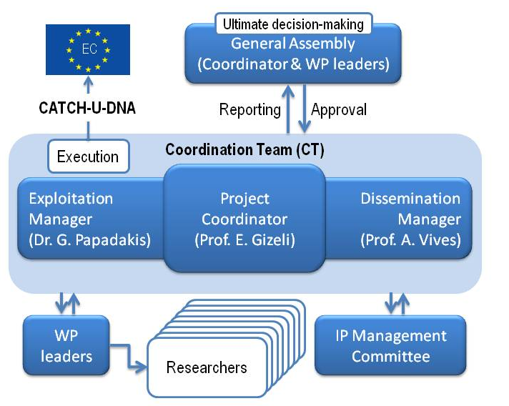
Project management structure
Dr R. Fernandez
Dr G. Papadakis
Dr R. Fernandez
CATCH-U-DNA M12-Review, 28/6/19

Slide 4
Regular 6-month meetings
Meeting dates | Location | No of Meeting | Participants
1-2/12/2018 | Madrid-Spain (UAM) | 4th (M18) | 14 members
20/5/2019 | Valencia (Spain) | 5th (M24) | 16 members
Several ad-hoc web-meetings/discussions
CATCH-U-DNA M24-Review, 28/6/19

Slide 5
Deliverables M12-M24
Deliverable | Deliverable name | WP | Leader | Type | Dissem. | Deliv.
 |  |  | Partic. |  | level | Date
D1.1 | Report on the design and electrical characterization of the sensor micro-array | 1 | AWS | R | CO | M14
D6.1 | Report on electrical and fluidics assembly providing high signal quality and compatibility with bio-functionalization | 6 | JOBST | R | CO | M15
D1.2 | Report on characterization of micro-sensors to biological sensing with frequency | 1 | AWS | R | PU | M18
D2.3 | Lipid vesicles: physical samples; synthesis protocols; characterization database | 2 | BGU | R | PU | M18
D4.2 | Report on optimized surface hybridization conditions | 4 | FORTH | R | PU | M18
D2.1 | Molecular dynamics simulations of DNA strands under GHz oscillatory shear flow | 2 | UAM | OTH | PU | M20
D1.3 | Design and implementation of the electronic characterization interface | 1 | AWS | R | CO | M24
D3.1 | Optimized protocol for ctDNA selective capturing on magnetic beads in serum | 3 | Curie | R | PU | M24
D5.1 | Collection of samples, creation of clinical database | 5 | UOC | DEM | PU | M24
D6.2 | Report on sensitivity increase scaling by local and temporal shear rate engineering | 6 | JOBST | R | CO | M24
D7.2 | Report on publications to the scientific community and general public per year | 7 | BGU | R | CO | M24
D7.3 | Report on staff exchange and workshops/conference attendance per year | 7 | UOC | R | CO | M24
D7.4 | Report on IPR issues and technology promotional events | 7 | AWS | DEC | CO | M24
D8.2 | Activity and management reports of months 12-24; two meetings of the GA | 8 | FORTH | R | CO | M24

Slide 6
No | Milestone name | WP | Date | Means of verification
M1 | Decision on type and frequency of TSBARs | 1 | M18 | Achieved: TSBARs were abandoned as an option and substituted by the HFFQCM devices; the latter have been tested successfully for their ability to detect DNA and liposomes’ binding
M2 | Functional array of acoustic devices | 1 | M18 | Achieved: Report on the design and electrical characterization of the sensor micro-array was submitted in D1.1.
M3 | Novel measurement technique for characterization of the acoustic array | 1 | M24 | In progress: Operation in real-time has been validated for individual sensors and results provided are in good agreement with reference methods.
M5 | Selection of the most dissipative particles | 2 | M18 | In progress: up to M24 a whole range of liposomes was tested; PMPC was identified as the most dissipative structure with a DC value 1.5 times higher than POPC
M6 | Hydro-simulations of coarse-grained complex structures in oscillatory flow | 2 | M24 | Achieved: we have produced a fast GPU code solving the hydrodynamics of the QCM response of analytes. Simulations reproduce the DC’s measured in experiments with liposomes. Also provided a theory for QCM response. These tools are now used to search more dissipative structures.
M9 | Construction of clinical sample data base (200 tissue samples; 100 blood samples) | 5 | M24 | Achieved: Tissue samples: 119; Plasma samples: 225
M12 | Sensitivity by shear rate engineering >100 fold | 6 | M24 | In progress: Experimental results comparing to standard flow

Slide 7
Description of risk | WP | Proposed risk-mitigation measures
Acoustic devices do not meet the expected sensitivity requirements (low to medium risk based on P3’s experience) | 1 | HHFQCM was selected operating at 150 MHz
Measurement system does not meet the expected stability requirements (medium) | 1 | In progress: Re-design steps and optimization loops have been included in work-plan
Failure to identify liposomes with dissipative capability>0.310⁻⁶ Hz⁻¹ (medium) | 2 | In progress: use of complex structures employing more than one liposomes
Mesoscopic simulations not able to reproduce the experimental values of resonant frequency shift due to too large time separation (high to medium risk) | 2 | Not applicable; same resolution in frequency achieved as in experiments
Failure to demonstrate 0.1 zM ctDNA detection without amplification (medium to high risk) | 3,4 | In progress: Current Lod: 10 zmol; select more dissipative probes & continue optimization of fluidized bed + enrichment process. If still a problem, use rapid RCA isothermal amplification step or allele specific PCR.
Damage or contamination to materials causing exclusion of samples (medium risk) | 5 | Not applicable; the guideline for sample preparation (D4.1) will contain measures to minimize this risk
NGS data not available from FFPE tumor tissue/plasma in many samples due to poor quality & limiting amount of DNA (high) | 5 | Not applicable; NGS was performed in small number of tissue samples due to limited amount of starting material. Targeted sequencing is used instead looking at specific mutations
Assembly deteriorates sensing signal (low, P5 has already experience in SAW devices) | 6 | Achieved: Repeated assessment of signal integrity along assembly development
ctDNA lost by adsorption to µfluidics walls (high) | 6 | In progress: Specific anti-adsorption surface priming
Hydraulic drag rate detaches captured ctDNA or liposomes (low risk) | 6 | In progress: Evaluation of upper shear rate limit of acceleration for ctDNA capture; liposome binding at low flow
CATCH-U-DNA M24-Review, 28/6/19

Slide 8
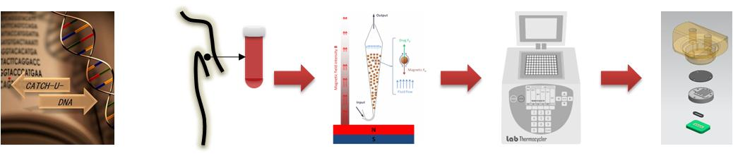
CATCH-U-DNA Work-flow diagram (Year 2)
Process | Blood draw | Fluidized bed capturingª | Ligase Chain Reaction^{b} | LCR + Acoustic detection^{d}
Sample | Plasma/serum | Serum | Buffer | Buffer
Starting volume | 1 ml | 1 ml | 15 μl | 25 μl
Ending volume | 1 ml | 15 μl | 25 μl | 125μl/sensor
Flow rate | - | 15 μl/min | - | 50 μl/min
Initial No of mutant copies | 50 (0.1 zmol) | 1.5x10¹² (1 fmol) | 33x10² (10 zmol) | 288x10⁷ (4.8 fmol)
Efficiency | n/a | 80% (capturing) | Exponential^{c} | n/a
Time | 5 min | 67 min | 35 min | min
CATCH-U-DNA M24-Review, 28/6/19

Slide 9
End of WP8

