Slide 1
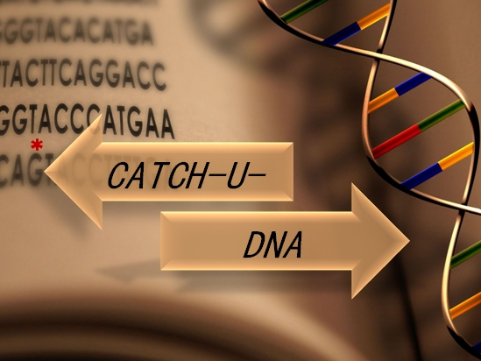

WP5 Validation of the acoustic platform during ctDNA detection in real samples
Kleita Michaelidou
Translational Oncology Laboratory
School of Medicine, University of Crete
CATCH-U-DNA Review Meeting M24, 28/06/19

Slide 2

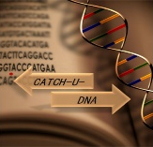
WP5 Validation of the acoustic platform during ctDNA detection in real samples
Objectives of WP5
Patient sample collection (tumor tissue and plasma/serum and relevant clinical information) (M24)
Perform targeted next generation sequence (NGS) analysis in tumor tissue (primary or metastatic) from 200 patients (non-small cell lung cancer (NSCLC): n=100 and colorectal cancer (CRC): n=100) (M12)
Perform targeted mutation analysis on ctDNA in 100 patients found by NGS analysis to harbor mutations in their tumors (based on mutation frequencies reported in the literature approximately 50% of the 200 patients are anticipated to harbor mutations in KRAS, EGFR and BRAF) (M30, ongoing)
Duration of WP5: from M1 to M36
CATCH-U-DNA Review Meeting M24, 28/06/19

Slide 3
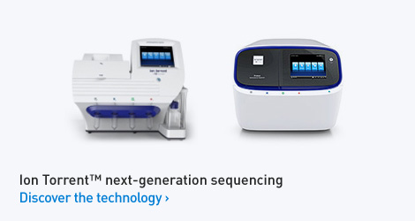
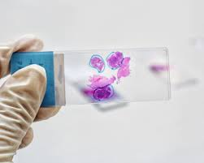
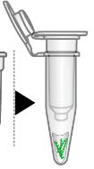
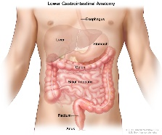
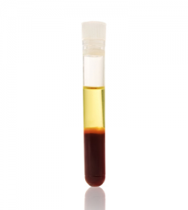
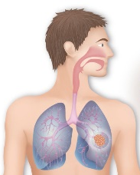

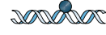
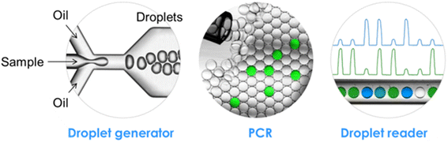
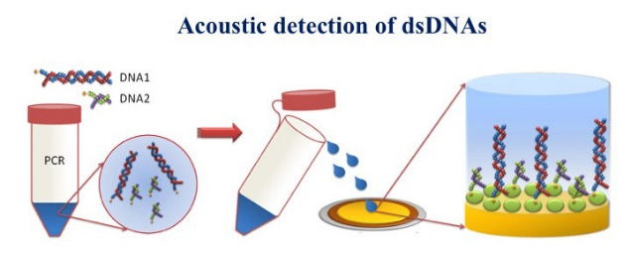
WP5 Validation of the acoustic platform during ctDNA detection in real samples
Overview
SNVs
CNVs
Fusions/Indels
M12
M30
Targeted mutational analysis on the ctDNA
M24 Collection of CRC and NSCLC samples
M36
Experimental validation of the acoustic method using model and clinical samples
CATCH-U-DNA Review Meeting M24, 28/06/19

Slide 4
TASK 1 (D5.1) Collection of samples (M1-24)
Objectives
To collect patient plasma and serum samples (n=200)
To collect corresponding tissue samples (n=200)
To collect relevant clinical information
To establish standard procedures for sample collection, preparation and handling
D5.1: Standard procedures for sample collection, preparation and handling; creation of clinical database (M24)
CATCH-U-DNA Review Meeting M24, 28/06/19

Slide 5
TASK 1 (D5.1) Collection of samples (M1-24)
KEY ACHIEVEMENTS
I. Establishment of clinical protocol
Key inclusion criteria are i) Definite histologic diagnosis of NSCLC and CRC ii) Patients scheduled to receive first-line or subsequent line of treatment for advanced or metastatic disease, iii) Age > 18 years’ old, and v) Adequate hepatic and renal function
II. Establishment of standard procedures for sample handling
III. Collection of samples
From June 2017 to May 2019, we collected plasma and serum samples from patients with NSCLC and CRC (n=225)
160 (71.1%) NSCLC patients
65 (28.89%) CRC patients
Tumor tissue specimens are available for 119 (53%) patients
small biopsies, cytological sample, sample exhaustion, diagnosis in remote centers
CATCH-U-DNA Review Meeting M24, 28/06/19

Slide 6
Descriptive statistics
 |  |  | Percentiles
Variable | Mean ± S.E. ª | Range | 25th | 50th (Median) | 75th
Patients’ Age (yrs) | 68.0 ± 1.13 | 43.0-89.0 | 60.8 | 68.0 | 73.8
PFS (months) | 10.8 ± 2.5 | 1.3 – 78.5 | 5.2 | 10.8 | 23.6
OS (months) | 17.7 ± 2.9 | 0.0 – 91.8 | 6.8 | 17.7 | 34.5
Variable | No. of patients (%)
TNM Stage ª
I/II | 5 (7.6)
III | 15 (22.7)
IV | 36 (54.5)
Unknown | 10 (15.2)
Treatment
Targeted treatment | 14 (21.2)
Chemotherapy | 45 (68.2)
Unknown | 7 (10.6)
CATCH-U-DNA Review Meeting M24, 28/06/19

Slide 7
TASK 3 (D5.3) Targeted mutational analysis on the circulating tumor DNA (ctDNA) (M1-30)
Objectives
To isolate high quality cfDNA from patient plasma (n=200)
To develop ddPCR-based assays for mutation detection in patient plasma
D5.3: Targeted mutation analysis on the ctDNA of 100 mutation-positive patients (M30) - In progress
KEY ACHIEVEMNTS
I. Blood processing protocol optimization
II. Optimization of cfDNA extraction protocol
III. Calculation of cfDNA extraction yield
IV. Extraction of circulating nucleic acids from patient samples
V. Droplet Digital PCR for the detection and quantification of KRAS mutations in codon 12/13
CATCH-U-DNA Review Meeting M24, 28/06/19

Slide 8
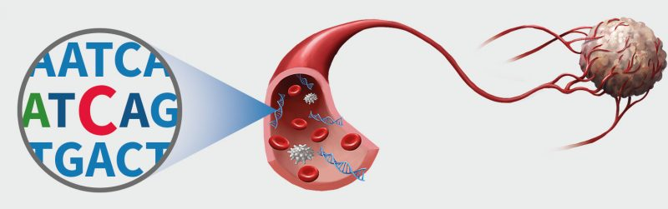
TASK 3 (D5.3) Targeted mutational analysis on the circulating tumor DNA
Cell-free DNA (cfDNA) refers to short fragments of extra-cellular nucleic acids detectable in almost all body fluids
cfDNA is involved in various physiological and pathological conditions
In cancer patients, a fraction cfDNA originates from tumors, circulating tumor DNA (ctDNA), and may harbor the same mutations and genetic alterations as those of the primary tumor.
ctDNA potentially provides the opportunity for noninvasive assessment of cancer
CATCH-U-DNA Review Meeting M24, 28/06/19

Slide 9
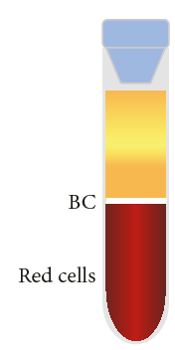

TASK 3 (D5.3) Targeted mutational analysis on the circulating tumor DNA
KEY ACHIEVEMENTS
I. Blood processing protocol optimization
For each patient, ~20 mL of peripheral blood are collected into K₂EDTA blood collection tubes
Blood samples are processed within 2h from collection
Prior to archiving, plasma is prepared by two-step centrifugation: 2500rpm for 15min and 2500g for 15min at 4^{ο}C
Plasma is carefully removed and stored at -80 °C in 2 ml aliquots
PRP
CATCH-U-DNA Review Meeting M24, 28/06/19
Platelet rich plasma is centrifuged again

Slide 10
TASK 3 (D5.3) Targeted mutational analysis on the circulating tumor DNA
II. Optimization of cfDNA extraction
cfDNA extraction from 2 mL of plasma using the QIAamp Circulating Nucleic Acid Kit
Several optimizations of the recommended protocol were done:
Incubation time on the sample lysis step was increased from 30 min to 1h
Carrier RNA concertation was reduced to 1/4 of the recommended
Two-step elution with 20 μL and 30 μL of elution buffer
Total elution volume is half of the recommended (more concentrated eluate)
CATCH-U-DNA Review Meeting M24, 28/06/19

Slide 11
TASK 3: Targeted mutational analysis on the circulating tumor DNA
III. Calculation of cfDNA extraction yield
QIAamp Circulating Nucleic Acid Kit was used
Extraction yield was calculated using spike-in templates in healthy plasma sample
1 μL (2x 10⁵ copies) from KRAS exon 2 gene fragment gblock were spiked-in 2 ml plasma from healthy volunteers
Real-Time PCR experiment using 1 μL from 2x 10⁵ copies gblock and 1μL from extracted DNA
Extraction efficiency: 54.68%
IV. Extraction of circulating nucleic acids from patient samples (n=66)
According to qubit measurements, dsDNA concertation extracted from patients’ plasma samples ranged from 0.2 - 22 ng/μL
CATCH-U-DNA Review Meeting M24, 28/06/19

Slide 12
TASK 3: Targeted mutational analysis on the circulating tumor DNA
V. Droplet Digital PCR for the detection and quantification of KRAS mutations in codon 12/13
KRAS mutations occur in one third of human cancers and cluster in several hotspots, with codons 12 and 13 being most commonly affected.
…..GGTGGC…..
WT
G12A
G12C
G12D
G12R
G12S
G12V
G13D
…..GCTGGC…..
…..TGTGGC…..
Mutations included in the ddPCR KRAS G12/G13 Screening Kit
…..GATGGC…..
…..CGTGGC…..
…..AGTGGC…..
…..GTTGGC…..
…..GGTGAC…..
CATCH-U-DNA Review Meeting M24, 28/06/19

Slide 13
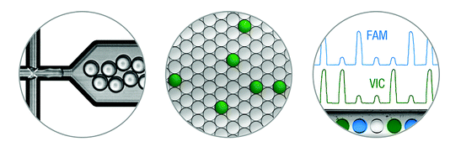
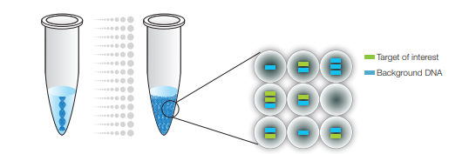
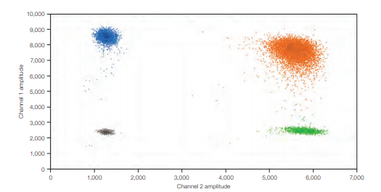
TASK 3: Targeted mutational analysis on the circulating tumor DNA
Droplet Digital PCR assay for the detection and quantification of mutations
ddPCR Workflow
Droplet Generation
Data analysis
PCR amplification
CATCH-U-DNA Review Meeting M24, 28/06/19

Slide 14
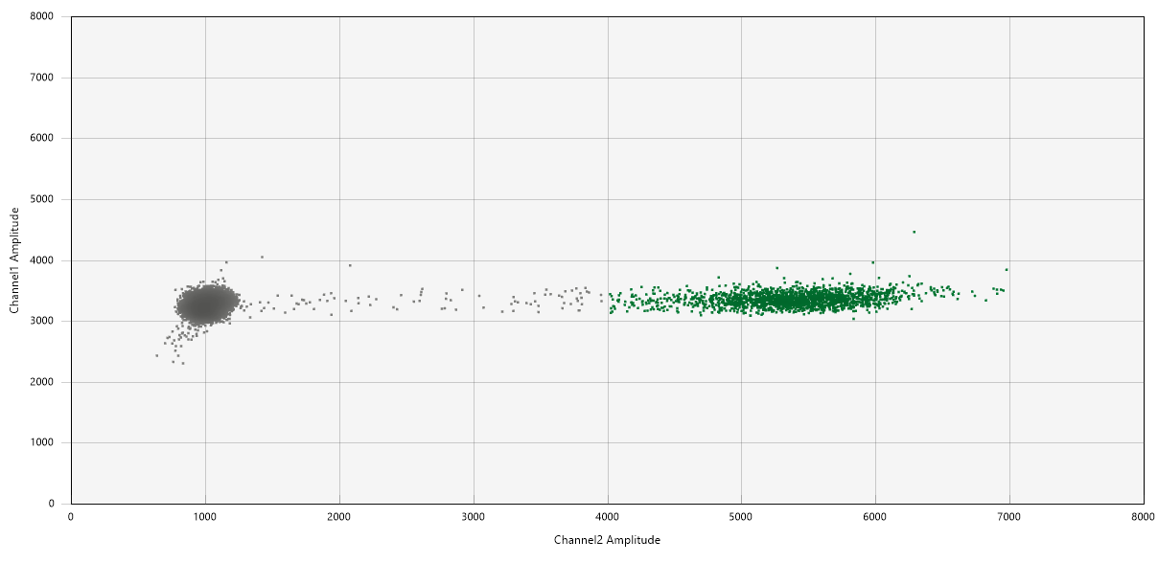
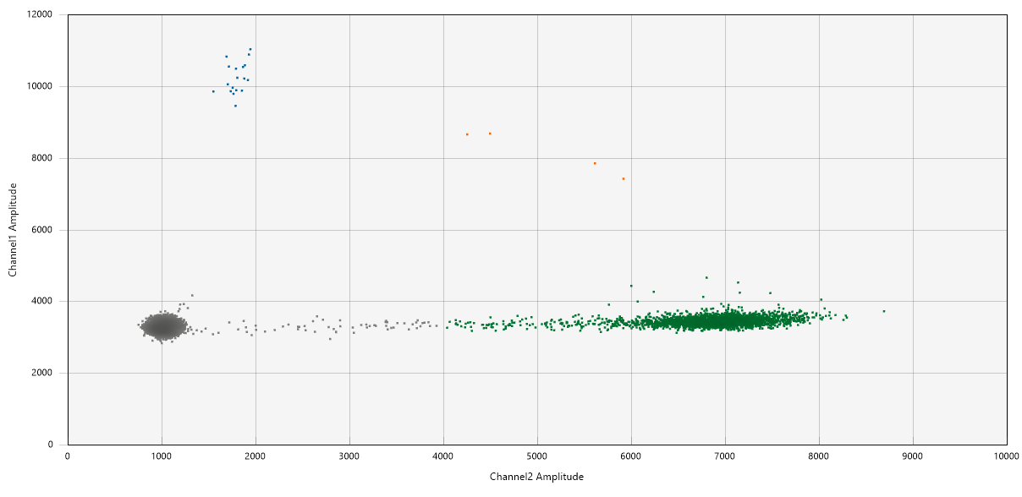
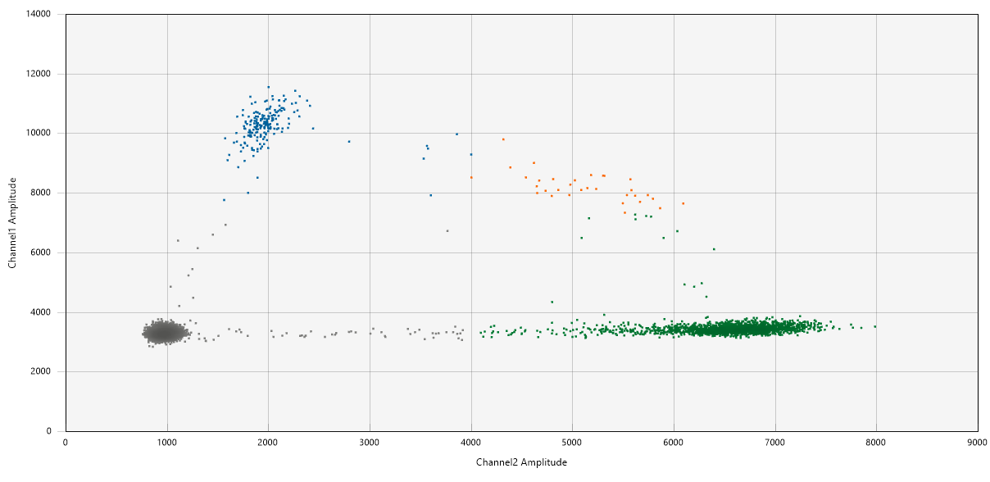
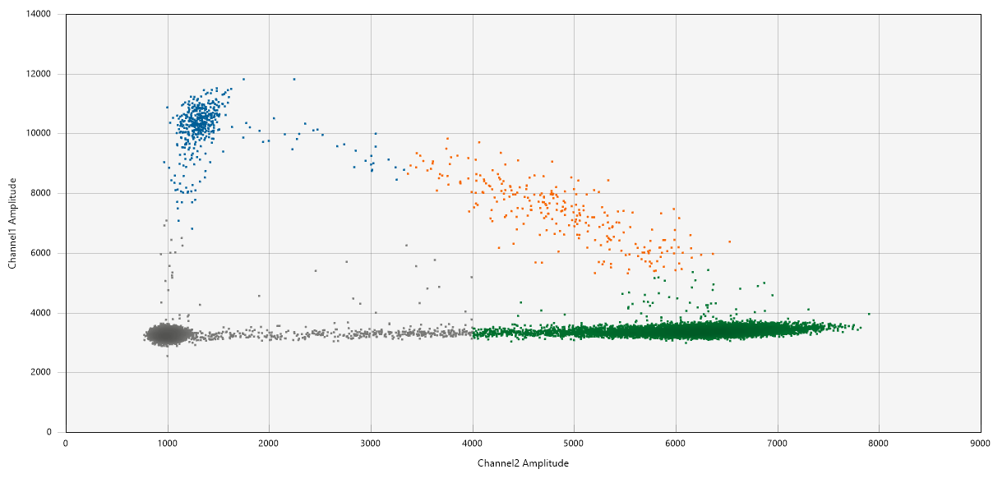
TASK 3: Targeted mutational analysis on the circulating tumor DNA
Droplet Digital PCR for the detection and quantification of KRAS mutations in codon12/13
Results
WT only
Low KRAS MUT concertation
Intermediate KRAS MUT concertation
High KRAS MUT concertation
Range of KRAS MUT copies/μL reaction= 0 - 157.0 copies/μL reaction
Range of KRAS WT copies/μL reaction= 0.17 – 1834 copies/μL reaction

Slide 15
TASK 3: Targeted mutational analysis on the circulating tumor DNA
Droplet Digital PCR for the detection and quantification of KRAS mutations in codon12/13
Results: Tissue KRAS status vs Plasma KRAS status – (CRC and NSCLC patients)
KRAS Tissue Status | KRAS plasma Status | Number of Patients
WT | WT | 26
WT | MUT | 6
MUT | WT | 16
MUT | MUT | 18
Total Tested |  | 66
Concordance between KRAS mutation status in tumor tissue and plasma was 70.3%
CATCH-U-DNA Review Meeting M24, 28/06/19

Slide 16
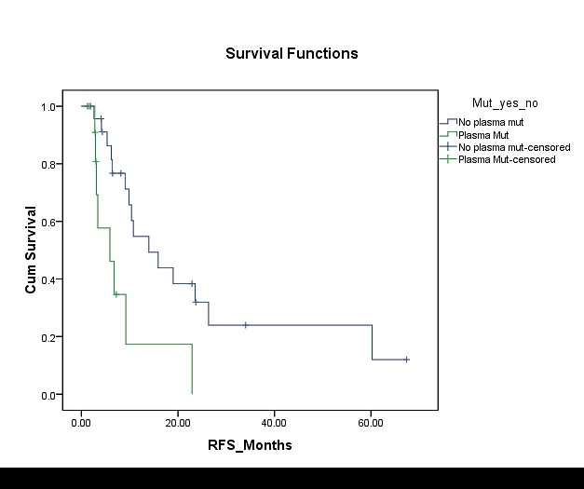
TASK 3: Targeted mutational analysis on the circulating tumor DNA
Clinical relevance of the detection of KRAS mutations in the plasma of patients with NSCLC by the use of ddPCR
KRAS mutations were detected in the plasma of 10 out of 40 patients with NSCLC
7 had mutations in both plasma and tissue and 5 had mutations in plasma only
Patients with KRAS mutations in cfDNA exhibited significantly (P<0.001) shorter progression-free survival (PFS) intervals compared to those with no KRAS mutations
Interestingly, KRAS tissue status was not predictive of PFS
KRAS -
KRAS +
PFS (Months)
Multivariate analyses identified KRAS mutation load* as an independent predictor of poor PFS (HR=2.71; P=0.008) and OS (HR=2.18; P=0.03).
CATCH-U-DNA Review Meeting M24, 28/06/19
*Percentage of KRAS MUT copies (normalized to KRAS WT copies)

Slide 17
D5.3 - Deviations
Deviations
No major deviations have been recorded so far
Delays
Minor delays are expected in the availability of n=100 plasma samples harboring mutations (D5.3, M30)
Future plans
Complete the targeted mutation analysis on the ctDNA for KRAS mutations (D5.3)
Perform targeted mutation analysis on the ctDNA for BRAF mutations (D5.3)
Experimental validation of the acoustic method using model and clinical samples (D5.4)
CATCH-U-DNA Review Meeting M24, 28/06/19

