Slide 1
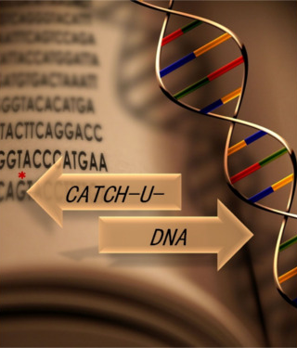

CATCH-U-DNA Capturing non-Amplified Tumor Circulating DNA with Ultrasound Hydrodynamics
Kleita Michaelidou
Translational Oncology Laboratory
School of Medicine, University of Crete
This project has received funding from the European Commission Horizon 2020-Research and Innovation. Programme H2020-FETOPEN-1-2016-2017 (Contract No GA737212, CATCH-U-DNA)

Slide 2

WP5 Validation of the acoustic platform during ctDNA detection in real samples
Objectives
Patient sample collection (tumor tissue and plasma/serum and relevant clinical information)
Perform targeted next generation sequence (NGS) analysis in tumor tissue (primary or metastatic) from 200 patients (non-small cell lung cancer (NSCLC): n=100 and colorectal cancer (CRC): n=100);
Perform targeted mutation analysis on ctDNA in 100 patients found by NGS analysis to harbor mutations in their tumors (based on mutation frequencies reported in the literature approximately 50% of the 200 patients are anticipated to harbor mutations in KRAS, EGFR and BRAF)

Slide 3
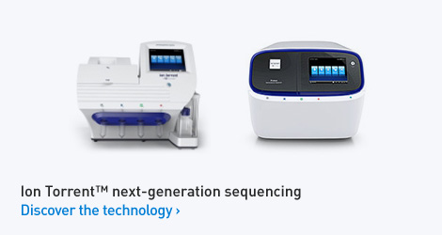
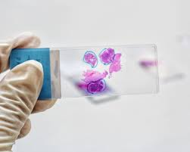
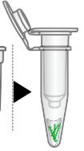
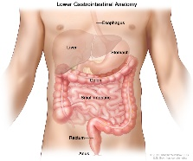
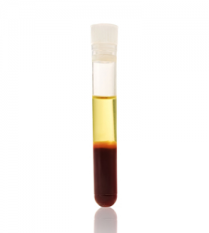

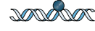
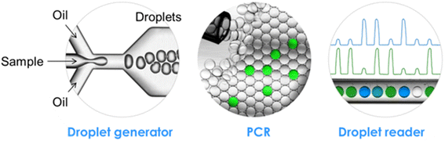
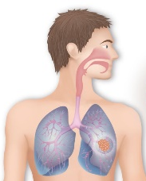
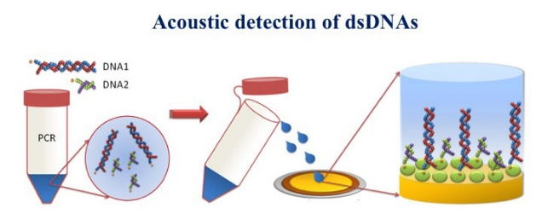
WP5 Validation of the acoustic platform during ctDNA detection in real samples
Overview
SNVs
CNVs
Fusions/Indels
TASK2: Targeted NGS analysis on the tissue samples
TASK3:
Targeted mutational analysis on the ctDNA
TASK1: Collection of CRC and NSCLC samples
TASK4: Experimental validation of the acoustic method using model and clinical samples

Slide 4
WP5 Validation of the acoustic platform during ctDNA detection in real samples
Deliverables
D5.1: Standard procedures for sample collection, preparation and handling; creation of clinical database (M24)-In preparation/To be submitted end May 2019
D5.2: Targeted NGS analysis in tumor tissue samples from 200 cancer patients (M12)
D5.3: Targeted mutation analysis on the ctDNA of 100 mutation-positive patients (M30)-In progress
D5.4: Validation using model and clinical samples (M36)-In progress

Slide 5

TASK 2 (D5.2) Targeted NGS analysis on the tissue samples
Task 2 of Work Package 5 has already been completed (Mo 12) during the first reporting period.
Gene | Mutation Status | Number of Patients
EGFR | WT | 85
 | Mutant | 10
 | Total Tested | 95
 | NA | 142
KRAS | WT | 85
 | Mutant | 34
 | Total Tested | 119
 | NA | 118
BRAF | WT | 87
 | Mutant | 11
 | Total Tested | 98
 | NA | 139
More details
1st Periodic Report
Deliverable 5.2
Notes:
More details about this task can be found in the already submitted and accepted deliverable D5.2 Report on Targeted NGS Analysis in Tumor Tissue Samples and in the first periodic report.
The remaining samples were not tested for the abovementioned mutations, due to a number of reasons that were not entirely controlled by us, such as inadequate sample size (small biopsies or cytological material), patients were treated to other hospital centers, the sample was depleted before completing all tests.

Slide 6
TASK 1 (D5.1) Collection of samples
KRAS tissue status has been evaluated in 119 patients (NSCLC, N=68 and CRC, N=51)
34/119 harbor KRAS tissue mutations (NSCLC, N=15 and CRC, N=19)
Plasma samples are available for all these patients
KRAS status analysis was performed in the plasma of 66 patients (34 patients KRAS mutant and 32 KRAS wild type)

Slide 7
TASK 1 (D5.1) Collection of samples
B) Descriptive statistics of ordinal clinicopathological features of cancer patients (N=66)
Variable | No. of patients (%)
TNM Stage ª
I/II | 5 (7.6)
III | 15 (22.7)
IV | 36 (54.5)
Unknown | 10 (15.2)
Treatment
Targeted treatment | 14 (21.2)
Chemotherapy | 45 (68.2)
Unknown | 7 (10.6)
Smoking Status
Former | 18 (27.3)
Current | 18 (27.3)
Never | 6 (9.1)
Unknown | 24 (36.4)

Slide 8
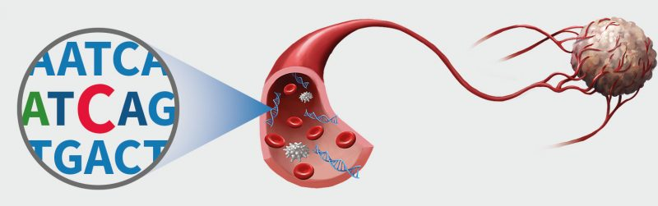
TASK 3 (D5.3) Targeted mutational analysis on the circulating tumor DNA
Cell-free DNA (cfDNA) refers to short fragments of extra-cellular nucleic acids detectable in almost all body fluids
cfDNA is involved in various physiological and pathological phenomena
In cancer patients, a fraction cfDNA originates from tumors, circulating tumor DNA (ctDNA), and may carry the same mutations and genetic alterations as those of a primary tumor.
ctDNA potentially provides an opportunity for noninvasive assessment of cancer
Notes:
such as immunity, coagulation, aging, and cancer.
Liquid biopsies are able to isolate the tiny amounts of ctDNA released by the tumor from the background cfDNA, by identifying hallmark genetic mutations.
Considerable body of evidence exists on analysis of ctDNA as a circulating biomarker to guide decisions for personalized treatment. Several studies have shown high concordance between mutations from ctDNA and tumor tissue in NSCLC.

Slide 9
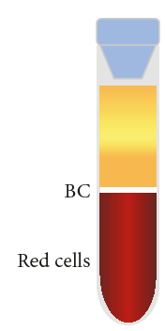

TASK 3 (D5.3) Targeted mutational analysis on the circulating tumor DNA
Blood processing
For each patient, 15mL of peripheral blood were collected into K₂EDTA blood collection tubes
Prior to archiving, plasma was prepared by two-step centrifugation: 2500rpm for 15min and 2500g for 15min at 4^{ο}C
Plasma was carefully removed and stored at -80 °C in 2 ml aliquots
PRP
Platelet rich plasma is centrifuged again

Slide 10
TASK 3 (D5.3) Targeted mutational analysis on the circulating tumor DNA
B) Extraction of circulating nucleic acids: Optimization
cfDNA was extracted from 2 mL of plasma using the QIAamp Circulating Nucleic Acid Kit
Several optimizations of the recommended protocol were done:
Plasma was preferred instead of serum.
Incubation time on the sample lysis step was increased from 30 min to 1h and carrier RNA concertation was reduced to 1/4 of the recommended.
The elution was done in two steps with 20 μL and 30 μL of elution buffer. The total elution volume is half of the recommended (more concentrated eluate)
Notes:
cfDNA from serum gets contaminated by blood cells and the amount of contamination increases with the number of days between blood withdrawal and serum separation
Carrier RNA serves two purposes. Firstly, it enhances binding of nucleic acids to the QIAamp Mini membrane, especially if there are very few target molecules in the sample. Secondly, the addition of large amounts of carrier RNA reduces the chance of RNA degradation in the rare event that RNase molecules escape denaturation by the
chaotropic salts and detergent in Buffer ACL

Slide 11
TASK 3: Targeted mutational analysis on the circulating tumor DNA
C) Extraction of circulating nucleic acids: Calculation of extraction yield
The extraction yield using QIAamp Circulating Nucleic Acid Kit was calculated, using spike-in templates in healthy plasma sample
We spiked-in 1 μL of 2x 10⁵ copies from KRAS exon 2 gene fragment gblock and performed cfDNA extraction
Real-Time PCR experiment using 1 μL from 2x 10⁵ copies gblock and 1μL from extracted DNA
Extraction efficiency was calculated to be 54.68%
According to qubit measurements, dsDNA concertation extracted from patients plasma samples ranged 0.2-22 ng/μL.
Notes:
cfDNA from

Slide 12
TASK 3: Targeted mutational analysis on the circulating tumor DNA
D) Droplet Digital PCR for the detection and quantification of KRAS mutations in codon 12/13
KRAS mutations occur in one third of human cancers and cluster in several hotspots, with codons 12 and 13 being most commonly affected.
…..GGTGGC…..
WT
G12A
G12C
G12D
G12R
G12S
G12V
G13D
…..GCTGGC…..
…..TGTGGC…..
Mutations included in the ddPCR KRAS G12/G13 Screening Kit
…..GATGGC…..
…..CGTGGC…..
…..AGTGGC…..
…..GTTGGC…..
…..GGTGAC…..
Notes:
cfDNA from

Slide 13
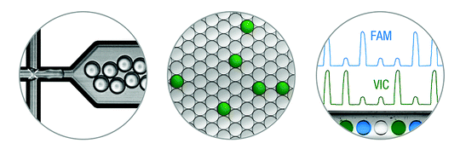
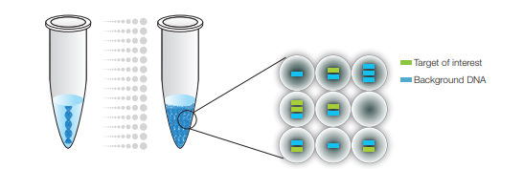
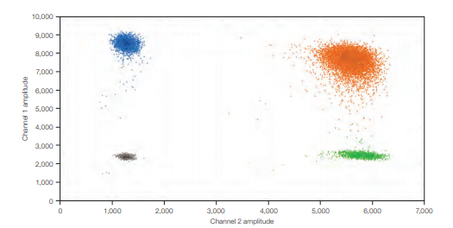
TASK 3: Targeted mutational analysis on the circulating tumor DNA
D) Droplet Digital PCR for the detection and quantification of KRAS mutations in codon12/13
ddPCR Workflow
Droplet Generation
Data analysis
PCR amplification
Notes:
cfDNA from

Slide 14
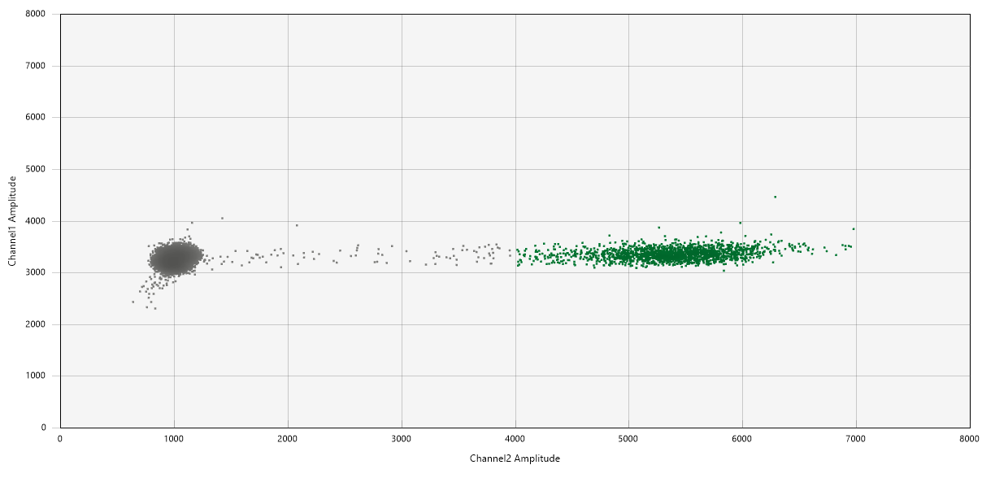
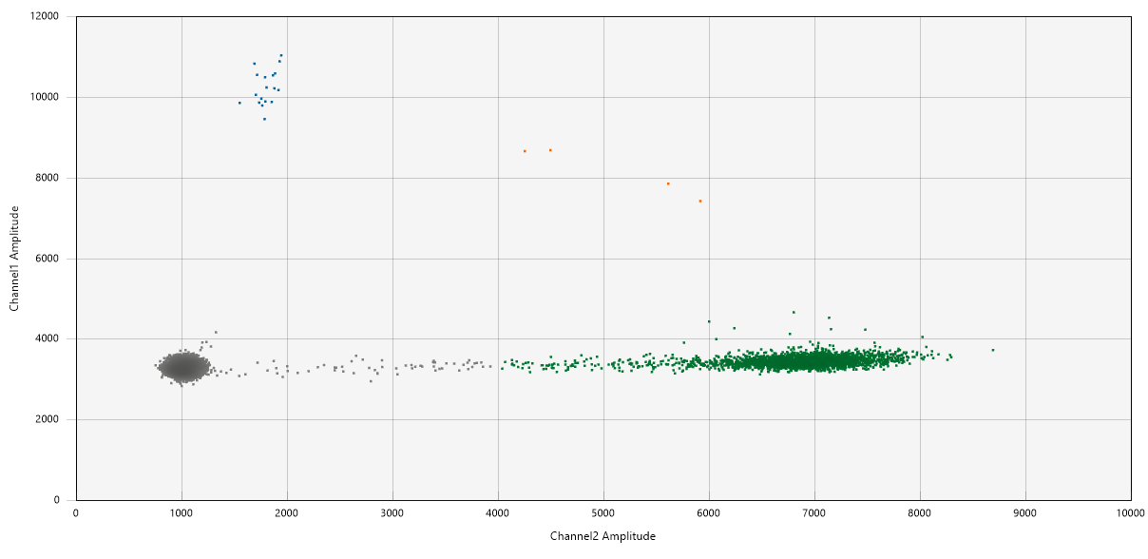
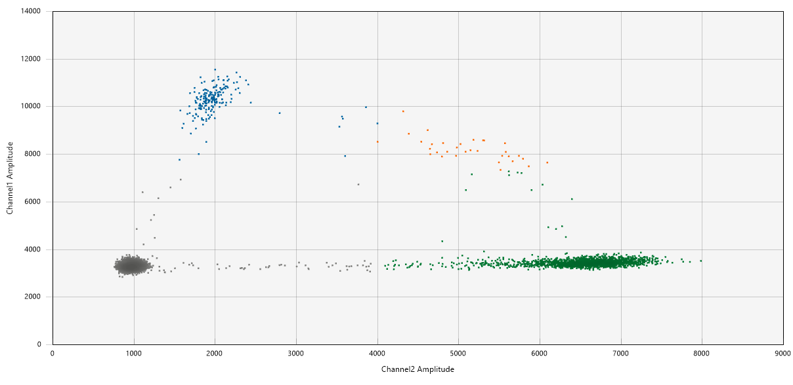
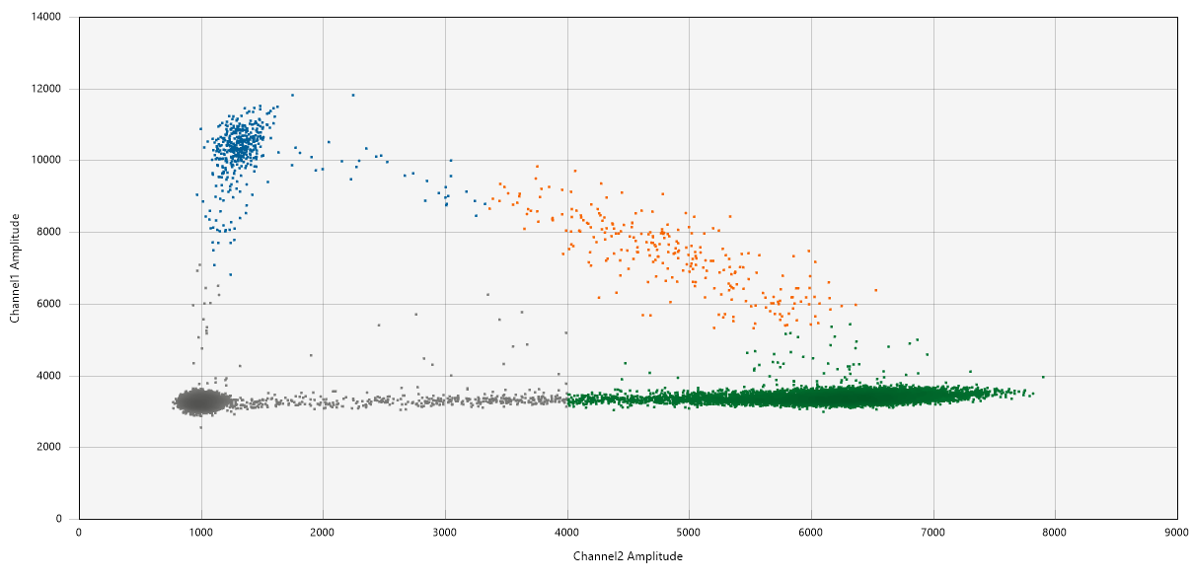
TASK 3: Targeted mutational analysis on the circulating tumor DNA
D) Droplet Digital PCR for the detection and quantification of KRAS mutations in codon12/13
Results
WT only
Low KRAS MUT concertation
Intermediate KRAS MUT concertation
High KRAS MUT concertation
Range of KRAS MUT copies/μL reaction= 0 - 157.0 copies/μL reaction
Range of KRAS WT copies/μL reaction= 0.17 – 1834 copies/μL reaction
Notes:
cfDNA from

Slide 15
TASK 3: Targeted mutational analysis on the circulating tumor DNA
D) Droplet Digital PCR for the detection and quantification of KRAS mutations in codon12/13
Results: Tissue KRAS status vs Plasma KRAS status
KRAS Tissue Status | KRAS plasma Status | Number of Patients
WT | WT | 25
WT | MUT | 6
MUT | WT | 16
MUT | MUT | 17
Total Tested |  | 66
Concordance between KRAS mutation status in tumor tissue and plasma was 70.3%
Notes:
For 6 patients tissue samples with ddpCR
Ap;o posous ston ist;o brethike sto plsamam

Slide 16
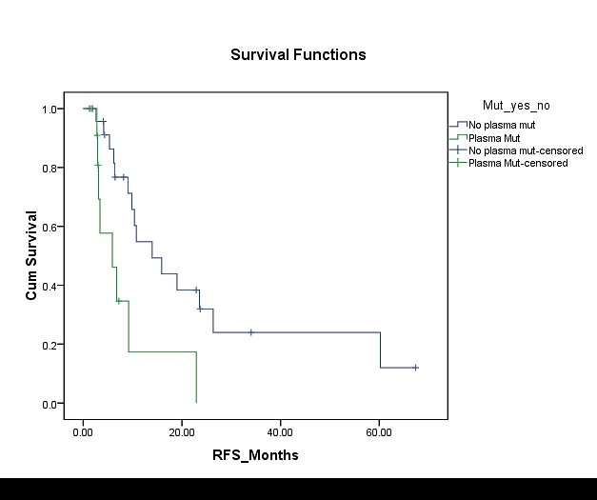
TASK 3: Targeted mutational analysis on the circulating tumor DNA
D) Clinical relevance of the detection of KRAS mutations by the use of ddPCR
KRAS mutations were detected in the plasma of 10 out of 40 patients with NSCLC
7 had mutations in both plasma and tissue and 5 had mutations in plasma only
Patients with KRAS mutations in cfDNA exhibited significantly (P<0.001) shorter progression-free survival (PFS) intervals compared to those with no KRAS mutations
Interestingly, KRAS tissue status was not predictive of PFS
KRAS -
KRAS +
PFS (Months)
Multivariate analyses identified KRAS mutation load* as an independent predictor of poor PFS (HR=2.71; P=0.008) and OS (HR=2.18; P=0.03).
*Percentage of KRAS MUT copies (normalized to KRAS WT copies)

Slide 17
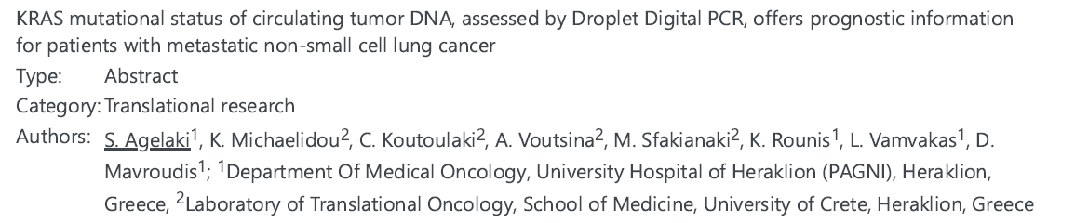
TASK 3: Targeted mutational analysis on the circulating tumor DNA
Abstract Submitted for ESMO Congress 2019

Slide 18
Next Steps for the completion of D5.3 and D5.4
Perform targeted mutation analysis on the ctDNA for BRAF mutations (D5.3)
Experimental validation of the acoustic method using model and clinical samples (D5.4)

