Slide 1
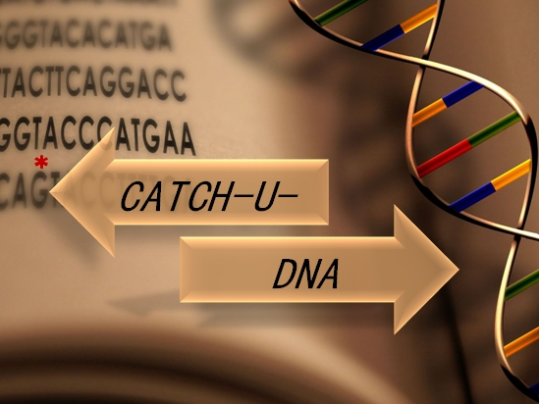

Project Overview
Heraklion 19/06/2017

Slide 2
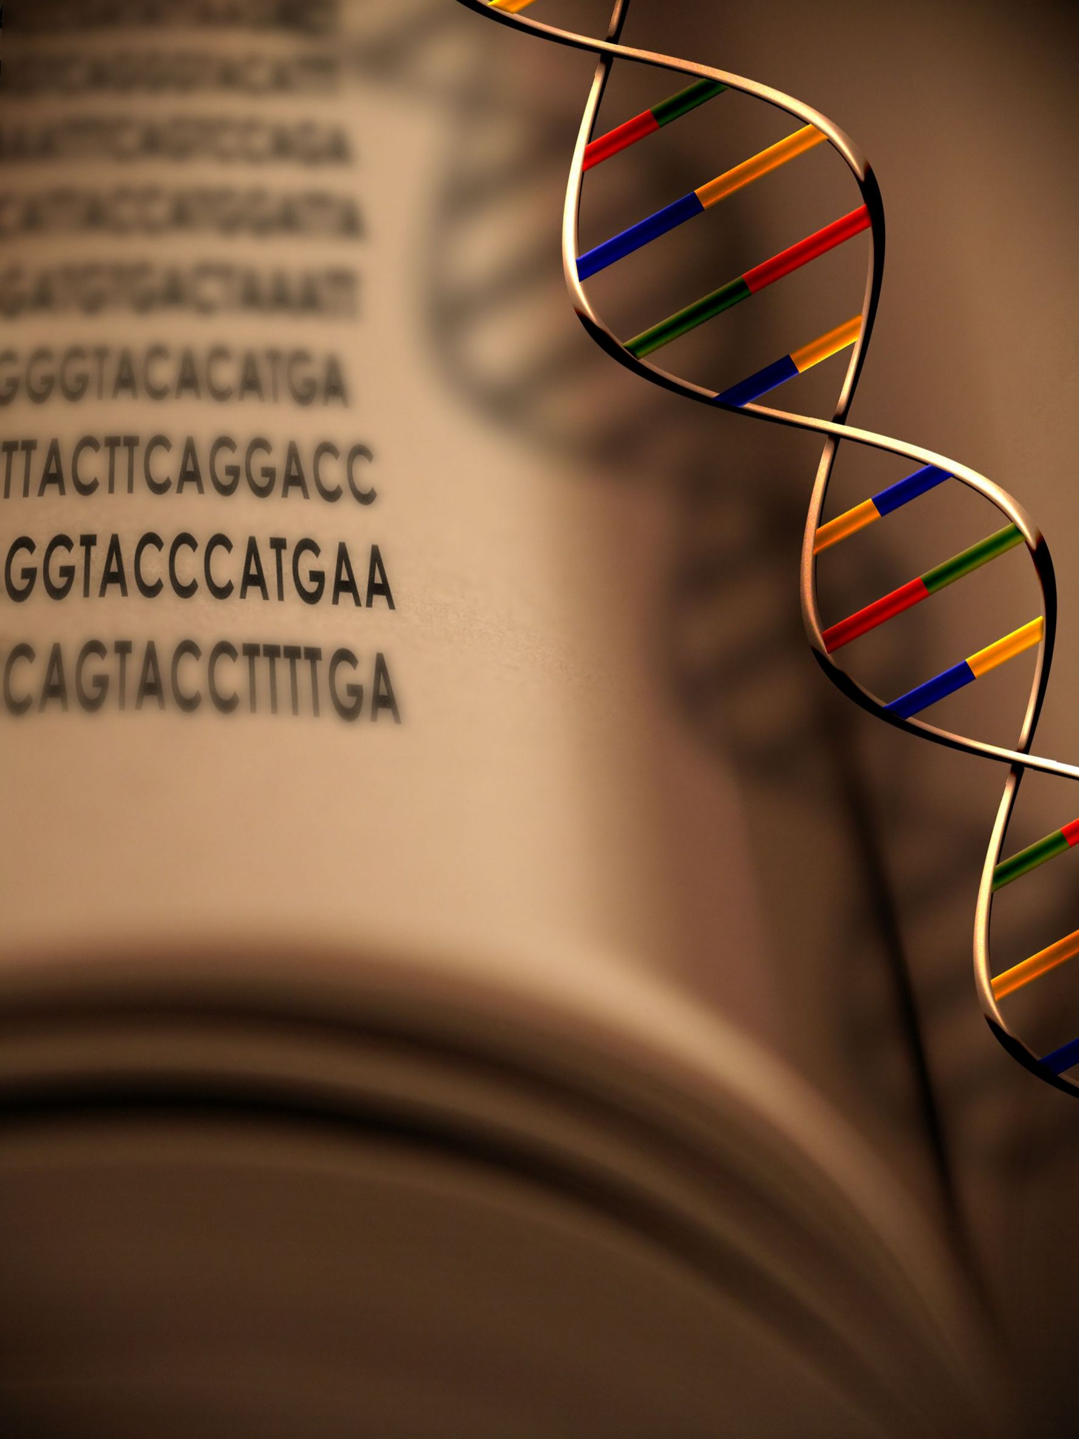
Targeted breakthrough Long-term vision Novelty Highly ambitious Foundational character Interdisciplinary
Capturing non-amplified tumor circulating DNA with ultrasound hydrodynamics
Started: 1st June 2017
Duration: 3 Years
Contract: 737212
Future Emerging Technologies (FET)
Review Meeting M24, Heraklion, 28/6/19

Slide 3
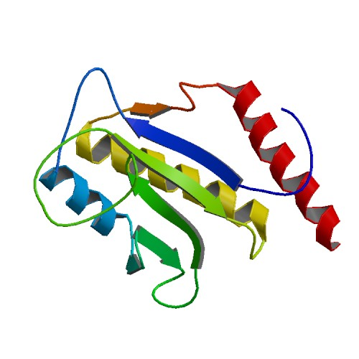
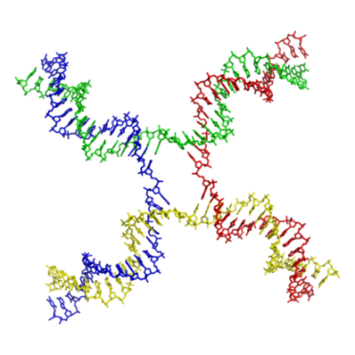
Molecular Diagnostics
Biophysics
1. Hydrodynamic acoustic sensing
1. DNA detection without PCR amplification
Complex
Prone to contamination
Bias towards some sequences
Challenge
2. Dissipation monitoring
2. Novel tool for ctDNA detection in
serum
Targeted breakthrough
D₁ <<<< D₂ <<<< D₃
3. Exhibit required LoD and selectivity
10-1000 copies in 1-5 ml
0.1-1% mt vs wt
Novel Scientific Concept
Ambition
Review Meeting M24, Heraklion, 28/6/19

Slide 4
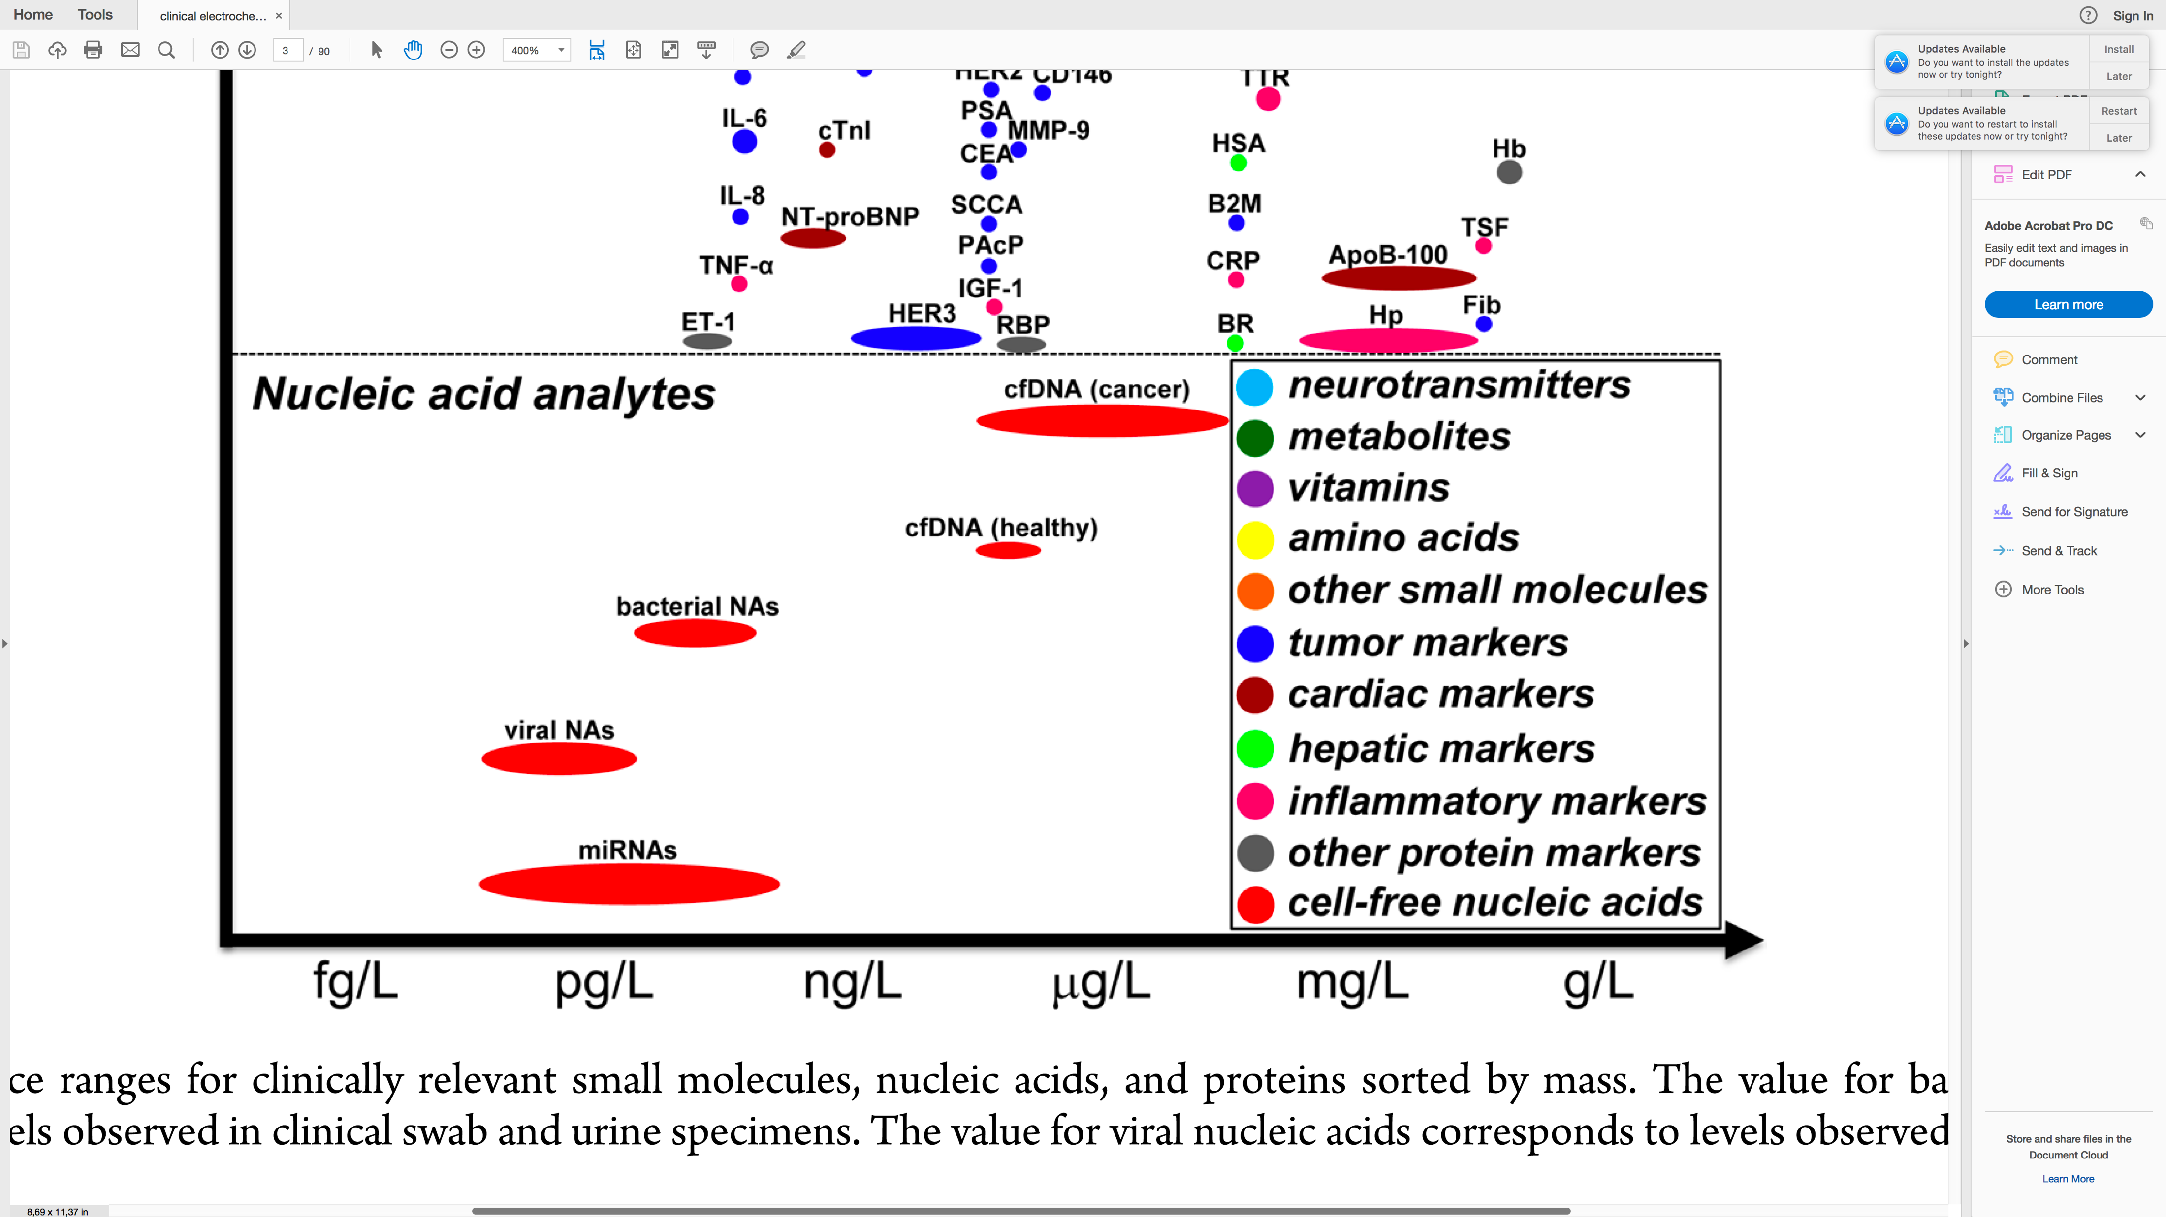
Clinically-relevant detection limits of ctDNA
WT: 50-5000 copies
MUT: 2-50 copies
ctDNA present at sub-pM;
Tumor-specific mutations
present in sub-aM (10⁻¹⁸)
10⁻¹⁵
10⁻¹²
10⁻⁹
10⁻⁶
Review Meeting M24, Heraklion, 28/6/19
Labib M. et al., Chem. Rev. (2016) 116, 9001
Notes:
Tumors are known to release NAs into the blood stream and the ability to monitor these molecular targets provides a means to collect genotypic information about a tumor noninvasively. Targeting ctDNAs is v. challenging as they are present with a large background of wild-type molecules. To circumvent this problem is to target within ctDNAs known mutations that are tumor specific; meaning v. low numbers of target DNA in the presence of a very high background noise in the level of 1:10000. Specificity is a serious issue.

Slide 5
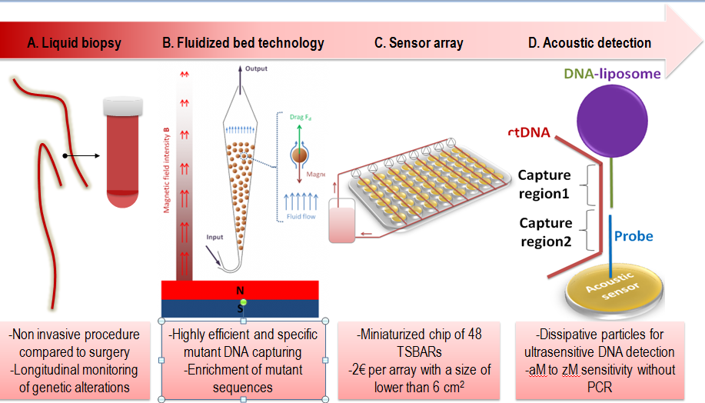
CATCH-U-DNA: concept & goals
Review Meeting M24, Heraklion, 28/6/19

Slide 6
Main achievements- Year 2
1st prototype of acoustic array with 4 sensors with microfluidics
Simulation results prove hydrodynamic nature of energy dissipation
Characterization of range of liposomes; new particles under investigation
Protocol for DNA capture from serum in fluidized bed
Improved protocol for of BRAF-V600E enrichment with LCR
Detection of 10⁵-10⁶ molecules upon LCR & acoustic
amplification with liposomes
Collection/testing of 119 tumor tissue and 225/66 plasma clinical samples
New prospects for commercial exploitation (QCMTEC)
24
3340
Review Meeting M24, Heraklion, 28/6/19

Slide 7







Consortium
Review Meeting M12, Brussels, 26/6/18

