Slide 1
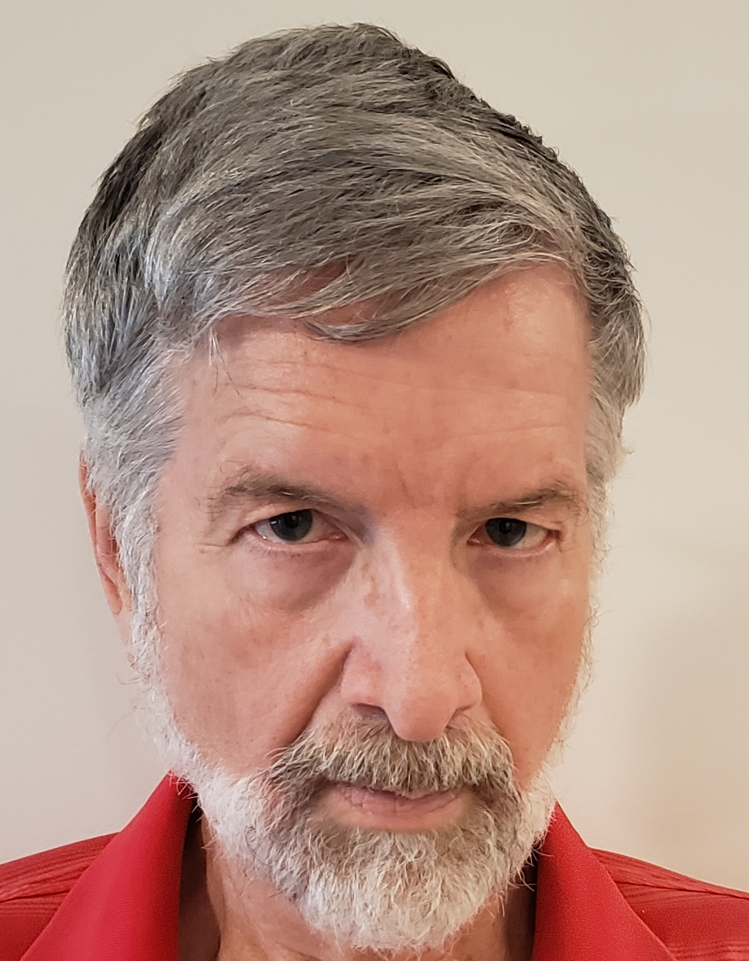
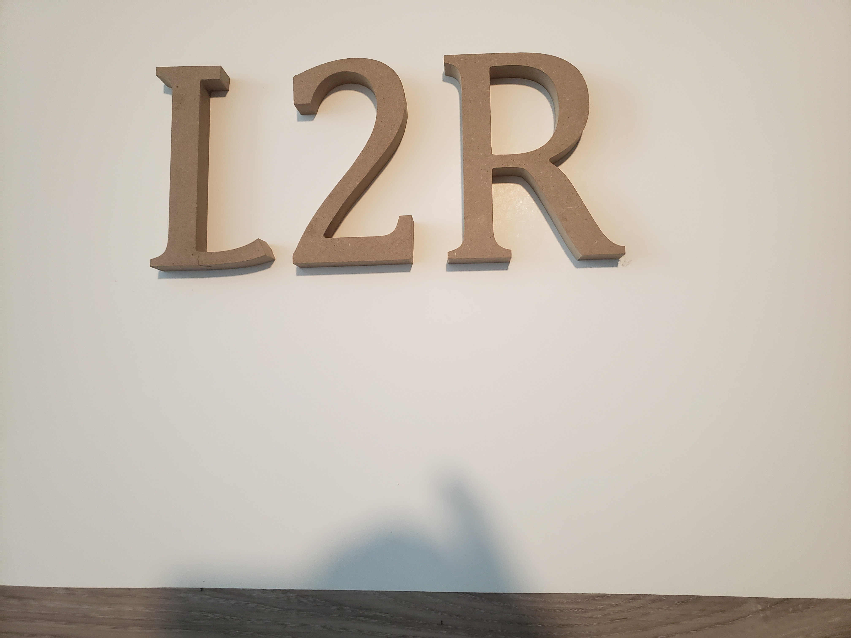
Seismic Unix Spreadsheet Statics: Shots on surface or in a hole, with 1 or 2 near surface layers.
With Numeric Examples. And Thoughts On Intermediate Datum.

Slide 2
************************************************
This video demonstrates the use of a Spreadsheet (LibreOffice “Calc”) for Simple Manual Statics, or similar computations.
All computations herein should be considered approximate.
Whether the resulting statics are suitable for your data is your decision.
************************************************

Slide 3
If you are unfamiliar with spreadsheet programs you should watch my video: Spreadsheet Uses: Dix Equation, Time->Depth.
You should also watch that video if you are unfamiliar with q-files.
Further, the video herein can be considered an extension of my video:
Manually Deriving Refraction Statics for Simple Near Surface.
I advise you to be familiar with that video before watching this video.

Slide 4
I am starting from SPS2 files, but you do not have to.
If you are looking at this video and creating your spreadsheet “from nothing”, I suggest you organize your columns the same way as I do.
Using the same columns in your spreadsheet makes errors less likely.
Better still, I suggest starting from my final spreadsheet setup.
You can find a link to the final spreadsheet in the description section of this YouTube video. You can also find a link to this presentation.
Also in Seismic Unix ../demos/Sushiftcsv/l2r_spreadsheet_tests.ods
and ../demos/Sushiftcsv/l2rstatics.odp

Slide 5
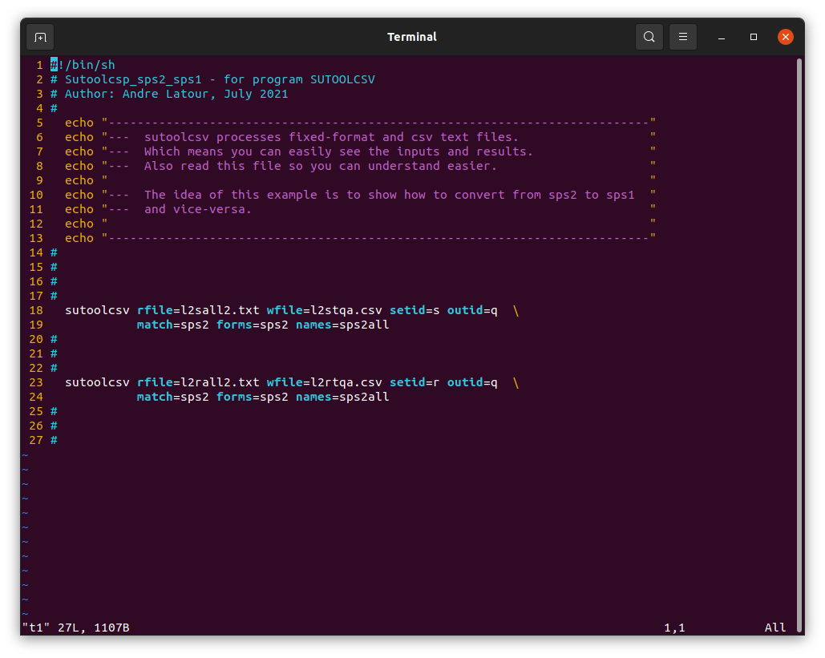
In this video, I start from an SPS2 S-file. But you can also start from an R-file.
First, use one of these sutoolcsv setups to convert it to a csv q-file.
You may already have converted SPS2 S or R-files for geometry purposes, in which case the output csv file will actually contain S or R-records rather than Q-records.
You can input that file into the Spreadsheet and easily change it to a Q-file.

Slide 6
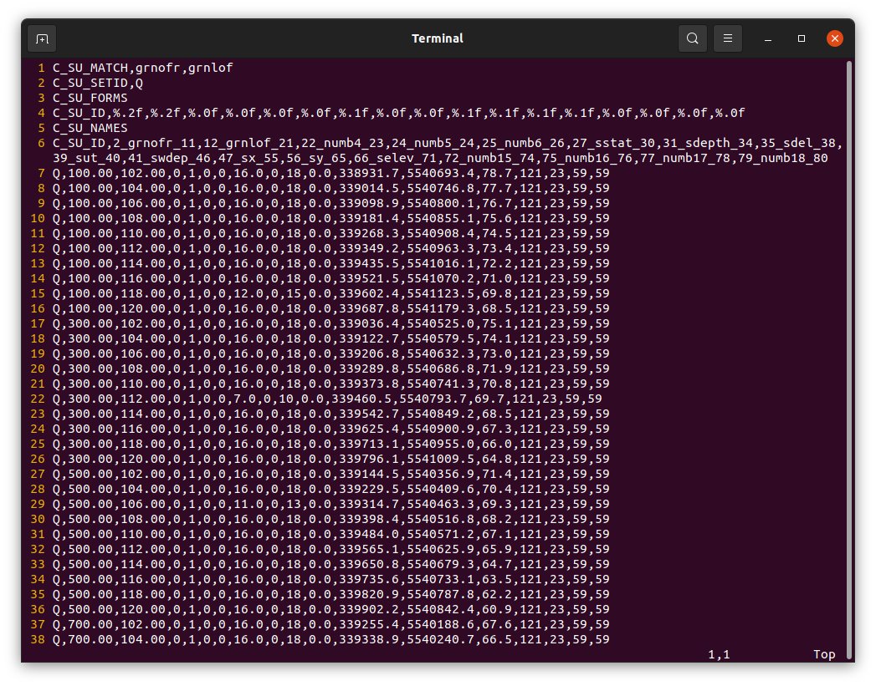
The output q-file looks something like this.

Slide 7
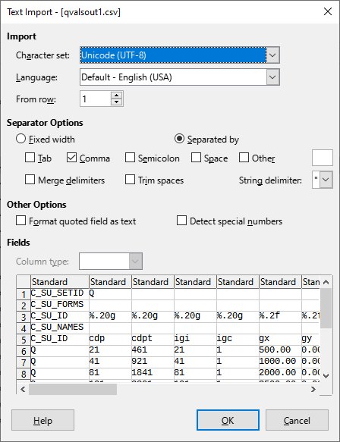
First, input the q-file.
Since it is a csv file, you see this →
Use options “Separated by” and “Comma”.

Slide 8
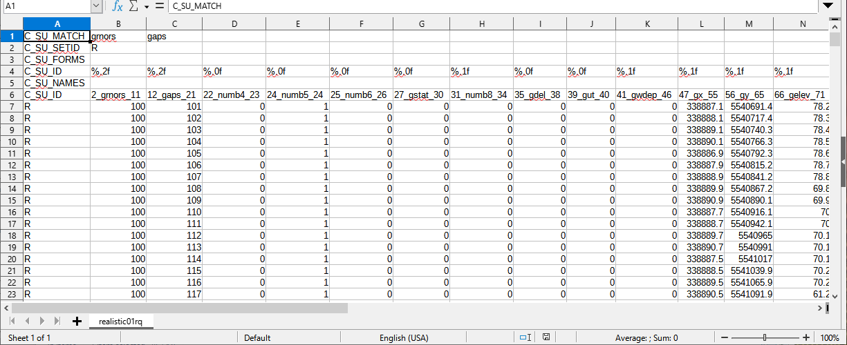
If your file actually has S-records or R-records, change these all to Q.

Slide 9

The first 6 rows here do not mean anything to the LibreOffice spreadsheet “Calc”.
But you should maintain them if you want to use the output later in Seismic Unix.

Slide 10
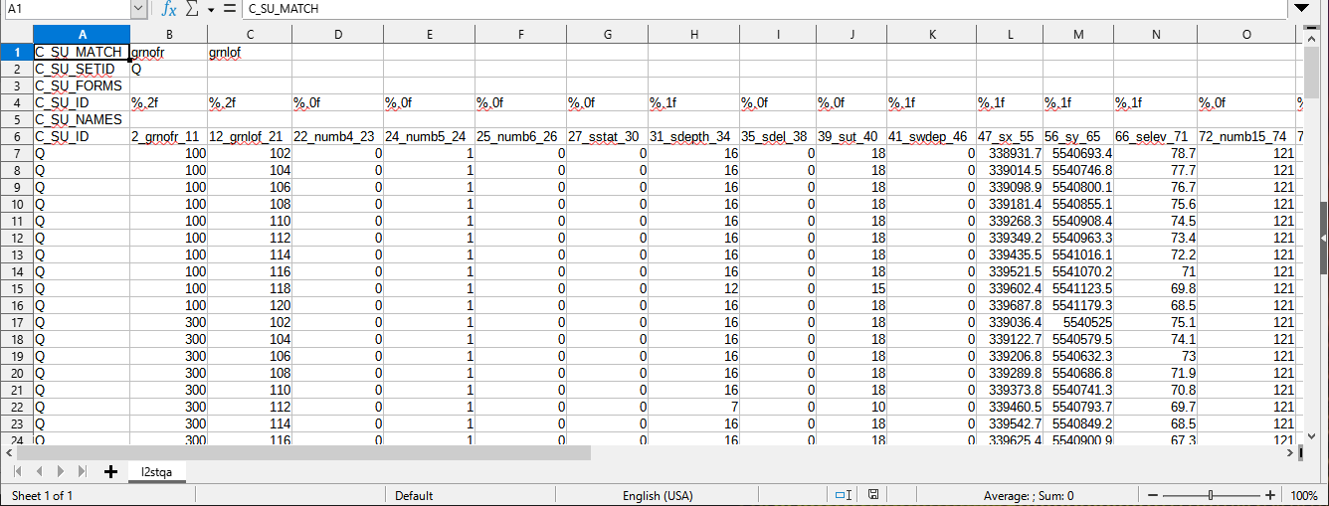
It you have converted you SPS2 S or R file using the previous sutoolcsv setup, then your spreadsheet looks like this. Now delete columns F,G,I,K,O,P,Q,R.
(Yes, delete G even though it may contain “statics”).

Slide 11
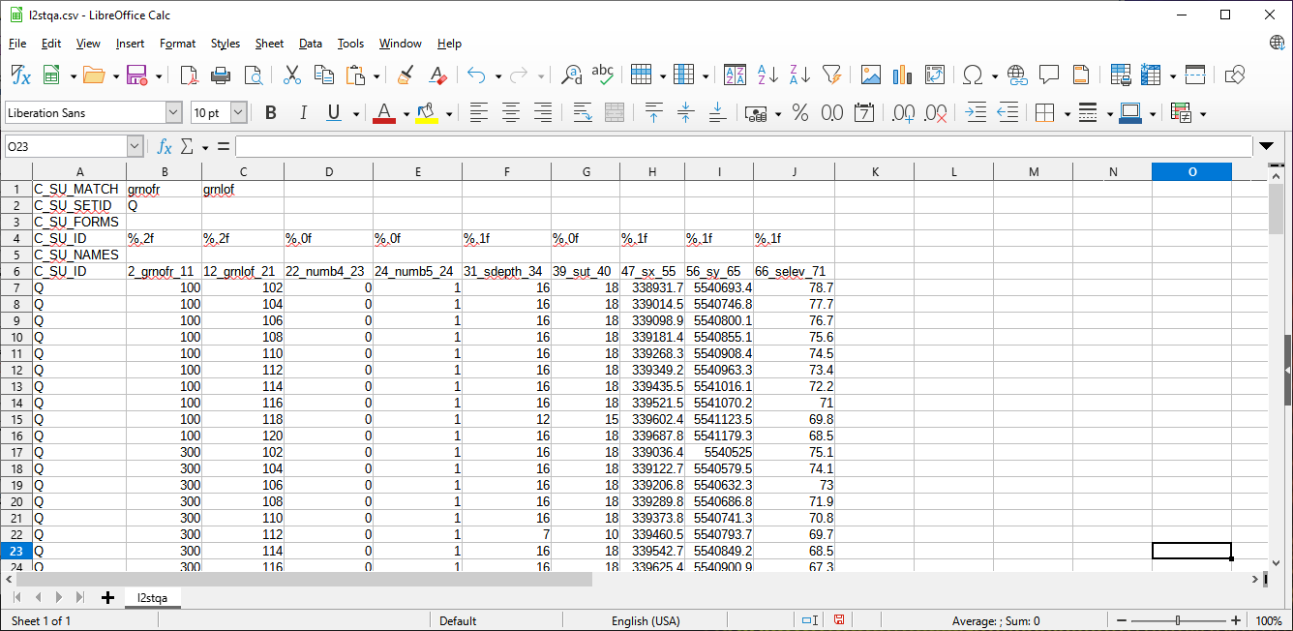
The remaining values look like this. The line and point numbers (columns B and C) and the coordinates (columns H and I) do not get used in static computations herein.
But retain them anyway.

Slide 12
If you are making the spreadsheet from “nothing”, still put shot depth in column F, shot uphole time in column G, and elevation in column J.
And, even if you are starting from an SPS R-file or other receiver information, still put nearest shot depth in column F, and nearest shot uphole time in column G.

Slide 13
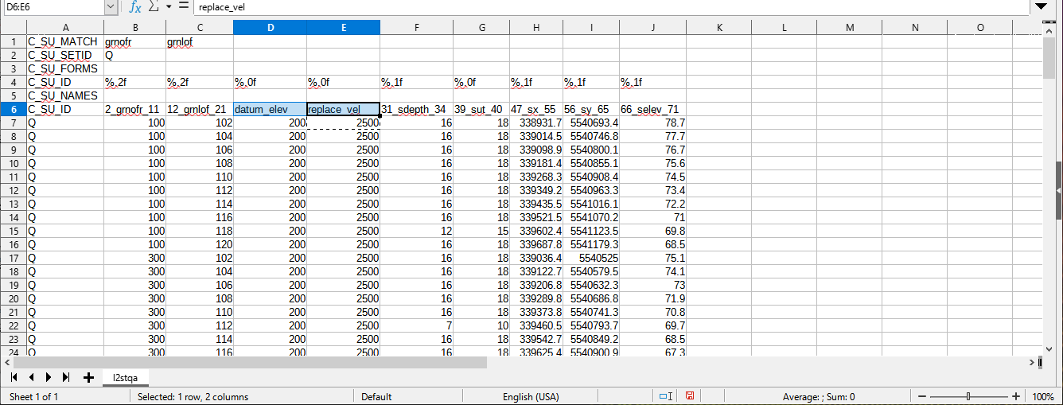
Change the names in row 6 columns D and E and put your Datum Elevation and Replacement Velocity in all rows below them.
(Note: These values are usually constants so they usually could be specified in only 2 cells in the spreadsheet. But having them in each row requires less explanation herein).

Slide 14
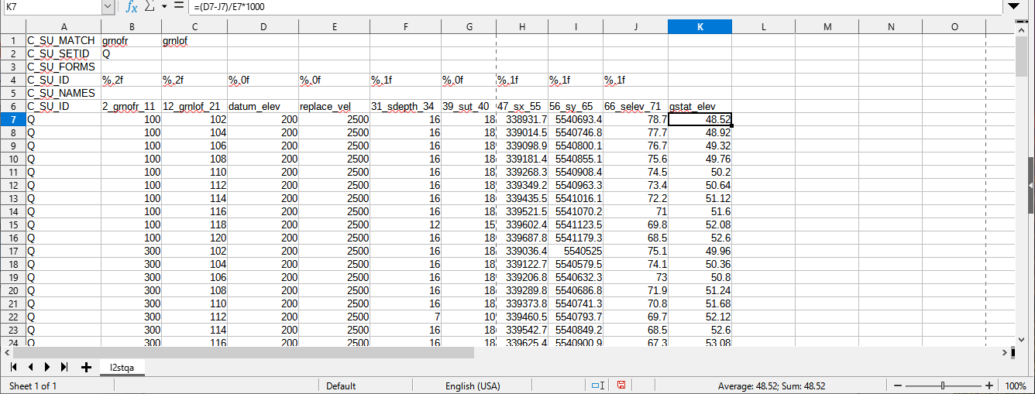
Select cell K7 and type =(D7-J7)/E7*1000
Then copy cell K7 to remaining cells in column K.
The results are simple statics computed purely from elevations.

Slide 15
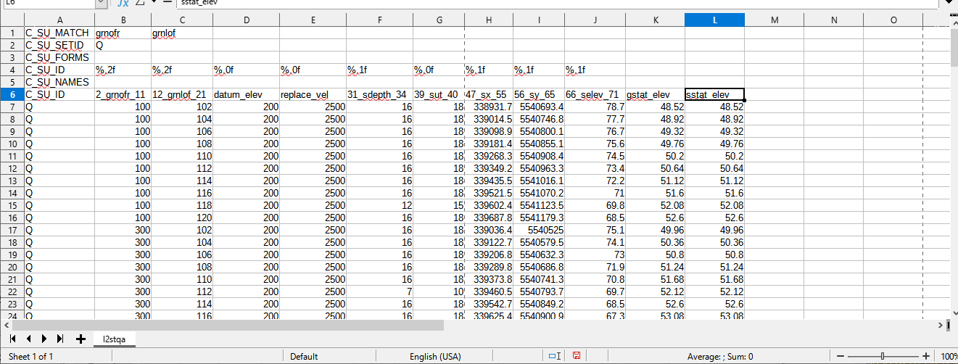
Select cell L7 and type =(D7-J7)/E7*1000
Then copy cell L7 to remaining cells in column L.
Note this is the same computation as for column K.

Slide 16
Only the names in row 6 are different (gstat_elev and sstat_elev).
This indicates how I am going to proceed. In every row I am going to compute various statics as if a receiver exists there, and also as if a shot exists there.

Slide 17
If you are not familiar with LibreOffice “Calc”, note that copying a cell containing an equation into another cell results in adjusting the cell references in that equation.
(Except if you use $ signs to “freeze” the cell references).

Slide 18
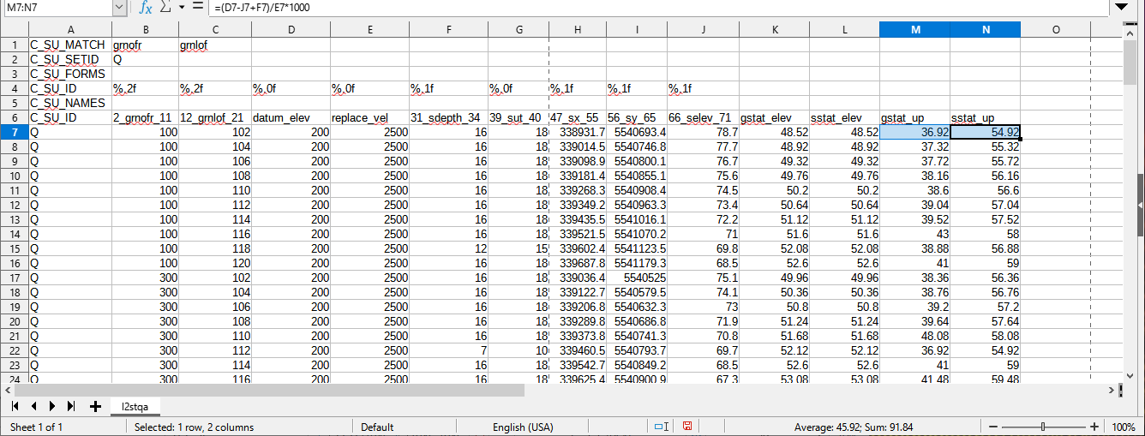
In cell M7 put =(D7-J7+F7)/E7-G7 And in cell N7 put =(D7-J7+F7)/E7
Then copy M7 to the rest of column M and N7 to the rest of column N.
The results are simple uphole statics (sometimes called “field” statics).

Slide 19
In cell M7 put =(D7-J7+F7)/E7-G7 And in cell N7 put =(D7-J7+F7)/E7
Then copy M7 to the rest of column M and N7 to the rest of column N.
The results are simple uphole statics (sometimes called “field” statics).
The calculations above are:
receiver_stat = (datum_elev – shot_elev + shot_depth) / replace_vel - shot_uptime
shot_stat = (datum_elev – shot_elev + shot_depth) / replace_vel
These simple computations make the assumption that the shot_depth is below any top layer that might exist.
(Things get more complicated later in this video).

Slide 20
In cell M7 put =(D7-J7+F7)/E7-G7 And in cell N7 put =(D7-J7+F7)/E7
Then copy M7 to the rest of column M and N7 to the rest of column N.
The results are simple uphole statics (sometimes called “field” statics).
The calculations above are:
receiver_stat = (datum_elev – shot_elev + shot_depth) / replace_vel - shot_uptime
shot_stat = (datum_elev – shot_elev + shot_depth) / replace_vel
Remember that in this spreadsheet I am pretending that all rows contain both a shot and a receiver at the same location.
So, for the receiver, it does not matter that the elevation value is “actually” the shot elevation. They are the same.

Slide 21
In cell M7 put =(D7-J7+F7)/E7-G7 And in cell N7 put =(D7-J7+F7)/E7
Then copy M7 to the rest of column M and N7 to the rest of column N.
The results are simple uphole statics (sometimes called “field” statics).
The calculations above are:
receiver_stat = (datum_elev – shot_elev + shot_depth)/ replace_vel - shot_uptime
shot_stat = (datum_elev – shot_elev + shot_depth) / replace_vel
It may appear odd that the shot uphole time appears in receiver computation and not in the shot computation. But signal did not travel through material above shot, while the signal did travel through material up to the receiver.
However, subtracting uphole time in receiver computation is an over-correction. The uphole time needs to be adjusted by shot_depth / replacement_velocity. That is why shot_depth also appears in the receiver computation.

Slide 22
Now I continue with the “intercept method” of deriving statics.
The “intercept method” is used in my video:
Manually Deriving Refraction Statics for Simple Near Surface.
The “intercept method” is usually done while looking at shot gathers.

Slide 23
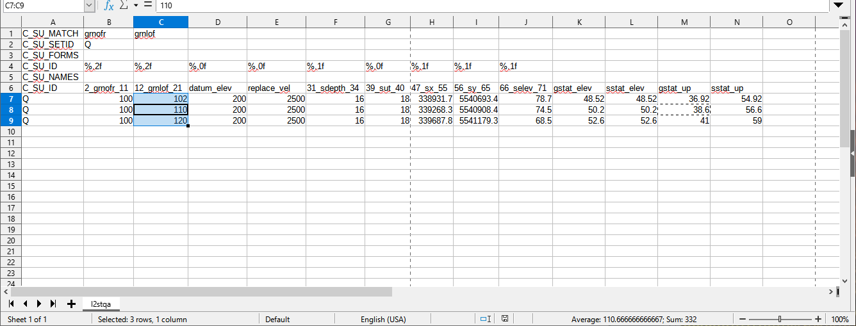
If manually deriving statics using the intercept method, you usually just want to perform analysis at “widely” spaced locations (like every 40th point). Here, for illustrative purposes, I am deleting all but 3 rows (just keeping stations 102,110,120).

Slide 24
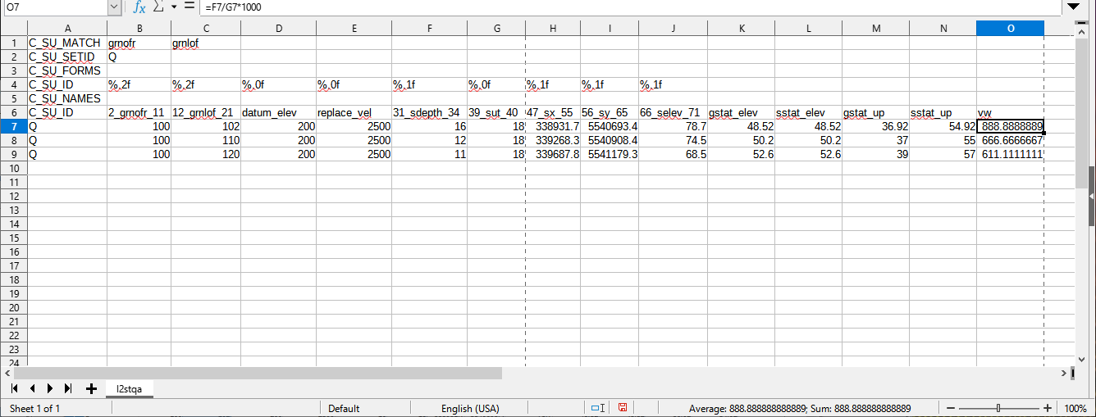
Further computations need a top layer velocity (weathering velocity).
Use column O to contain it. I am putting =F7/G7*1000 in O7 to compute it from shot depth and uphole time for a situation that might exist. But your situation may require you to just guesstimate a value for it.

Slide 25
Further computations need a top layer velocity (weathering velocity).
Use column O to contain it. I am putting =F7/G7*1000 in O7 to compute it from shot depth and uphole time for a situation that might exist. But your situation may require you to just guesstimate a value for it (details later).
If your shots are on the surface, then =F7/G7*1000 cannot be put in column O.
For that case you must set the values in column O manually.

Slide 26
************************************************Advice: A value you should definitely check is in column O.
Column O contains Vw (top layer velocity).
The next values to check are in columns F and G.
Column F contains shot depth. Column G contains shot uphole time.
Column F divided by column G produces a value for column O.
But that Vw value is often wrong.
Near the end of this video, this is discussed in more detail in a section called:
Other Considerations Related to Shot Holes.
************************************************

Slide 27
For the intercept method, consider a shot on the surface of a simple near surface:
The refracted arrival path is downward through the top layer,
along the top of the next layer, and then upward through the top layer.
Obvious Note: A shot depth of zero does not mean there is no top layer. It just means the shot is on the surface.

Slide 28
For that simple surface shot case, this equation converts intercept time to top thickness:
Ti * Vb * Vw
Zw =
2 2
Vb - Vw
2
Where:
Zw is weathering layer thickness (the thickness of top layer)
Vw is weathering velocity (the velocity of top layer)
Vb is “base” velocity (the velocity under top layer)
Ti is the zero intercept time (the projected time at zero offset)

Slide 29
For that simple surface shot case, this equation converts intercept time to top thickness:
Ti * Vb * Vw
Zw =
2 2
Vb - Vw
2
Note that much of the literature about refraction layers introduces the “velocity triangle” and the “critical angle” and then formulates this equation (and others) in terms of sines and cosines.
I am not going to do that. I do not want to define intermediate variables. The spreadsheet is going to contain plenty of variables already.

Slide 30
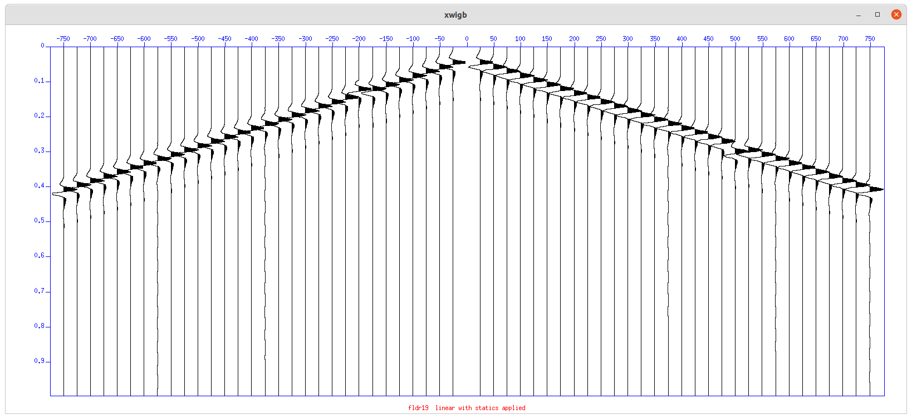
So you need to determine this intercept time (Ti), and this base velocity (Vb) from a display of first arrivals.

Slide 31
Ti is easy. And to compute Vb, we just need 2 time-offset points (near and far).

Slide 32
However, unlike these fake traces, remember that recorded traces within the “critical distance” do not contain refracted wavelets. But they do contain a lot of other energy, so do not be fooled when choosing the near time-offset pair.

Slide 33
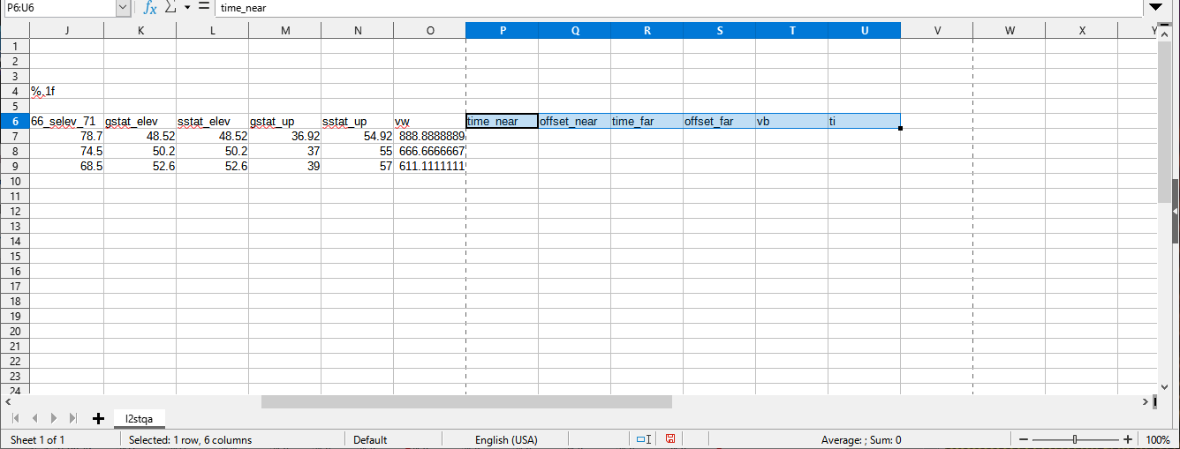
Use columns in the spreadsheet to contain your values from the first arrival display.
These values are: time_near, offset_near, time_far, offset_far.
Also Vb and Ti, which the spreadsheet can compute from those time-offset pairs.

Slide 34
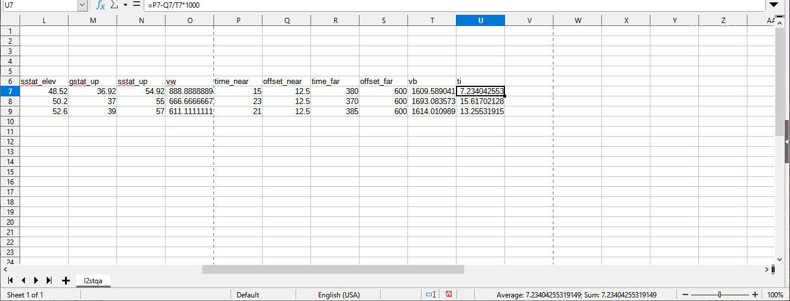
Enter some values for the time-offset pairs.
And in cell T7 put =(S7-Q7)/(R7-P7)*1000 and copy T7 to rest of column T.
And in cell U7 put =P7-Q7/T7*1000 and copy U7 to rest of column U.
These computations yield velocity and zero-offset intercept time.

Slide 35
Note the specified equation in column U uses the velocity from column T.
You can, of course, specify numbers for some-or-all cells in columns T and/or U.
In that case, the time-offset pairs will be ignored for Vb and/or Ti.

Slide 36
Now we have sufficient values for the equation seen previously:
Ti * Vb * Vw
Zw =
2 2
Vb - Vw
2
Where:
Zw is weathering layer thickness (the thickness of top layer)
Vw is weathering velocity (the velocity of top layer)
Vb is “base” velocity (the velocity under top layer)
Ti is the zero intercept time (the projected time at zero offset)

Slide 37
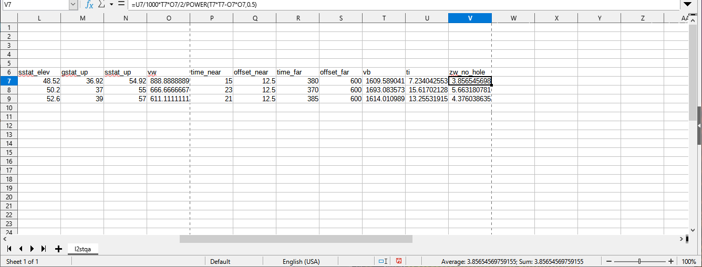
To compute Zw, in cell V7 put =U7/1000*T7*O7/2/POWER(T7*T7-O7*O7,0.5)
Then copy V7 to all subsequent cells in column V.
Note I use the name of zw_no_hole since this does not consider shot depth yet.

Slide 38
If the shot is in a hole, the top layer thicknesses of column V need adjustment.
Next I continue with how the adjustment is computed. But near the end of this video there is a section called “Other Considerations Related to Shot Holes”.

Slide 39
Consider a shot in a hole:
If the shot is in the top layer, the shot end of the path contributes a smaller amount to the intercept time.

Slide 40
Consider a shot in a hole:
If the shot is in the top layer, the shot end of the path contributes a smaller amount to the intercept time. This means the previous equation would compute a first layer thickness that is the average of the shot end and the receiver end(s).

Slide 41
Consider a shot in a hole:
If the shot is in the top layer, the shot end of the path contributes a smaller amount to the intercept time. This means the previous equation would compute a first layer thickness that is the average of the shot end and the receiver end(s).

Slide 42
Consider a shot in a hole:
If the shot is in the top layer, the shot end of the path contributes a smaller amount to the intercept time. This means the previous equation would compute a first layer thickness that is the average of the shot end and the receiver end(s).
To get the “true” thickness, the hole depth has to be accounted for.

Slide 43
For a shot in the top layer, since we’ve used a divisor of 2 in this equation:
Ti * Vb * Vw
Zw =
2 2
Vb - Vw
2
Then we need to adjust the Zw value by summing half the shot depth Ds:
Zw = Zw + Ds / 2

Slide 44
But if the shot is below the top layer, the intercept time only contains the contribution of the receiver ends.
So, if the shot is below top layer, since we’ve used a divisor of 2 in to compute the current zw value, Zw should be multiplied by 2. Zw_true = zw * 2

Slide 45
The choice wanted in the spreadsheet is:
If Ds / 2 is less than current zw value, then add Ds / 2 to current zw value
Otherwise use double the current Zw value.
In “Calc” this can be accomplished by using the IF function.

Slide 46
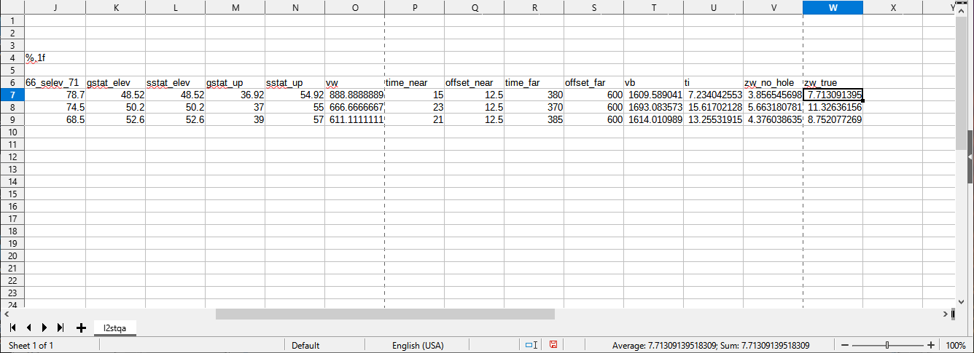
In cell W7 put =IF(F7/2<V7,F7/2+V7,V7*2) and copy to rest of column W.
This means: if Ds/2 is is less than current Zw, set Zw_true to Ds/2 + current Zw;
otherwise set Zw_true to double the current Zw.

Slide 47
In cell W7 put =IF(F7/2<V7,F7/2+V7,V7*2) and copy to rest of column W.
After doing that, notice that all values in column W are double column V.

Slide 48
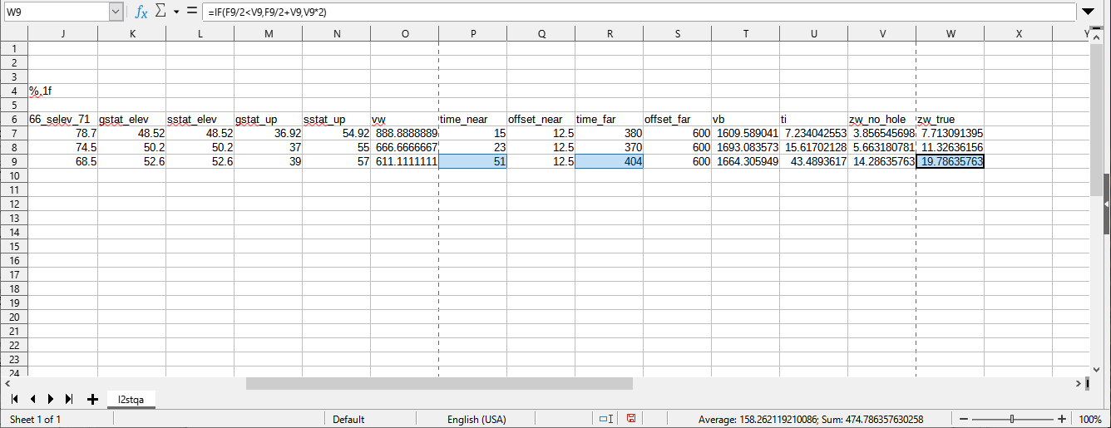
To make sure the IF function is doing what is wanted, reset P9 and R9 so that F9/2 is less than V9.
Now notice that W9 becomes V9 plus half of shot depth, as wanted.

Slide 49
So now the layer thicknesses and velocities have been computed.
Next, how are the statics computed from that information?

Slide 50
It is helpful here to remember that statics are corrections for the reflection signals, not the refraction signals.
The reflection signals did not go through the parts of layers above them when going down from the shots.

Slide 51
It is helpful here to remember that statics are corrections for the reflection signals, not the refraction signals.
The reflection signals did not go through the parts of layers above them when going down from the shots.

Slide 52
It is helpful here to remember that statics are corrections for the reflection signals, not the refraction signals.
The reflection signals did not go through the parts of layers above them when going down from the shots.
But the reflections did go through those parts when going up to the receivers.

Slide 53
The next diagrams indicate the static computations for 1-layer situations.

Slide 54
In the following diagrams:
Ed is the Datum Elevation
Vrep is the Replacement Velocity
Ep is the surface elevation of a point “p”
Dp is the depth of a point “p”
Zw is the thickness of the top layer
Vw is the velocity of the top layer
Vb is the velocity under the top layer
Tp is the static time of a point “p” (either a shot or a receiver)

Slide 55
Ed
Ep
Vw
Zw
Vb
If point is on surface (Dp = 0), then Tp equals:
(Ed – Ep) / Vrep
+ Zw / Vrep – Zw / Vw
Which reduces to:
(Ed-Ep+Zw) / Vrep – Zw / Vw
(Green arrows point to the associated interval)

Slide 56
Ed
Ep
Vw
Zw Dp
Vb
If Dp is <= Zw, then Tp equals:
(Ed – Ep) / Vrep
+ Dp / Vrep
+ (Zw-Dp) / Vrep – (Zw-Dp) / Vw
Which reduces to:
(Ed-Ep+Zw) / Vrep – (Zw-Dp) / Vw
Then
(Ed-Ep+Zw) / Vrep + (Dp-Zw) / Vw

Slide 57
If Dp is > Zw, then Tp equals:
(Ed – Ep) / Vrep
+ Zw / Vrep
+ (Dp-Zw) / Vb
Which reduces to: (Ed-Ep+Zw) / Vrep + (Dp-Zw) / Vb
Ed
Ep
Vw
Zw
Vb
Dp

Slide 58
Ed
Ep
Vw
Zw
Vb
Dp
Notice that Vb velocity is used in the last term below.
You might consider dividing by Vrep instead.
But, consider that this part of the reflection paths for the receiver has not been “replaced” with Vrep. So the path going up to the receiver has Vb in this part. I feel that the path downward from the shot should be “corrected” to that same Vb.
+ (Dp-Zw) / Vb

Slide 59
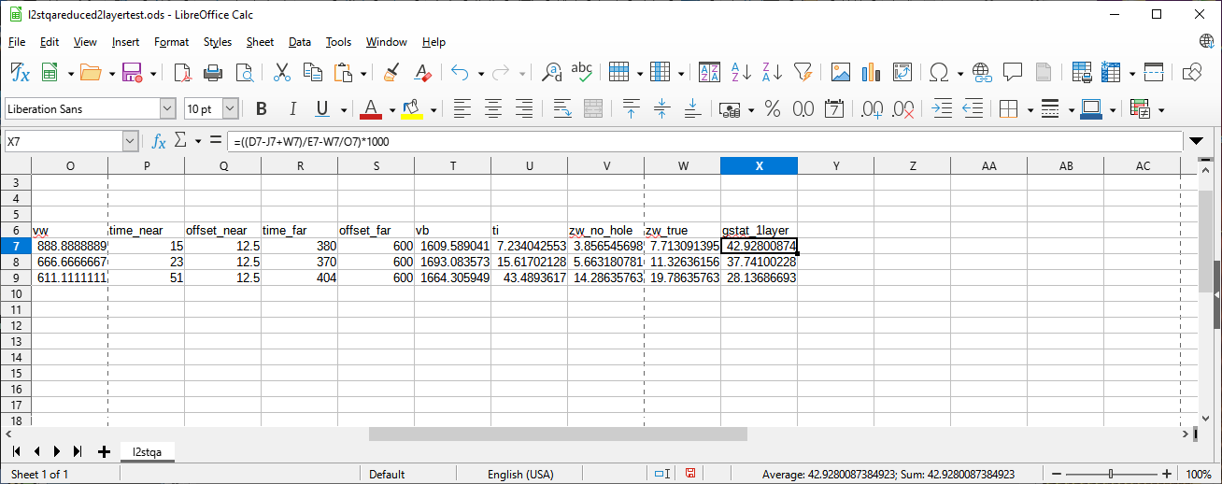
In cell X7 put this to get the receiver static (the static at the surface)
=((D7-J7+W7)/E7-W7/O7)*1000
then copy X7 to rest of column X.

Slide 60
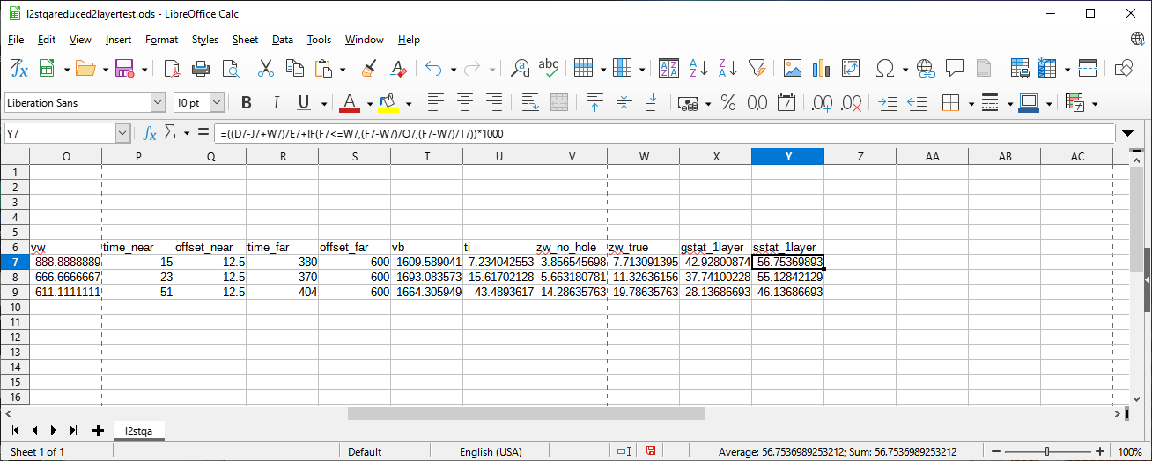
In cell Y7 put this to get the shot static (the static at the point depth).
=((D7-J7+W7)/E7+IF(F7<=W7,(F7-W7)/O7,(F7-W7)/T7))*1000
then copy Y7 to rest of column Y.

Slide 61
That is all I want to show about 1-layer static computations.
To use the results in various programs, you can output a csv file.
You can do that using “save as” in Calc.
The “csv” option just outputs the numeric values themselves.
But before you output a csv file, if you want to use the output in Seismic Unix programs like sushiftcsv, you should maintain the top 6 q-file records.

Slide 62
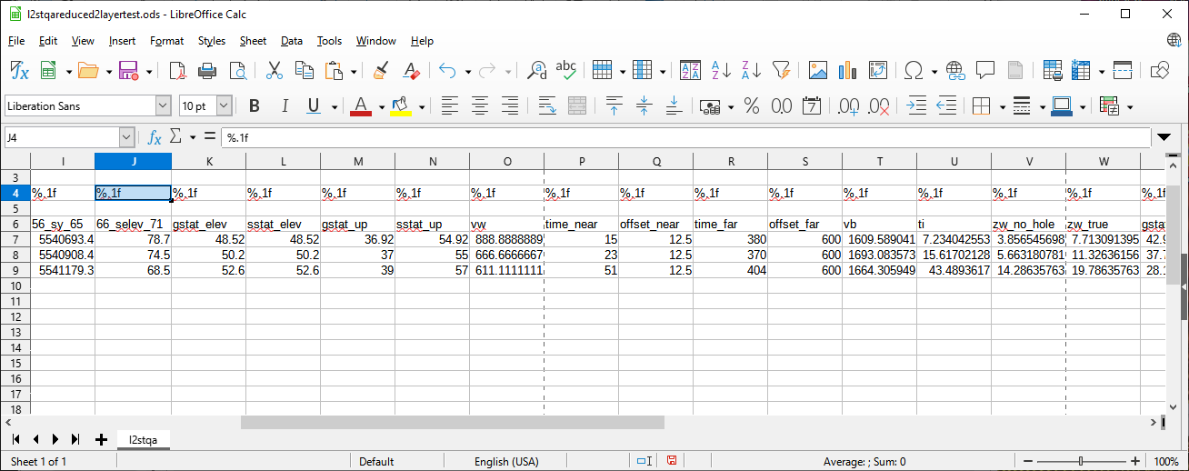
We have already given everything a “q-file name” (row 6).
Now we should supply good “q-file formats” (row 4).
So copy J4 to all cells to the end of row 4 (K4 to Y4).

Slide 63
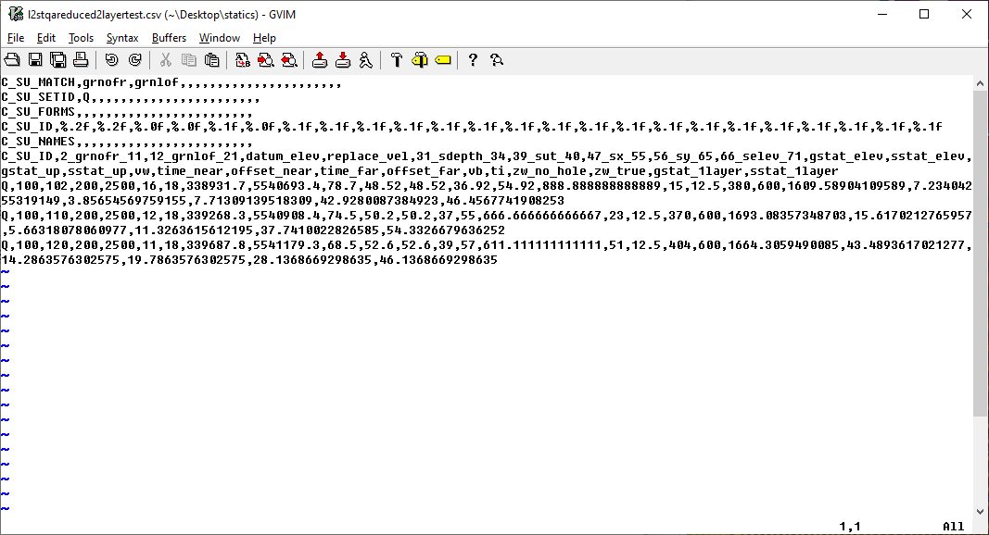
Using the “save as csv” option, the output file looks something like this.
This file is an acceptable q-file for shot statics in program sushiftcsv.
It can also be used by program subinqcsv for 2D spatial interpolation using grnlof shot point numbers (stations). And then by susmoqcsv to perform 2D spatial smoothing. After that, sushiftcsv can use the q-files output by those programs.

Slide 64
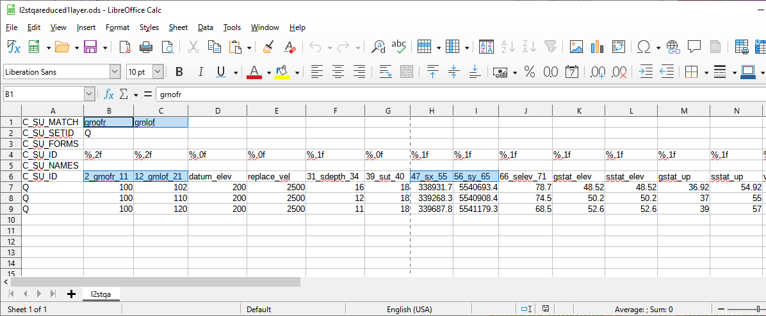
But the previous q-file is not an acceptable q-file in sushiftcsv for receiver statics.
The problem is not with the receiver statics values in that file,
the problem is with these q-names.
These are shot keys.
They need to be receiver keys for the receiver statics file input to sushiftcsv.

Slide 65
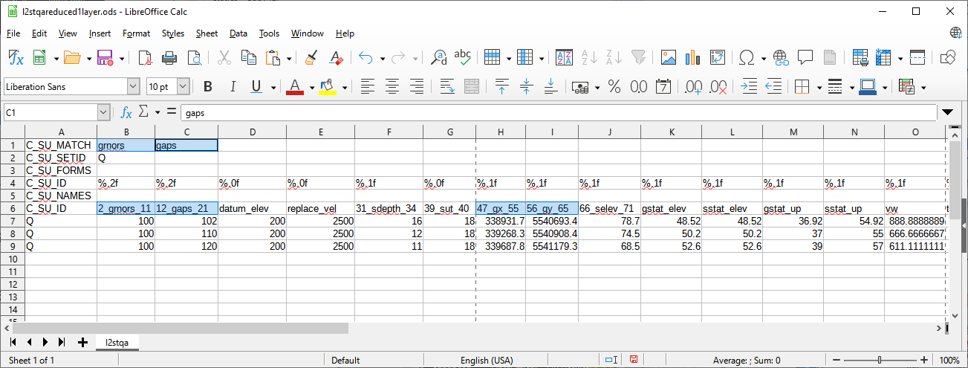
But the previous q-file is not an acceptable q-file in sushiftcsv for receiver statics.
The problem is not with the receiver statics values in that file,
the problem is with these q-names.
For 2D surveys you can often just change the names to grnors, gaps, gx, gy.
Then re-output another csv file and use it in sushiftcsv for receiver statics.

Slide 66
Note that you do not need to change the q-file names for the statics values.
The sushiftcsv program allows you to choose which q-names contain the shot or receiver statics you want to apply from the q-files.
But sushiftcsv does default the static names it wants to apply to gstat and sstat.
Notice that I do not use gstat and sstat as static names in the spreadsheet.
That is because both receiver and shot statics are computed in the spreadsheet, and also because several types of statics are computed.
The effect is to force you to specify which statics you want sushiftcsv to use.
(You can, of course, modify your spreadsheet so the final static values you want to use are named gstat and sstat, so the defaults of sushiftcsv will use them).

Slide 67
For 3D surveys you cannot just re-name grnofr,grnlof to grnors,gaps because 3D receiver line,point numbering is not the same as 3D shot line,point numbering.
However, coordinate numbering is the same. So sx,sy can be re-named to gx,gy to apply nearest statics using sushiftcsv – as done for the technique in my video:
Manually Deriving Refraction Statics for Simple Near Surface.

Slide 68
The shot q-file for sushiftcsv only needs the shot key identifiers and statics (or the shot key coordinates and statics).
The receiver q-file for sushiftcsv only needs the receiver key identifiers and statics (or the receiver key coordinates and statics).
If you want to reduce the size of output csv q-files, you can do so by deleting columns that do not contain the values you want.
But you need to do something before deleting those columns.
You need to get rid of the spreadsheet equations and just keep the numbers.

Slide 69
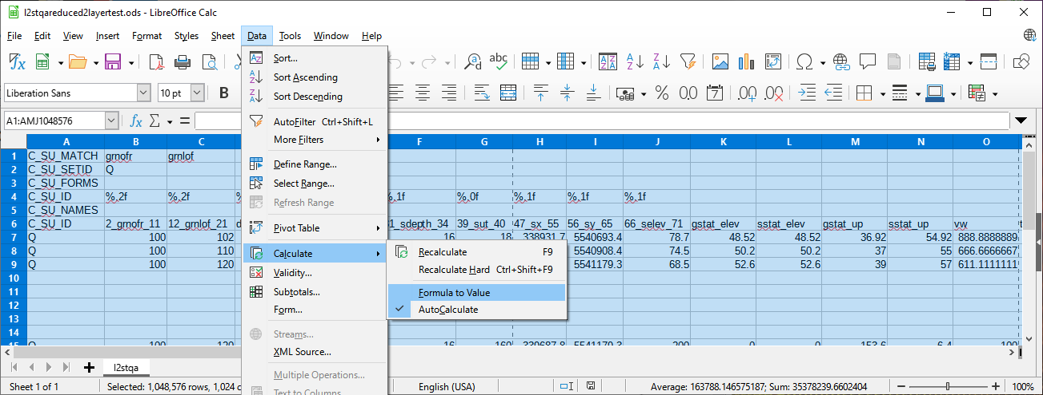
To do that, select every cell in the spreadsheet (click between A and 1 at top left).
Then Data→Calculate→Formula to Value
Then delete the columns you do not want.
And output using “save as” csv.

Slide 70
Onward to 2-layer computations:
The intercept time from first refractor was named Ti, I’m naming the next Tj.
The velocity from first refractor was named Vb, I’m naming the next vc.
The top layer thickness was named zw, I’m naming the next zb.

Slide 71
A shot in a hole, some names, and raypaths for a 2-layer situation:
Vw
Zw
Vb
Zb
Vc

Slide 72
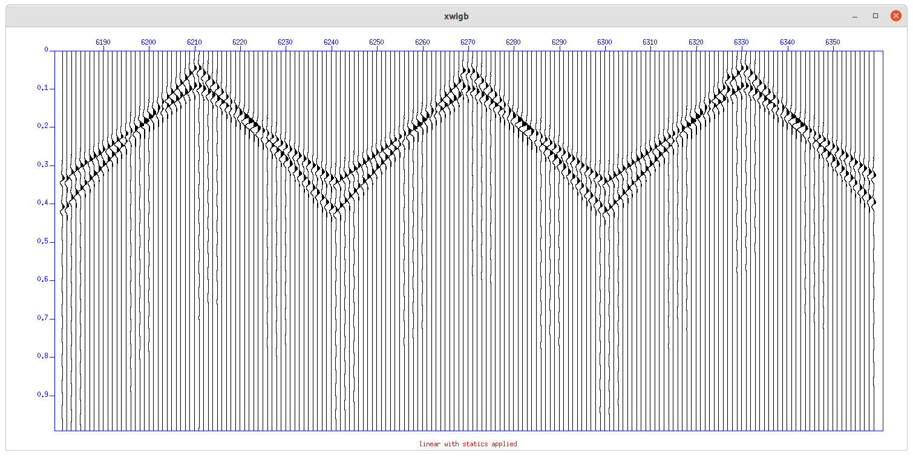
Tj is this zero intercept time.
To compute Vc, we need 2 time-offset points (near and far).

Slide 73
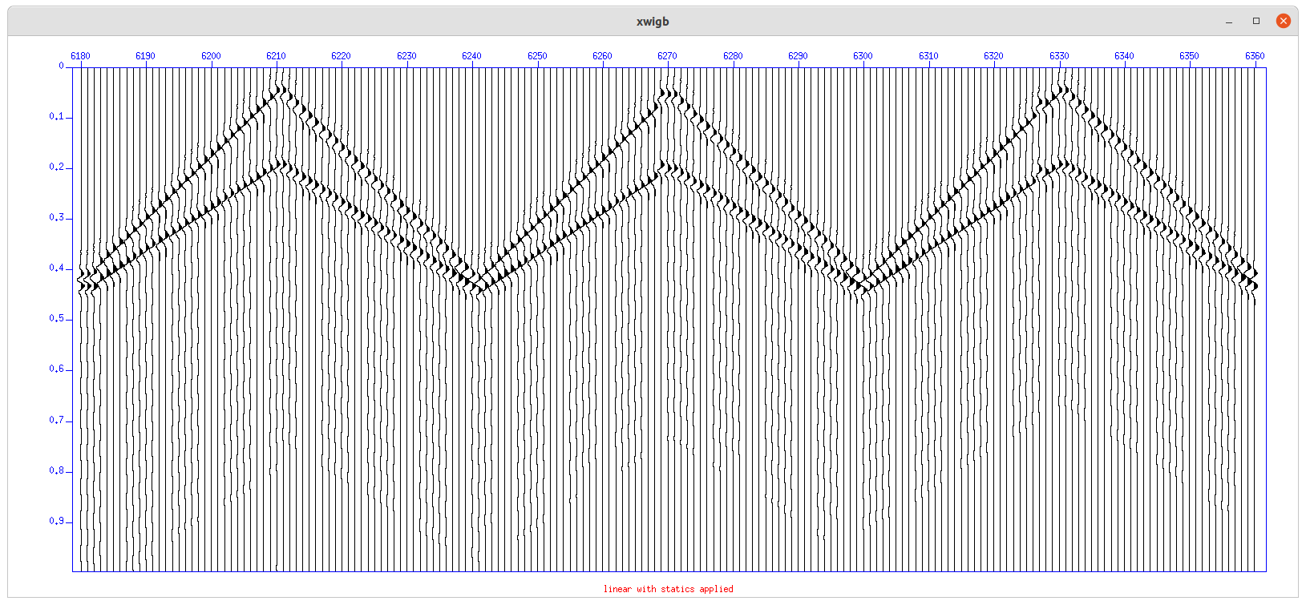
Note that the next layer velocity and zero intercept can still be obtained even when the refracted wavelets never become the first arrival.

Slide 74
Tj is this zero intercept time.
To compute Vc, we need 2 time-offset points (near and far).

Slide 75
However, unlike these fake traces, remember that recorded traces within the “critical distance” do not contain refracted wavelets. But they do contain a lot of other energy, so do not be fooled when choosing the near time-offset pairs.

Slide 76
You can find the n-layer intercept time equation online:
n - 1
2 2
Vn - Vk
2
Zk *
Tn =
Vn
Vk
k = 1

Slide 77
Unrolling the summation to 2-layers,
substituting the previous definitions into it,
and re-arranging terms,
produces the following equation for thickness Zb:
Vc * Vw
2 2
Vc - Vb
Zw * 2 *
Zb =
*
Tj -
Vc * Vb
2 *
2 2
Vc - Vw

Slide 78
Note the Zw value to use in this equation is not Zw_true.
It is the zw before adjustment for shot depth because neither of the intercept time values includes time from above the shot.
Vc * Vw
2 2
Vc - Vb
Zw * 2 *
Zb =
*
Tj -
Vc * Vb
2 *
2 2
Vc - Vw

Slide 79
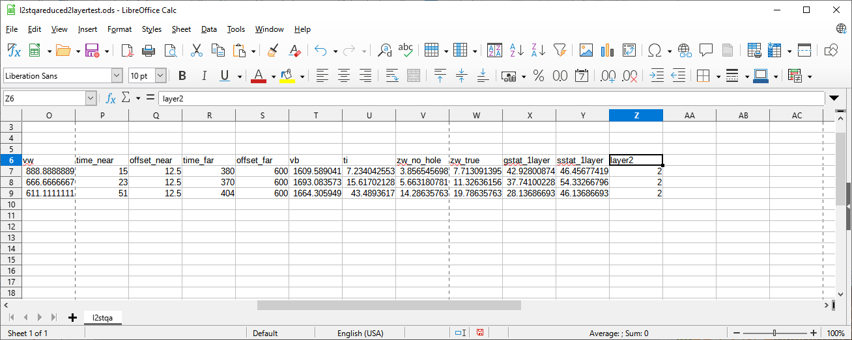
Just to keep things a bit clearer,
use column Z to indicate that layer2 computations start in the next column.
The values in this column are not used.

Slide 80
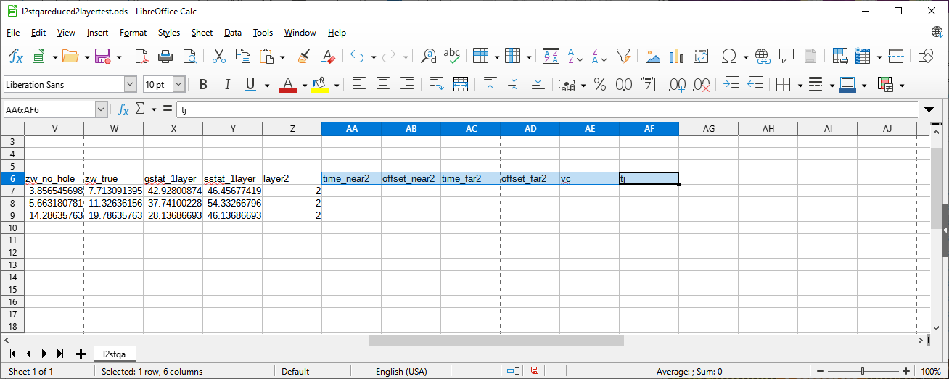
Now add columns for time_near2, offset_near2, time_far2, offset_far2.
And columns for Vc velocity and Tj intercept that will be computed from these pairs.

Slide 81
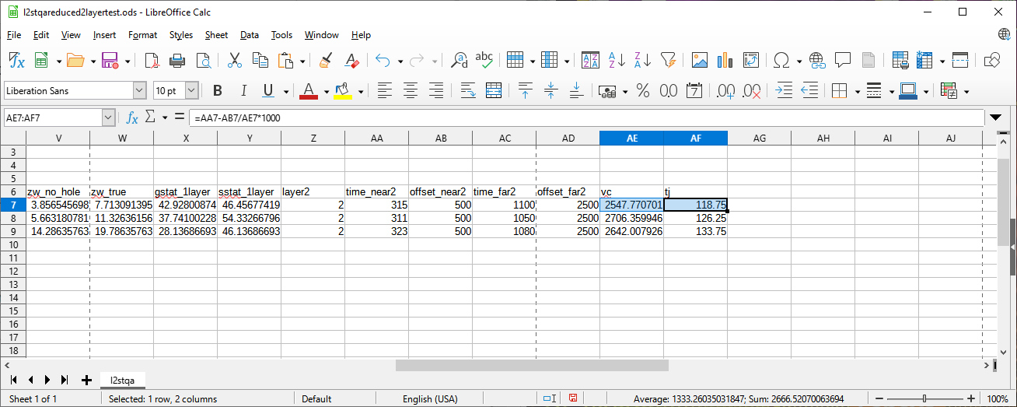
Put in some reasonable values for the time-offset pairs.
In cell AE7 put =(AD7-AB7)/(AC7-AA7)*1000 and copy to rest of column AE.
In cell AF7 put =AA7-AB7/AE7*1000 and copy to rest of column AF.

Slide 82
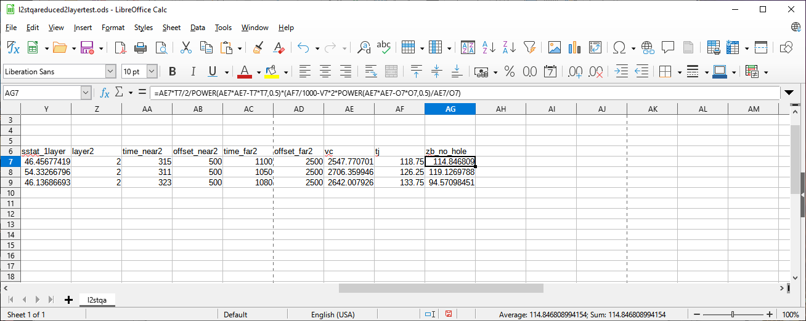
To compute Zb without considering the shot depth, in cell AG7 put
=AE7*T7/2/POWER(AE7*AE7-T7*T7,0.5)*(AF7/1000-V7*2*POWER(AE7*AE7-O7*O7,0.5)/AE7/O7)
and copy AG7 to rest of column AG.

Slide 83
And, to compute “true” zb, we need to distinguish which layer contains the shot.
This requires using an IF function inside another IF function.

Slide 84
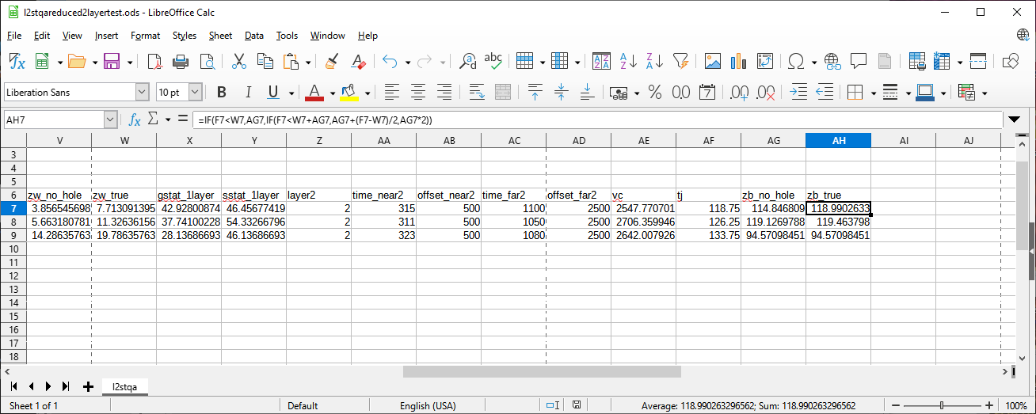
To compute the “true” Zb, put this double IF function in cell AH7.
=IF(F7<W7,AG7,IF(F7<W7+AG7,AG7+(F7-W7)/2,AG7*2))
and copy AH7 to rest of column AH.

Slide 85
Note the previous IF functions used the “true” Zw value, not the Zw_no_hole value.
Note also that when the shot depth is within the layer below the top layer, these IFs are only adding half the amount between shot depth and bottom of top layer.
This is because only the receiver ends of the paths contribute fully to Tj intercept. The shot ends of the paths did not contribute the difference in time between the bottom of the top layer and the shot depth. (This is analogous to the 1-layer case when the shot is within the top layer).

Slide 86
The next diagrams indicate the static computations for 2-layer situations.

Slide 87
In the following diagrams:
Ed is the Datum Elevation
Vrep is the Replacement Velocity
Ep is the surface elevation of a point “p”
Dp is the depth of a point “p”
Zw is the thickness of the top layer
Vw is the velocity of the top layer
Vb is the velocity under the top layer
Zb is the thickness of the layer under the top layer
Vc is the velocity of the next layer
Tp is the static time of a point “p” (either a shot or a receiver)

Slide 88
Ed
Ep
Vw
Zw
Vb
Zb
Vc
If point is on surface (Dp = 0), then Tp equals:
(Ed – Ep) / Vrep
+ Zw / Vrep – Zw / Vw
+ Zb / Vrep – Zb / Vb
Which reduces to: (Ed-Ep+Zw+Zb) / Vrep – Zw / Vw – Zb / Vb

Slide 89
Ed
Ep
Vw
Zw Dp
Vb
Zb
Vc
If Dp is <= Zw, then Tp equals:
(Ed – Ep) / Vrep
+ Dp / Vrep
+ (Zw-Dp) / Vrep – (Zw-Dp) / Vw
+ Zb / Vrep – Zb / Vb
Which reduces to: (Ed-Ep+Zw+Zb) / Vrep - ((Zw-Dp) / Vw + Zb / Vb)

Slide 90
Ed
Ep
Vw
Zw
Vb
Zb Dp
Vc
else if Dp is <= Zw+Zb, then Tp equals:
(Ed – Ep) / Vrep
+ Zw / Vrep
+ (Dp-Zw) / Vrep
+ (Zw+Zb-Dp) / Vrep - (Zw+Zb-Dp) / Vb
Which reduces to: (Ed-Ep+Zw+Zb) / Vrep – (Zw+Zb-Dp) / Vb

Slide 91
Ed
Ep
Vw
Zw
Vb
Zb
Vc
Dp
else if Dp > Zw+Zb, then Tp equals:
(Ed – Ep) / Vrep
+ Zw / Vrep
+ Zb / Vrep
+ (Dp-Zw-Zb) / Vc
Which reduces to: (Ed-Ep+Zw+Zb) / Vrep – (Zw+Zb-Dp) / Vc

Slide 92
Ed
Ep
Vw
Zw
Vb
Zb
Vc
Dp
Notice that Vc velocity is used in the last term below.
You might consider dividing by Vrep instead.
But, consider that this part of the reflection paths for the receiver has not been “replaced” with Vrep. So the path going up to the receiver has Vc in this part. I feel that the path downward from the shot should be “corrected” to that same Vc.
+ (Dp-Zw-Zb) / Vc

Slide 93
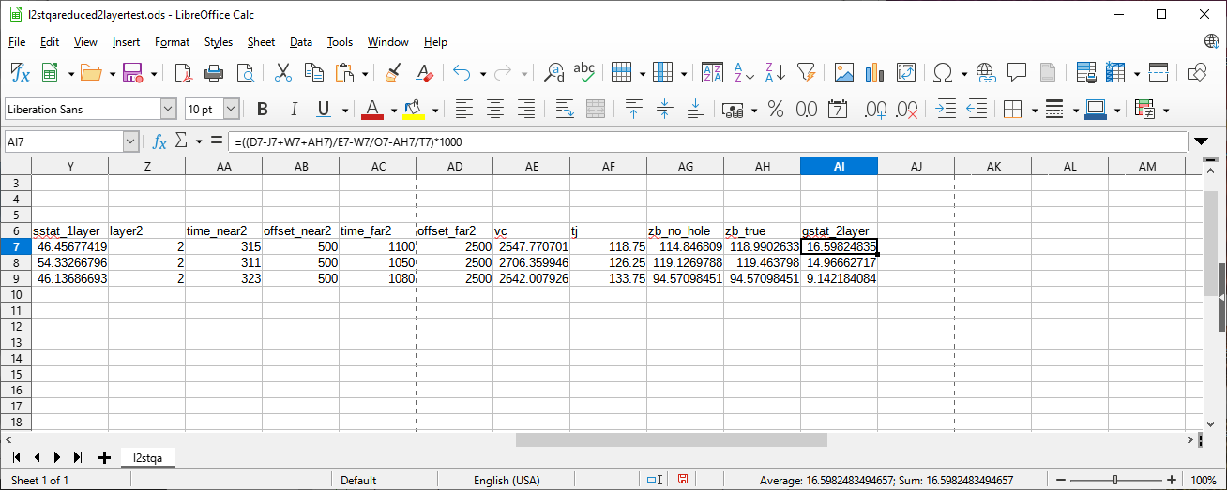
To compute the 2 layer receiver static, put this in cell AI7.
=((D7-J7+W7+AH7)/E7-W7/O7-AH7/T7)*1000
then copy AI7 to rest of column AI.

Slide 94
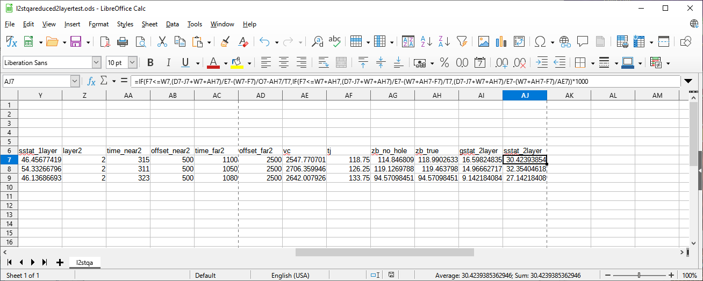
To compute the 2 layer shot static, put this double IF in cell AJ7
=((D7-J7+W7+AH7)/E7-IF(F7<=W7,(W7-F7)/O7+AH7/T7, IF(F7<=W7+AH7,(W7+AH7-F7)/T7,(W7+AH7-F7)/AE7)))*1000
and copy AJ7 to rest of column AJ.

Slide 95
We have already given everything a “q-file name” (row 6). Now we should supply good “q-file formats” (row 4).
So copy J4 to all cells to the end of row 4 (K4 to AJ4).
Then, to output a csv q-file use the procedures shown previously.

Slide 96
Next, some example tests.
Spreadsheets make testing (relatively) simple.
You can find a link to the final spreadsheet in the description section of this YouTube video. You can also find a link to this presentation.
Also in Seismic Unix ../demos/Sushiftcsv/l2r_spreadsheet_tests.ods
and ../demos/Sushiftcsv/l2rstatics.odp

Slide 97
This example is in row 7 of the spreadsheet.
A shot in a hole with depth Ds=16, layer thicknesses Zw=40 and Zb=30,
and velocities Vw=100, Vb=1000, and Vc=10000.
Vw = 100
Ds = 16
Zw = 40
Vb = 1000
Zb = 30
Vc = 10000

Slide 98
Since the velocity contrast is high, the path ends are nearly vertical.
Vw = 100
Ds = 16
Zw = 40
Vb = 1000
Zb = 30
Vc = 10000

Slide 99
The time vertically through these layers at their velocities
Vw = 100
Ds = 16
Zw = 40
Time = 400 ms.
Vb = 1000
Zb = 30
Time = 30 ms.
Vc = 10000

Slide 100
The shot uphole time.
And the remaining vertical time under the hole.
Vw = 100
Up Time = 160 ms.
Ds = 16
Zw = 40
Time = 400 ms.
Time = 240 ms.
Vb = 1000
Zb = 30
Time = 30 ms.
Vc = 10000

Slide 101
Since paths ends are nearly vertical, Ti intercept time is approximately 240 + 400.
Vw = 100
Up Time = 160 ms.
Ds = 16
Zw = 40
Time = 400 ms.
Time = 240 ms.
Vb = 1000
Zb = 30
Time = 30 ms.
Vc = 10000

Slide 102
Since paths ends are nearly vertical, Ti intercept time is approximately 240 + 400.
Time = 400 ms.
Time = 240 ms.

Slide 103
And Tj intercept time is approximately 240 + 30 + 30 + 400, which is 700.
Time = 400 ms.
Time = 240 ms.
Time = 30 ms.

Slide 104
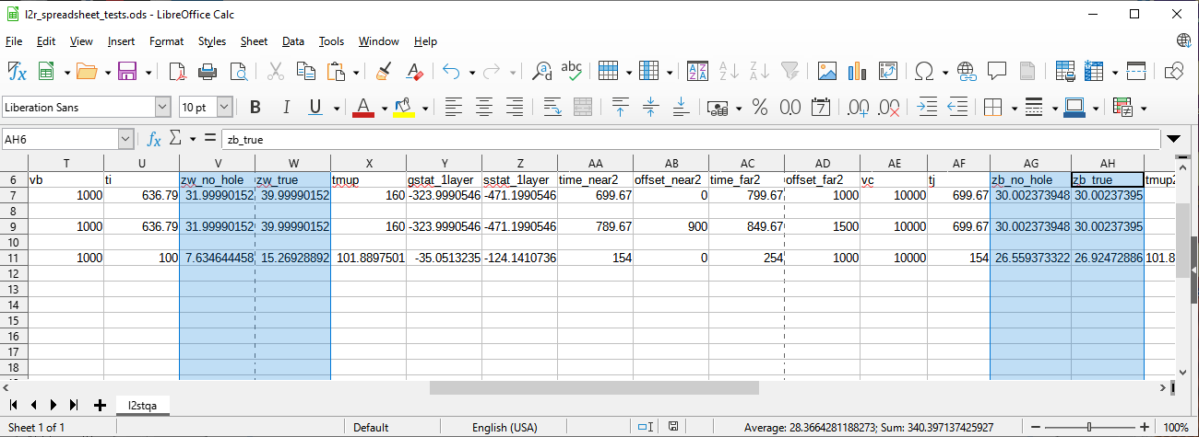
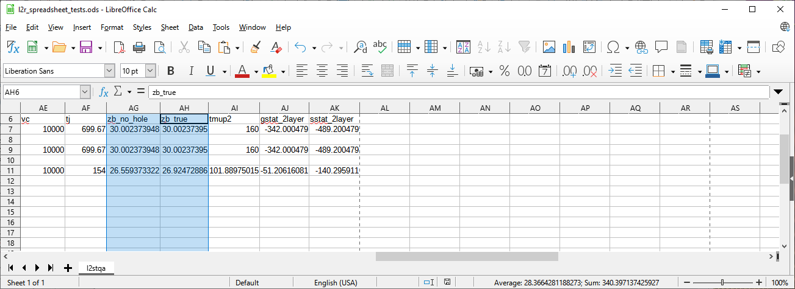
Using the n-layer equation seen previously and a calculator:
exact Ti intercept time is 636.79 and exact Tj intercept time is 699.67
Using those values in row 7 of spreadsheet yields a zw_true of 40 (as it should):
And a Zb_true value of 30 (as it should):

Slide 105
This example is in row 9 of the spreadsheet.
Now I change the shot hole depth to 52 (which is deeper than top layer).
Vw = 100
Zw = 40
Up Time = 412 ms.
Time = 400 ms.
Vb = 1000
Ds = 52
Zb = 30
Time = 30 ms.
Time = 18 ms.
Vc = 10000

Slide 106
Note that the dotted red line indicates a raypath through the layer.
If the shot depth was far enough below the top of the layer, this would cause trouble in determining the Vb velocity and Ti intercept time using time-offset pairs.
Vw = 100
Zw = 40
Up Time = 412 ms.
Time = 400 ms.
Vb = 1000
Ds = 52
Zb = 30
Time = 30 ms.
Time = 18 ms.
Vc = 10000

Slide 107
Note that the dotted red line indicates a raypath through the layer.
If the shot depth was far enough below the top of the layer, this would cause trouble in determining the Vb velocity and Ti intercept time using simple time-offset pairs.
If you do suspect that the shot depth is far below the top of the layer, then I suggest you use far-offset traces to make an estimate of the velocity and intercept, and derive a preliminary value for the layer thickness. Then, correct the offsets in some nearer time-offset pairs using the preliminary value for the layer thickness. That should improve the estimate of the layer velocity and thickness.

Slide 108
For this example, using the n-layer equation and a calculator, the intercept times are:
Ti=397.99 and Tj=447.74
Vw = 100
Zw = 40
Up Time = 412 ms.
Time = 400 ms.
Vb = 1000
Ds = 52
Zb = 30
Time = 30 ms.
Time = 18 ms.
Vc = 10000

Slide 109
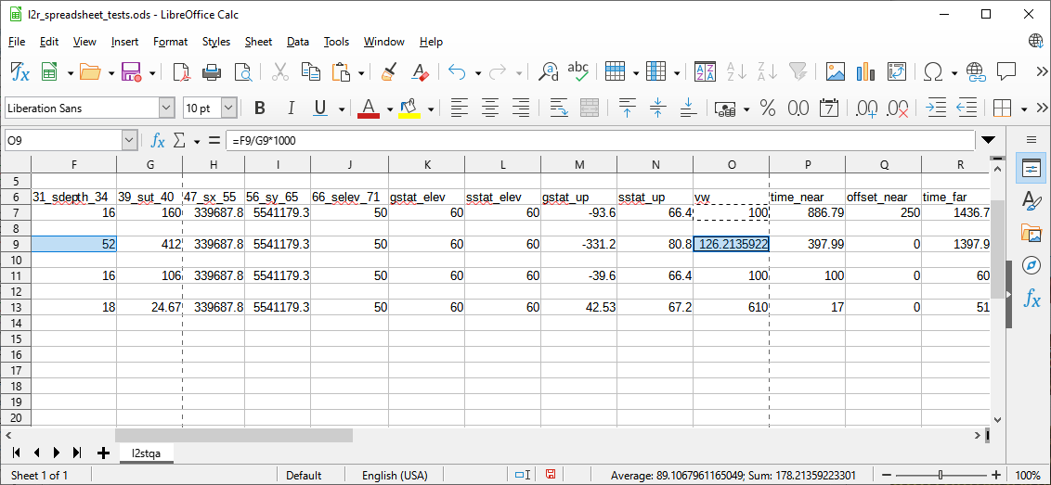
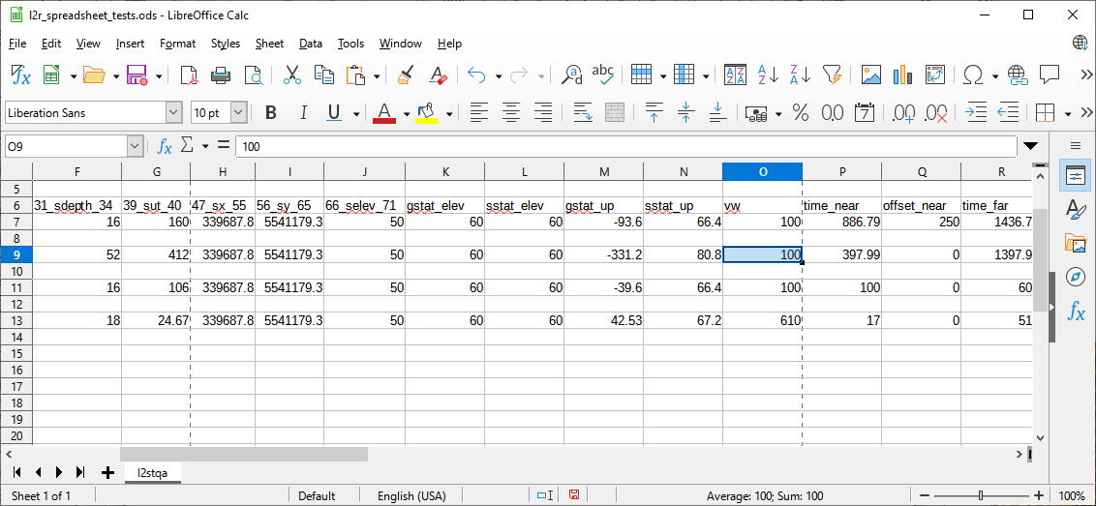
Setting 52 as shot depth and 412 as uphole time, notice we get 126.21 as Vw.
This is because the Vw computation in column O is simply depth / uphole_time.
The spreadsheet does not “know” that Vw is 100.
But we “know” that Vw is 100, so reset it to 100.
(Often, you have to guesstimate a Vw value, or guesstimate Zw, or both).

Slide 110
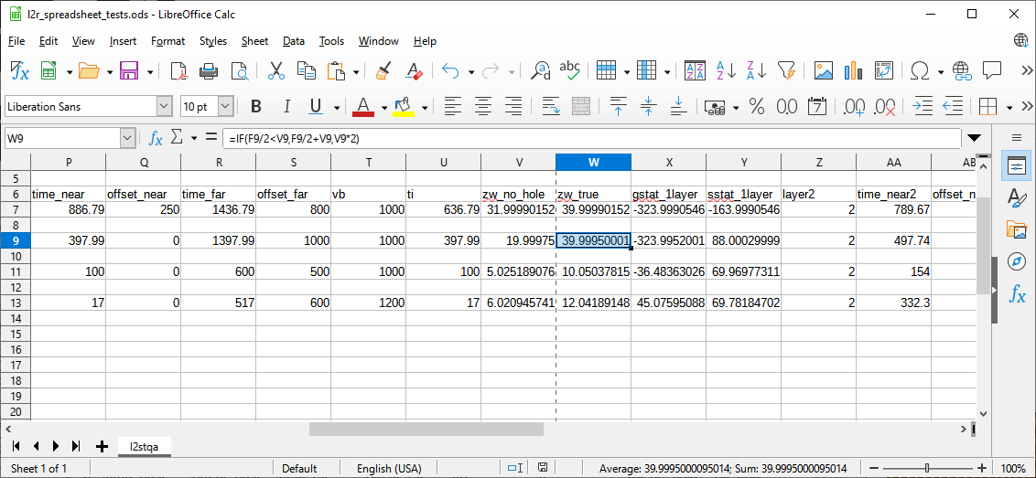
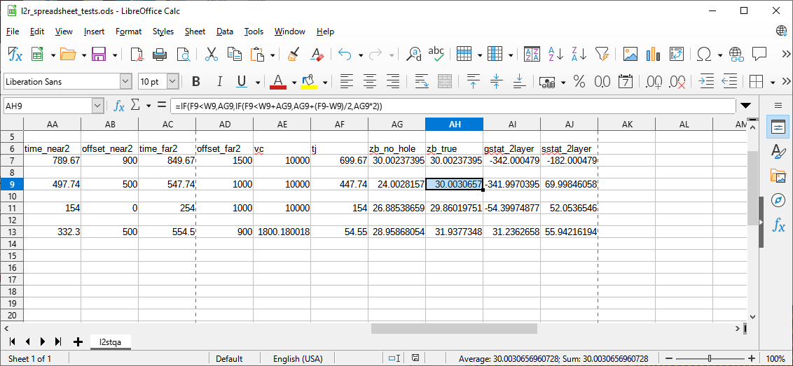
Entering some reasonable time-offset values to produce Vw and Vb velocities and Ti and Tj intercept times:
- we get the correct Zw and Zb thicknesses.

Slide 111
This example is in row 11 of the spreadsheet.
A slightly different example (less top thickness and less shot depth):
Since raypath ends are nearly vertical, Ti intercept time is approximately 100.
Tj intercept time is approximately 24+30+100
Zw = 10
Vw = 100
Time = 100 ms.
Up Time = 106 ms.
Ds = 16
Vb = 1000
Zb = 30
Time = 30 ms.
Time = 24 ms.
Vc = 10000

Slide 112
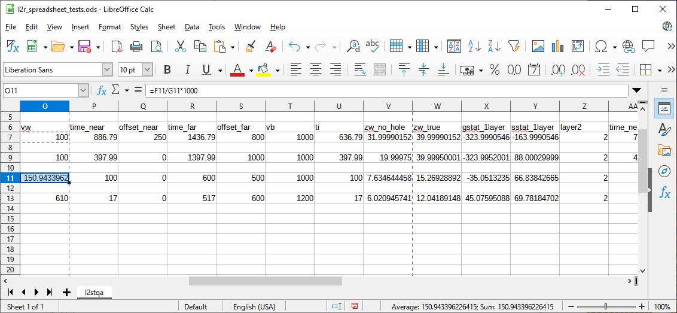
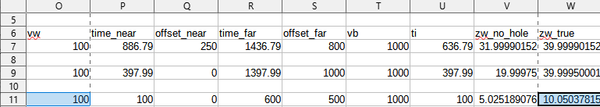
Entering this example into row 11 we see that Vw is computed wrong because the uphole time traverses part of the next layer.
Setting Vw to known value of 100 produces approximate Zw and other values.

Slide 113
Remember that we used the approximate intercept times for this example.
This example gives you some idea of how sensitive the results are.
Setting Vw to known value of 100 produces approximate Zw and other values.

Slide 114
This example is in row 13 of the spreadsheet.
A more realistic example (the raypaths are not approximately vertical):
Using a calculator: Ti intercept time is 16.94
Tj intercept time is 54.53
Zw = 12
Vw = 610
Time = 19.67 ms.
Up Time = 24.67 ms.
Ds = 18
Vb = 1200
Zb = 32
Time = 26.67 ms.
Time = 21.67 ms.
Vc = 1800

Slide 115
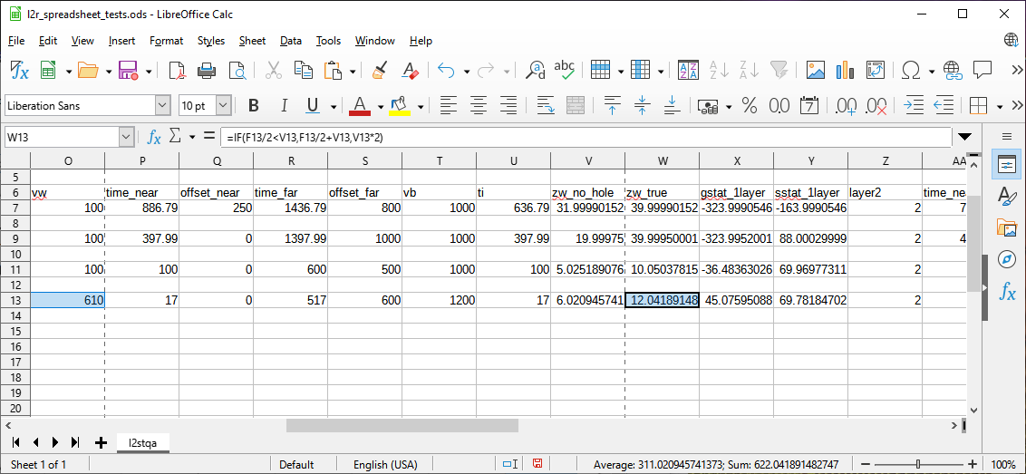
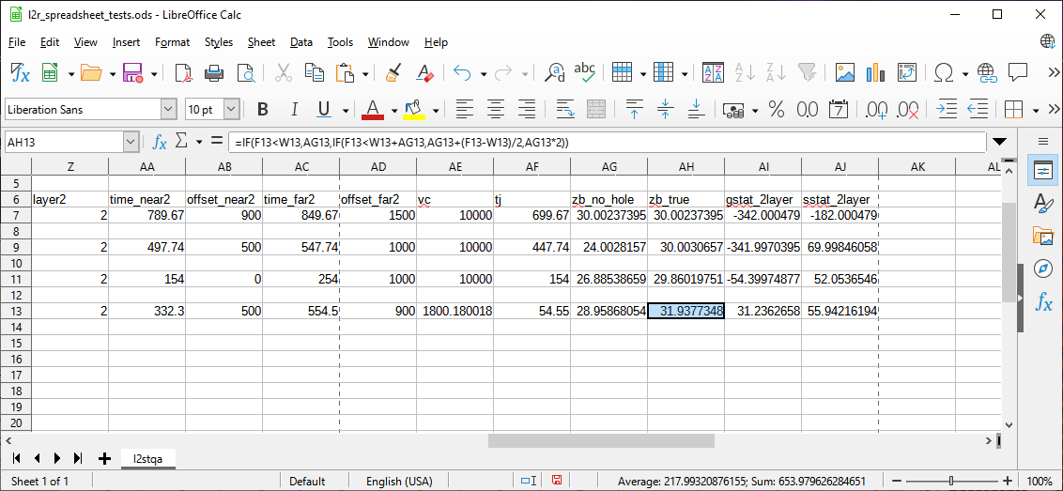
Setting time-offset pair values so they produce the Vb,Vc and Ti,Tj values and also setting Vw to 610 and entering the rest of the realistic example:
- we get the correct Zw and Zb thicknesses.

Slide 116
So far the examples have been used to check the computation of velocities, intercept times, and layer thicknesses from time-offset pairs.
Next, the examples are used to check the computed statics values.

Slide 117
Returning to the first example (spreadsheet row 7), manual computation of the 1-layer static for a point on the surface gives:
(Ed-Ep+Zw) / Vrep – Zw / Vw
(200-50+40)/2500 – 40/100 => -324 ms.
And the 1-layer static for depth 16 (which is within layer 1):
(Ed-Ep+Zw) / Vrep + (Dp-Zw) / Vw
(200-50+40)/2500 + (16-40)/100 => -164 ms.

Slide 118
Continuing with the first example (row 7), manual computation of the 2-layer static for a point on the surface gives:
(Ed-Ep+Zw+Zb) / Vrep – Zw / Vw – Zb / Vb
(200-50+40+30)/2500 – 40/100 – 30/1000 => -342 ms.
And the 2-layer static for depth 16 (which is within layer 1):
(Ed-Ep+Zw+Zb) / Vrep - ((Zw-Dp) / Vw + Zb / Vb)
(200-50+40+30)/2500 - ((40-16)/100 + 30/1000) => -182 ms.

Slide 119
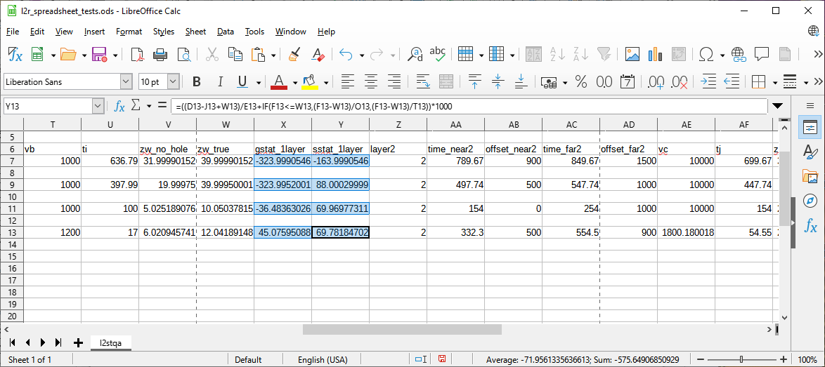
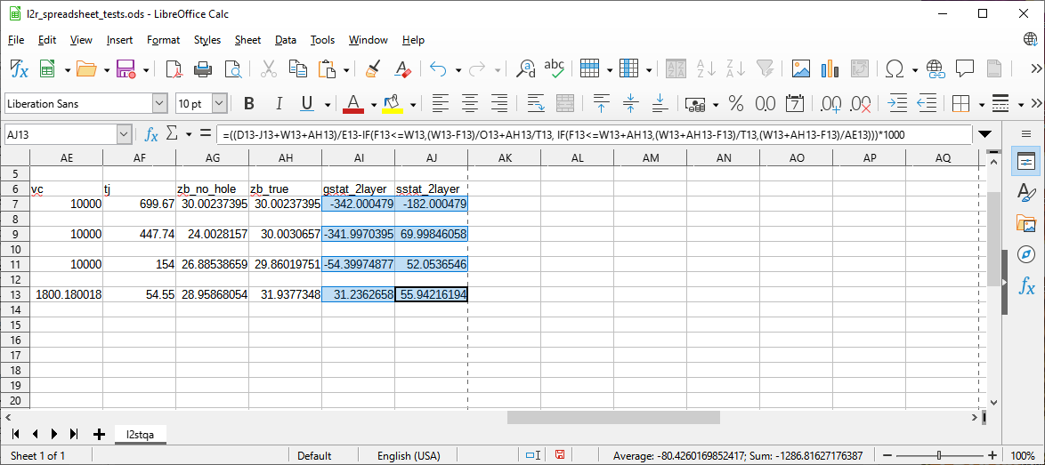
And we see those static values in columns X,Y and AI,AJ.

Slide 120
In the second example (spreadsheet row 9), manual computation of the 1-layer static for a point on the surface gives:
(Ed-Ep+Zw) / Vrep – Zw / Vw
(200-50+40)/2500 – 40/100 => -324 ms.
And the 1-layer static for depth 52 (which is below layer 1):
(Ed-Ep+Zw) / Vrep + (Dp-Zw) / Vb
(200-50+40)/2500 + (52-40)/1000 => 88 ms.

Slide 121
Continuing with the second example (row 9), manual computation of the 2-layer static for a point on the surface gives:
(Ed-Ep+Zw+Zb) / Vrep – Zw / Vw – Zb / Vb
(200-50+40+30)/2500 – 40/100 – 30/1000 => -342 ms.
And the 2-layer static for depth 52 (which is within layer 2):
(Ed-Ep+Zw+Zb) / Vrep – (Zw+Zb-Dp) / Vb
(200-50+40+30)/2500 - (40+30-52)/1000 => 70 ms.

Slide 122
And we see those static values in columns X,Y and AI,AJ.

Slide 123
In the third example (spreadsheet row 11), manual computation of the 1-layer static for a point on the surface gives:
Ed-Ep+Zw) / Vrep - Zw / Vw
(200-50+10)/2500 - 10/100 => -36 ms.
And the 1-layer static for depth 16 (which is below layer 1):
(Ed-Ep+Zw) / Vrep + (Dp-Zw) / Vb
(200-50+10)/2500 + (16-10)/1000 => 70 ms.

Slide 124
Continuing with the third example (row 11), manual computation of the 2-layer static for a point on the surface gives:
(Ed-Ep+Zw+Zb) / Vrep – Zw / Vw – Zb / Vb
(200-50+10+30)/2500 – 10/100 – 30/1000 => -54 ms.
And the 2-layer static for depth 16 (which is within layer 2):
(Ed-Ep+Zw+Zb) / Vrep – (Zw+Zb-Dp) / Vb
(200-50+10+30)/2500 - (10+30-16)/1000 => 52 ms.

Slide 125
And we see those static values in columns X,Y and AI,AJ.
(Remembering that row 11 uses approximate intercept times).

Slide 126
In the fourth example (spreadsheet row 13), manual computation of the 1-layer static for a point on the surface gives:
Ed-Ep+Zw) / Vrep - Zw / Vw
(200-50+12)/2500 - 12/610 => 45.12 ms.
And the 1-layer static for depth 18 (which is below layer 1):
(Ed-Ep+Zw) / Vrep + (Dp-Zw) / Vb
(200-50+12)/2500 + (18-12)/1200 => 69.8 ms.

Slide 127
Continuing with the fourth example (row 13), manual computation of the 2-layer static for a point on the surface gives:
(Ed-Ep+Zw+Zb) / Vrep – Zw / Vw – Zb / Vb
(200-50+12+32)/2500 – 12/610 – 32/1200 => 31.26 ms.
And the 2-layer static for depth 18 (which is within layer 2):
(Ed-Ep+Zw+Zb) / Vrep – (Zw+Zb-Dp) / Vb
(200-50+12+32)/2500 – (12+32-18)/1200 => 55.93 ms.

Slide 128
And we see those static values in columns X,Y and AI,AJ.

Slide 129
End of comparison between manual computations and spreadsheet.
You can, of course, perform other relatively easy manual tests by changing Datum Elevation, Point Elevation, and Replacement Velocity.

Slide 130
Other Considerations Related to Shot Holes.

Slide 131
Is the shot hole depth less than the top layer thickness?
If you have been told that the shots were drilled to less than the bottom of top layer, then the top layer velocity Vw in column O is just shot depth / shot uphole time.

Slide 132
Is the shot hole depth the same as the top layer thickness?
If you have been told that the shots were drilled to the bottom of top layer, then the top layer velocity Vw in column O is also just shot depth / shot uphole time. And top layer thickness (Zw) in column W can be set to shot hole depth.

Slide 133
Is the shot hole depth more than the top layer thickness?
If you have been told that the shots were drilled to below the bottom of top layer, then the shot uphole time and shot depth are not sufficient to compute both the top layer thickness in column W and the top layer velocity in column O. You have to guesstimate either top layer thickness Zw or velocity Vw.

Slide 134
Is the shot hole depth more than the top layer thickness?
If you have not been told the shot is within the top layer then the shot uphole time and shot depth are not sufficient to compute both the top layer thickness and the top layer velocity because the uphole time may be a sum of times from the top layer velocity and part of the next layer(s) velocity.

Slide 135
Some Advice:
It has been my experience that information about simple shot uphole times and shot hole depths is quite approximate and unreliable.
It may be better to guesstimate the top layer velocity (Vw) value even if you have values for shot uphole times and shot hole depths and have been assured that the drill stayed in the top layer.

Slide 136
But you might also have more information to resolve the “top layer” problems.
An “uphole survey” might have been done.
An “uphole survey” consists of drilling different holes and putting special geophones down those holes to record the signal from a shot down that hole. The time the signal takes to travel between the downhole geophones allows computation of velocities. A change in velocity also allows distinguishing (“picking”) the bottom of the top layer.

Slide 137
But you might also have more information to resolve the “top layer” problems.
An “uphole survey” might have been done.
So, an “uphole survey” means you may be able to directly specify top layer thickness and velocity. No need to determine the intercept time at all.
But if the holes of the “uphole survey” are too shallow, you still need the intercept time to determine the top layer thickness.

Slide 138
Remember, for “uphole surveys” the actual seismic shots may still be on the surface.
So be careful with the shot “depth” values in the spreadsheet.
The “upholes” can be used to compute some layer velocities and thicknesses
and the actual seismic shots time-offset pairs used to compute other layers.

Slide 139
Some advice for 3D Surveys Follows.

Slide 140
First, note that all statics computations are the same for 3D Surveys.
However, for 3D surveys, to use program subinqcsv for spatial interpolation you need to have locations that form “enclosing rectangles”.
One way to do that is to use the same locations as for velocity analysis (Velans).
See my videos about Bilinear Interpolation and Velans and Mutans.
But you should understand that the Velan locations are cdps. You will need to use traces near those cdps to perform the intercept method within this video.
Usually the intercept method of interpretation is done while looking at shot gathers.
To do that, you need to find shots near the Velan cdps cell coordinates.

Slide 141
There is nothing that prevents using the intercept method on the super-cdps of traces made by the subinbigcsv program (as done for Velans). But, of course, the traces to use should not have undergone as much processing as for Velans.
Since these super-cdps contain traces from multiple shots, this means the interpretation will not be exact for any shot.
But average interpretation is desirable if you are going to assign the statics to nearest shots and nearest receivers using the sushiftcsv program and then resolve the statics using the surescsv program. That is discussed in my video:
Manually Deriving Refraction Statics for Simple Near Surface.

Slide 142
Thoughts on Intermediate Datum.
First, to clarify what I am referring to herein by “Intermediate Datum”:
An Intermediate Datum is not the same as a Floating Datum.
A Floating Datum is essentially a smoothed version of the total statics at a cdp.
A Floating Datum does not change the total static shift of any trace.
(See my video about Floating Datum).
An Intermediate Datum does change the statics.
You will have noticed that the thickness of the bottom layer is not set herein.
An Intermediate Datum is a constant or varying elevation you decide to specify. That elevation is used to produce a thickness for the bottom layer.
Typically, the velocity assigned to that thickness is the bottom layer velocity.
Using the thickness, the difference between that assigned velocity and the Replacement Velocity produces a time, which is added to the statics.

Slide 143
Why use an Intermediate Datum?
Consider a 2D survey with some reflectors.
Final Datum Elevation
Surface

Slide 144
A “typical” assumption is that deeper structures follow surface topology (approximately). So, the reflectors below “should” have a similar physical shape as the surface.
Final Datum Elevation
Surface

Slide 145
If this green line is the bottom of the near surface, and we use a Replacement Velocity that is similar to the velocity below the near surface, then the statics should correct the traces to produce the approximate shape of the reflectors.
Final Datum Elevation
Surface

Slide 146
Now remember that the “replacement” includes the difference in elevation up to the Final Datum Elevation as well as the thickness of the near surface layer(s).
As shown at two example locations below.
Replace
Final Datum Elevation
Surface
Replace

Slide 147
But, what if the reflectors do not follow surface topology?
Final Datum Elevation
Surface

Slide 148
That’s when it might be beneficial to use an Intermediate Datum (constant or varying).
Final Datum Elevation
Surface
Intermediate Datum Elevation

Slide 149
By replacing some additional thickness, rather than the just the near surface layers, the resulting trace statics should produce the approximate shape for this situation.
Final Datum Elevation
Surface
Replace
Replace
Intermediate Datum Elevation

Slide 150
We have a “reasonable” velocity from the “last” near surface layer, but not a thickness.
The Intermediate Datum elevation allows us to compute a “reasonable” thickness.
Final Datum Elevation
Surface
Extra
Replace
Intermediate Datum Elevation
Extra Replace

Slide 151
I am not going to put an Intermediate Datum computation in the spreadsheet.
I’ll leave that as an exercise for you.
Assuming the shot depth is above the bottom layer, a procedure could be:
- use “next” column for Intermediate Datum elevation you want.
- use “next+1” column for velocity you want (probably copy the bottom velocity)
- use “next+2” column to compute the intermediate datum thickness from the surface elevation, layer1 thickness, layer2 thickness, and intermediate datum elevation in “next” column.
- use “next+3” column to divide the thickness in “next+2” column by the Replacement Velocity column and subtract the same thickness divided by the velocity in column “next+1”.
- use “next+4” column and sum column “next+3” with previous receiver statics.
- use “next+5” column and sum column “next+3” with previous shot statics.

