Slide 1
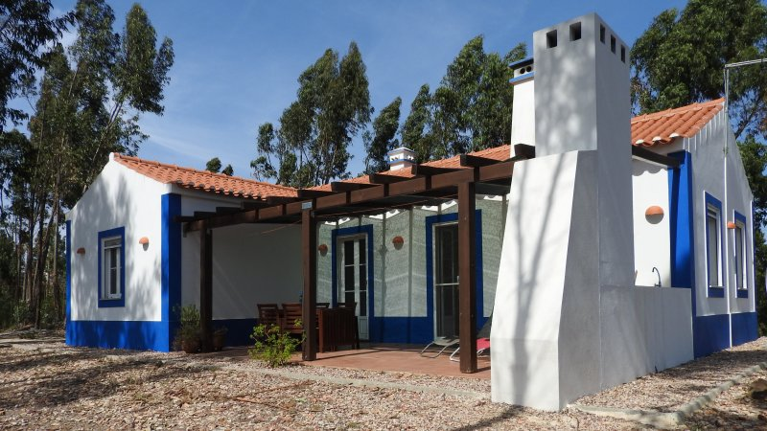
FINAL PROJECT: MONTE DO CASARAO
By: Pablo Iglesias Quián

Slide 2
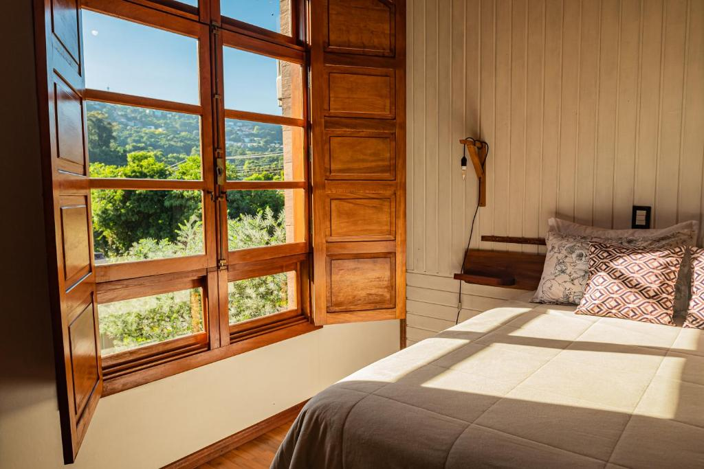
THE BUSINESS

Slide 3
THE COTTAGES
6 p
Casa Boa
Casa Valorosa
Casa Marcanta
8 p
Casa Basta

Slide 4
CLIENT REQUESTS
Cottage performance
Guest profile
Guest booking habits
Occupation
Revenue

Slide 5
COTTAGE PERFORMANCE

Slide 6
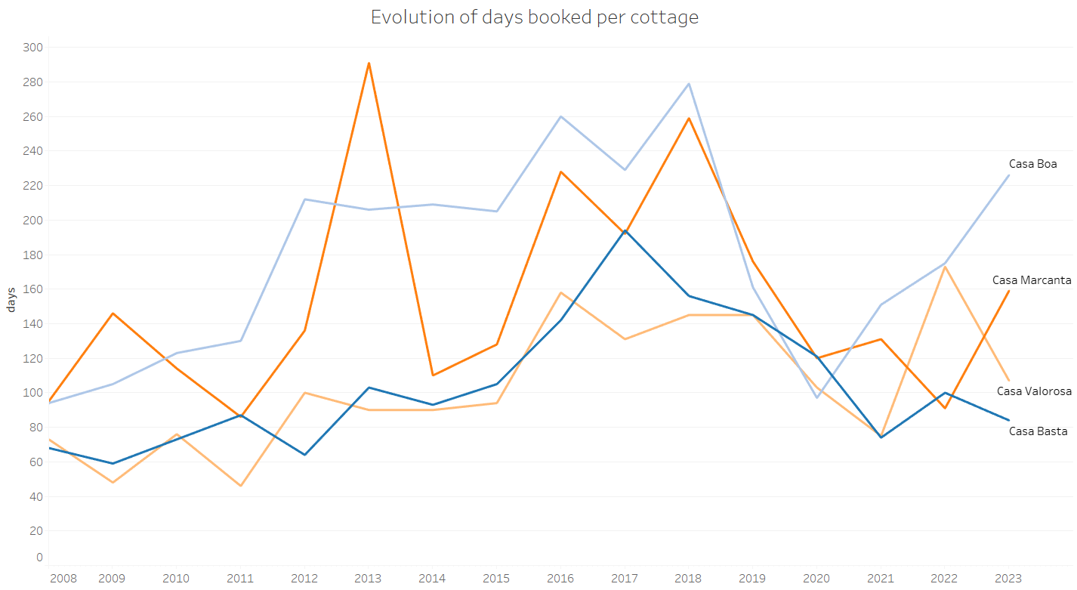

Slide 7
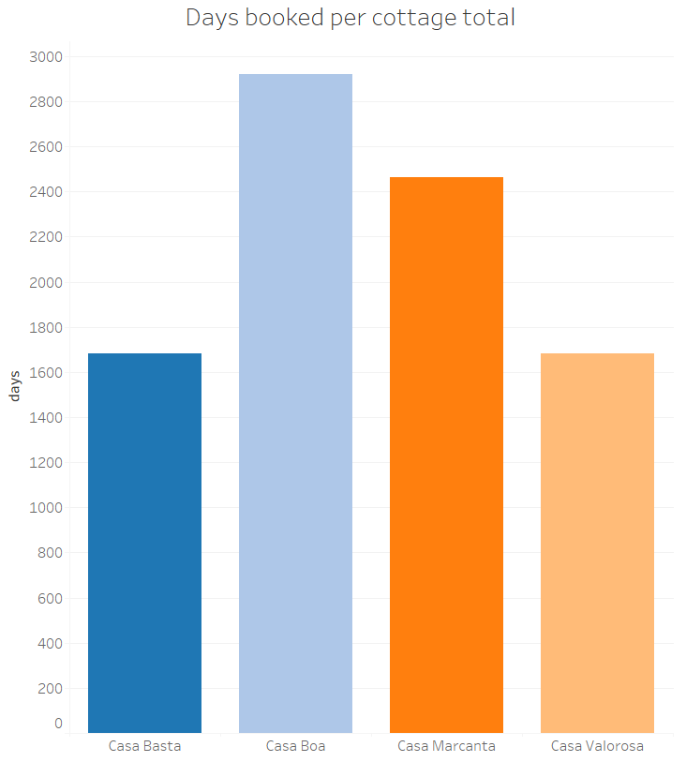

Slide 8
GUEST PROFILE

Slide 9
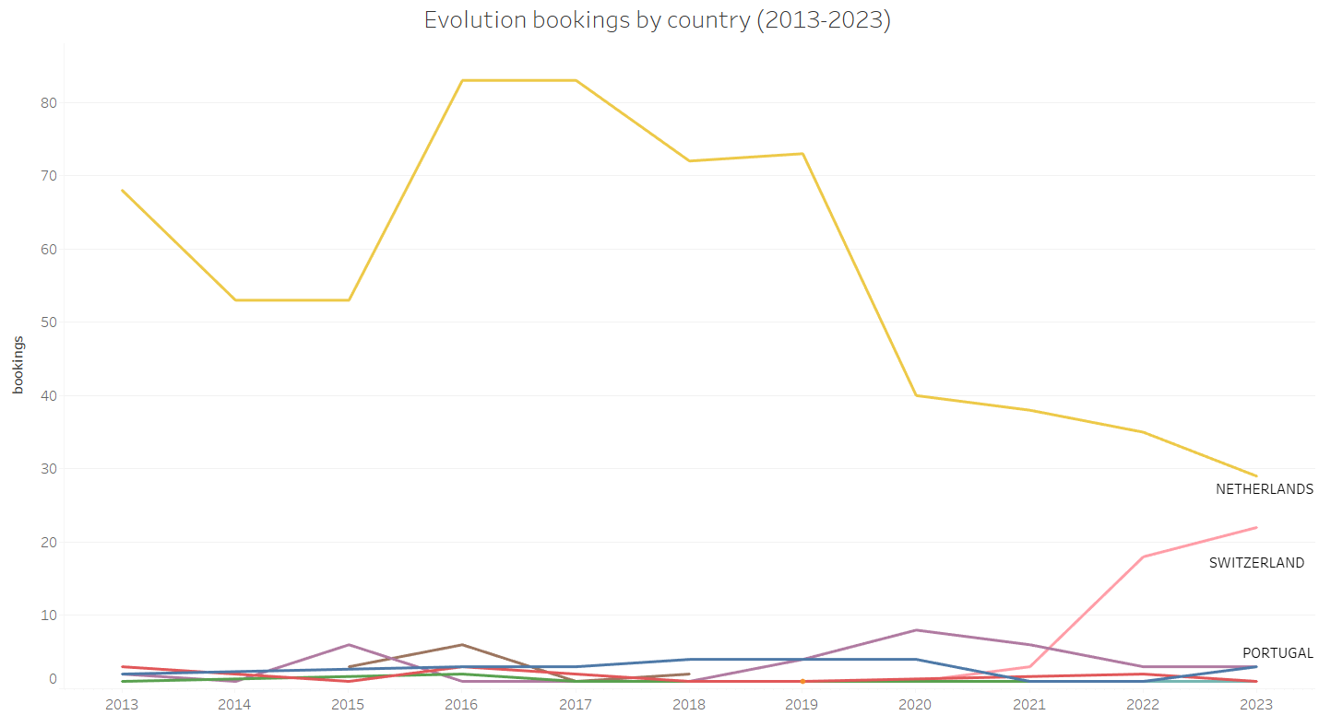

Slide 10
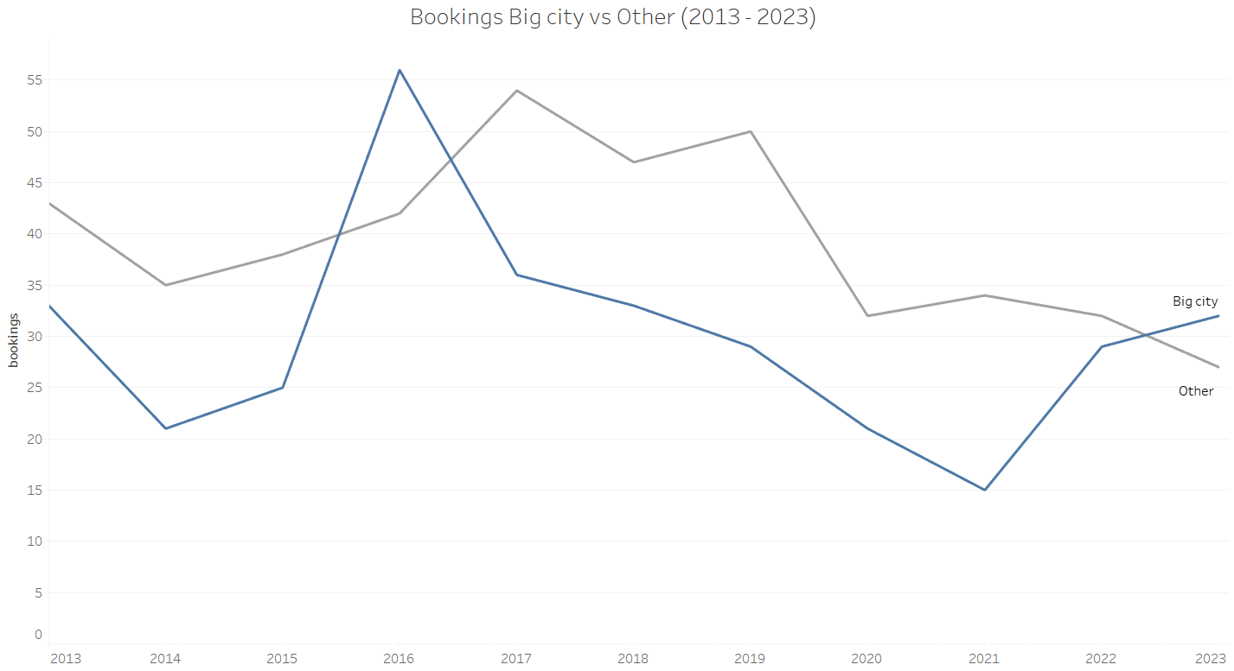

Slide 11
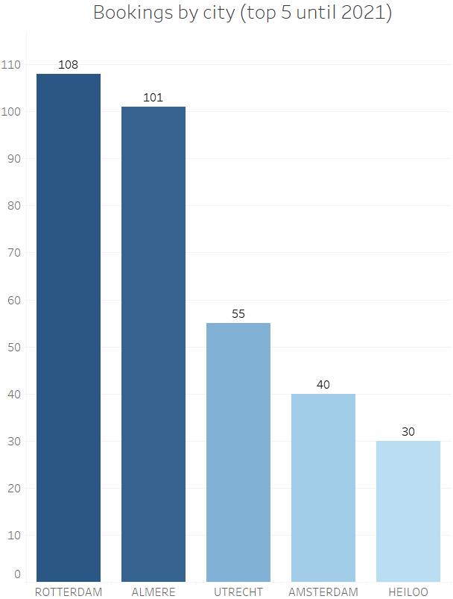

Slide 12
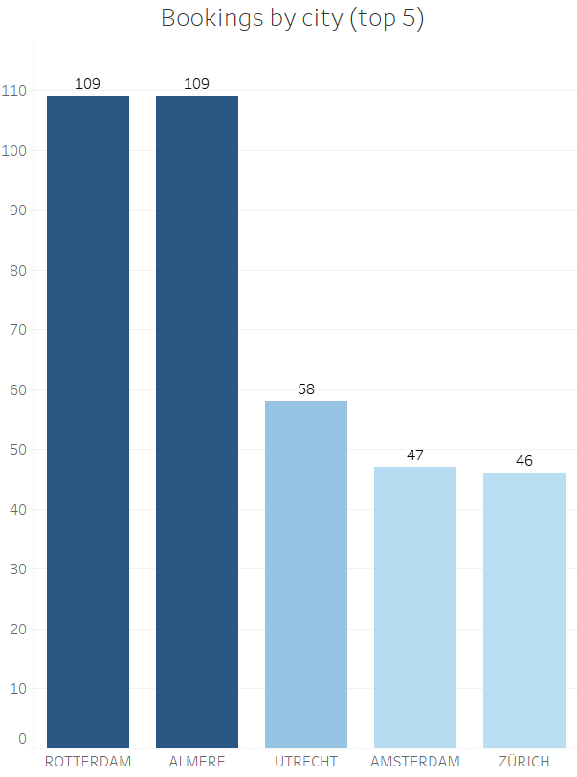

Slide 13
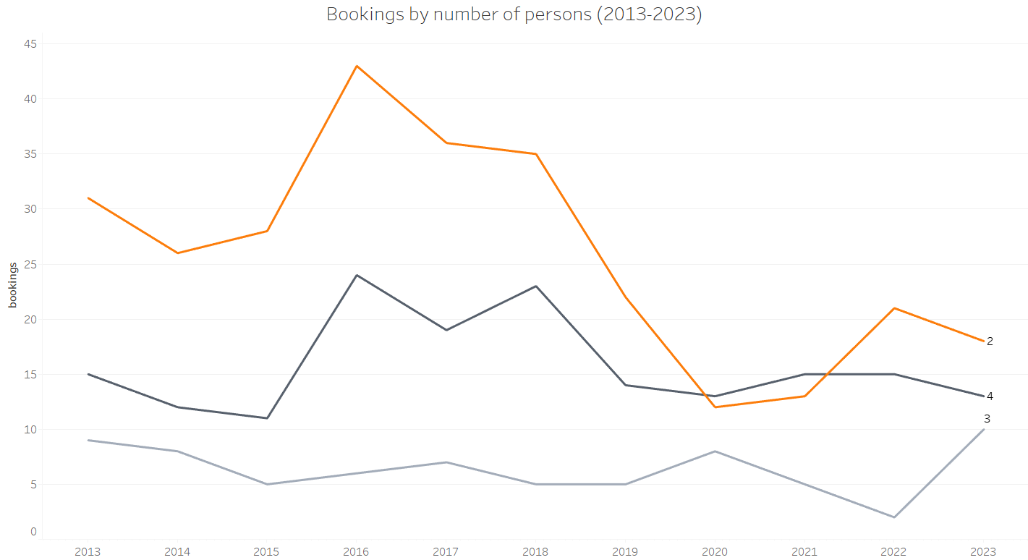

Slide 14
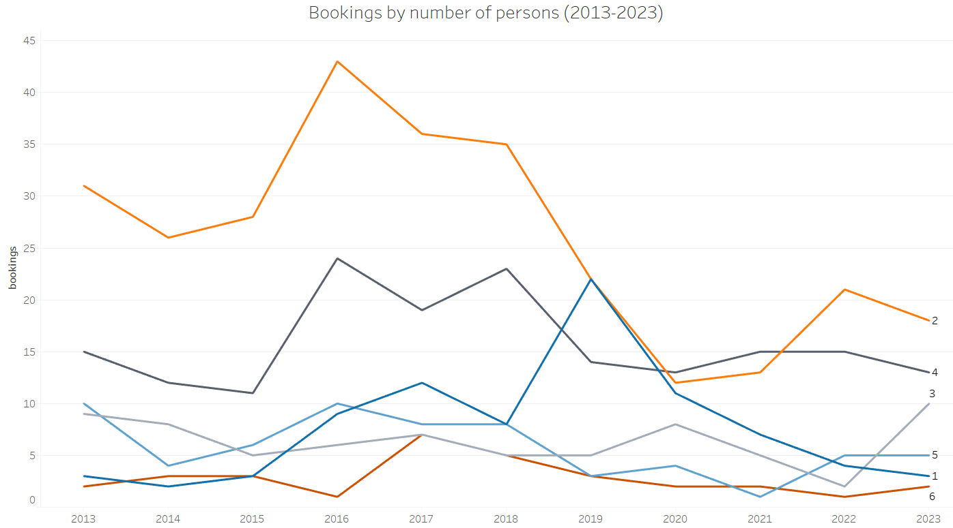

Slide 15
GUEST BOOKING HABITS

Slide 16
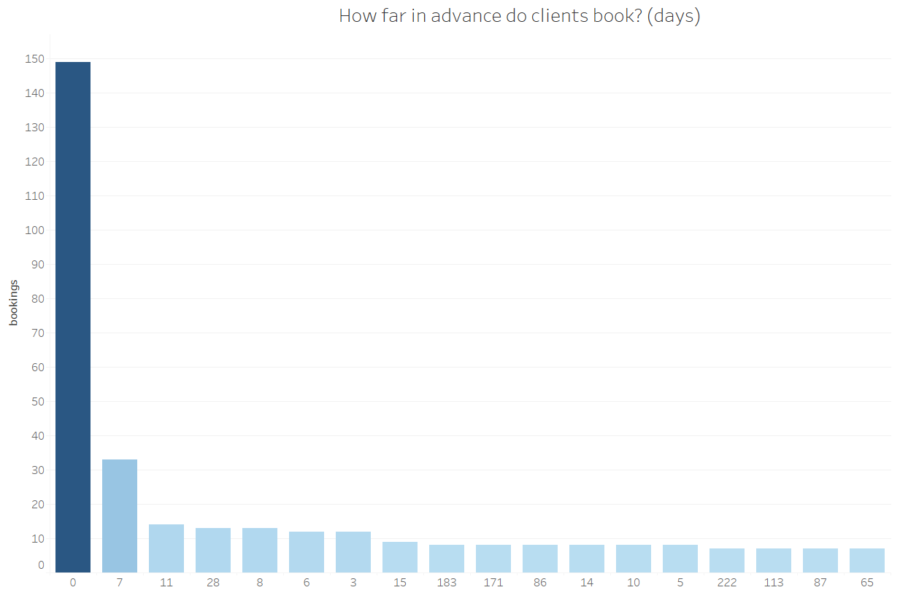

Slide 17
OCCUPATION

Slide 18
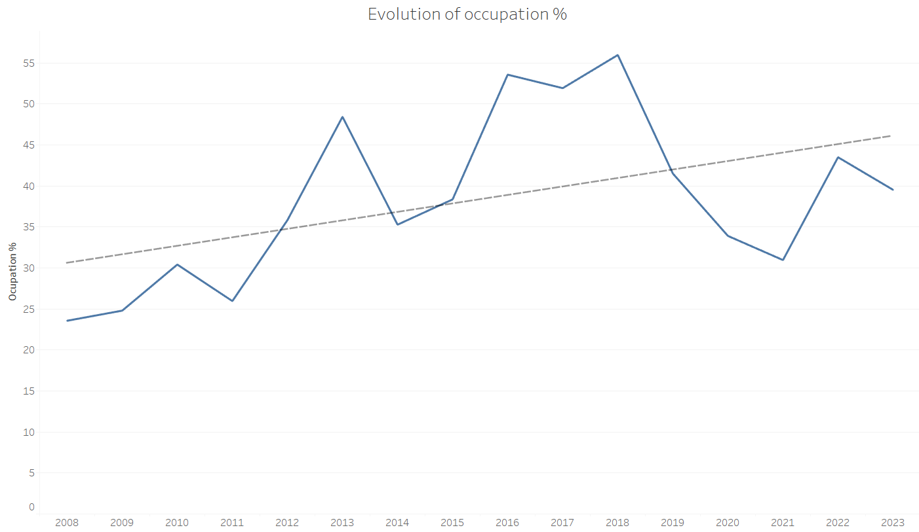

Slide 19
REVENUE

Slide 20
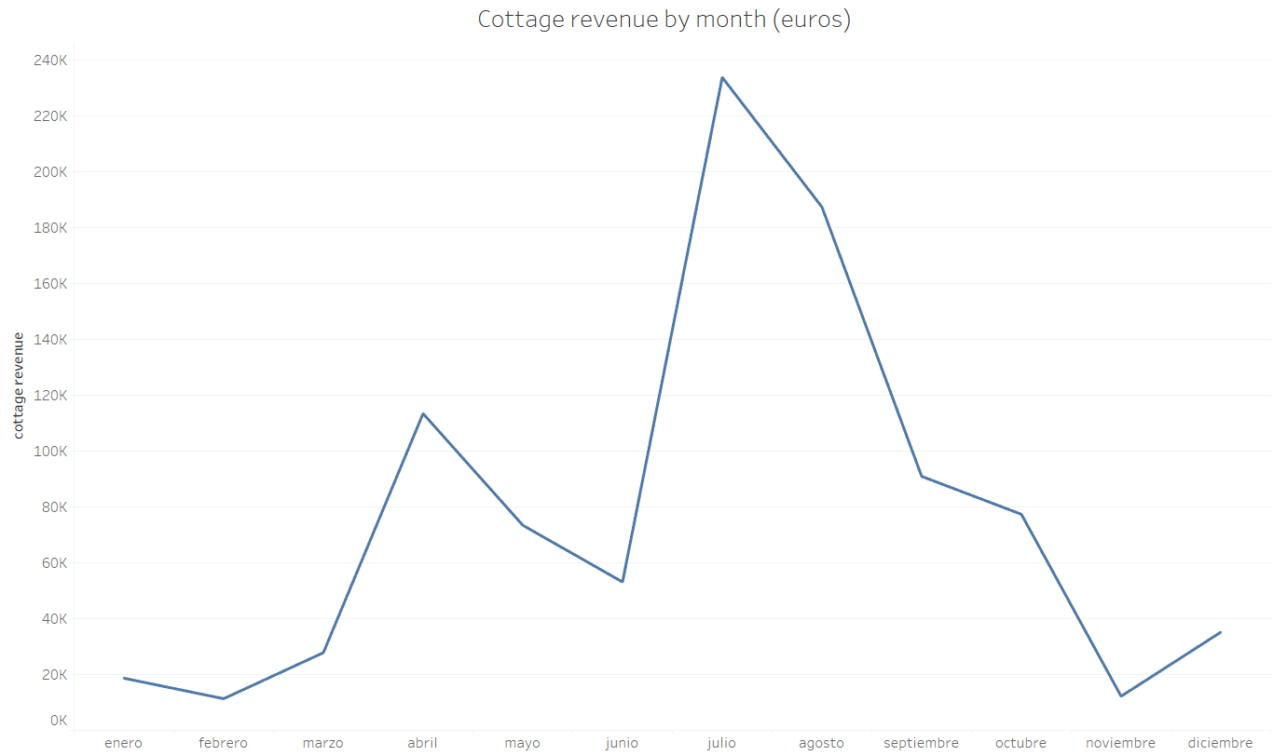

Slide 21
Painting week

Slide 22
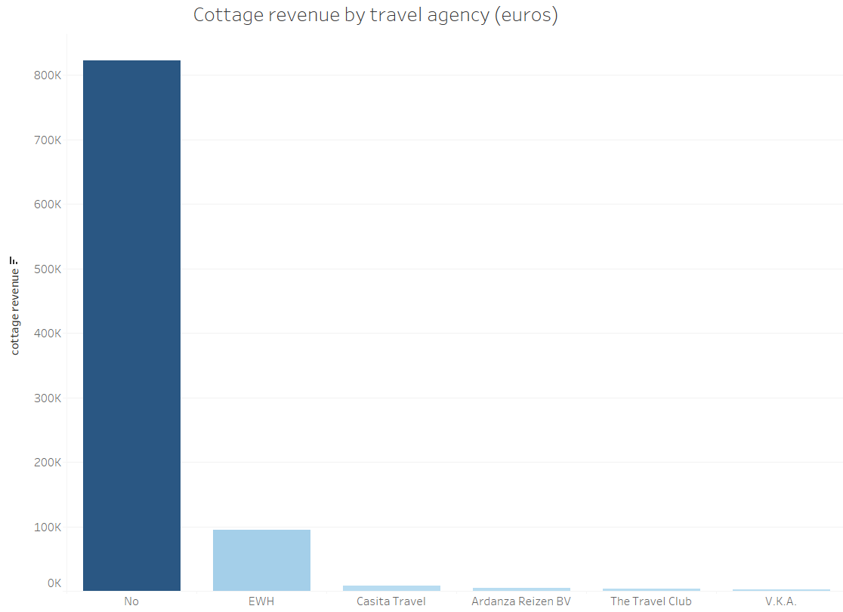

Slide 23
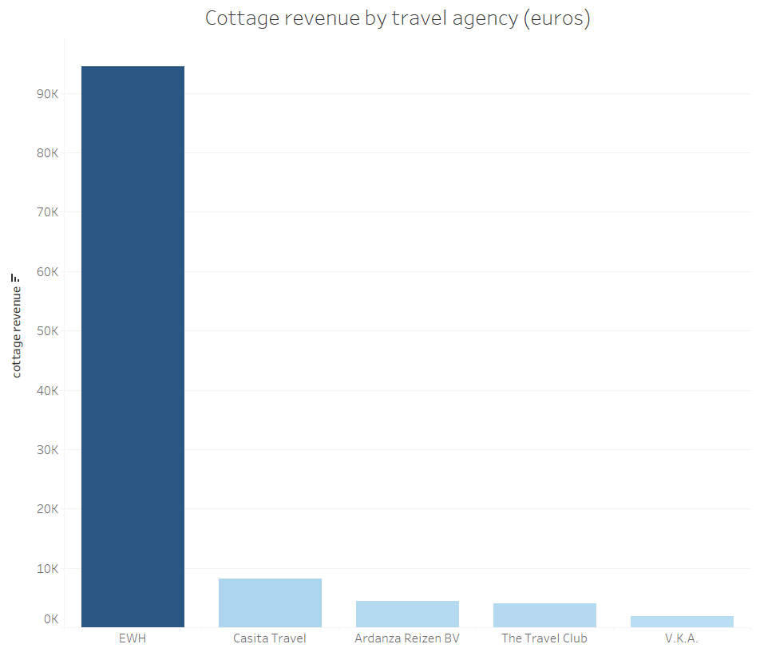

Slide 24
CONCLUSIONS
Casa Boa is the most demanded cottage
Guest profile: couples or families from Netherlands
Guests usually don’t book far in advance
Occupation % trend line is positive
Revenue comes mostly from April and the Summer Season
The travel agency that brings the most revenue is EWH

Slide 25
THANK YOU ANY QUESTIONS?

