Slide 1
Concurrency in C++11/14 series
pabloxrl@gmail.com

Slide 2
Index

Slide 3
Problems with sharing data between threads
Problems arise due to the consequences of modifying data shared between threads (read-only is ok)
Handy concept: Invariants
Example of invariant: For doubly linked list
If you follow a “next” pointer from one node (A) to another (B), the “previous” pointer from that node (B) points back to the first node (A).

Slide 4
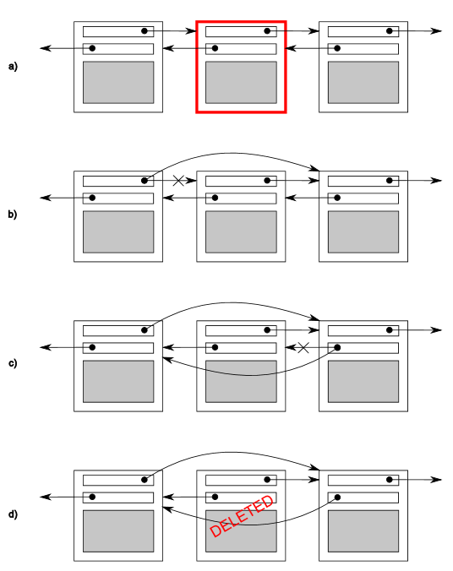
Deleting element from doubly linked list
Steps for deletion:
Identify node to delete (N)
Update link from N-1 to N+1
Update link from N+1 to N-1
Delete N
Unless something is done
other threads could see the
list in an inconsistent state

Slide 5
Problems with sharing data between threads
Race conditions are the biggest threat
Outcome depends on the relative ordering of execution
May lead to broken invariants
Ultimately can cause undefined behavior
Ways to avoid race conditions
Wrap data structures with protection mechanisms
Modifications are done as a series of indivisible changes preserving invariants (lock free programming)
Handle updates as transactions

Slide 6
Protecting shared data with mutexes
Using a mutex → MUTually Exclusive
1- Lock the mutex
2- Do stuff
3- Unlock the mutex
Using an instance of std::mutex
1- Call std::mutex::lock()
2- Do stuff
3- Call std::mutex::unlock()

Slide 7
Protecting shared data with mutexes
Using a mutex → MUTually Exclusive
1- Lock the mutex
2- Do stuff
3- Unlock the mutex
Using an instance of std::mutex
1- Call std::mutex::lock() Not recommended
2- Do stuff
3- Call std::mutex::unlock()

Slide 8
Protecting shared data with mutexes
Using mutexes in C++14
Standard provides std::lock_guard<T> class template which implements RAII (scoped locking/unlocking on supplied mutex) (s2t01)
std::lock_guard and std::mutex are both declared in <mutex> header
Potential danger: Returning references to protected data or passing functions that access protected data. (s2t02, s2t03)

Slide 9
Protecting shared data with mutexes
Neat tricks for avoiding deadlocks
Locking more than one object at once (s2t04)
Flexible locking with std::unique_lock (s2t05)
Trasferring ownership of locks (s2t06)
Bonus:
Thread-safe lazy initialization of a class member using std::call_once() vs std::mutex (s2t07)
Example of actual usage of std::call_once (s2t08)

Slide 10
Protecting shared data with mutexes
General guidelines for avoiding deadlocks
Avoid nested locks
Avoid calling user-supplied code while holding a lock
Acquire locks in a fixed order
Extend these guidelines beyond locks

Slide 11
Protecting shared data with mutexes
Structuring code for protecting shared data
Not as easy as slapping std::lock_guard everywhere
Spotting race conditions inherent in interfaces (Example: stack)
Top()
Pop()
Push()
Empty()
Size()
Example of definition of thread safe stack (s2t09)

Slide 12
Protecting shared data with mutexes
Top():
Returning the object: copy or reference?
What about the results of empty() and size()
What about this code in a shared stack?
std::stack<int> s;
if(!s.empty())
{
int const value = s.top(); // race #1
s.pop(); // race #2
do_something(value);
}

Slide 13
Protecting shared data with mutexes
Possible solution: Combine top() + pop()
Option 1: Passing a reference:
std::vector<T> result;
some_stack.pop(result);
Disadvantages:

Slide 14
Protecting shared data with mutexes
Possible solution: Combine top() + pop()
Option 1: Passing a reference:
std::vector<T> result;
some_stack.pop(result);
Disadvantages:
Having to construct an instance of the stack’s value prior to the call
For certain types it can be too expensive
Some types may not be assignable

Slide 15
Protecting shared data with mutexes
Possible solution: Combine top() + pop()
Option 2: Return a pointer to the popped item
Advantages:
Relatively cheap
Disadvantages:

Slide 16
Protecting shared data with mutexes
Possible solution: Combine top() + pop()
Option 2: Return a pointer to the popped item
Advantages:
Relatively cheap
Disadvantages:
Having to manage the allocated memory (can be dealt with through std::shared_ptr)

Slide 17
Protecting shared data with mutexes
Summary
How to use std::mutex and std::lock_guard
Avoiding deadlock with std::lock
Alternative data protection facilities like locking hierarchy or std::call_once
Example of a broken-by-design thread-(un)safe interface
Next meeting:
Waiting for events and using atomics
std::future

Slide 18
The end
Any questions?

