Slide 1

Idea
Create a 2D/3D game that uses accelerometer data for positioning
Server stores the respective client positions
A "firing" mechanic that considers angle and respective positions to calculate whether the shot hits
LEDs represent lives and will deplete when taking damage
"Critical hits" to reward good gameplay when shots are more accurate with two hitboxes
"High score" calculated system as a rewarding gameplay element
Using the FPGA as a controller with motion controls

Slide 2
Challenges
Inexperience with game design and production
3D graphics could be challenging to design, extension for a 2D system
Latency can cause things to not update as they should
Requires a "lobby" system for starting offsets so players aren't all starting in the same location
Will likely require some terrain to make the game fun
Secret text secret text secret text

Slide 3
Milestones + distribution of work
Milestone 1
Simple game dev (3 people)
Getting data from the FPGA (3 people)
Milestone 2
Translate FPGA data into game control (3 people)
Making game multi-player (3 people)
Milestone 3
Transmitting data from FPGA to server
Milestone 4
Extending Game features and High-score system
Using additional FPGA features (LEDs and HEX display) in game (3 people)

Slide 4
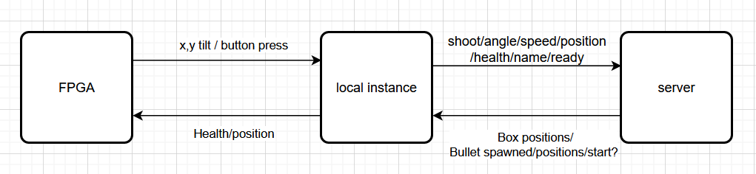
functionality
It just works
A 2D game that uses the FPGA as a controller
FPGA sends accelerometer and button data and across to the server
Button data is used to ready up, and to shoot
Accelerometer data is used to move forwards/backwards, as well as rotate left and right
The number of lives is displayed on the LEDs and the position in which the player finishes the game is displayed on the 7_seg display

Slide 5
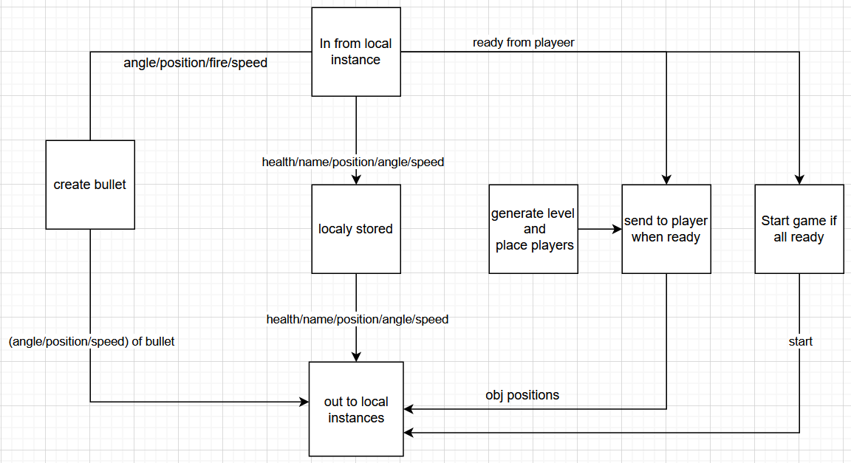
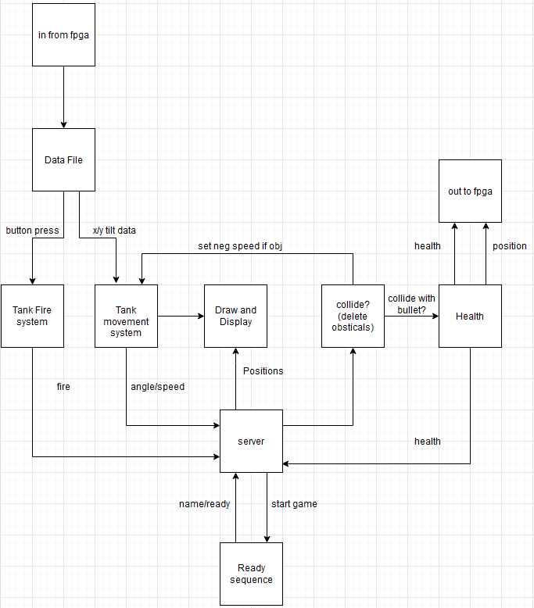
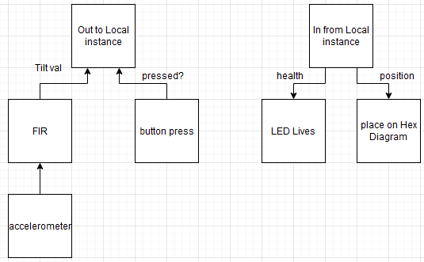
functionality
It just works
server
local instance
FPGA

Slide 6
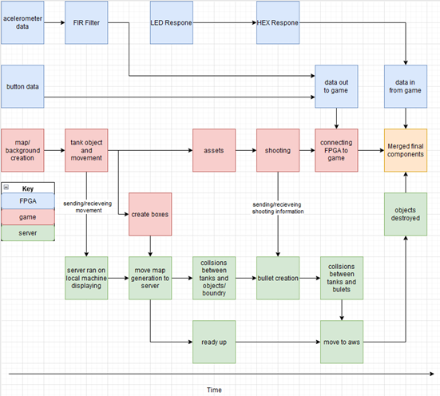
testing
We took a modular approach
We decided to develop the FPGA controller and the game/server separately
Allowed us to ensure the FPGA and game/server fully worked before we integrated the two paths
Sped up the testing process so we didn’t have to blast the board every time️ we modified the game
(╯°□°)╯︵ ┻━┻

Slide 7
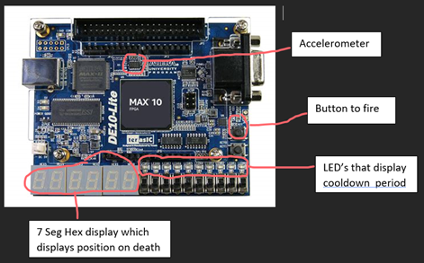
Live demo
lives

Slide 8
Optimisations
Check rectangular collision detection -> check pixel perfect collision
Distribution of processing demands across host computer and server
Moving all collisions from server side to client side

