Slide 1
Maximizing Productivity with GitHub Copilot and ChatGPT
Notes:
This presentation was automatically generated by PowerPoint Copilot based on content found in this document: https://microsoft-my.sharepoint.com/personal/pablosal_microsoft_com/_layouts/15/Doc.aspx?sourcedoc=%7B1690F9F2-E1B3-41AA-8CE4-907235953E5A%7D&file=AI_Generated_Guide.docx&action=default&mobileredirect=true&DefaultItemOpen=1 AI-generated content may be incorrect.

Slide 2
Agenda
Introduction
Installing GitHub Copilot
Enabling GitHub Copilot in Your IDE
Authenticating and Activating
Using GitHub Copilot
Basic Usage
Getting Next Suggestions
Manual Trigger for Suggestions
Advanced Features and Troubleshooting
Copilot Is Slow or Unresponsive
Customizing Suggestions
Editing Jupyter Notebooks with Visual Studio Code
Method 1: Using SSH
Method 2: Connecting to a Remote Jupyter Server
Conclusion
Appendix and Additional Resources
Notes:
Agenda * Introduction * Installing GitHub Copilot * Enabling GitHub Copilot in Your IDE * Authenticating and Activating * Using GitHub Copilot * Basic Usage * Getting Next Suggestions * Manual Trigger for Suggestions * Advanced Features and Troubleshooting * Copilot Is Slow or Unresponsive * Customizing Suggestions * Editing Jupyter Notebooks with Visual Studio Code * Method 1: Using SSH * Method 2: Connecting to a Remote Jupyter Server * Conclusion * Appendix and Additional Resources

Slide 3
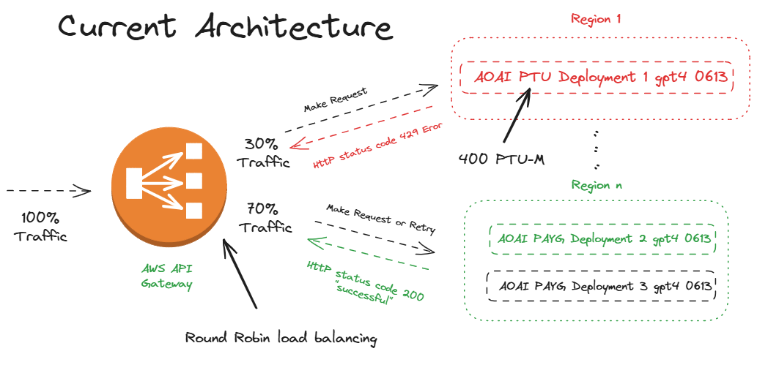
Introduction
Notes:
Today, we begin with an introduction and a glance at the table of contents, setting the stage for the detailed content that will follow. Original Content: Introduction Table of Contents

Slide 4

Enabling GitHub Copilot in Your IDE
Enabling GitHub Copilot
Open Visual Studio Code
Access Extensions with `Ctrl+Shift+X`
Search and select 'GitHub Copilot'
Install the official extension
Notes:
To install GitHub Copilot, start by opening Visual Studio Code and accessing the Extensions view. Search for the official GitHub Copilot extension and proceed to install it. Original Content: Installing GitHub Copilot #### Step 1: Enabling GitHub Copilot in Your IDE · For Visual Studio Code: 1. Open Visual Studio Code. 2. Go to the Extensions view by pressing `Ctrl+Shift+X`. 3. Search for "GitHub Copilot" and select the official extension provided by GitHub. 4. Click on `Install`.

Slide 5

Authenticating and Activating
Installation Completion
Sign in using GitHub account credentials post-installation.
Extension Activation
Authenticate through the browser if necessary to activate the extension.
Notes:
Once you've installed the extension, simply sign in with your GitHub credentials. You may need to authenticate via your browser to fully activate the extension. Original Content: #### Step 2: Authenticating and Activating · After installation, sign in with your GitHub account credentials. · If required, authenticate via the browser to activate the extension.

Slide 6
Basic Usage
Inline Suggestions
Begin typing in your IDE for automatic code completions.
Accept suggestions quickly with the 'Tab' key.
Notes:
Discover the ease of coding with GitHub Copilot. As you type, it offers code completions, and you can seamlessly integrate suggestions with just a tap of the 'Tab' key. Original Content: Using GitHub Copilot #### Basic Usage · Inline Suggestions: - Start typing in your IDE. Copilot will automatically suggest code completions. - Press `Tab` to accept the suggestion.

Slide 7

Getting Next Suggestions
Navigating Suggestions
Use 'Alt+]' for next suggestion
Use 'Alt+[' for previous suggestion
IDE Specific Shortcuts
Visual Studio Code: 'Alt+]' and 'Alt+['
JetBrains IDEs: 'Alt+]' and 'Alt+['
Notes:
To move through suggestions, use 'Alt+]' for the next and 'Alt+[' for the previous. This applies to Visual Studio Code and JetBrains IDEs. Original Content: #### Getting Next Suggestions · To navigate through suggestions: - Visual Studio Code: `Alt+]` for next, `Alt+[` for previous. - JetBrains IDEs: `Alt+]` for the next, `Alt+[` for previous.

Slide 8
Manual Trigger for Suggestions
Manual Triggering of Copilot
Useful for instances where automatic suggestions are not provided
Commands for Code Editors
Visual Studio Code: 'Ctrl+Alt+\'
JetBrains: 'Alt+\'
Notes:
For times when Copilot doesn't suggest automatically, remember 'Ctrl+Alt+\' for Visual Studio Code and 'Alt+\' for JetBrains to manually activate suggestions. Original Content: #### Manual Trigger for Suggestions · If Copilot does not automatically suggest, you can manually trigger it: - `Ctrl+Alt+\` for Visual Studio Code. - `Alt+\` for JetBrains.

Slide 9

Copilot Is Slow or Unresponsive
Assessing Copilot Responsiveness
Check internet stability for active connection requirements
Initiate manual suggestions or IDE restart to resolve unresponsiveness
Notes:
If Copilot seems slow or unresponsive, first check your internet connection as it's essential for Copilot's functionality. For persistent issues, try manual suggestions or restart your IDE. Original Content: Advanced Features and Troubleshooting #### Copilot Is Slow or Unresponsive · Ensure your internet connection is stable, as Copilot requires an active connection. · Manually trigger suggestions or restart the IDE.

Slide 10
Customizing Suggestions
Clear Code Comments
Provide detailed comments for clarity.
Include context to guide suggestions.
Specific Naming Conventions
Use descriptive function names.
Choose variable types carefully.
Notes:
To refine the accuracy of code suggestions, ensure your comments are clear and provide context. Opt for specific function names and variable types for better guidance. Original Content: #### Customizing Suggestions · To get more accurate suggestions, provide clear comments and context in your code. · Use specific function names and variable types to guide Copilot's suggestions.

Slide 11
Method 1: Using SSH
Install Remote - SSH Extension
Find and install the extension from VS Code marketplace
Connect to Remote Machine
Use `F1` and 'SSH: Connect to Host...' command
Enter machine details for connection
Access Jupyter Notebooks
Open the folder with the notebooks on the remote machine
Notes:
To edit Jupyter Notebooks with VS Code using SSH, first install the Remote - SSH extension, then connect to your host machine, and finally, access your notebooks by opening the remote folder. Original Content: Editing Jupyter Notebooks with Visual Studio Code #### Method 1: Using SSH 1. Install the Remote - SSH extension from the Visual Studio Code marketplace. 2. Connect to your remote machine: - Press `F1`, type "SSH: Connect to Host..." and enter your machine's details. 3. Open the folder containing your Jupyter notebooks.

Slide 12
Method 2: Connecting to a Remote Jupyter Server
Initiating Jupyter Notebook Connection
Press `F1` and type 'Create New Jupyter Notebook'
Selecting Python Interpreter
Use command palette to choose 'Python: Select Interpreter'
Select your remote Jupyter server from the list
Notes:
To connect to a remote Jupyter server, start by creating a new Jupyter Notebook and then select your remote server as the Python interpreter. Original Content: #### Method 2: Connecting to a Remote Jupyter Server 1. Press `F1`, type "Create New Jupyter Notebook". 2. Use the command palette to select "Python: Select Interpreter" and choose your remote Jupyter server.

Slide 13

Conclusion
AI-Powered Coding Assistance
GitHub Copilot and ChatGPT boost productivity
Seamless integration with IDEs
Streamlined Development Process
Leverage AI for efficient coding
Transform coding experience with AI assistance
Notes:
Discover how GitHub Copilot and ChatGPT can transform your coding workflow, providing AI-powered assistance directly in your IDE for a more efficient development process. Original Content: Conclusion GitHub Copilot and ChatGPT can significantly enhance your coding efficiency and streamline your development process. By integrating these tools into your IDE, you can leverage AI-powered coding assistance for a more productive coding experience.

Slide 14
Appendix and Additional Resources
Getting Started with GitHub Copilot & ChatGPT
Access comprehensive guides for initial setup and use
Explore advanced features and customization options
Official Documentation & Support
Refer to the official GitHub Copilot documentation for detailed information
Join community forums for discussions and support
Notes:
Discover the essentials of GitHub Copilot and ChatGPT with our start guide. Dive into the official documentation for in-depth knowledge and join community forums for ongoing discussions and support. Original Content: Appendix and Additional Resources · Official GitHub Copilot Documentation: [Visit GitHub Docs](https://docs.github.com/en/copilot) · Community Forums for GitHub Copilot: [GitHub Discussions](https://github.com/community/discussions) This guide aims to provide you with all the necessary information to get started with GitHub Copilot and ChatGPT. For further customization and advanced features, refer to the official documentation or community forums.

