Slide 1

THRESHOLDING METHODS

Slide 2
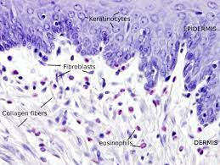
DATA
Transcriptomic data from 5 types of fibroblasts during their transition to senescence
Interested:
- ENSEMBL_ID
- DATA
Marthandan, S., Baumgart, M., Priebe, S., Groth, M., Schaer, J., Kaether, C., ... & Hemmerich, P. (2016). Conserved senescence associated genes and pathways in primary human fibroblasts detected by RNA-seq. PloS one, 11(5), e0154531.

Slide 3
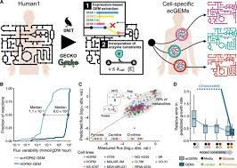
HUMAN1 MODEL
Human1 is a genome-scale model, integrating gene information, as well as the proteins and reactions to which they are related.
There are different versions.

Slide 4
PRE-PROCESSING
Normalize the data to use it in the algorithms, for that:
Norm_Data = log10(data + 1)

Slide 5
THRESHOLDING ALGORITHMS
- Global Threshold.
- LocalT2 Thresholding.
- LocalGini Thresholding.
- StanDep.

Slide 6
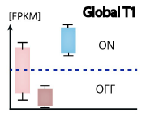
GLOBAL THRESHOLDS
Go through each sample, and based on the data, set the threshold at the desired percentile. Genes whose expression is above that value are considered core-genes
Richelle, A., Joshi, C., & Lewis, N. E. (2019). Assessing key decisions for transcriptomic data integration in biochemical networks. PLoS computational biology, 15(7), e1007185.

Slide 7
LOCALT2
LocalT2 is a gene-specific threshold approach.
Set upper and lower thresholds (usually 75% and 25%)
Reactions with a expresión higher than 1 are considered as core-reactions
Data
localT2 function
mapExpressionToReactions

Slide 8
LOCALT2 FUNCTION
Set upper and lower threshold
If data is above upper threshold = upper threshold
Below upper theshold -> Mean value or lower threshold
Set the values -> upper – mean or lower threshold
Exp data / value

Slide 9
LOCALGINI
Gene-specific thresholding method. Different threshold values for different based on their Gini coefficients.
Gini coefficient: a measure of inequality between two variables, where 0 is equality and 1 is inequality.
Establish core genes -> set core reactions
Kumar S, P., & Bhatt, N. (2023). Localgini: A method for harnessing inequality in gene expression to improve the quality of context-specific models. bioRxiv, 2023-09.

Slide 10
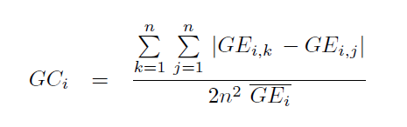
LOCALGINI
Gini coefficient
Notes:
GE = mean expresión of the ith gene across contexts.
Multiply GC by 100.
Localgini threshold:

Slide 11
STANDEP

