Slide 1
THRESHOLDING METHODS

Slide 2
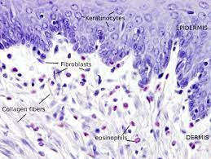
DATA
Transcriptomic data from 5 types of fibroblasts during their transition to senescence
Interested:
- ENSEMBL_ID
- DATA
Marthandan, S., Baumgart, M., Priebe, S., Groth, M., Schaer, J., Kaether, C., ... & Hemmerich, P. (2016). Conserved senescence associated genes and pathways in primary human fibroblasts detected by RNA-seq. PloS one, 11(5), e0154531.

Slide 3
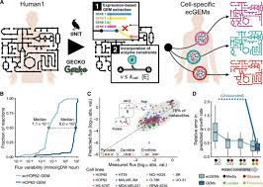
HUMAN1 MODEL
Human1 is a genome-scale model, integrating gene information, as well as the proteins and reactions to which they are related.
There are different versions.

Slide 4
PRE-PROCESSING
Normalize the data to use it in the algorithms, for that:
Norm_Data = log10(data + 1)

Slide 5
THRESHOLDING ALGORITHMS
- Global Threshold.
- LocalT2 Thresholding.
- LocalGini Thresholding.
- StanDep.

Slide 6
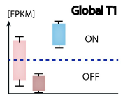
GLOBAL THRESHOLDS
Go through each sample, and based on the data, set the threshold at the desired percentile. Genes whose expression is above that value are considered core-genes
Richelle, A., Joshi, C., & Lewis, N. E. (2019). Assessing key decisions for transcriptomic data integration in biochemical networks. PLoS computational biology, 15(7), e1007185.

Slide 7
LOCALT2
LocalT2 is a gene-specific threshold approach.
Set upper and lower thresholds (usually 75% and 25%)
Reactions with a expresión higher than 1 are considered as core-reactions
Data
localT2 function
mapExpressionToReactions

