Slide 1

C++ Course
Reviewed and Updated by:
Bertoa Nicolas, 2013 / 2015
Rodriguez Matias, 2013 / 2014
Quesada Manuela, 2013 / 2014

Slide 2

Class 9 – Exceptions
Exception Processing
Polymorphic Handlers
Syntax

Slide 3

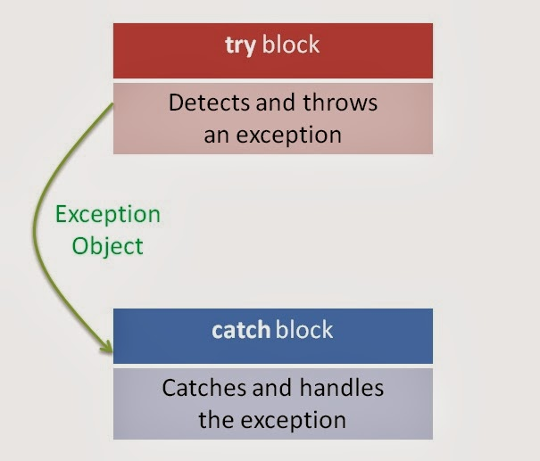

Exceptions Introduction
Exceptions
Indicate problems that occur during a program’s execution.
Occur infrequently.
Exception handling
Can resolve exceptions
Allow a program to continue executing or
Notify the user of the problem and
Terminate the program in a controlled manner
Makes programs robust and fault-tolerant

Slide 4
Fundamental Philosophy
Traditional Exception Handling
Exceptions
Intermixing program and error-handling logic
Pseudocode outline
Perform a task
If the preceding task did not execute correctly
Perform error processing
Perform next task
If the preceding task did not execute correctly
Perform error processing
…
Makes the program difficult to read, modify, maintain and debug
Impacts performance
Remove error-handling code from the program execution’s “main line”
Programmers can handle any exceptions they choose
All exceptions
All exceptions of a certain type
All exceptions of a group of related types
Programs can:
Recover from exceptions
Hide exceptions
Pass exceptions up the “chain of command”
Ignore certain exceptions and let someone else
handle them

Slide 5
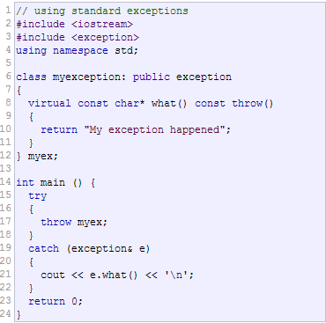
Fundamental Philosophy
Exception Definition
Sample Code
An exception is a class
Usually derived from one of the system’s exception base classes
If an exceptional/error situation occurs, program throws an object of that class
Object crawls up the call stack
A calling program can choose to catch exceptions of certain classes
Take action based on the exception object
The standard C++ base class for all exceptions
Provides derived classes with virtual function what
Returns the exception’s stored error message
.

Slide 6
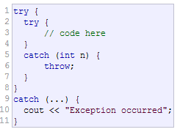
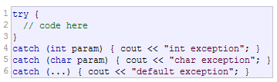
Try - Catch block
Try Block
Catch Block
Keyword try followed by braces ({})
Should enclose:
- Statements that might cause exceptions
- Statements that should be skipped in case of an exception
.
Immediately follow a try block
One or more catch handlers for each try block
Keyword catch
Exception parameter enclosed in parentheses
Represents the type of exception to process
Can provide an optional parameter name to interact with the caught exception object
Executes if exception parameter type matches the exception thrown in the try block
Could be a base class of the thrown exception’s class
.

Slide 7
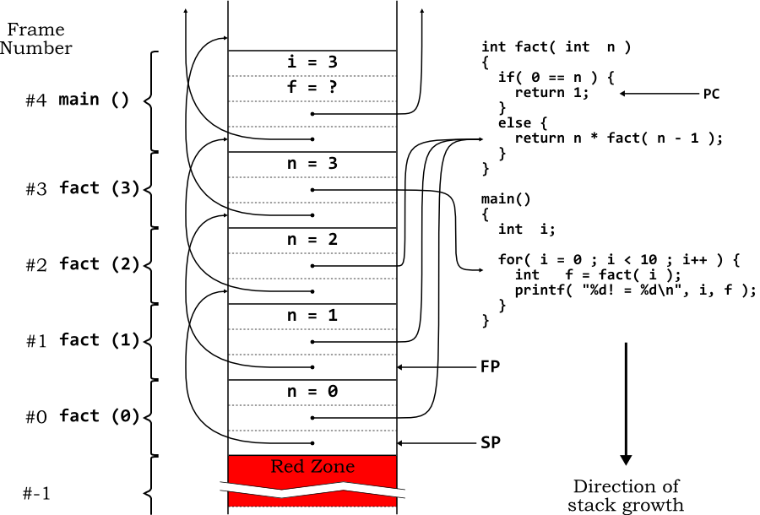
Stack Unwinding
How it Works
Visual Example
Occurs when a thrown exception is not caught in a particular scope
Unwinding a Function terminates that function
All local variables of the function are destroyed
Invokes destructors
Control returns to point where function was invoked
Attempts are made to catch the exception in outer try…catch blocks
If the exception is never caught, the function terminate is called
.

Slide 8
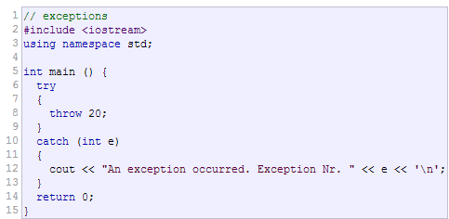
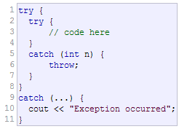
Throwing an Exception
Throw statement
Example
Use keyword throw followed by an operand representing the type of exception
The throw operand can be of any type
If the throw operand is an object, it is called an exception object
The throw operand initializes the exception parameter in the matching catch handler, if one is found
Rethrowing an exception
Empty throw; statement
Use when a catch handler cannot or can only partially process an exception
Next enclosing try block attempts to match the exception with one of its catch handlers

Slide 9
Exception Specifications
Throw Lists
Example
Comma-separated list of exception classes in parentheses
A function can throw only exceptions of types in its specification (or derived types)
If a function throws a non-specification exception, function std::unexpected is called
This normally terminates the program
- Absence of exception specification indicates that the
function can throw any exception
An empty exception specification, throw(), indicates the function cannot throw any exceptions.
The compiler will not generate a compilation error if a function contains a throw expression for an exception not listed in the function’s exception specification.
Error occurs only when that function attempts to throw that exception at run time.
Check your code to ensure that functions do not throw exceptions not listed in their exception specifications

Slide 10
Exception in Constructors & Destructors
Constructors
Example
Exceptions enable constructors to report errors
Unable to return values
Exceptions thrown by constructors cause any already-constructed component objects to call their destructors
Only those objects that have already been constructed will be destructed

Slide 11

Q&A

