Slide 1

C++ Course
Reviewed and Updated by:
Bertoa Nicolas, 2013 / 2014
Rodriguez Matias, 2013 / 2014
Quesada Manuela, 2013 / 2014

Slide 2

Class 4 – Flow Control
Branching
Looping
Operator Precedence

Slide 3
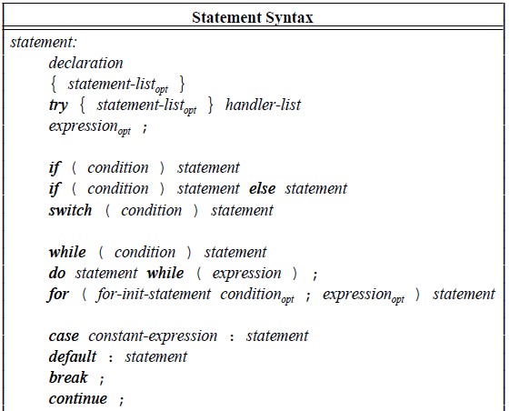
Statements

Slide 4
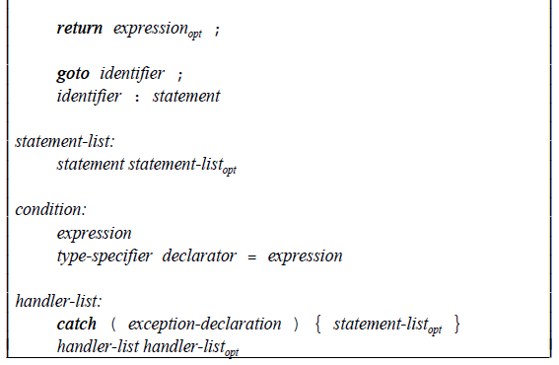
Statements

Slide 5
If – Else Statements
if (condition) statement
if (condition) statement else statement
The condition is usually built using:
Comparison operators:
== != < <= > >=
Logical operators:
&& || !

Slide 6
If – Else Condition Scope
The condition can declare and initialize a single variable
if ( int d = prim(true) ) {
left /= d;
break;
} else {
right *= d;
}
The variable scope extends to the if, else-if and else statements.

Slide 7
If - Statements
The if and else statements implicitly define a local scope, even when the braces are not explicitly written.
So, the following codes are equivalent:
if ( x )
int i;
if ( x ) {
int i;
}

Slide 8
If – Else Statements Short Circuit Evaluation
Short circuit evaluation refers to the condition where an expression is not longer evaluated since further evaluation cannot change the value of the expression.
For example, consider this code:
if ( (1 == 0) && foobar() ) {
// do something
}
In this scenario, foobar() is never called.

Slide 9
What value gets printed by the program?
int main() {
int i = 10;
int* ip = &i;
ip = 0;
if (ip && *ip == 10) {
std::cout << "SUCCESS" << std::endl;
} else {
std::cout << "FAILURE" << std::endl;
}
}

Slide 10
What value gets printed by the program?
int main() {
int i = 10;
int* ip = &i;
ip = 0;
if (ip && *ip == 10) {
std::cout << "SUCCESS" << std::endl;
} else {
std::cout << "FAILURE" << std::endl;
}
}
FAILURE

Slide 11
What value gets printed by the program?
int main() {
int i = 10;
int* ip = &i;
ip = 0;
if (ip && *ip == 10) {
std::cout << "SUCCESS" << std::endl;
} else {
std::cout << "FAILURE" << std::endl;
}
}
FAILURE
The first statement is zero because ip is NULL, so the second statement is not executed and the condition is false

Slide 12
Switch Statement
switch (condition)
case value: statement break;
case value: statement break;
default: statement break;
Tests the value of its condition against a set of constants
condition must be able to be evaluated as an integral
the constants following the case labels must be distinct
if the value tested does not match any case label, the default is chosen
default is optional
break statements exit the switch statement

Slide 13
Switch Statement – Error if condition is not integer
float x = 3.14f;
switch (x) {
case 1:
cout << "1";
break;
case 2:
cout << "2";
break;
}
So, the following one is wrong because x can not be evaluated as an integral.

Slide 14
What is printed by the program?
int main() {
int value = 0;
switch (value++) {
case 0:
std::cout << "case 0" << std::endl;
case 1:
std::cout << "case 1" << std::endl;
default:
std::cout << "default" << std::endl;
}
}

Slide 15
What is printed by the program?
int main() {
int value = 0;
switch (value++) {
case 0:
std::cout << "case 0" << std::endl;
case 1:
std::cout << "case 1" << std::endl;
default:
std::cout << "default" << std::endl;
}
}
case 0
case 1
default

Slide 16
What is printed by the program?
int main() {
int value = 0;
switch (value++) {
case 0:
std::cout << "case 0" << std::endl;
case 1:
std::cout << "case 1" << std::endl;
default:
std::cout << "default" << std::endl;
}
}
case 0
case 1
default
Beware that a case of a switch must be terminated somehow unless you want to carry on executing the next case

Slide 17
Switch Statement - Local case variable
int main() {
int value = 0;
switch (value) {
case 0:
{
int j = 10;
std::cout << "case 0" << std::endl;
}
default:
std::cout << "default" << std::endl;
}
}
In case we need to declare an object to be used within a case, then it is necessary to define a block.

Slide 18
Iteration Statements
while (condition) statement
do statement while (expression)
for (for-init-statement; condition; expression)
statement

Slide 19
Iteration Statements
These statements executes a statement repeatedly until the condition becomes false or the programmer breaks out of the loop some other way:
break
continue
return
goto
throw
exit()

Slide 20
Break keyword
for (int j = 0 ; j < 3 ; j++)
{
cout << “A“ << endl;
break;
cout << “B“ << endl;
}
for (int j = 0 ; j < 3 ; j++)
{
cout << “A“ << endl;
goto J;
cout << “B“ << endl;
}
J:
/* Statements */
The break keyword quits the loop without executing the rest of the statements in the loop.

Slide 21
Continue keyword
for (int j = 0 ; j < 3 ; j++)
{
cout << “A“ << endl;
continue;
cout << “B“ << endl;
}
The continue keyword jumps to the end of the loop, just after the last statement in the loop

Slide 22
Return and Throw Statements
The return statement quits the current loop being executed and also returns from the current function it is invoked
The throw statement quits the loop only if its nearest “catch” is out of the loop scope.

Slide 23
What is printed by the program?
int main() {
const unsigned int max = 10;
for (unsigned int i = max; i >= 0; --i) {
std::cout << i << std::endl;
}
}

Slide 24
What is printed by the program?
int main() {
const unsigned int max = 10;
for (unsigned int i = max; i >= 0; --i) {
std::cout << i << std::endl;
}
}
All integers in descending order

Slide 25
What is printed by the program?
int main() {
const unsigned int max = 10;
for (unsigned int i = max; i >= 0; --i) {
std::cout << i << std::endl;
}
}
All integers in descending order
When i becomes 0 and we execute --i, we get the biggest positive int, because i is unsigned

Slide 26
The comma operator
The comma operator is for constructing statements from substatements, in other words, an statement could be formed by several substatements separated by comma.
Substatements are executed left-to-right and the rightmost substatement’s return value is returned
In contexts where comma is given a special meaning, the comma operator can appear only in parentheses

Slide 27
comma not as an operator
Declaration statements
float i, j, k;
Initializer lists
int a[] = { 0, 1, 2 };
Function calls and declarations
f ( 1, 2, 3 );
int t;
int i, j = (t=3, t+2);
int a[] = { 0, (t=7,t+5), 2 };
f ( 1, (t=17,t+3), 3 );
makes j = 5
makes a[1] = 12
makes the 2nd argument 20

Slide 28
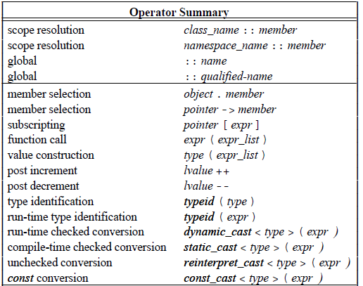
Operator Precedence

Slide 29
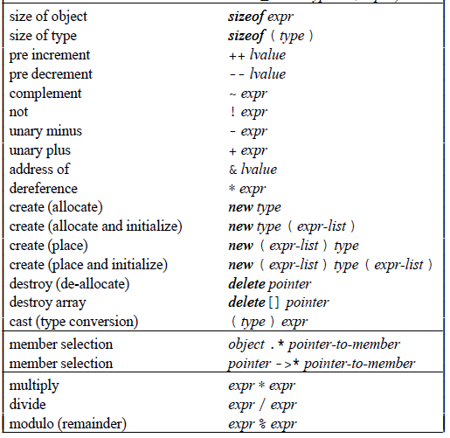
Operator Precedence

Slide 30
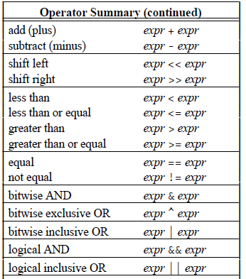
Operator Precedence

Slide 31
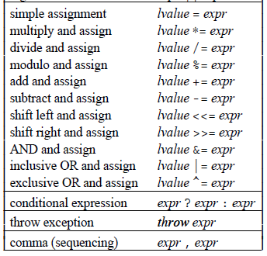
Operator Precedence

Slide 32
Operator Precedence
Unary operators and assignment operators are right-associative
All the others are left-associative
Arithmetic operators produce a result of the largest operand type.
Operands that are smaller than an int are converted to int before the operator is applied

Slide 33
What happens in the following example?
int main()
{
int intArray[2] = {0, 1};
int i = 1;
intArray[i] = i++;
}

Slide 34
What happens in the following example?
int main()
{
int intArray[2] = {0, 1};
int i = 1;
intArray[i] = i++;
}
Undefined

Slide 35
What happens in the following example?
The order of evaluation of subexpression within an expression is undefined
int main()
{
int intArray[2] = {0, 1};
int i = 1;
intArray[i] = i++;
}
Undefined

Slide 36
What happens in the following example?
The order of evaluation of subexpression within an expression is undefined
int main()
{
int intArray[2] = {0, 1};
int i = 1;
intArray[i] = i++;
}
Undefined
May be evaluated as either
intArray[1] = 1 or intArray[2] = 1 or may cause some even stranger behavior

Slide 37

Q&A

